Slide 1
Adjusting Pre-deployment Language Training to Shifting International Commitments
National Defense Academy of Georgia, Language Training School, English Language Program Leader
Marina Paichadze
2014

Slide 2
Nelson Mandela
“ Education Is The Most Powerful Weapon Which You Can Use To Change The World “

Slide 3
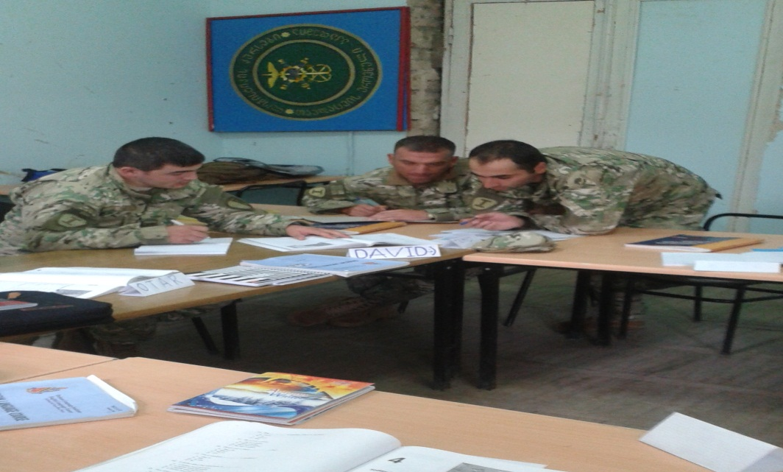
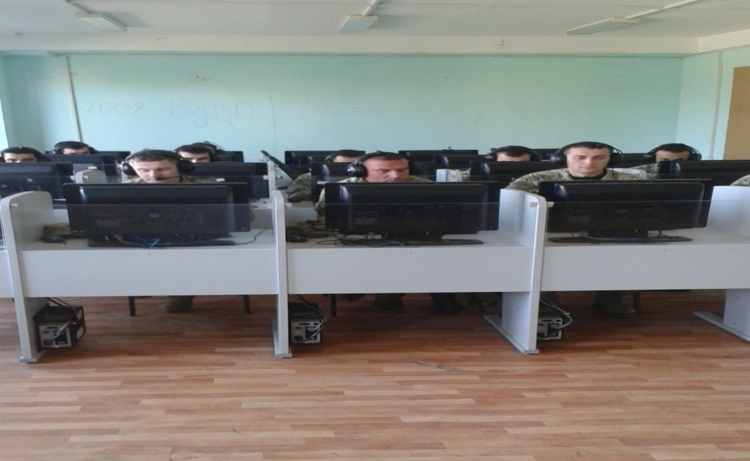
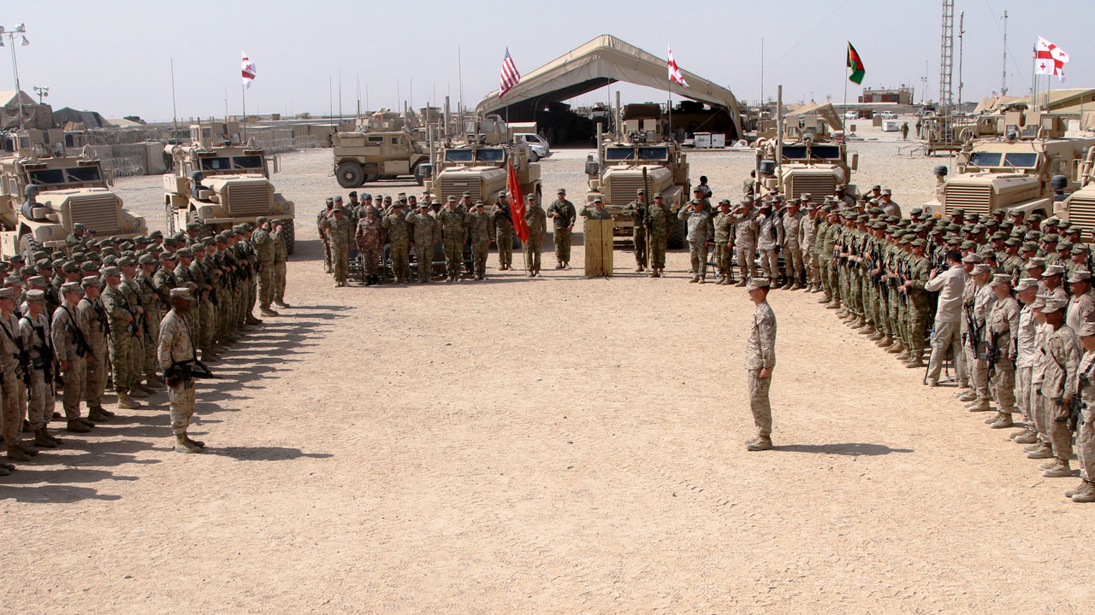
From Aa, Bb, Cc to UXO and EOD

Slide 4
Who and What We Teach for - Purpose
MILITARY AND CIVILIAN PERSONNEL OF THE ARMED FORCES OF GEORGIA
Different Peacekeeping Missions and Operations
International Military Education and Training
To meet requested criteria in the job description

Slide 5
What We Teach with – Text-books
DLI-American Military Course –ALC
DLI – English for Specific Purposes – General Military Topics
DLI - Army Topics -1; Army Topics – 2;
DLI - Topics in Counterinsurgency
English for Specific purposes:
Campaign – 1; 2; 3
Command English

Slide 6
Format of Teaching -ALC – 30 Books -Intensive
Course Duration – 36 weeks
Contact Hours – 30 (weekly) total- 1080
Classroom Practice - 890
Laboratory Activities -150 hours
Book Quiz- progress check (after every book – 30 hours)
Level Check – ALCPT(twice)
Self –study Hours -360
Final exams – ALCPT + OPI
Total - 1080+360 =1440

Slide 7
How We Asses ALC – Book quiz; ALCPT
ALC Book Quiz Score – 100%(50 correct answers)
Pass
ALC Book Quiz Score -90%-98%(45-49 correct answers)
Pass
ALC Book Quiz Score – 80% - 90%(40-45 correct answers)
Pass
ALC Book Quiz Score 78% (11 incorrect answers)
Fail
ALCPT Book – 18
Score – 55
(Testing Group)
ALCPT Book – 24
Score – 65
(Testing Group)
Final ALCPT Book – 30
Score – 70
(Testing Group)
Evaluation in Speaking Skill
(Testing Group)
Periodical Speaking and Listening Evaluation
(USA Instructors)

Slide 8
How We Assess Model of weekly assessment form for ISAF classes
Student’s name, rank
Poor – 1 Good - 3
Fair - 2 Outstanding - 4
Book# | Monday | Tuesday | Wednesday | Thursday | Friday | Total Score
homework | 3 | 4 | 3 | 4 | 4 | 18
participation | 4 | 4 | 4 | 4 | 4 | 20
interpretation | 4 | 3 | 4 | 4 | 4 | 19
comprehension | 4 | 4 | 4 | 4 | 4 | 19
Teacher’s signature |  |  |  |  |  | 76 95%

Slide 9
Who Facilitates Studies
Program Leader
Senior teachers -2
East Georgia – Tbilisi - 33 instructors
West Georgia: 11 instructors
Tbilisi – Language Training School: 4 American ( DLI – USA,TX )instructors.
Since 2012 there has been five rotation of DLI instructors. Total number - 17 instructors

Slide 10
Faculty Development Opportunities
Trainings Abroad:
DLI –USA
BALIC (27- week course)– 8 instructors
AELIC (16 -week course) – 5 instructors
ALPS (12 – week course) – 3 instructors
MACS (8-week course) – 4 instructors
MELT (8 – week course) – 2
George C. Marshall Center – PLTCE
CITC (3-week Course) – 18 instructors
MTT (2-week course) – 6 instructors
LTS (2-week course) – 3 instructors
LSAS (9 –day course) – 1 instructor
Defence Academy of the UK
TTT (3-week course) – 2 instructors
Hungary
Advanced Military Terminology and Teaching Training Seminar - 3 instructors
In-service Training - Ingrida Leimanis – trained most of the faculty-2014

Slide 11
Where We Work - Locations
West Georgia:
Senaki – 2nd Infantry Brigade -1group
Kutaisi – 3rd Infantry Brigade – 2 groups
Khoni – 2nd Artillery Brigade – 2groups
Batumi -21st Light Infantry Battalion-3 grs
Sachkhere-Mountain Training School-1gr
East Georgia:
Tbilisi-language Training School-24grs
Akhaltsikhe –Armored Battalion -1group

Slide 12
ISAF
Reports
SIGACT REPORT – Significant Action reporting is submitted for any actions that directly impact on mission accomplishment(10 line)
CAS - Close Air Support Request –(9 line)
IDF - Indirect Fire report – (8 line) –is submitted immediately when a unit receives enemy indirect fire
SHELL – (12 line) is submitted within 30 minutes of an IDF
CRATER ANALYSIS – (13 line)is submitted upon receiving enemy IDF
EOF –(16 line) – is submitted when units conduct any escalation of forces

Slide 13
ISAF
Reports
EOF-AFTER ACTION REPORT-is a follow- on report to the initial required EOF 16- line report in order to provide more details and confirm accuracy of initial report INITIAL DETAINEE REPORT-is submitted when a unit detains an individual suspected of insurgent/criminal activity
IED / UXO -10 LINE - is submitted upon discovering /receiving an attack from an IED to RCT
AMPLYFYING INFO FOR IED/UXO -10 LINE REMARKS
BDAR – BATTLE DAMAGE ASSESSMENT REPORT - is due within 2 hours of any CAS or INDIRECT FIRE MISSION
VEHICLE RECOVERY 15 – LINE REPORT – is used to request recovery assets in the case that a unit cannot self-recover

Slide 14
First Impression Report -(FIR) – CIVCAS – (2 hr. to RCT) Sample
EVENT #
DTG of REP. | UNIT
WHEN
WHERE | Outside local mosque
WHAT Happened | 1st Plt, B Co, 31st Bn, engaged LN veh with 5.56mm when it failed to stop at hasty CP. LN was wounded when CF employed disabling shots due to speed of veh and ignoring warning signs, hand/arm signals, and pyro.
What Have We Done | LN was treated on site and turned over to ANA for evacuation to LN hospital. Local tribal leader notified of incident. Tribal elder was asked to assist with ensuring LN’s what was required when approaching CF ECP
What Next | BN will re-engage local leaders to ensure that LN’s understand CF signs/warnings at ECP. Bn will review SOP’s (standard operation procedures) for EOF(escalation of forces)
Any addt.inf | Confirmed Unconfirmed
Casualty Estimate | KIA WIA KIA WIA CF ANF CIV 1-LN-male INS

Slide 15
Second Impression Report (2IR) - (6 hour) Sample
JOC Watch #
DTG of Rep | UNIT
 | Description
Report Drafted by | Capt .A.B. Jones
Background information | EOF procedures with 1 LN Wounded
Storyline | 1 Local National was wounded by apparent small caliber round from EOF procedures executed by 1st Plt, Co –B, 31st Bn, while conducting a ECP near the local mosque. The battalion is conducting a preliminary inquiry at this time.
Local Officials conducted | Local Tribal Leaders contacted. He understands EOF and will ensure his people understand them as well
Medical Assessment | Injury to right arm. CF treatment has stabilized wounded LN. LN is expected to make full recovery.
Actions Taken or intended | Will review EOF SOP(standard operation procedures) Bn wide. Will ensure LN’s are aware of CF actions.
Media Assessment | PAO (public affairs officer) determines that due to the lack of media in the area, there will be no coverage of incident
Casualties (MedOps) | confirmed Unconfirmed KIA WIA KIA WIA
 | CF ANSF CIV 1-LN male INS
CAS/IDF/JF(close air support, indirect fire, jointfires) | NO Assets Ordnance

Slide 16
ISAF
Some Military Terms & Acronyms
Corpsman – Navy hospital corpsman attached to a Marine unit; also known as ”doc”(he has served in combat with marines), inappropriate to address as “medic” or “aid man”(Army terms)
All hands – all unit personnel
Bag nasty – A-ration bagged meal issued to Marines in the field
Brain bucket – helmet
Brass – 1.gun casing, uniform insignia, senior officer
Beans – rations
Bullets – ammunition
Bandages – medical care
Ant farm / ant hill- combat outpost with a large number of radio antennae visible
Above my pay grade – indicating that the issue should be brought to higher-ranked officials

Slide 17
ISAF
Some Military Terms & Acronyms
Helo – helicopter, “chopper” is an Army term
Deuce – reference to the number two in various unit or equipment names; the senior intelligence officer (S2) for a unit
Get some – spirited(courageous) cry expressing approval and the desire for more or to continue
Good to go – phrase meaning difficulties overcome; ready; well done or satisfactory
How copy? – do you understand?
Solid copy – I understand
Click – kilometer
Push – move
Hold - stay in place
Cordon – surround
Mass Cas – massive amount of casualties
Red air - weather not good for flights

Slide 18
ISAF
Military acronyms & abbreviations
ANSF –Afghan National Security forces
AAF – Anti-Afghan forces
GIORA – government of Islamic Republic of Afghanistan
ANA – Afghan National Army
ANP – Afghan National Police CF – Coalition Forces
AO – Area of Operations
ROE – Rules of Engagement LOC – Lines of Communication
UXO – Unexploded Ordnance
IED – Improvised Explosive Device
EOD – Explosive Ordnance Disposal
FRAGO – Fragmentary Order, (additional material) to published operational order

Slide 19
NEW Vocabulary
Military acronyms & abbreviations
RCT – Regimental Combat Team
COIN – counter insurgency
ANSF – Afghan National Security Forces
AO – area of operations
TF - task force
MAG - Marine Air Group
CAB - Combat Aviation Brigade
Integrate, insert, conduct, decisive, regiment, insurgency

Slide 20
ISAF
Concept of Operation
(Situation)
RCT 8 has completed the stage of operations to receive and integrate the force and successfully inserted significant tactical units into selected areas. As the operation continues, RCT 8 continues to clear selected area of enemy forces and conduct COIN operations with ANSF partners throughout the AO. While no single operation or effort during the conduct of COIN operations is decisive, the main effort throughout the operation is TF1/5, whose AO is centered on the key population center of the regimental battle space and continues to serve as a base of operations for the insurgency. Aviation support is provided by MAG 40 and USA 59 CAB.

Slide 21
Military acronyms & abbreviations Sample of the FRAGO CLP
FRAGO – fragmentary order
CLP - combat logistic patrol
AAF – anti-Afghan forces
IED – improvised explosive device
G2 – assistant chief of staff, intelligence
AO – area of operations
IOT – in order to
ANA/ANP –Afghan National Army/Police
COIN – counter insurgency
TF – task force
JTAC – joint task force commander
EOD – explosive ordnance disposal
CAS – close air support
TCO – tactical convoy operations
SP – shore patrol / self- propelled
IPB – intelligence preparation of the battle field
PSD – personal security detachment
FOB – forward operating base
MEDEVAC – medical evacuation
OPORD – operation order
RED - ready
CLS – combat life saver
ASF – Afghan Security Forces
I AW – in accordance with
SOI – signal operations instructions

Slide 22
Q U E S T I O N S ?

