Slide 1


Teaching Writing in a Flexible Learning Environment
Peggy Garza
Associate BILC Secretary
and
Andrea Gjorevski

Slide 2


Two Online Writing Courses for NATO staff officers
ELTEC 2
NATO Writing Strategies Course

Slide 3

ELTEC2 10 Microlessons
Direct and Concise Language
Cohesion (Types of Transitions)
Tone in Written Communications
Parallel Structure
Gender-Neutral Language
Common Phrases
Using "the"
NATO Spelling
Comma Usage
Hyphen Usage

Slide 4
Analysis Phase
BILC Feasibility Study WG
8 nations + ELTEC team
Training Needs Analysis
NATO ADDIE Model

Slide 5
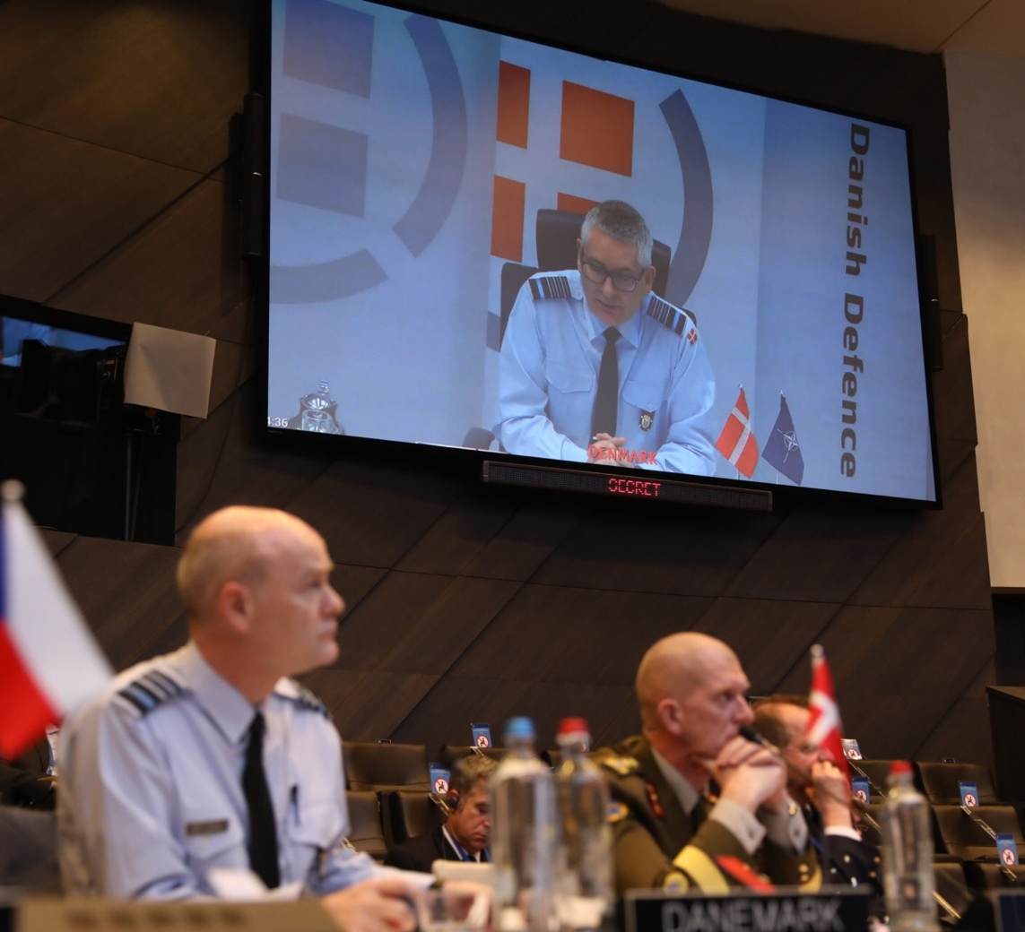
Target Audience and Course AIM
Analysis Phase
Participants should be current/future NATO staff officers
The course is designed to develop the participants’ work-related writing skills and to familiarize them with strategies for producing written documents and correspondence IAW NATO conventions.

Slide 6
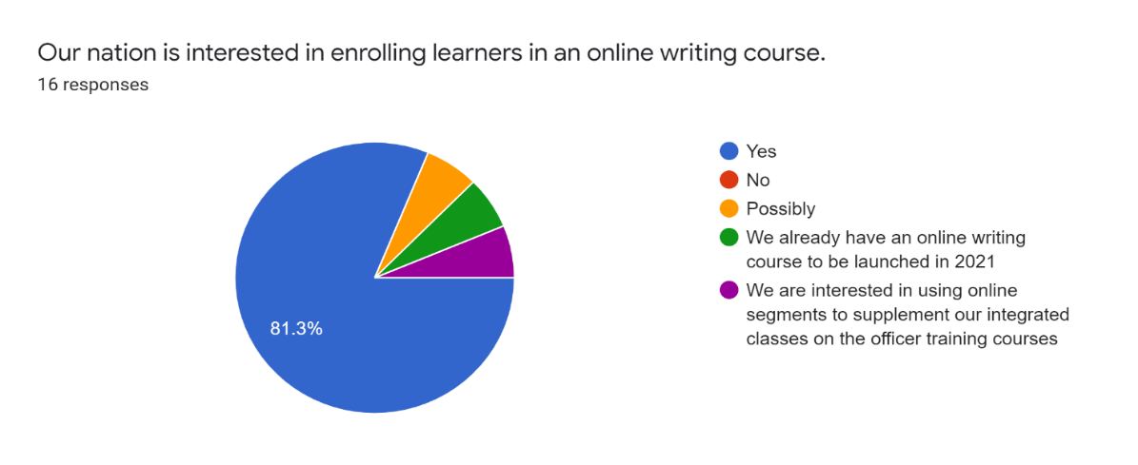
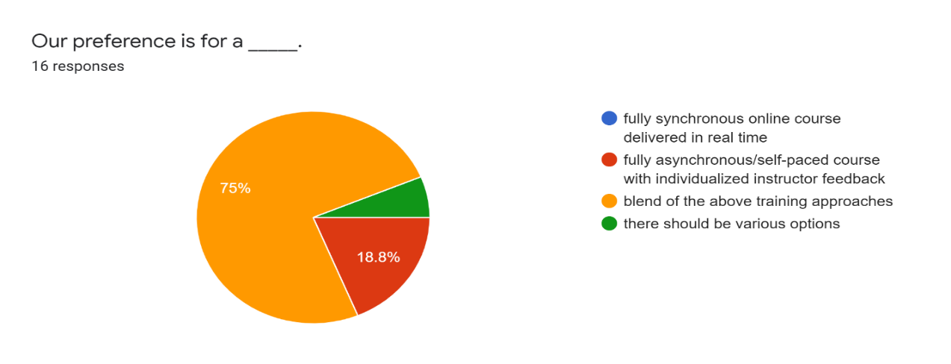
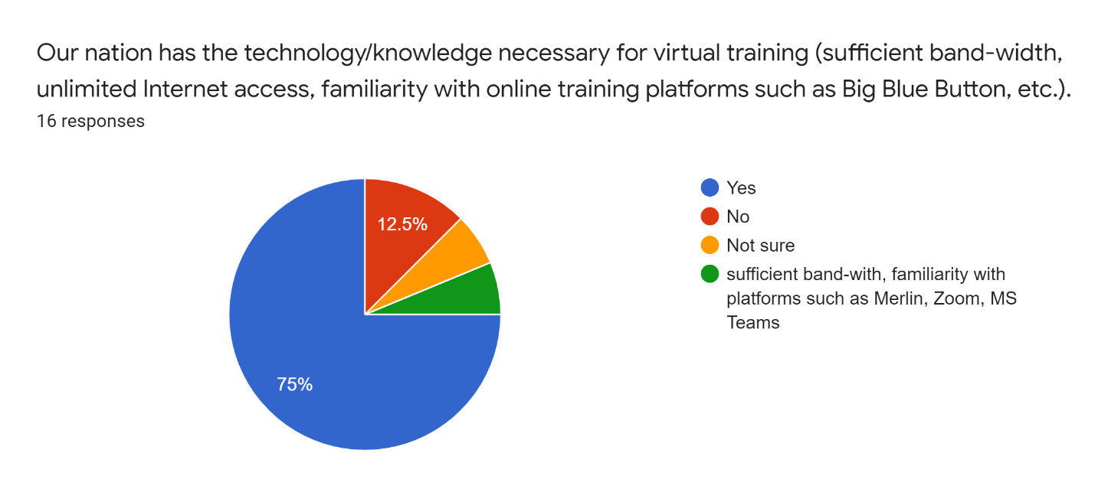
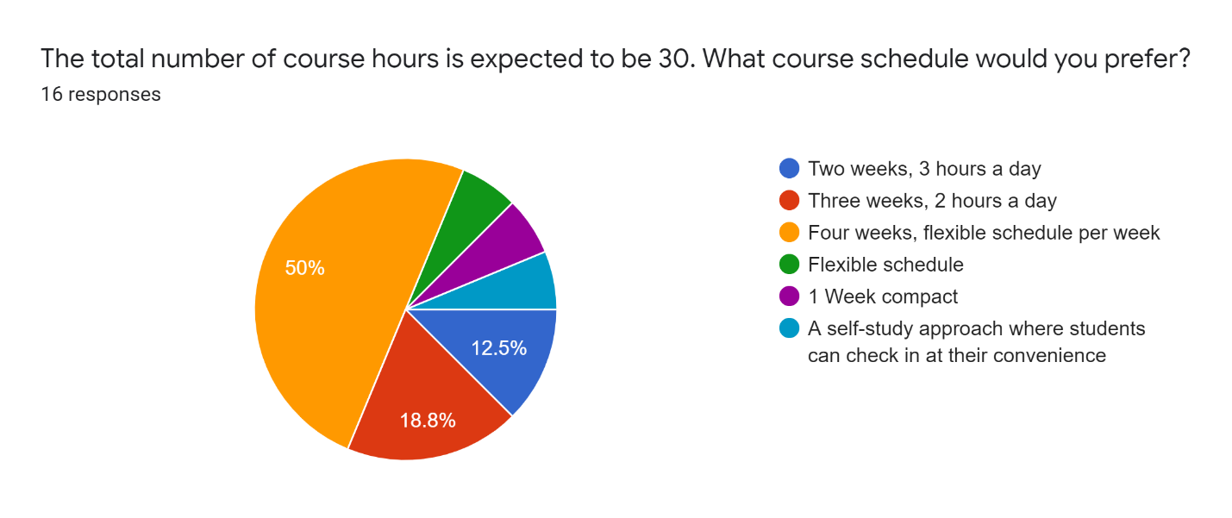
Survey results
16 Nations responded

Slide 7

Performance Objectives
Produce clear, concise and well-organized writing
Demonstrate STANAG 6001 Level 3 (professional) writing proficiency
Implement standard NATO conventions in written documents and correspondence
Apply the principles of the writing process
Develop editing skills (self-editing and peer-editing)

Slide 8
Course Design Phase
Decision: Fully online NATO Writing Strategies Course
Online Writing Instruction (OWI) Grounding Principles
  Principle 3: Appropriate composition teaching/learning strategies should be developed for the unique features of the online instructional environment
  Principle 4: Appropriate onsite composition theories, pedagogies and strategies should be migrated and adapted to the online environment
  Conference on College Composition and Communication Committee (CCCC)

Slide 9
Course Design Phase: asynchronous/synchronous BALANCE
Synchronous 3 hours per week
Asynchronous 5 hours per week
Individual Conferencing 1 hour per week

Slide 10
Individual Conferences
Why?
When?
What?
Providing tailored, specific feedback to writers is the cornerstone of any effective writing course
Facilitators met once a week on BBB for 1 hr. with each participant at a mutually agreed upon time
Facilitators provided written feedback on the draft BEFORE each conference
Participants led the discussion about what questions they had on their texts
Facilitators provided resources and helped participants plan next steps
General Q&A (rapport building)

Slide 11


Course Development PHASE: Platforms
Big Blue Button
  Plenary sessions
  Syndicates
  Pair work
  Individual conferences
GlobalNET LMS
  Discussion forum
  Micro-lectures
  Activities/resources
  Portfolios

Slide 12
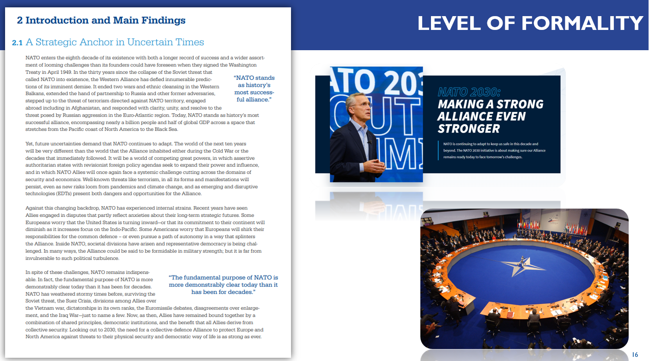
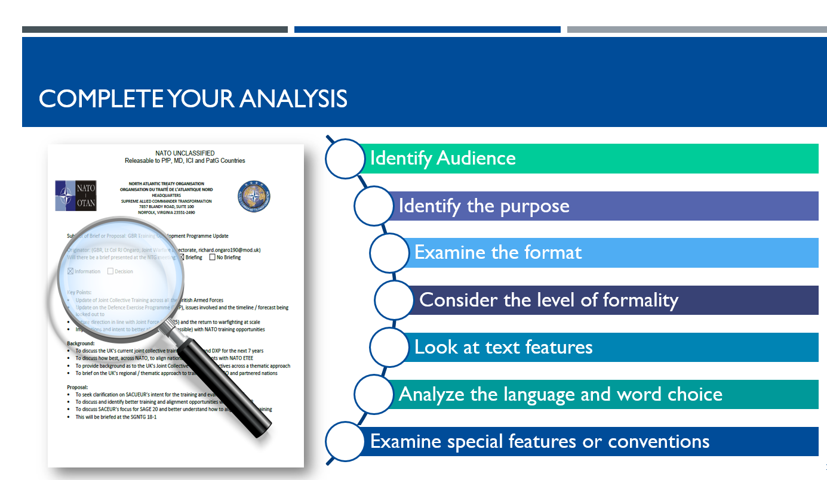
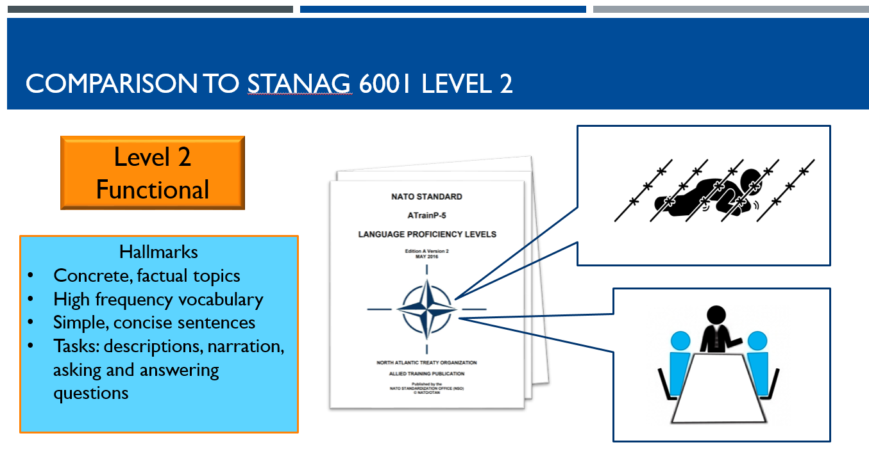

Course Development PHASE: Content
Microlectures
The Writing Process
Clear and Concise
Genre Analysis
Good NATO Writing
Tactical vs Strategic (L2 vs L3) writing

Slide 13
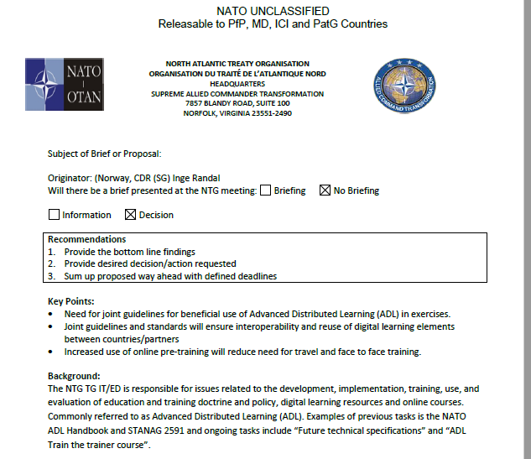

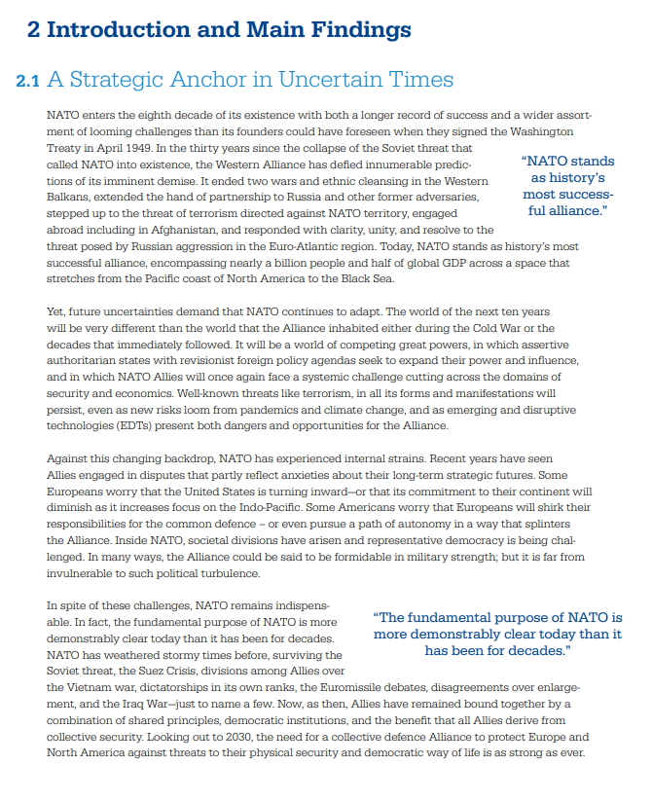
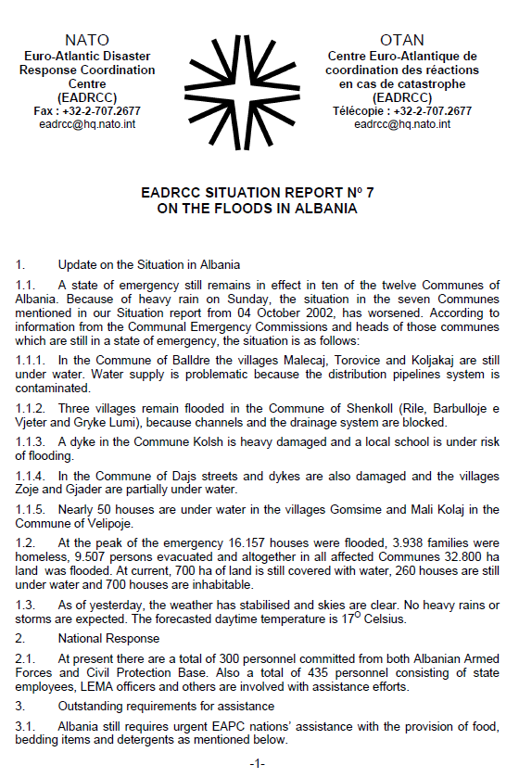
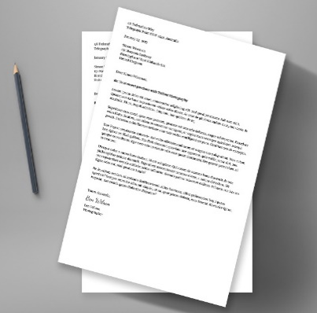
Course Development Phase:
Core Writing Tasks
Formal Email
Point Paper
Executive
Summary
Level 3 Opinion, Summary and Analysis

Slide 14
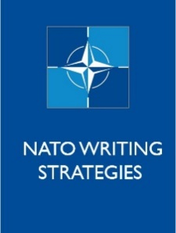
Course Development PHASE: Content
Portfolio Assessment
Writing Samples | Draft | Final
Pre-course Assignment (optional)
Individual Writing (optional)
E-mail- Week 1
Point Paper- Week 2
Executive Summary- Week 3
Analysis Level 3 Writing- Week 3

Slide 15

Implementation phase : Pilot course
24 May-18 June 2021
8 participants, & countries
BGR (2), CZE, DNK, ESP, ROU, SVK, SVN

Slide 16
Course Outline
Pre-course tasks
Self–assessments
Authentic writing samples
0
Week 1
Writing in NATO
Emails
Writing process
Genre analysis
1
Week 2
Point papers
Editing (peer and self)
2
Week 3
Executive summaries
Meeting minutes
3
Week 4
Individual writing challenges
Portfolio assessments
4

Slide 17
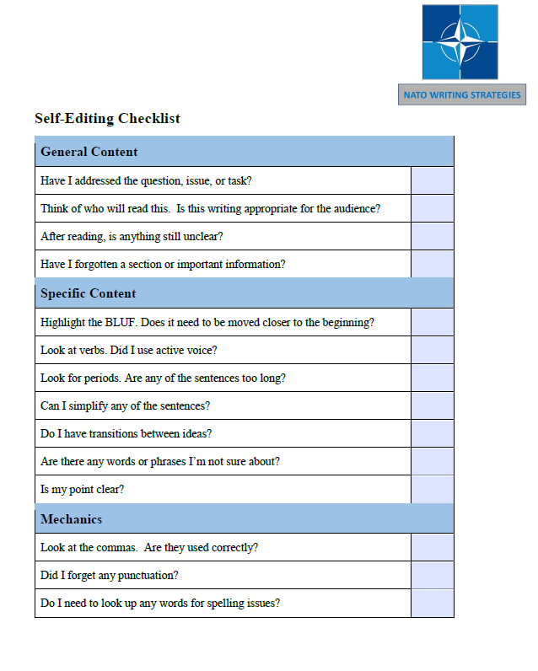
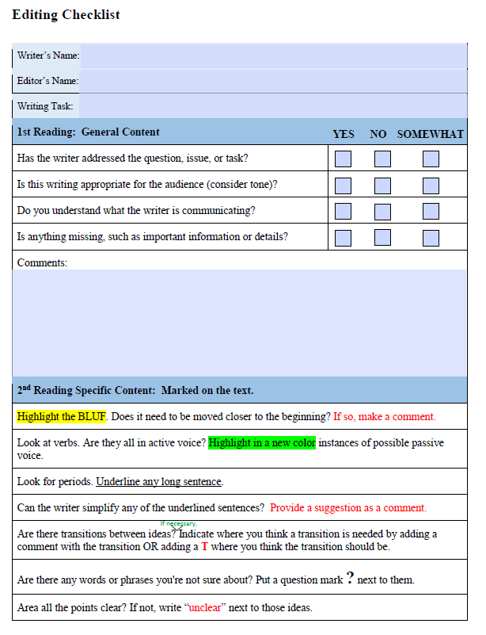
Editing (self and peer) task
Editing (self and peer)
  YouTube video
  Automated writing tools: Spellcheck, Grammarly
  Checklists for self and peer
Peer Editing
  Facilitators modeled Peer Editing Checklist on previous writing assignment; conferenced
  Peers met, decided on when/how to provide feedback
  Peers filled out checklist, provided comments and exchanged work

Slide 18
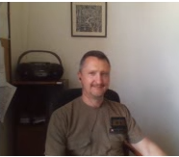
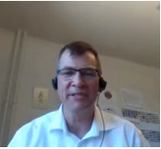
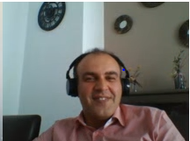

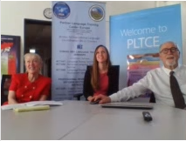
Evaluation Phase: Participant Feedback
Weekly Survey
End of Course Survey
Focus Group

Slide 19
Week 1 Survey
Summary of ParticipANT Feedback
Highlights of asynchronous micro- lectures
Introduction to the writing process (clearly outlined the information about writing)
All of them were equally informative
"What is Good NATO Writing?" explanation of main principles of NATO writing
Email writing as it sets standardization that adds to each and everyone considers common sense and basic rules when writing an email
Highlights of synchronous sessions
Meeting peers and facilitators of the course
Speaking and listening to native speakers
Details of BLUF and KISS principles
The rerun of essential parts of the micro- lectures
Getting the technical aspects straight away
The explanations provided by the instructors
Working in small groups; discussions

Slide 20
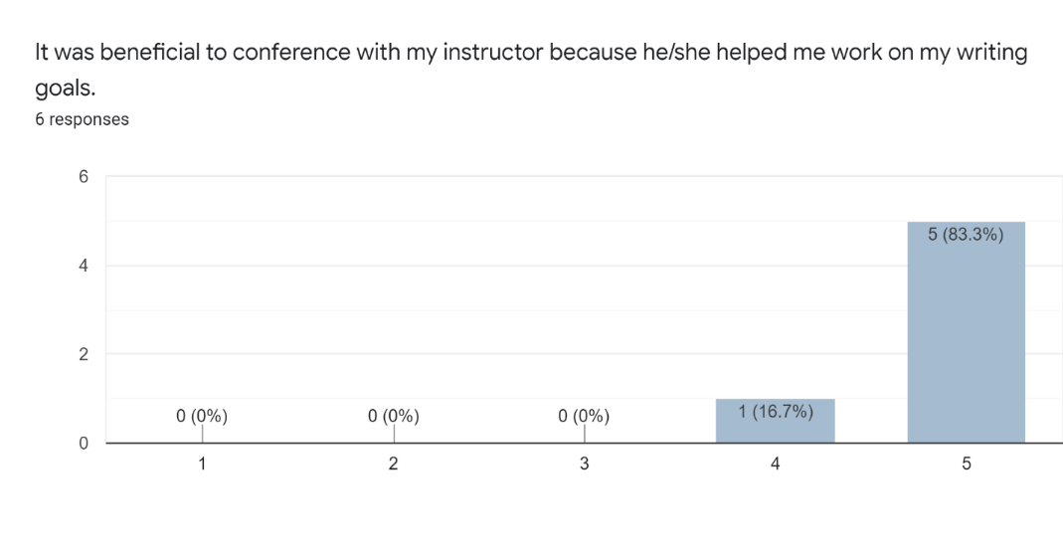
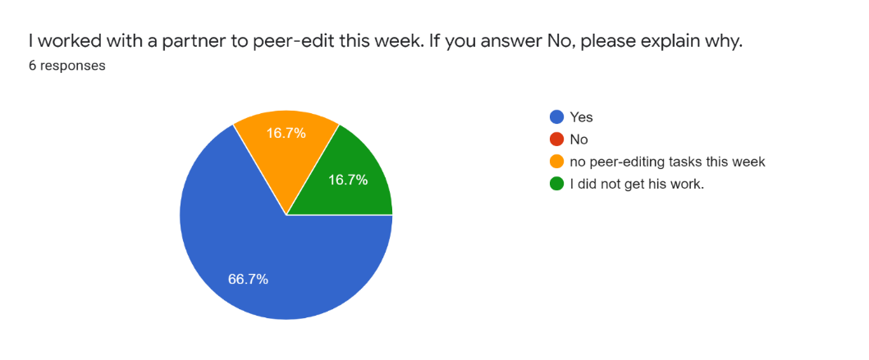
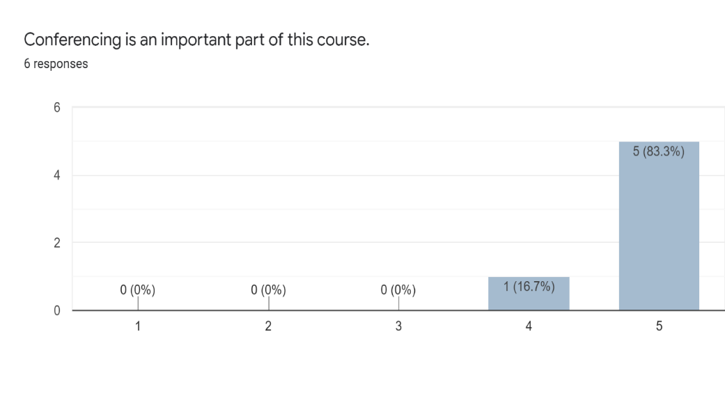
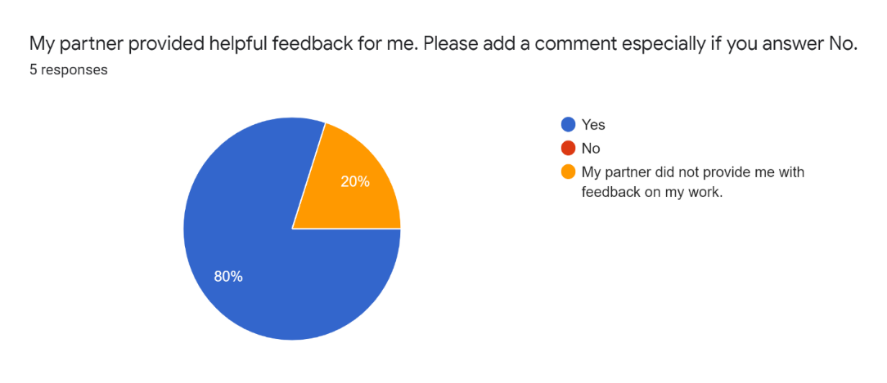
Week 3 Survey
Participant Feedback
Feedback on Conferencing
Feedback on Peer Editing

Slide 21
FoCUS Group
General Questions What did you like best about the course? What was the most challenging part of the course? Do you think that the material you worked with was authentic and relevant to the NATO context and a staff officer’s writing tasks? Synchronous-Specific Questions What are your learning preferences: learning collaboratively with others in your class or learning independently with asynchronous work only? Did the synchronous sessions help you feel like part of a learning community? Were the synchronous sessions helpful as a review of the asynchronous material or way to practice what you learned in your asynchronous assignments? In your opinion, did the synchronous sessions foster NATO interoperability? If so, how? Questions on the Course Structure Assume a total of 40 hours and individual conferencing... Keep as is Make the synchronous sessions optional Fully online over two weeks, not four Include a one week in-person component at PLTCE Other
I really liked the structure of the course…that there was synchronous work, asynchronous work. The flexibility, well, even though I had to skip a couple of synchronous, I still felt that I was doing the course…
It provided needed standardization…as to what are the documents that need specific NATO writing and how to properly prepare them. I have encountered these types of documents but I have never had them…in a form of training. It provided the needed standardization and formatting for what NATO writing is.
The synchronous work was pretty much like a classroom lesson. It gives one the sense, the social sense of being in a group with someone that, and that you are trying to learn something.
The most challenging being able to attend at the specific time a synchronous or asynchronous session or one-on-one discussion with the instructor.

Slide 22
Fully OnLine Pros and CONs
Cons
  Work schedules did not allow for full participation
  Some limitations on participant access to technology
  Asynchronous learners may have felt uncomfortable
  Constraints in terms of activities and on-the-spot adjustments; additional planning required
Pros
  Available to a global audience
  Suitable for a writing course
  Achieved the performance objectives
  Variety of engaging, self-paced multimodal asynchronous activities
  Comprehensive repository for all course content through the LMS

Slide 23
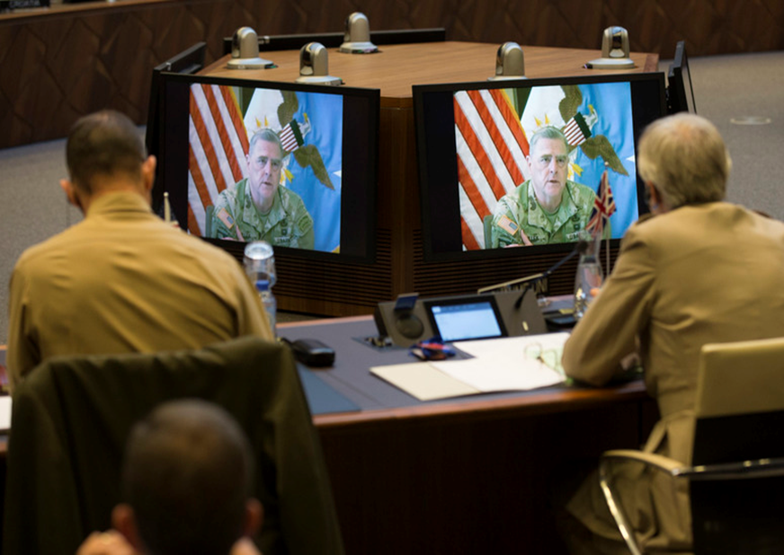
Should we re-define the target audience?
Current/future NATO staff officers at SHAPE, HQ SACT, or other NATO HQ?
  Question- Would they be permitted to take a 35-hour writing course during duty hours?
Other staff officers?
  In national positions
What about BILC language teachers?
  If so, what aspects of the NATO Writing Strategies Course would be of interest?

