Slide 1
NATO BILC STANAG 6001 Testing Workshop Alternative placement tests designed by Czech testers/teachers to substitute ALCPT Riga, Latvia 4 – 8 September, 2023
Jan Křivka

Slide 2
Presentation Outline
1. ALCPT in the Czech context
2. The need for change
3. Test content and format
4. Teacher training
5. Overloaded Testing Department
6. Policy/politics
7. Current situation
8. Conclusion
Jan Křivka

Slide 3
Brno Language Centre Placement Test
(BLCPT)
Rozřazovací test k pretestaci jazykový kompetencí
(ROZTEPJAK)
Jan Křivka

Slide 4
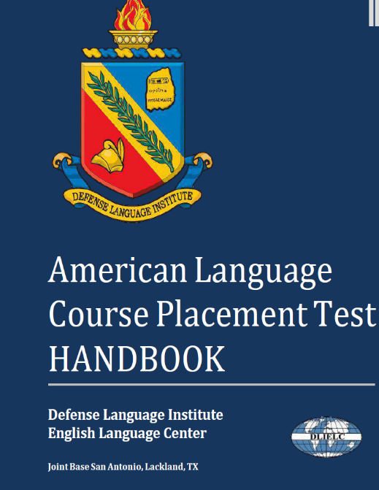
1. ALCPT in the Czech context
ALCPTs must be used for the following purposes only:
Place students in American language course (ALC) program
Evaluate student progress at the end of an ALC level
Screen candidates for readiness to take English Comprehension Level (ECL) test
Evaluate the English Language abilities of local personnel working for, or being considered for positions on overseas US military installations as required by US military service regulations
Jan Křivka

Slide 5
1. ALCPT in the Czech context
ALCPTs have been used in the Czech enviroment for the following purposes:
Place students in MoD STANAG 6001 language courses (ALC books not used at all)
Evaluate student progress at the end of MoD STANAG 6001 language courses
Assign recruits into STANAG 6001 exam (mandatory testing of all new recruits)
Jan Křivka

Slide 6
Testing of language competencies
Number of people tested by LC
YEAR | ALCPT | STANAG 6001
2015 | 1755 | 2631
2016 | 2281 | 3961
2017 | 2389 | 4411
2018 | 2234 | 4124
2019 | 1975 | 4177
2020 | 2523 | 3094
2021 | 1183 | 3451
2022 | 1897 | 4146
Jan Křivka

Slide 7
2. The need for change
Misuse/overuse of ALCPT
ALCPT Forms – free download – compromised
ALCPT results not reliable
Our MoD not successful in acquiring new ALCPT Forms
Unexpected circumstances
Jan Křivka

Slide 8
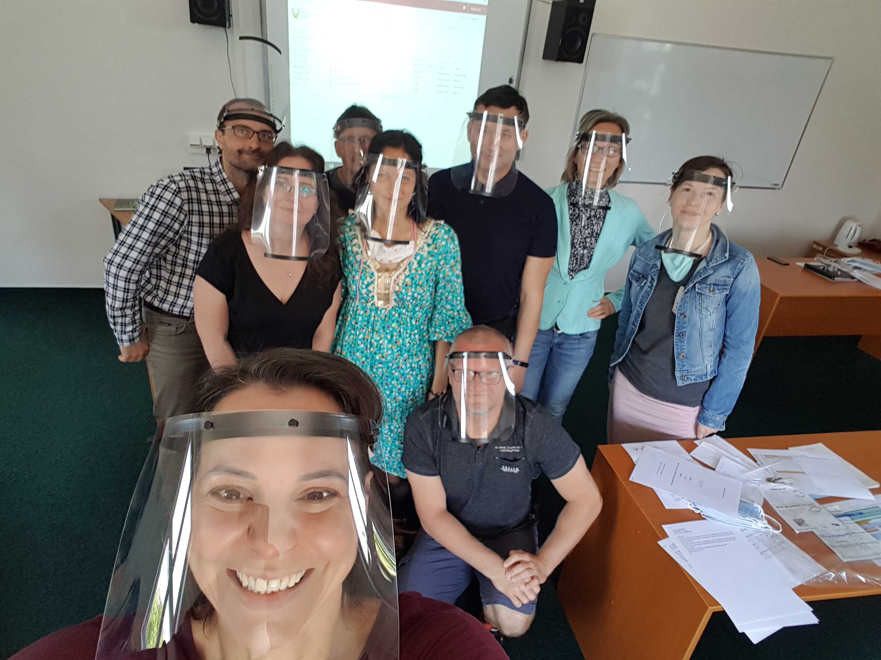
2. The need for change
Overuse and misuse of ALCPTs leading to the discrediting of most test versions
MoD not successful in acquiring new versions of ALCPTs
Colonel (GS) Assoc. Prof. Ing. Vladan Holcner, Ph.D

Slide 9
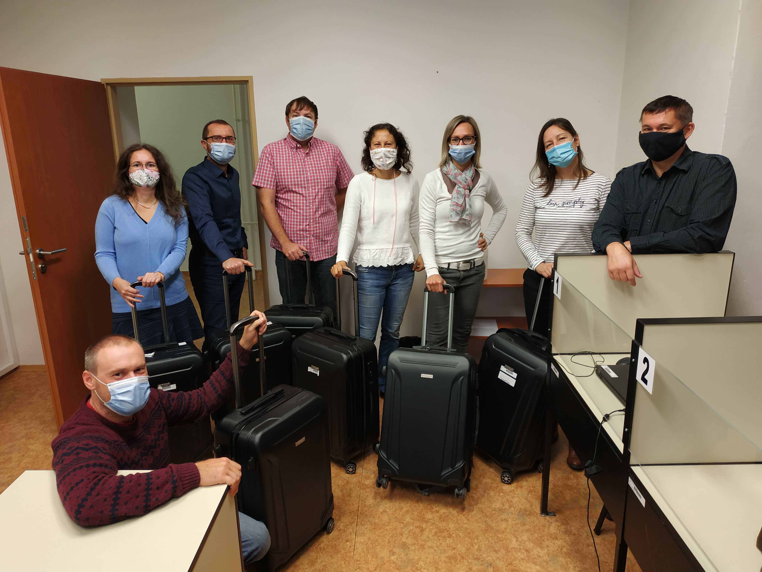

Slide 10
Jan Křivka

Slide 11
3. Test content and format
Define/Design/Develop:
Skill modality: only reading vs reading/listening
Number of items
weighting (some items worth 2 points vs practicality
Test specifications
Scoring
Procedures/guidelines for item writers
Procedures/guidelines for test takers
Text/audio typology and selection
Overall organization
Jan Křivka

Slide 12
3. Test content and format
Test content and format:
The BLCPT assesses English proficiency through items that evaluate comprehension of grammar and vocabulary and comprehension of general meaning of a text through the modes of listening and reading.
A 100 item test (multiple choice)
All BLCPT forms are equivalent in terms of difficulty.
2 parts, listening (50 items – app. 20 minutes) and reading (50 items – 40 min)
Test format:
Jan Křivka

Slide 13
3. Test content and format
Listening
50 items (15 L1, 25 L2, 10 L3) = 50 points
Item type: V, G and F
Reading
50 items (12 L1, 25 L2, 10 L3) = 50 points
Item type: V, G, F and R (6 items)
L1 two R items, L2 3 R items and L3 one R item
L1: 13 points (5xV, 6xG, 2xF) + 2 points (2xR) = 15 points
L2: 22 points (9xV, 10xG, 3xF) + 3 points (3xR) = 25 points
L3: 9 points (5xV, 4xG) + 1 points (1xR) = 10 points
Jan Křivka

Slide 14
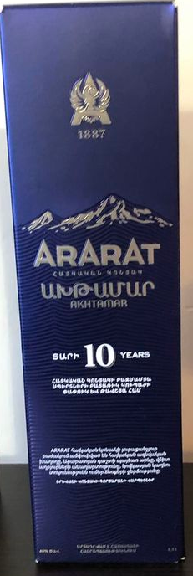
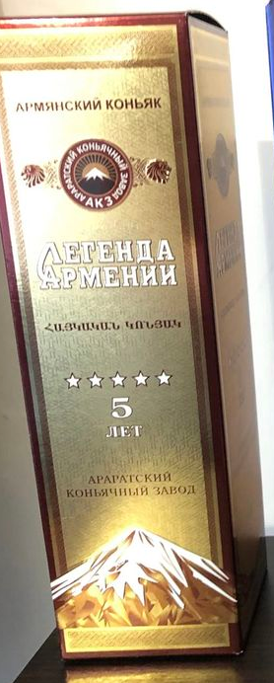
Level 1
Level 2
Level 3
Jan Křivka

Slide 15
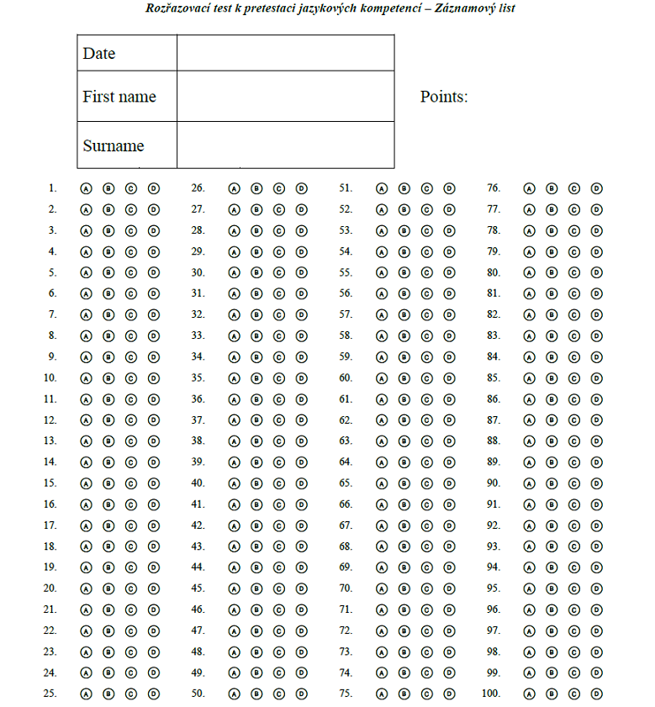
Jan Křivka

Slide 16
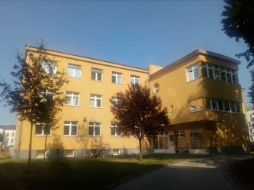
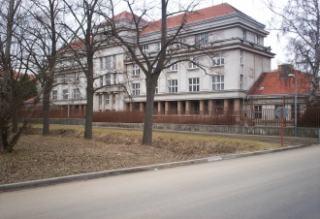
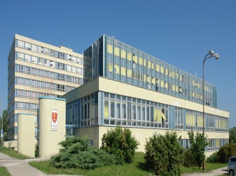
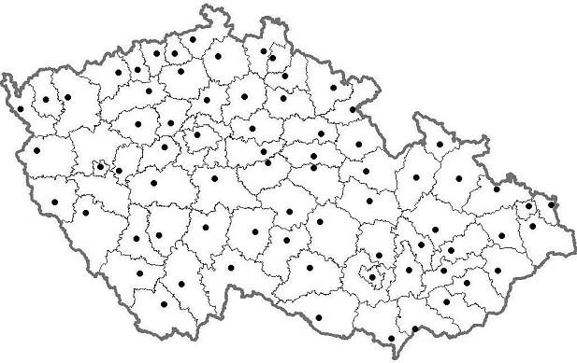
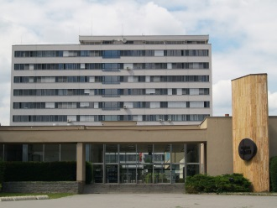
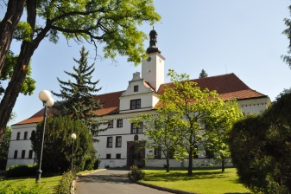
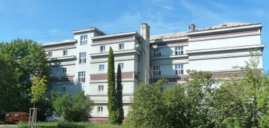
4. Teacher training
Olomouc
Hradec Králové
Praha - Ruzyně
Vyškov
Chocerady
Brno
Jan Křivka
.

Slide 17
4. Teacher training
Online seminars:
Types of items (G, V, F, R)
Submitting and moderation procedures
Action plan:
10 BLCPT Forms by June 2023
Phase 1 – June – September 2021 – BLCPT Form 1 compiled
Intensive pretesting – correlating ALCPT – BLCPT
List of grammar structures and vocabulary topics recommended for each STANAG 6001 level
Phase 2 – using anchor items to compile further BLCPT Form – pretesting correlating ALCPT - BLCPT
Jan Křivka

Slide 18
4. Teacher training – grammar list
Level 2
Active knowledge- all features listed in SLP 1111 + following:
past/future simple tenses, negative, question
past continuous tense
present perfect
used to + infinitive
modal verbs can, could, must, may, might, will, would, shall, should
past tense, future tense of modal verbs be able to, be allowed to, to have to
passive – present, past and future tense
zero and first conditionals
time clauses
relative clauses
collective nouns
Jan Křivka

Slide 19
4. Teacher training – grammar list
comparisons
articles
reflexive pronouns
word-building (prefixes, suffixes)
Passive knowledge
infinitive with to and without to
infinitive with accusative
reported speech
reported questions
commands
indirect questions
decimal numbers and fractions
phrasal verbs
second conditional
Jan Křivka

Slide 20
Grammar Items – Level 2 examples

Slide 21
4. Teacher training – TLU
Level 2
All topics listed in SLP 1111 + following:
Family and interpersonal relationships
Job description and career
Education, qualification and training Future plans and predictions
Daily routines and lifestyle
Traditions and customs Entertainment and culture
Sports and games Places to live, accommodation facilities
Tourism
Holidays, trips
Jan Křivka

Slide 22
4. Teacher training – TLU
Orientation in the country
Transacting official matters (e.g. a passport check, customs inspection, dealing with immigration police)
Media, newspapers
Current events
Weather and weather conditions
Technology and inventions
Military topics connected with candidate’s job (ranks, units, military training, weapons, equipment...)
Jan Křivka

Slide 23
Vocabulary items – Level 2 examples
Jan Křivka

Slide 24
Functions items – Level 2 examples
Jan Křivka

Slide 25
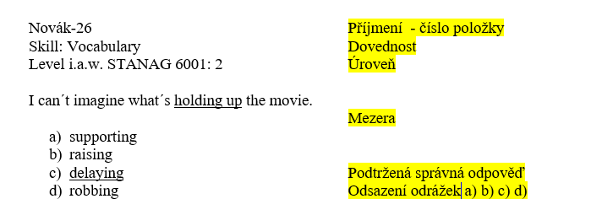
Item format for G, V, F
Jan Křivka

Slide 26
5. Overloaded Testing Departmet
Intensive continuous moderations (3-4 experienced testers)
Compiling tests (2 micro teams for listening and reading)
Proofread by 2 native speakers
Piloting
Pretesting on MoD language courses and cadets
Answer sheets scored/processed with Remark OMR
Correlating ALCPT – BLCPT (0,94) (minimally 120 candidates)
CTT
BLCPT item database (currently more than 5000 tagged items)
Jan Křivka

Slide 27
6. Policy/politics
BLCPTs are/will be administered/proctored only by our LC staff.
Each LC Teaching Department has assigned TCO and ATCO
BLCPTs will be used only for “high stake” purposes
Reducing the risk of compromising the tests to a minimum
Jan Křivka

Slide 28
7. Current situation
10 BLCPT Forms (2-11) – last forms still being intensively pretested
Some teachers became excellent BLCPT item writers
Expanding BLCPT item bank
Minimally 2 versions created every year
Retaining the ability to switch to CDT
Jan Křivka

Slide 29
Thank you for your attention!
Questions?
Jan Křivka

