Slide 1
2023 NATO BILC Professional Development Seminar
Baku, Azerbaijan
16 – 19 October, 2023
BILC Information and Update BILC Secretariat
Notes:
(General Piriyev), estimeed colleagues, members of BILC
Good morning.
For those who do not know me, I am Irena (Prpić Đurić). I am the director of the FLC of the Croatian Armed Forces. Teacher of English by vocation, not only by profession.
Today, I am honored to welcome you all to the NATO BILC Professional Development Seminar on behalf of the BILC Secretariat.
My goal is to provide you with information on who we are, what we do and why that matters to you.
Before starting my presentation, I would like to thank host nation for organising this Seminar in such a lovely venue, and beautiful city of Baku. I extend a warm welcome to new delegates.

Slide 2
What is BILC?
Bureau for
International
Language
Co-ordination
a consultative and advisory body for language training matters in NATO
Notes:
The shortest and simplest definition… but what it means is something to be expained in the slides to come…

Slide 3
Bureau for International
Language Co-ordination
1966 – DEU, FRA, GBR, ITA, USA
1967: Belgium, Canada, Netherlands 1975: SHAPE and IMS/NATO (non-voting members) 1978: Portugal 1983: Turkey 1984: Denmark and Greece 1985: Spain 1993: Norway 1999: Czech Republic, Hungary, Poland 2004: Bulgaria, Estonia, Latvia, Lithuania, Romania, Slovakia, Slovenia
2009: Albania, Croatia
2017: Montenegro
2020: North Macedonia
2023: Finland
PfP, MD & ICI countries, ‘partners across the globe’ – welcome to attend and/or observe
Notes:
BILC has been NATO’s advisory body since 1966.
Founding members are France, Germany, Italy, the United Kingdom, and the United States. 1967 – Belgium, Canada, the Netherlands….
BILC is comprised of three constitutional components: a. Members. b. The Secretariat. c. The Steering Committee.
Participating nations are represented at BILC through a Steering Committee .
Under the current terms of reference PfP nations, Mediterranean Dialogue nations, nations from the Istanbul Cooperation Initiative, Global Partners (Australia in particular) and NATO bodies attend as observers, and, although welcome to contribute to the discussions of the Steering Committee, they are excluded from voting. All, however, are quite active in the business of standardizing language education, training, and assessment for general linguistic proficiency, as well as for specialized uses, and they regularly contribute papers and presentations at conferences, professional seminars, and workshops. All are equally concerned with governance and management of language programs.

Slide 4
BILC Steering Committee
GBR (1966-1981)
DEU (1982-1996)
USA (1997-2008)
CAN (2008-2014)
USA (2014-2016)
BGR (2016-2019)
SVN (2019-2022)
HRV (2022-2025)
Chair
Irena Prpić Đurić
Senior Advisor
Dr. Ray Clifford
Secretaries
Suzana Horvat
Borjana Soldo
Associate Secretaries
Peggy Garza
Julie Dubeau
Jana Vasilj-Begovic
Notes:
This is our formal structure. To the left you can see the countries which have provided the secretariat over the years. The Presidency of the Secretariat was handed to Croatia at the end of the 2022 BILC annual conference in Loreto, Italy.
Currently the Secretariat consists of 7 members: BILC Chair, Senior advisor Dr. Ray Clifford, BILC Secretaries Suzana Horvat and Borjana Soldo, and the three associate secretaries, Ms. Peggy Garza from PLTCE/USA and Ms. Julie Dubeau and Jana Vasilj-Begovic from Canada.
BILC Chair presides over the Steering Committee and represents BILC.
The BILC Secretariat is accountable to its steering committee, which meets in person each year at the annual conference, but is informed and consulted year-round through email.
On behalf of the Secretariat and the BILC community, I would like to thank Mr. Keith Werth (in absence) who retired in June this year, for his invaluable and countless contributions to BILC, and for his continued support and guidance over this challenging but rewarding year.

Slide 5
Bureau for International
Language Co-ordination
1978 – 2011 – the Joint Services Sub-Group within NATO Training Group (NTG)
2011 – 2022 – under the auspices of the Supreme Allied Commander Transformation (HQ SACT); the HQ SACT Joint Force Development, Human Capital Enhancement & Individual Training Branch (HCEIT Branch) → MEMORANDUM OF COOPERATION between SACT and BILC (2019)
2023???
Notes:
From 1978 to 2011, BILC was associated with the NATO Training Group through the Joint Services Sub-Group. With the reorganization of NTG, since 2011, relations with BILC have been placed under the auspices of the Supreme Allied Commander Transformation (HQ SACT), and relations have been regulated by the Memorandum of Cooperation between Headquarters, Supreme Allied Commander Transformation and the Bureau for International Language Co-ordination. Thus, BILC became better aligned as a strategic rather than tactical element while retaining its status as an independent advisory body. BILC’s involvement is integral to the implementation of strategic planning in NATO.
Some time ago we recieved the information about recent changes and reorganization within NATO. So, we will most probably have to find new ways, a new niche, for our relation to NATO.

Slide 6
Bureau for International
Language Co-ordination
Mission:
To promote and foster interoperability among NATO and Partner nations by furthering standardization of language training and testing.
To support the Alliance's operations through the exchange of knowledge and best practices, IAW established procedures and agreements.
Vision:
To achieve levels of excellence where progress made by one is shared by all.
27 active NATO nations and over 25 partner nations including NATO bodies NMI, SHAPE and IMS
Notes:
You are probably familiar with our vision and mission statements.
As they capture, our primary mission is to promote interoperability through standardization of training and testing practices. Our goal is to foster the exchange of knowledge and best practices. Because: Language is key to interoperability. Without an adequate level of proficiency, there can be no interoperability... And learning a language takes time, but there are no successful shortcuts.
There are plenty of civilian / academic language training and testing professional associations. But the BILC world is the defense-sponsored world and accordingly has some special aspects such as military interoperability, military terms, large numbers of people to train and at frequently higher levels than the purely civilian world of language teaching. BILC is a unique language organization as a result.
The BILC vision is to share progress made with member nations, partner nations and any nation who wishes to advance in the field of language training for military purposes. How is this done? Through the secretariat, there are a variety of initiatives that aim to foster these exchanges and promote standardization.

Slide 7
STANAG 6001 Key to Interoperability
Main responsibility: custodian of STANAG 6001
Language proficiency descriptions developed by BILC
Adopted by NATO in 1976
SLP (Standardized Language Profile) SLP 3232
Four numbers for Listening, Speaking, Reading, and Writing
0-5 scale (0: No Ability; L1: Survival: L2: Functional; L3: Professional; L4: Expert; L5: equivalent to a highly-articulate, well–educated native speaker)
SLPs in job descriptions, prerequisites for training, Language Capability Goals, Partnership Goals, etc.
BILC is responsible for periodically updating STANAG 6001
Notes:
The primary responsibility of BILC is to be the custodian of STANAG 6001. It is the standard that drives most BILC activities. It is the only shared standard that we formally ascribe to, forming the backbone of our training and testing systems. It influences WHAT and HOW language is taught and tested. It is the guidance underpinning the serious subject of Standardized Language Profiles (SLPs), which are found in many basic personnel requirements, not to mention national directives and ministerial orders related to military personnel. It can be found on the BILC website. The current edition of STANAG 6001 is Edition 5, version 2.
1976 was an important year for BILC because the language proficiency level descriptors that BILC had been working on from 1972 to 1975 were finally published as NATO STANAG 6001.

Slide 8
NATO Language Context
Each nation is responsible for own training / testing program
No common tests - only a common standard - STANAG 6001
Varying interpretations of standard? Nations certify their own military and give their members Standardized Language Profiles (SLPs) based on their own STANAG – based tests.
Language is viewed as a critical factor in the interoperability shortfall
Notes:
The point of BILC ultimately is INTEROPERABILITY and promoting it through standardization of training and testing practices and exchange of knowledge and best practices.
However, each nation is responsible for its training/testing program. There is no overarching language training/testing authority – all is done nationally – and in good faith. BILC is an advisory body only - we certainly suggest, but we do not prescribe.
There are no common tests – only a common standard. Each nation certifies its military members and gives Standardized Language Profiles (SLPs) based on national STANAG–based tests which may vary from one country to another.
Varying testing methods and interpretations of the standard can cause differences in SLPs. And even though BILC has made huge progress with many nations through standardizing efforts, a few still need to develop professional training and testing programs still issue STANAG 6001 proficiency certificates. Furthermore, Nations may not be setting realistic training goals, for example, aiming to train all officers to level 3…
This is an incredible challenge for most nations. In some nations, we know it is challenging to find qualified teachers with this high level of proficiency.

Slide 9
Major BILC Events
1) NATO BILC Conference
May 2023 was CANCELLED (Istanbul, Turkey)
SC Meeting – held virtually
May 12 – 19, 2024 – Vienna, Austria
2) NATO BILC Professional Development Seminar
October 2022, hosted by Provo, Utah, U.S.A.
Theme: “Applied Research and Practical Experience in Teaching and Learning Languages”
Notes:
The secretariat organises the conferences, Seminars and workshops in terms of the content of the work, however, without host nations, we could not exist.
We have three main events and the fourth recently added, which are themed to reflect current concerns or topical interests.
These two events form the backbone of BILC.
The Conference in the spring and the Professional Seminar in the fall promote the standardization of NATO and Partner nation teaching and testing systems by providing a forum for exchanging information, best practices, and new approaches in the language training and testing field.
The BILC civilian and military representation is a rich and unique mix (language teachers, testers, managers, and military language stakeholders), which makes BILC so valuable for the military language education and training world.
This allows us to scrutinize the problems of foreign language training and testing from different aspects. But not only this – we can also implement the advice and absorb the knowledge and experience of all these people. Studying the need for decent English language competence for the NATO member and partner nations from various angles allows us to have opinions from political, strategical, managerial, and practical points of view.
Although our Annual Conference was cancelled, the Secretariat held an on-line Steering Committee meeting to inform the delegates on the BILC activities for the past year.

Slide 10
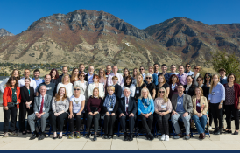
2022 NATO BILC Professional Development Seminar Provo, Utah, USA 16 – 20 October, 2022
Applied Research and Practical Experience in Teaching and Learning Languages
Topics:
Utilizing language acquisition principles to optimize adult learner engagement
Benefits of self-directed learning in language studies
Developing STANAG 6001/proficiency-based curricula in languages other than English
Operationalizing the STANAG 6001 construct in test development practices
Enhancing adult student motivation and content retention
Learning by doing: benefits of experiential learning
Conducting basic research to enrich the classroom experience
Attaining teaching excellence by integrating research into practice
Setting training goals and developing curricula using the backward
design
Notes:
Just a year ago, we were in the USA; and now on the opposite side of the world.
The seminar theme was, as you can see, “Applied Research and Practical Experience in Teaching and Learning Languages”. It was introduced through 19 presentations, three digital posters and two sets of four simultaneous workshops. At the end of each set of presentations, panel discussions were organized during which the participants had the possibility to further explore the topic with the presenters.
23 countries and 43 participants from, literally, the whole world (Australia and Egypt)

Slide 11
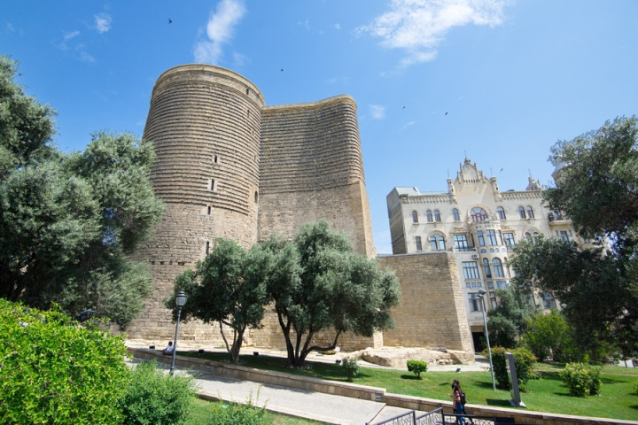
2023 NATO BILC Professional Development Seminar (October 16 – 19)
Language Teaching Theory and the Teaching Practice: Are They Always in Synch?
What does it take to design a good LSP/ESP course: the importance of needs analysis in LSP/ESP course design
Principles of successful integration of general and LSP/ESP content and its assessment
Frameworks for evaluating the success of language programmes
Authenticity in curricula and test design
Interlinks between language, culture and training
Student perceptions of effective teaching practices
Language teaching theory
Enhancing teacher competence and performance through professional development
Native versus non-native teachers
Using technology tools to enhance instruction
Notes:
And what we are going to do this year….
Focus is on designing ESP/LSP courses and evaluating language programs, and of course…TECHNOLOGY, or better to say, different tools to reinforce language training and testing.
Thank you all who whole-heartedly accepted our invitation to share your experiance with us…

Slide 12
3) NATO BILC STANAG 6001 Testing Workshop
September 2023, hosted by Riga, Latvia
Theme: “Furthering the Validity Argument by Keeping Pace with Technological Developments”
4) NATO BILC Military Terminology Conference – ACT.212.56
biennial event, April 8 – 12, 2024, to be hosted by Stockholm, Sweden
Theme: “Terminology Management in the 21st Century”
Notes:
The STANAG Testing Workshop is explicitly intended for testing professionals
The purpose is:
• Need for periodic renorming/standardization
• Chance to update approaches and knowledge of proficiency testing
• Forum for exchanging ideas/lessons learned
Military Terminology Conference
Military terminology is used in training and numerous documents, and it is essential that it be standardized with the help of linguists and translators. It is, therefore, important to establish close cooperation between military and language SMEs. The Conference aims to initiate terminology management discussions, interoperability, security, capability aspects, and challenges in terminology development.
A new BILC event has been added in eprime ACT.212.56

Slide 13
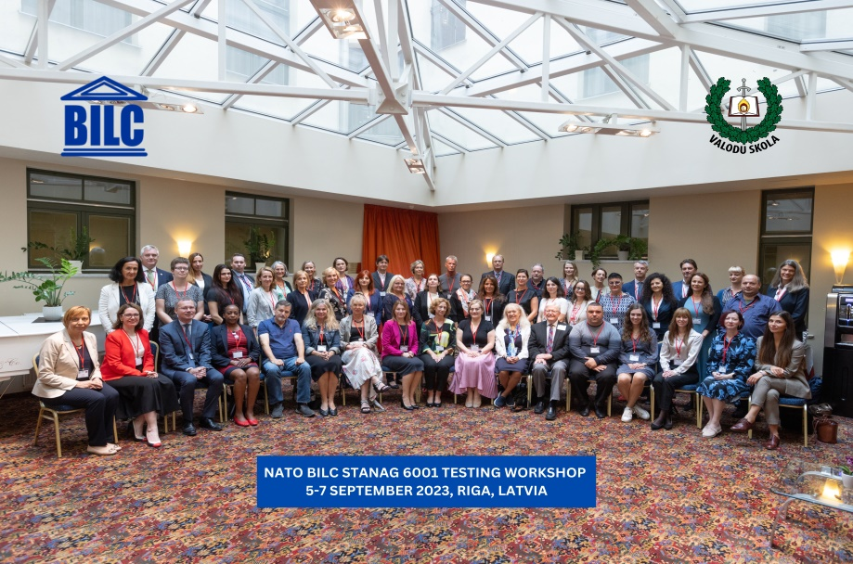
2023 NATO BILC STANAG 6001 Testing Workshop
Riga, LATVIA
4 – 7 September, 2023
Theme: Furthering the Validity Argument by Keeping Pace with Technological Developments
Norming
Shared Item Bank accomplishments and practices
Utilizing AI and ChatGPT for test development
Neoclassical Statistical Analysis and IRT Models
Test development and administration in the digital age
(testing writing, authenticity)
Notes:
The primary objectives of the Testing Workshop encompassed the promotion of standardization in language assessment, particularly in the domains of speaking and writing skills; the exchange of insights on the integration of AI technologies in language testing; the presentation of IRT and Neo-classical Statistical Analysis and their application for anchor item linking; and an overview of the Shared Item Bank Project, detailing its current achievements and potential future implications for the language testing community. These objectives were successfully met through a comprehensive program that included ten plenary sessions, seven specialized workshops, five digital poster presentations, and three expert panels. These platforms facilitated an exchange of ideas and best practices among specialists from 25 NATO and partner nations and two NATO bodies (ACO and NMI) on the Workshop topics.
Cca 50 participants

Slide 14
BILC Professional Development Programme in Partnership Cooperation Menu (PCM. i. e. ACT-sponsored BILC courses)
1. Language Testing Seminars (conducted at PLTCE):
Language Testing Seminar, ACT.647, 2 weeks;
Advanced Language Testing Seminar, ACT.658, 3 weeks;
Language Standards and Assessment Seminar, ACT.648, 2 weeks.
2. BILC Methodology Workshops
English Teaching Faculty Development Workshop “Teaching Speaking and Writing for Military Purposes”, ACT.659, 2 weeks. Conducted at 3 PTECs PLTCE, Bulgaria and Slovenia.
Facilitators: BILC teaching & testing experts from 24 nations.
Notes:
The Language Testing Seminar and the Advanced Language Testing Seminar are high-quality, graduate-level professional seminars that try to make language interoperability a reality.
They help nations establish independent testing systems, train testers in test development and offer follow-up assistance. They are focused on making STANAG 6001 language tests in each NATO and partner country comparable.
The two existing BILC testing seminars are intended for STANAG 6001 testers.
Other language teaching professionals, who are not STANAG testers, can participate in a seminar covering STANAG 6001 familiarization, classroom assessment, and guidelines for building language proficiency consistent with the STANAG 6001 descriptors. It is the Language Standards and Assessment Seminar.
The English Teaching Faculty Development workshop addresses teaching writing and speaking to military personnel as teachers very often (mainly civilians) have problems defining the formats and situations in which military use their speaking and writing skills.
These courses are conducted by faculty and experts from many countries. While we offer seminars at PLTCE in Garmisch , the facilitators come from many different countries. Two additional Language school PTECs, in Bulgaria and Slovenia, host iterations of the Faculty Development Workshop as well.

Slide 15
English Language Faculty Development Workshop Lite
New BILC Methodology Workshop:
developing speaking and writing skills in military environment,
communicative approach,
familiarization with STANAG 6001.
First pilot workshop:
February 2024, Slovenia
Target population:
Instructors and teachers of English without experience and lower level of English language proficiency
Notes:
This is a new methodology workshop focused on the development of the speaking and writing skills and familiarization with STANAG 6001. It is intended and designed for NCOs (language instructors) and less experienced teachers without formal education in teaching. It gives you very basic knowledge about how to approach teaching a language. Starting with setting goals and preparing for each period in the classroom. And then some basic classroom technics that can help you survive and thrive.
We are going to do the pilot session in Slovenia in February so you may contact me for details.

Slide 16
Other BILC activities
Standardization efforts and support:
- Non-resident activities (in person and online - DEEP, DCB TF)
DEEP – Defence Education Enhancement Programme
(https://www.nato.int/cps/en/natohq/topics_139182.htm)
12th DEEP Clearing House – June 19 – 21, 2023, Bled, Slovenia
2nd Annual DEEP Conference of NCO Academies and Schools – September 19 – 20, 2023, Split, Croatia
Notes:
Most NATO and partner nations have relatively large communities of teachers who teach languages at different levels in various military institutions (military universities, staff courses, and language centers). It has become evident that teachers often need more professional training (especially in big partner nations that need help sending teachers abroad and/or providing in-country teacher training). Following recommendations from several scoping and advisory visits, BILC started to provide in-country tailor-made faculty development workshops, which help nations to develop and consolidate their language training systems.
The visits and workshops are conducted at a nation’s request. Small teams of experts are formed and led by members of the BILC Secretariat and supported by SHAPE, DEEP, the George Marshall Center, and/or Partner Language Training Center Europe (PLTCE).
For the past two years most of these activities have been carried out under the DEEP umbrella since BILC has actively been supporting DEEP in its efforts to assist military educational systems build efficient language training systems, develop language programs and establish reliable STANAG 6001 national testing teams. To make communication with DEEP smooth and easy, BILC has designated a DEEP BILC POC e.g. I am responsible for Azerbaijan, Geogria and Mauritania.
What we do will be shown in the next slides...
Before that, as you can see, BILC representatives, Ms. Peggy Garza, Ms. Branka Petek and I participate in the 12th DEEP Clearing House on Defence Education, and held a twenty-minute presentation on how BILC contributed to the development of language training and testing systems in partner nations. They also reported on the status of BILC activities in indivdual countries.
Besides, I represented BILC at the 2nd Annual DEEP Conference on NCO schools and academies, and had a presentation on BILC with an emphasis on what we can do for NCO language instructors.

Slide 17
BILC support to DEEP October 2022 – October 2023
ARMENIA
Development of language training and testing capacity
AZERBAIJAN
Support for STANAG 6001 testers and teachers on test development
Developing and designing ESP courses
BOSNIA AND HERZEGOVINA
Pre-service training for newly-hired instructors
Military terminology & translation
Leadership discussions
Norming & continuous professional development for STANAG 6001 testers

Slide 18
BILC support to DEEP October 2022 – October 2023
COLOMBIA
Professional Development of English language instructors
Development of STANAG 6001 testing capacity
GEORGIA
Professional development for teachers of English
Support for STANAG 6001 testers on test development
IRAQ
Professional development of IDLI teachers
(Initial) training of STANAG 6001 testers
JORDAN
Development of STANAG 6001 testing capacity

Slide 19
BILC support to DEEP October 2022 – October 2023
MAURITANIA
Support to Higher Institute of English (HIE) instructors
UKRAINE
Professional development for instructors of English
STANAG 6001 familiarization for language instructors and program managers
Support for STANAG 6001 testers on test development and statistical analysis
Language program management
Notes:
It is through these efforts that BILC has been most tangibly effective in supporting nations’ training and testing programmes. It has been gratifying for the secretariat and the many facilitators at the seminars and collaborators involved in the visits - to see real progress in many nations, both long-standing NATO and Partner nations.

Slide 20
BILC WGs & Projects
Shared Item Bank Project
Review of JTAC language requirements
STANAG 6001 Update – Focus Group

Slide 21
Report on the Shared Item Bank Project
WG members from:
Canada, Croatia, Estonia, Latvia, Romania, Slovakia, and Slovenia
Project goal:
To create a bank of reading and listening anchor items for
Levels 1, 2 and 3

Slide 22
Reading Item Development
Designed 47 items (L1 – 12 items, L2 – 17 items, L3 – 18 items)
- Revised and moderated items in national teams
- Held 14 online item moderation sessions
- Piloted items on teachers from Canada, Latvia, Romania and Slovakia
- Kept 42 items for pre-testing and compiled two pre-test versions
- Asked nations for volunteers for pre-testing

Slide 23
Pre-testing from October to December 2022
Volunteers from 16 countries:
- Austria, Belgium, Bosnia and Herzegovina, Bulgaria, Croatia, Estonia, Georgia, Italy, Latvia, Lithuania, Montenegro, North Macedonia, Poland, Portugal, Romania, and Spain
Version 1 N= 515
Version 2 N= 497
THANK YOU!

Slide 24
Statistical Analysis and Results
Programmes used: TiaPlus for CTT and jMetrik, Jamovi, gui Dexter module in RStudio for Rasch analysis, Wright Map module in Rstudio
Retained:
L1 – 4 items
L2 – 3 items
L3 – 7 items

Slide 25
Work-in-Progress and Next Steps
Finalising report on reading anchor items, the non-disclosure form, guidelines for using anchor items
Setting up the bank for reading items
Selecting sample items for the BILC webpage and LTS/ALTS training purposes
Created item specifications for listening
Designed & submitted 45 listening items (L1 – 15 items, L2 – 15 items, L3 – 15 items)
Revised and moderated L1 and L2 items in national teams
Held 3 online item moderation sessions
Large scale pre-testing of listening items in 2024
Analysis & setting up the item bank of listening items
Inviting other nations to join the project

Slide 26
BILC JTAC Working Group (WG) Update

Slide 27
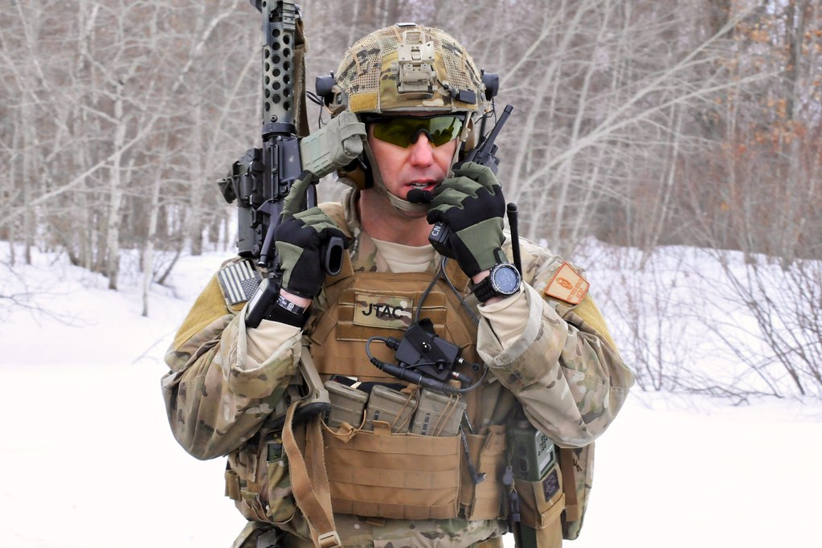
How is BILC Involved?
JTACs have a language requirement
STANAG 6001 SLP 3332
US Joint Fires Integration Division JTAC stakeholders asked BILC to conduct a language needs analysis
Analyze the unique JTAC language tasks
Consider a “more focused test” taking the JTAC environment into account
This Photo by Unknown Author is licensed under CC BY-ND

Slide 28
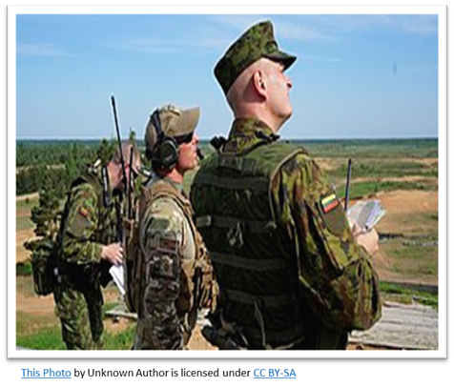
Study Highlights
WG members:
Consulted with JTAC SMEs in Denmark, Norway and Slovenia
Observed a CAS exercise in Denmark, certification training in Norway, and JTAC classroom and simulation training in Slovenia
Observed the Adriatic Strike Exercise with 26 participating nations and conducted semi-structured interviews
Sent survey on critical JTAC language tasks and unique TLU factors
246 responses from JTACs, JTAC evaluators, and
JTAC program managers

Slide 29
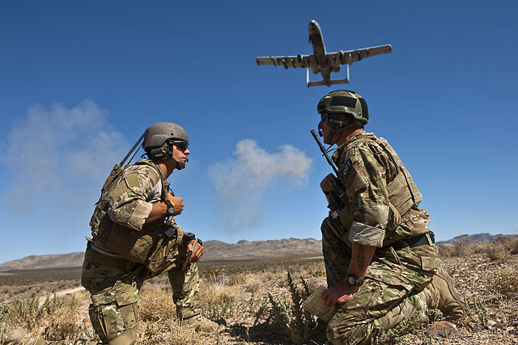
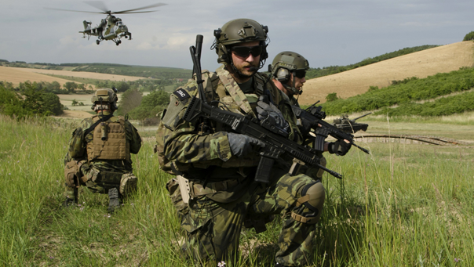
Joint Terminal Attack Controller
(JTAC) Working Group
JTAC Tasks | Level 3 Speaking Tasks
Can describe terrain features & give coordinates | Can describe in detail
Can understand & respond to radio communications with possible interference (talk ons) | Can discuss abstract topics
Can use JTAC brevities & plain English equivalents | Can support opinions and hypothesize
Can respond readily with good pacing | Can converse in most formal and informal situations
BILC Steering Committee Survey Results
Does your national language testing center administer STANAG 6001 tests to JTACs?
Does your nation have special language courses for JTACs?
JTAC language requirement: SLP 3332
YES
76.5%
16.7%
83.3%
NO
23.5%
Misalignment of JTAC language tasks and the way JTACs are tested
Problem
JTAC-focused language test
BILC nations
N=25
Solution
Consult with JTAC SMEs, observe live JTAC and CAS exercises, conduct research on Aviation English and ICAO testing
Validate JTAC language tasks with JTAC SMEs via a survey; NS JTACs had additional questions. Respondents:
N= 246, 25 nations
Define the construct
Develop and pilot test tasks, coordinate with JTAC SMEs
Operationalize and trial JTAC-focused test
JTAC WG Project: The Design and Development of a JTAC-focused Prototype Test
Phase 1
Phase 2
Phase 3
Phase 4
Phase 5

Slide 30
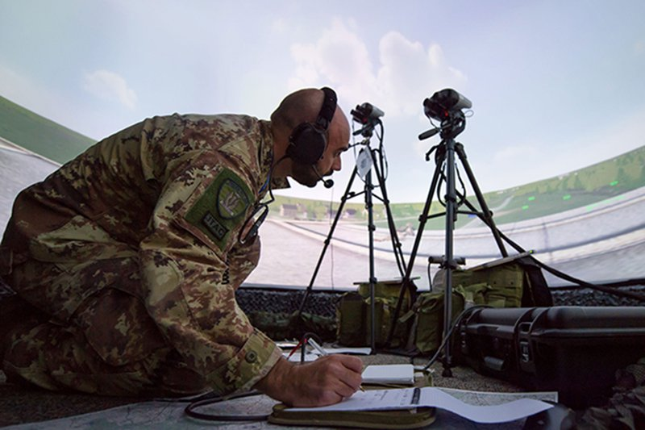
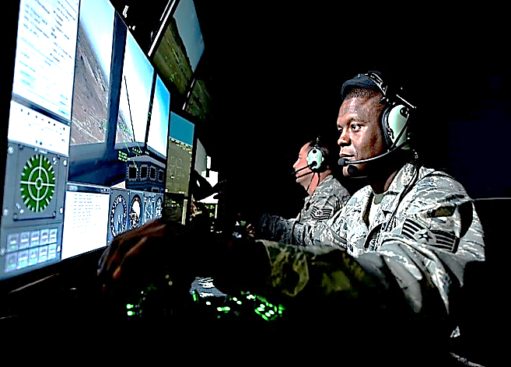
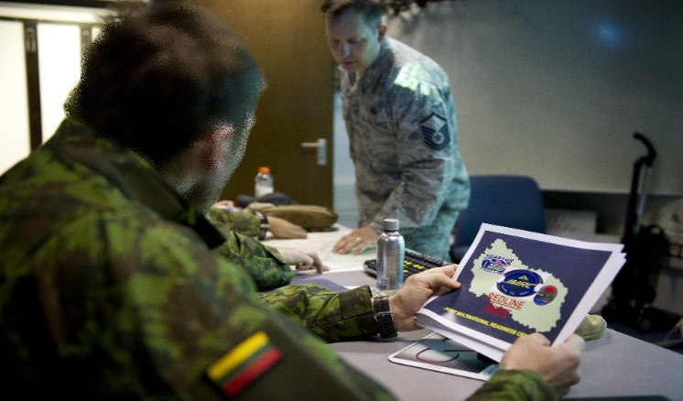
Findings
Two research questions:
#1: Is SLP 3332 needed for successful performance of JTAC tasks?
No, but ………..
#2: Is there a more suitable test format for evaluating JTACs’ target language use (TLU?)
Yes!
Report published 10 May 2023

Slide 31
1st Meeting STANAG 6001 Focus Group
Background and Discussion
Periodic reviews of STANAG are expected by NATO NSO
Noted inconsistencies and inadequacies in French led to opportunity to revisit overall standard
Discussion on advantages to drafting and visually presenting the English and French standards, side by side.
Ongoing discussion on the native speaker as reference point, in Standards in general, and in STANAG 6001.
Notes:
BILC, as STANAG 6001 custodian, is expected to review the standard, periodically.
Every few years, BILC secretariat is asked if there are changes to STANAG 6001. No change in over a decade. CLICK
At the 2022 BILC Professional Development Seminar in Utah, the French delegate presented on the inconsistencies of the French translation of the STANAG 6001, highlighting translation flaws, and the fact that the French version did not reflect current socio-cultural norms of the French language.
In December 2022, Ms. Dubeau spent a week at the War College in Paris reviewing the French version of STANAG 6001 with Mr. Collin and discussed how it could be improved. We soon concluded that the French descriptors should not be revised until the English version had been updated, as periodic updates are expected.
A Focus Group was formed after the May online SC, to explore and discuss the status of STANAG 6001. The F. Group is comprised of several members of the secretariat, and members from Estonia, France, the Netherlands, and Norway.
As both English and French are NATO’s de facto official languages, and to avoid any linguistic or cultural bias, we feel it would be beneficial to review both language versions in parallel.
Discussed the multiple advantages to both drafting and visually presenting the English and French versions, side by side. While the focus is on English and French in NATO contexts, the revised scale could also be used to describe proficiency in any language.
Among the other points of discussion during the meetings were the following: CLICK
The advantages of removing the mention of the native speaker in STANAG 6001, as it has been done by the committee that revised the ILR scale. We discussed potentially replacing the reference with a ”highly proficient speaker, reader etc.” or one who demonstrates mastery or full command of the language.
This discussion is TBC.

Slide 32
1st Meeting STANAG 6001 Focus Group
Discussion
Reorganization of the scale so that each criterion (content/context, discourse, tasks, and accuracy) is clearly delineated and distinct, with little to no overlap, and predictable in presentation.
Benefits of adding some military contexts and linguistic tasks linked to these content/context domains to set the STANAG scale apart from others.
Status quo on the overall levels of language but discussed the removal of the L 4+ descriptor.
Notes:
We also discussed the reorganization of the scale so that each criterion (content/context, discourse, tasks, and accuracy) is clearly delineated and distinct from each other, with little to no overlap. They should always be presented in a logical and regular sequence, from on skill to the next, and one level to the next, to remove some randomness. CLICK
In addition, we discussed mentioning the qualifiers “tactical” and “strategic” in the labels of levels, or incorporating them into the descriptors would also highlight the military aspect of the scale. CLICK
We also discussed making no substantive changes to the overall levels of language but considering the removal of the 4+ descriptor (0, 0+,1, 1+, 2, 2+, 3, 3+, 4 and 5) and collapsing the levels 4 and 5 together. CLICK

Slide 33
1st Meeting STANAG 6001 Focus Group
Way Ahead
Info on recent STANAG review process will be obtained from the NSO
FG will do parallel revision of speaking descriptors in French and English
A presentation will be prepared for the Steering Committee meeting in May 2024 at the Annual Conference
Nations will have an opportunity to review and comment on the proposed approach.
Notes:
The meetings concluded with defining the way ahead as below:
information on the most recent STANAG review process is being obtained from the NSO. CLICK
The initial focus will be on the speaking descriptors in all skills, and drafted in English and French by the Focus Group members.
CLICK
The FG members will present on this initial work, at the SC meeting at the Annual BILC Conference in May 2024, in Vienna. If the proposal is accepted, a Working Group might be formed.
CLICK
Nations will have an opportunity to view, review and comment on the proposed approach, after the Working Group is established.

Slide 34
BILC site – www.natobilc.org

Slide 35
BILC site – www.natobilc.org
Recommendations and policy documents
The STANAG 6001 Overview for Non-Specialists
Presentations from events
Materials on Level 4
Materials on STANAG 6001 testing
Resources in French
Updated version of the 2023 and 2024 calendars
Notes:
Conclusion
In the end I would like to repeat that BILC is always here for you, involved in language training.
With four major events and language testing/teacher training seminars, we have been providing as many opportunities as possible for the military language training community to advance in English and foreign language training and testing.
The annual BILC professional seminar deals with various topics connected to teaching, so it provides a unique training opportunity for teachers as well as opportunity to exchange experiences with teachers from other countries.
Estimeed colleagues, you are here because your superiors have recognized you as experts in the various aspects of language teaching, training and testing, and have supported your attendance. The informal connections you make here at all levels, intellectual, social, and ideological, together with frank and open panels and in sidebars, are of immense value to your nations and to NATO.
Finally, I am taking this oportunity to thank our hosts, who have gone to great efforts to provide a milieu that will allow us to collaborate with no stress and great delight on reaching our goals. When return home, I hope you will all be able to say that you have accomplished much and that you will share those accomplishments with your colleagues.
I wish you all, all of us, a successful and fruitful seminar.
Thank you for your attention.

Slide 36
Contacts:
BILC site https://natobilc.org
Email: irena.prpic.djuric@morh.hr
BILCteam.hrv@gmail.com

Slide 37
THANK YOU FOR YOUR ATTENTION!
Questions???

