Slide 1
Enhancing Teacher Competene and Performance through PD
Chichak Badalova
Senior Teacher
Military Institute named after H.Aliyev
BILC Professional Development Seminar
Baku, Azerbaijan
October 19, 2023

Slide 2
Teacher policy
“The quality of teacher professional development is strictly influenced by the policies and processes” (Saber,2012). Developing teacher policy and aligning it with the national education policy is a priority.
Four concepts should be core objectives of the teacher policy:
teacher motivation
teacher effectiveness
teacher professionalism.
Lifelong learning Framework

Slide 3
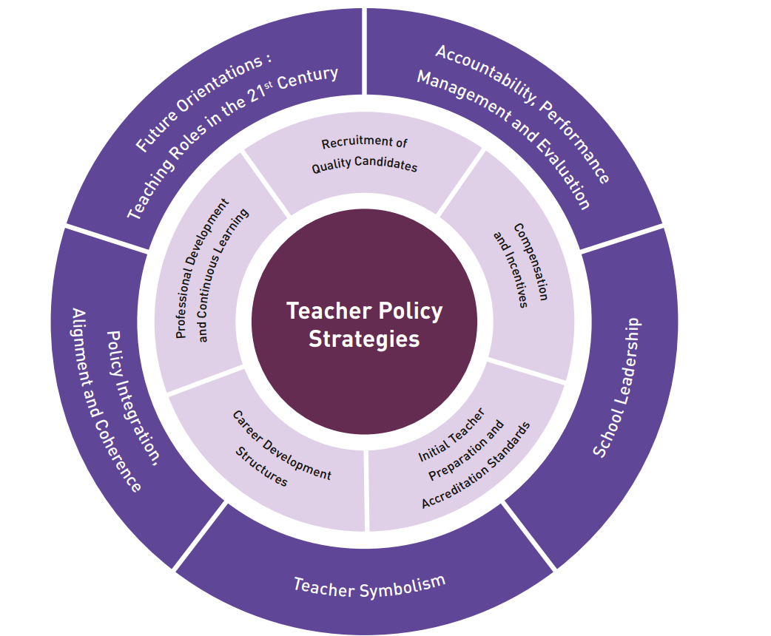
Teacher policy needs to provide:
Reflective thinking
Professional conversation
Collegial learning
Research and Innovation

Slide 4
Teacher quality “The quality of an education system cannot exceed the quality of its teachers.” (McKinsey & Company, 2007)
“Teacher quality is a school-based predictor and crucial resource in the education system that is tightly intertwined with student learning (Hanushek & Rivkin, 2010)”.
The ideal teacher is one with the right balance of aptitude and attitude.

Slide 5
Qualities and skills of twenty-first-century teachers:
Reflectiveness
Commitment to teaching and the development of learning
Willingness to share ideas and network with colleagues
Keenness to participate in personal learning and development
Integrating and reflecting on the theory and practice
A rich repertoire of teaching strategies. The strategies should include direct, whole-group teaching, guided discovery group work, and the facilitation of self-study and individual discovery
Teachers need to have a deep understanding of how learning happens and be aware of individual students’ motivations, emotions, needs, and expectations
Teachers need to acquire strong skills in technology and optimize the use of digital resources

Slide 6
Professional Development
“Teacher professional development is a large-scale growth with the long-term goals of urging the teachers to make sense of their position, values, attitudes, and principles and make a reflection on their teaching practices in a collaborative school environment” Richard and Farrell (2005) .
“PD opens a wide range of opportunities for the teaching staff to redefine their new roles, practice, and teaching methods which also improves them professionally and personally”Eleonora (2003).
“Teacher development is the professional growth a teacher achieves as a result of gaining increased experience and examining his or her teaching systematically” Farzaneh & Ozkan (2015).

Slide 7
Reasons to engage in TPD
The areas that are identified for improvement include:
content knowledge in the discipline that they teach
pedagogical skills
teaching skills to enable them to better engage and motivate their learners
keeping their discipline knowledge current
staying abreast of the latest changes in the educational landscape through networking
cascading knowledge
role modeling life-long learning
motivating themselves to stay passionate about teaching
fulfilling their responsibility of being professional.

Slide 8
Characteristics of high quality PD
Content-focused
Extended
Collaborative
Coherent and integrated
Ongoing
Inquiry-based
Reflective
Part of daily work
Teacher-driven
Self-evaluation

Slide 9
Models of Teacher Professional Development
Mentoring | a form of coaching that tends to be short-term and provides feedback, support, problem-solving guidance, observation etc.
Content-Based Collaborative Inquiry | creates deeper understandings of how their students think about and understand particular subjects
Cognitively-guided Instruction | develops instructional materials that address students’ learning needs
Lesson study | a multi-step process in which teachers work together to create, study, and improve their lessons
Action Research | pursuing problem-based inquiries that seek to identify problems of practice and understand them
Coaching | an ongoing and long-term PD process by which the colleague becomes a critical listener, observer.

Slide 10
Networked professional learning communities
A shared goal and focus on a concrete outcome
Collaboration and active participation
Reflective dialogue
Collective focus on student learning
Trust
Individual prior knowledge and motivation (professional boundaries)

Slide 11
Novice teachers
Experienced teachers
Courses/workshops (e.g. on subject matter or methods and/or other education-related topics).
Participation in a network of teachers formed specifically for the professional development of teachers.
Reading professional literature (e.g. journals, evidence-based papers, thesis papers).
Engaging in informal dialogue with their colleagues on how to improve their teaching.
Mentoring and/or peer observation and coaching,
Reading professional literature (e.g. journals, evidence-based papers, thesis papers).
Educational conferences or seminars (where teachers and/or researchers present their research results and discuss educational problems).
Observation visits to other schools/institutes.

Slide 12
Teacher satisfaction with the PLC process
Changes in knowledge, skills, attitude and behavior
Application of knowledge and skills

Slide 13
TPD and leadership
Instructional leadership
Capacity-building
Focuses on developing teaching and learning, higher PD plans, more involvement in teaching observations, innovation, higher levels of mutual respect, communication, and greater job satisfaction.
school-based and mandatory programs should also consider the duration, teacher selection, and proportional allocation of PD events
Bottom-up approach
Advocacy and Collaboration
A backward mapping approach in which analysis of needs, expectations, and resources are initially taken into consideration during the implementation process. This involves empowering teachers to participate in decision-making processes
An environment where employees can work together productively and efficiently to achieve common objectives. It involves cascading knowledge

Slide 14
Tensions and dilemmas in teacher PD
1.İndividual versus organizational needs: a balance can be achieved. When these are not in sync, tensions or dilemmas arise.
2. Responsibility to stay current versus being there for student learning.
What is the balance to achieve between disruption to students’ learning and teachers’ professional development?
3. Compulsory versus voluntary professional development
There are views that TPD should be made compulsory so that teachers stay current and relevant to their profession.
Others prefer voluntary PD to take ownership and pace of the learning process.

Slide 15
Barriers to implementation of effective PD
Motivation
Beliefs
The structure and teachers’ time
The content of PD
School factors
Costs

Slide 16
Suggestions to improve TPD
coherence and alignment between the teacher policies and desired teaching and learning outcomes
the merit-based teacher salary and incentives to make more effective and ongoing PD and increase results of student learning.
the development of a career ladder system to create a competitive environment to increase both the learning and teaching process.
Increased networking
ongoing professional development of the managerial staff
Advocacy campaigns

Slide 17
References
Coffield, F. (2012). Why the McKinsey reports will not improve school systems. Journal of Education Policy, 27(1), 131-149.
Darling-Hammond, L. (2000). How teacher education matters. Journal of teacher education, 51(3), 166-173.
Golob, H. M. (2012). The impact of teacher's professional development on the results of pupils at a national assessment of knowledge. Procedia-Social and Behavioral Sciences, 47, 1648-1654.
Hanushek EA, Rivkin SG. Teacher quality. Handbook of the Economics of Education. 2006 Jan 1; 2:1051-78.
Harris, D. N., & Sass, T. R. (2011). Teacher training, teacher quality, and student achievement. Journal of public economics, 95(7-8), 798-812.
Kennedy, Mary. "Form and Substance in Inservice Teacher Education. Research Monograph." (1998).
Levin, B. B., & Rock, T. C. (2003). The effects of collaborative action research on preservice and experienced teacher partners in professional development schools. Journal of Teacher Education, 54(2), 135-149.
Mahmoudi, F., & Özkan, Y. (2015). Exploring experienced and novice teachers’ perceptions about professional development activities. Procedia-Social and Behavioral Sciences, 199, 57-64.
Joo, L. K. (2017). Singapore Teachers: SABER Country Report 2015.

Slide 18
Thank you!

