Slide 1
Introduction to the 2023
STANAG 6001 Testing Workshop
Theme: Furthering the Validity Argument by Keeping Pace with Technological Developments
Norming
Shared Item Bank accomplishments and practices
Utilizing AI and ChatGPT for test development
Neoclassical Statistical Analysis and IRT Models
Test development and administration in the digital age (testing writing, authenticity)
Workshop Activities:
Presentations
Panels
Workshops
Digital Posters
Professional Development Sharing
Workshop Goals: Norming; Sharing; Planning Course Updates, New Projects & New Directions

Slide 2
Updates & New Directions
BILC website, Testing Resources page
Neoclassical statistical model
Additional practice with statistical analysis
Remote speaking tests
Rethinking how we test writing
More sharing of national practices
Emphasis on the “blended” format of the A(LTS)
How is the BILC testing community keeping up with the times?

Slide 3
Continuous Improvement
Feedback from participants and facilitators
Findings from annual STANAG 6001 testing workshops
Trends in the field, based on professional conferences, associations, SIGs, webinars
NATO-approved testing courses:
Language Testing Seminar (LTS)
Advanced Language Testing Seminar (ALTS)

Slide 4

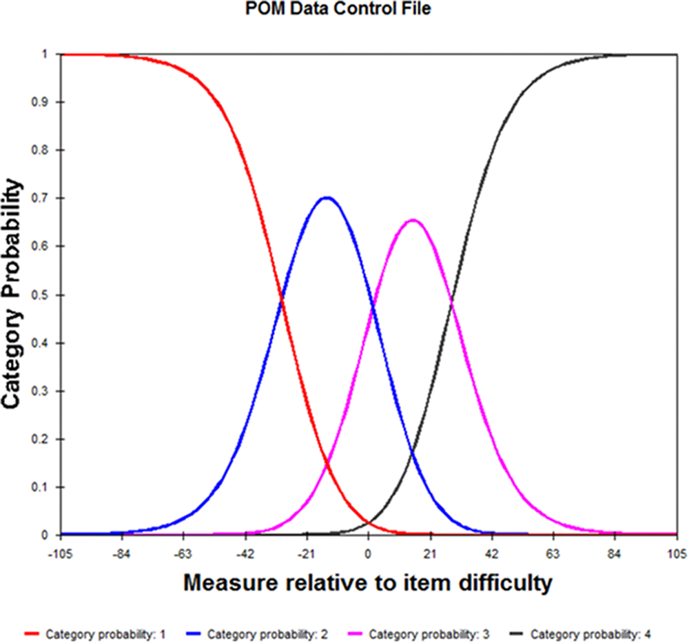
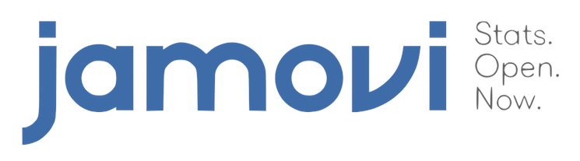
Under consideration
A new standalone course on statistical analysis methods including IRT

