Slide 1
National Defence University,
Foreign Language Center
Nargiz Khalilova

Slide 2
Interlinks between Language, Culture and Training
Nargiz Khalilova

Slide 3
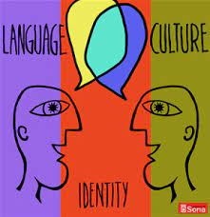
Language and Culture
Language isn’t just the sum
total of words,
grammatical principles
and sentence construction,
but also unique cultural norms,
social systems
and cognitive processes.

Slide 4
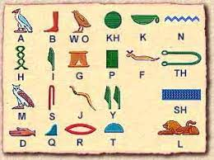
Language and Culture

Slide 5
What is culture?

Slide 6
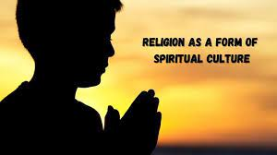
What is culture?

Slide 8
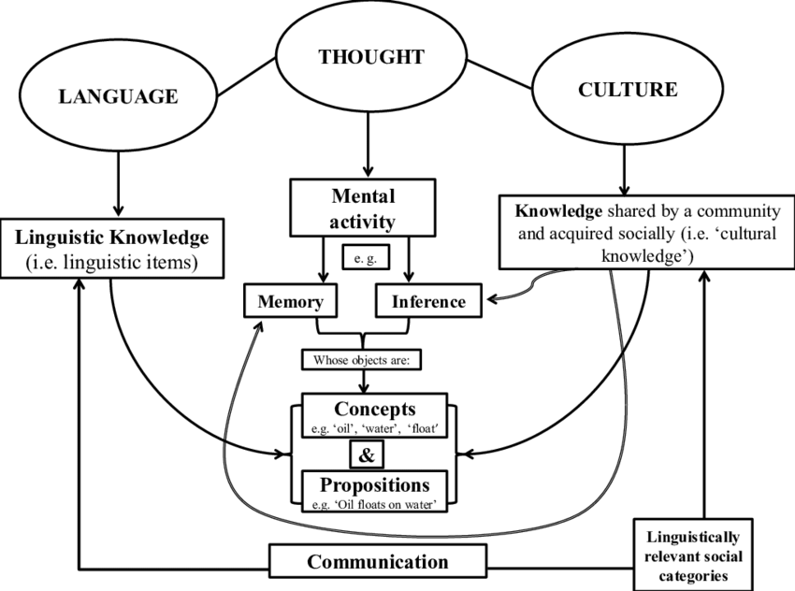

Slide 10
Paralanguage

Slide 11
Homologous relation
What is homologous? In general science,
the word “homologous” is used to show
a degree of similarity. It may be in position,
structure, function, or characteristics.

Slide 12
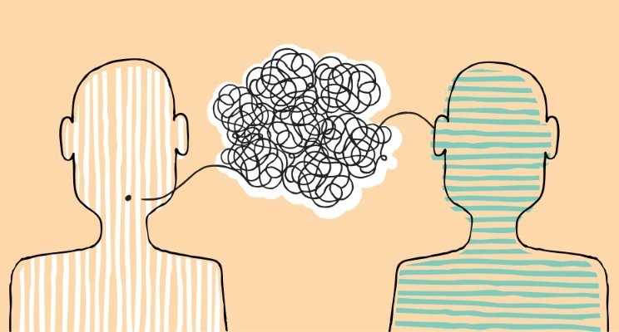
How Language And Culture Are Interlinked?

Slide 13
How Language And Culture Are Interlinked?
The comprehension of the surrounding culture is key to learning a language.

