Slide 1
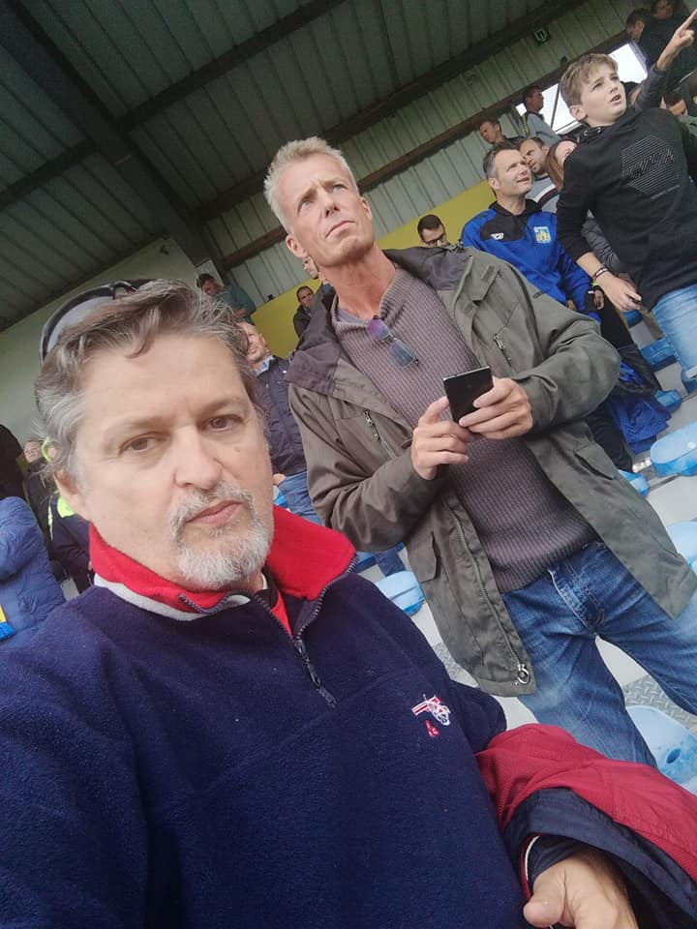

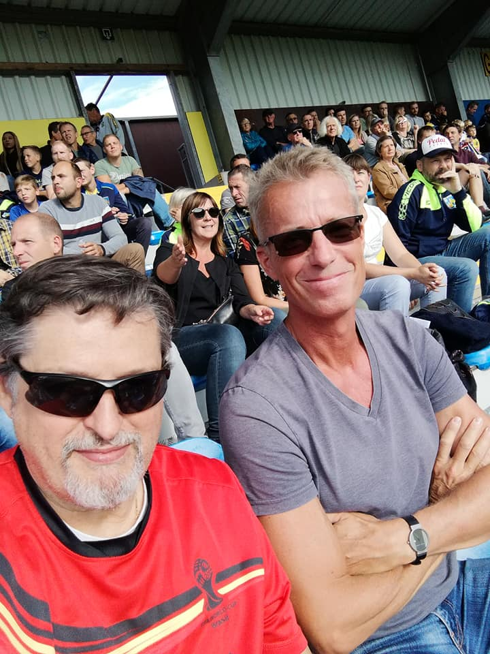
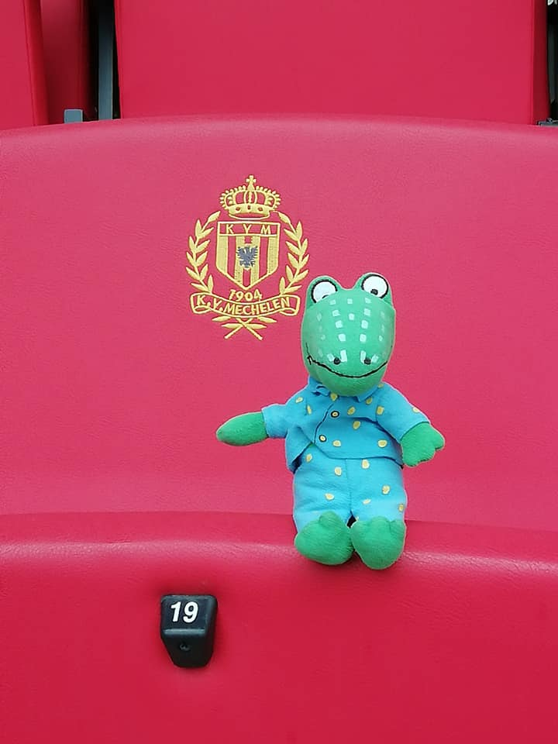
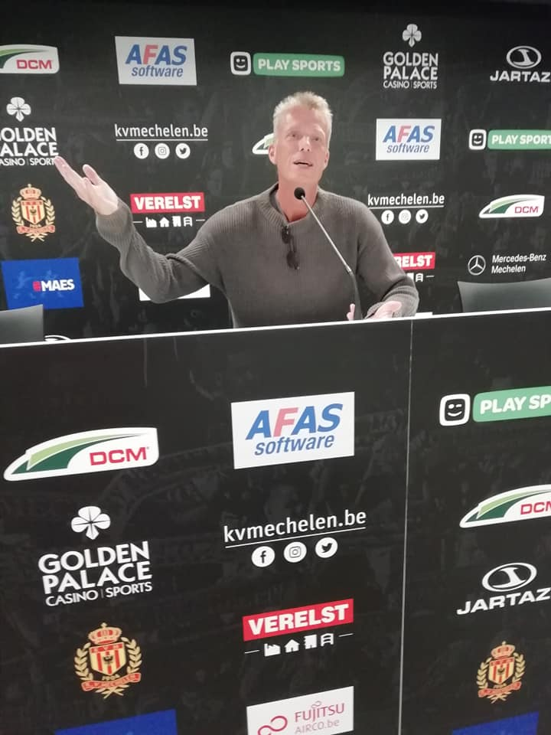
The Birth of the Presentation

Slide 2
Language Testing Tourism
Michael Adubato
SHAPE Language Testing Centre
ACO/SHAPE, Belgium

Slide 3
OR…
Michael Adubato
SHAPE Language Testing Centre
ACO/SHAPE, Belgium

Slide 4
My country’s test is harder than your country’s test so I’m coming to your country to take my test!
Michael Adubato
SHAPE Language Testing Centre
ACO/SHAPE, Belgium

Slide 5
STANAG TESTING FOR YOUR NATION…
QUESTIONNAIRE

Slide 6
15 REPLIES TO THE QUESTIONNAIRE
DO YOU TEST PERSONNEL FROM COUNTRIES OTHER THAN YOUR OWN?
YES – 13 & NO – 2
IF YES, WHAT IS THE CRITERIA FOR TESTING OTHER NATIONALITIES?
IMPOSSIBILITY TO TAKE THE NATIONAL TEST
AUTHORIZATION OF CANDIDATES HOME COUNTRY
PERMISSION FROM THEIR COUNTRY (TO AVOID TRAVELING TO
GET BETTER RESULTS)
ATTENDING COURSES
REQUEST FROM OTHER COUNTRIES
ATTENDING A LANGUAGE COURSE
OFFICIALLY ASK OUR MOD FOR PERMISSION TO TAKE TEST
FORMAL REQUEST OF THE SENDING NATION
IF THEY ARE CURRENTLY WORKING IN MULTINATIONAL STAFF
IN OUR COUNTRY
- SPECIAL REQUEST AT MINISTERIAL LEVEL

Slide 7
IF TESTED IN YOURS AND ANOTHER COUNTRY, WERE THE TEST RESULTS THE SAME?
YES
WE TESTED ONLY ONE & THE RESULTS WERE THE SAME
NO
YES, YES, YES, NO
IN SOME CASES NO
GENERALLY SPEAKING: YES
PARTLY
IN SOME CASES YES BUT SOMETIMES THERE WAS ALSO A CONSIDERABLE AMOUNT OF TIME BETWEEN TESTS
NOT NECESSARILY; DEPENDS ON CIRCUMSTANCES AND COUNTRIES
WHAT NATIONS HAVE YOU TESTED?
WHAT NATIONS HAVE TESTED YOUR PERSONNEL?

Slide 8

HAS YOUR NATION USED THE BAT FOR THE TESTS YOU ARE CURRENTLY USING?
YES – 8
NO – 7

Slide 9
WHAT CAN WE CONCLUDE FROM THIS?
- THE MAJORITY OF COUNTRIES TEST PERSONNEL FROM OTHER COUNTRIES
- THERE IS NO CLEAR, CONCRETE POLICY ON TESTING ACROSS
BORDERS IN MOST CASES
HALF OF THE NATIONS WHO DEVELOP THEIR TESTS DON’T USE THE BAT TO ASCERTAIN IF THEY HAVE GOOD
    OR NOT

Slide 10
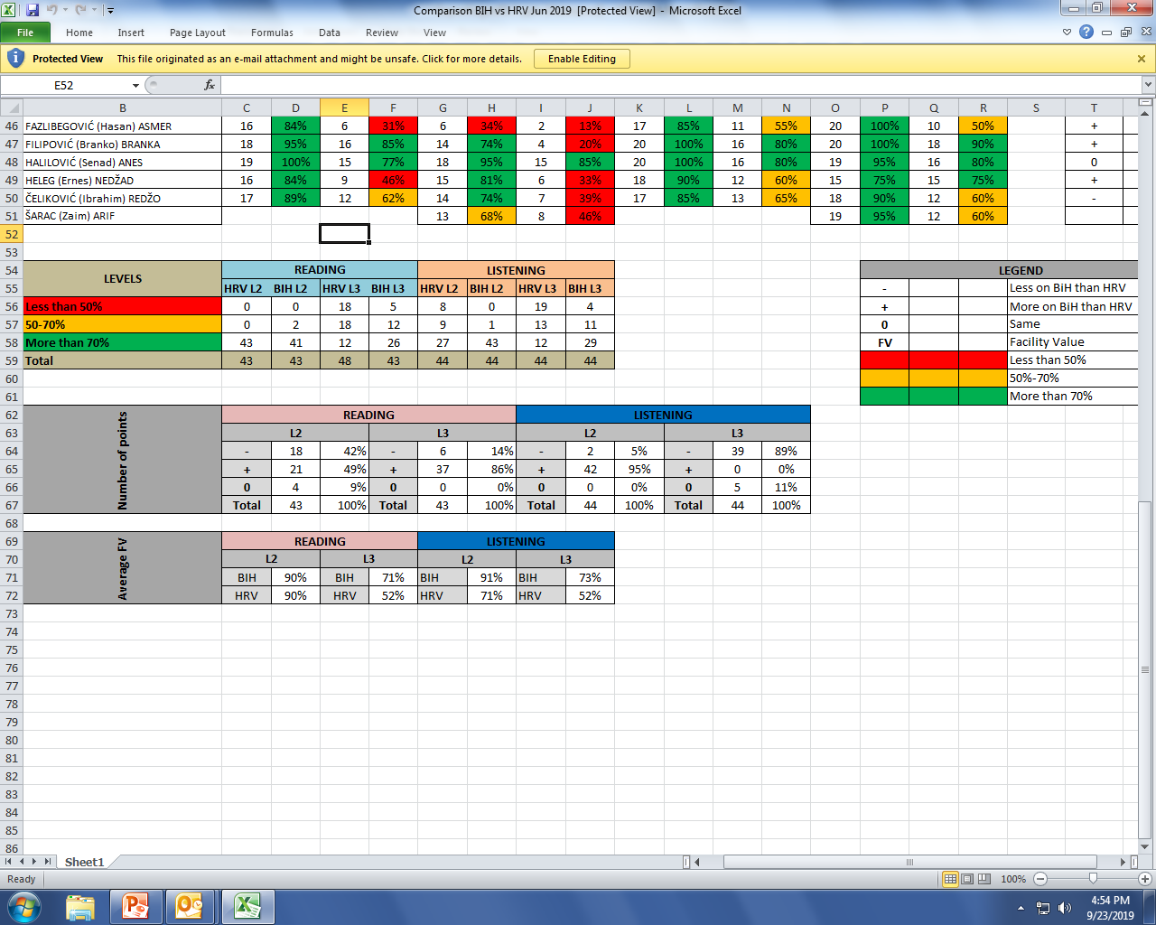
Comparing results B-H Style!
Notes:
We had 27 people tested abroad (Slovenia, Hungary, Italy, Serbia, Bulgaria, UK, Canada) and in our country. Out of those 27, 16 people got better profile in our country than abroad, 8 people got worse results in our country than they brought from abroad and 3 people did the same in both, our country and abroad.
We do not have precise trend when it comes to difference in results. They are distributed equally to different countries; they are not specifically connected with only one country from which we could draw some conclusions.
We run statistics regularly after pretesting sessions of Croatian STANAG test in our country and also we did the same for Bulgarian STANAG test pretested in our country. I am sending you two attachments from which you can see how they differ from our test. You may find them interesting. They compare results from their pretest in our country against official results on our test.

Slide 11
You should come to SHAPE
with a language certificate
because you will never pass
the test here!
- Old Italian Shapian proverb

Slide 12
Summer of 2018 French Newcomers
54 newcomers
28 met the slp requirements
26 did not!
Of 26 tested, 3 passed
(those 3 were not tested in
France before arriving at shape)

Slide 13
OF 23 TESTED WHO WERE TESTED PRIOR TO THEIR ARRIVAL, 9 HAD THE EXACT SAME RESULTS – 40%
LISTENING – 5 HIGHER LEVEL (@ SHAPE) & 2 LOWER
SPEAKING – 5 HIGHER LEVEL
READING – 1 HIGHER, 2 LOWER
WRITING – 4 HIGHER

Slide 14
INTERESTING FACT…
MILITARY PERSONNEL FROM ONE NATION ARE TRAVELING TO OTHER NATIONS TO IMPROVE THEIR TEST SCORES BECAUSE “THE TEST IS MUCH EASIER IN ROPOLVAKVIALAND THAN MY COUNTRY!”

Slide 15





The easiest way to go from 2222 to 3333
SLP 2222
SLP 3333

Slide 16

HOW DO WE FIX THIS
OBVIOUS PROBLEM?

Slide 17
Are there a lot of
first-person singular
objective pronouns,
or is it just me?

Slide 18
YOUR QUESTIONS

