Slide 1
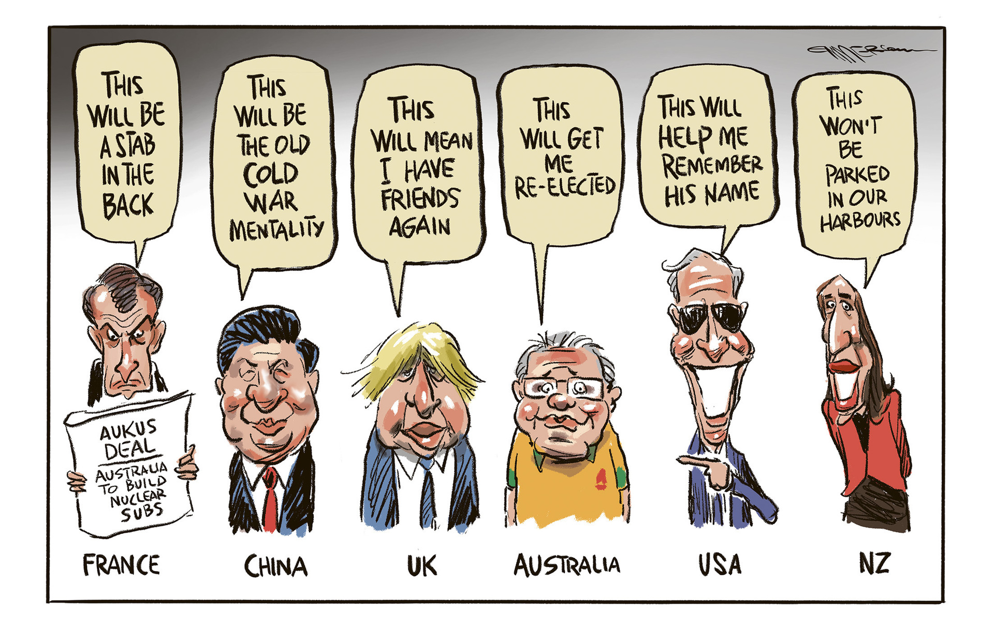

Slide 2
No Writer without a Reader – When Writing Becomes a Cultural Competence
Emilie Alice Cleret
Head of the English Studies Department
French Higher Military Education

Slide 3
Military Writing
Writing to subordinates
Focused
Organised
Clear
Understandable
Supported

Slide 4
Military Writing
Writing to higher-ups
BLIND method
BL: Bottom Line
I: Impact on organization
N: Next steps
D: Details to support the bottom line and any significant discussion points
BLUF method

Slide 5
Academic Writing
Formal in tone and style
Structured
Planned and focused
Evidenced

Slide 6
Academic Writing
Position Paper
Reader
Evidence
Warrant-building
Food-for-Thought Paper
Develop an argument to challenge status quo
Targeted readers
Analytical skills

Slide 7
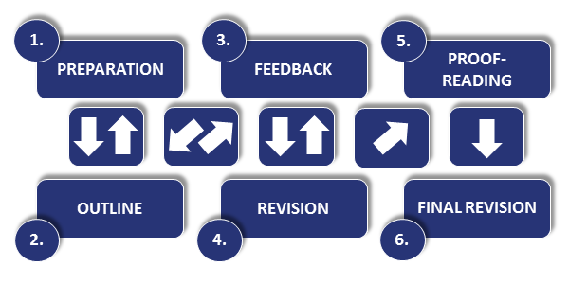

Slide 8
Instructional Strategies for Academic Writing
Process-driven
Product-oriented
Project-oriented

Slide 10
Mission Statement
To give the officers the confidence to interact effectively and comfortably with English-speaking counterparts in future staff work, using a student-led project of research, writing and speaking that results in a paper and oral presentation. The aim is to develop key leadership skills – such as critical analysis, persuasive argumentation, competent writing, and confident public speaking – to be fully interoperable in an Anglophone professional context.

Slide 11
FICINT

Slide 12
Writing is a process Trust the process

