Slide 1
Peer Exchange Partnership (PEP)
Mr. Murad Khalliev, Instruction Branch
Defense Language Institute English Language Center
19 October 23

Slide 2
Peer Exchange Partnership (PEP)
Overview
DLIELC Mission
DLIELC Instruction Branch
Professional Development
PEP Development Team
PEP Launch & Implementation
References

Slide 3
Defense Language Institute English Language Center (DLIELC)
DLIELC Mission:
Provide world-wide English language training and resident cultural immersion to enable US military and international partners to communicate in support of Defense Security Cooperation objectives.
1500+ trainees/year
110+ countries
Resident & non-resident training

Slide 4
Defense Language Institute English Language Center (DLIELC)
Instruction Branch (IB): 190 instructors
Specialized English
General English
Advanced English

Slide 5
Defense Language Institute English Language Center (DLIELC)
Instruction Branch Professional Development
External Training
Conferences: TESOL, LREC, ACTFL, BILC, LPC
Air Force: Emerging Leader and Developing Team Leader
Commercial Trainings
Internal Training: Academic & Professional Expertise
DLIELC Onboarding Training
Professional Development Day: bi-annual
TESOL Booth/Expo
In-Service Training: Monthly
PEP Initiative: No/Low Cost PD Training

Slide 6
Peer Exchange Partnership (PEP)
PEP Development Team:
3 instructors
1 supervisor
2 chiefs
Focus on what teachers want
Research peer coaching
Peer coaching models
Create coordinator and participant guidebooks
Develop PEP Training for participants
Beta test
Commander’s approval

Slide 7
Peer Exchange Partnership (PEP)
Notes from the research
Voluntary
Confidential, based on trust
Formative assessment of teaching, not tied to evaluation and annual appraisal
Self-directed, single focus of improvement
Observation of teaching primarily
Self-reflection, usually written

Slide 8
Peer Exchange Partnership (PEP)
Traditional Coaching Model
Coachee
Peer Observation Coordinator
(POC)
Coach
Coachee
Coachee
Coachee
Coach
Coachee
Coachee
Coach
Coachee
Coachee
Coachee

Slide 9
Peer Exchange Partnership (PEP)
Triad Exchange Model
POC
Peer 1
Peer 1
Peer 2
Peer 3
Peer 2
Peer 3
Peer 1
Peer 2
Peer 3

Slide 10
Peer Exchange Partnership (PEP)
Peer-to-Peer Model
POC
Peer 1
Peer 2
Peer 1
Peer 2
Peer 1
Peer 2

Slide 11
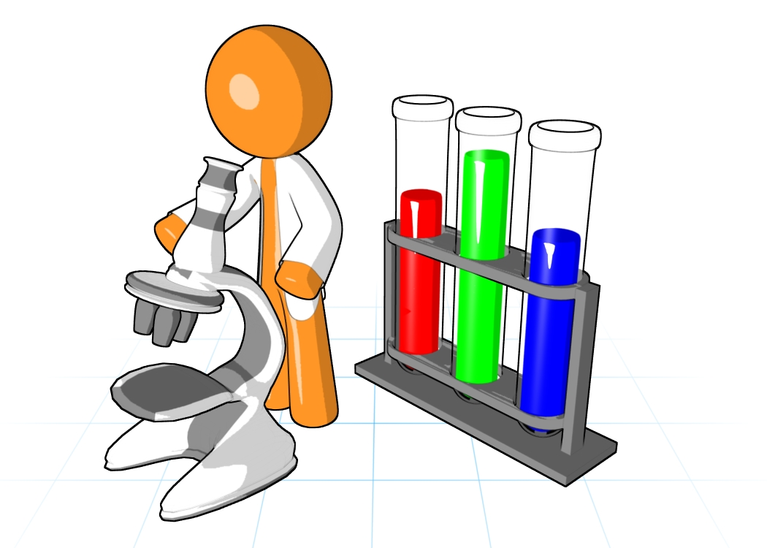
Peer Exchange Partnership (PEP)
PEP Beta Test: Dec 22 – Feb 23
Participant & Facilitator training manuals created
Program supervisor role established
Participants: 15 instructors
Input from 40 stakeholders

Slide 12
Peer Exchange Partnership (PEP)
Peer Coaching Vision
To offer faculty a collaborative framework for:
Exchanging ideas
Practicing innovative teaching
Thriving in a community of peers
PEP initiative – idea of informal, low stakes, coaching opportunity

Slide 13
Defense Language Institute English Language Center (DLIELC)
PEP Process
POC meets with and trains all peer partners
Peer Partners begin observation cycle
Step 1: Pre-observation
Peer Partners meet to set focus
Step 2: Observation
Peer 1 observes Peer 2
Pays special consideration to focus
Completes feedback form
Step 3: Post-Observation
Partners meet and discuss feedback
Peer 1 and Peer 2 switch roles and repeat.
Partners can observe each other multiple times.
Each partner writes a self-reflection on the feedback received and how that informs their teaching practices.

Slide 14
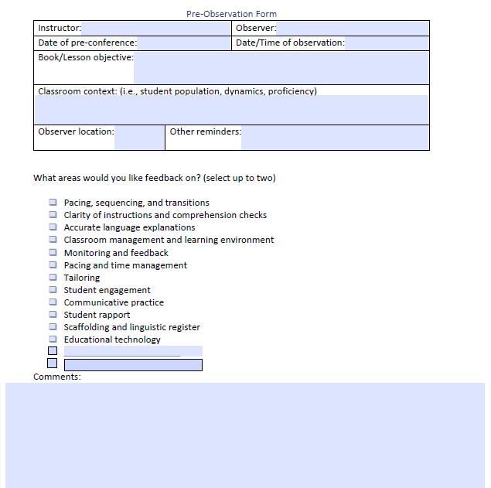
Peer Exchange Partnership (PEP)
Sample pre and post observation sheet

Slide 15
Peer Exchange Partnership (PEP)
Beta Test Feedback:
Positives:
Enjoyed the opportunity to collaborate
Found tips picked up from observations useful
Appreciated taking the time for reflection
Aligned with DLI’s mission

Slide 16
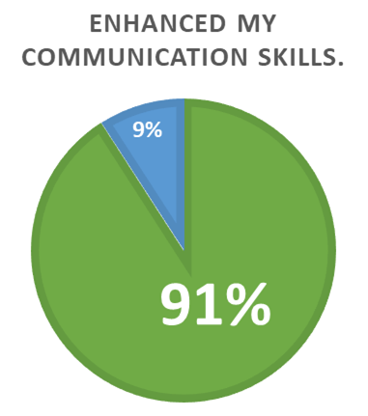
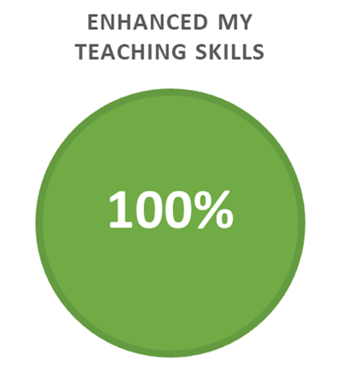
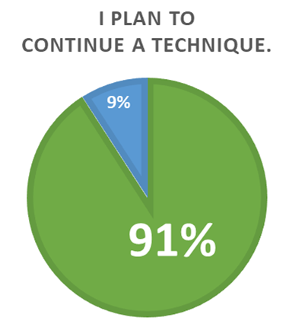
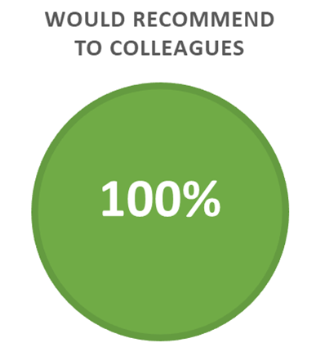
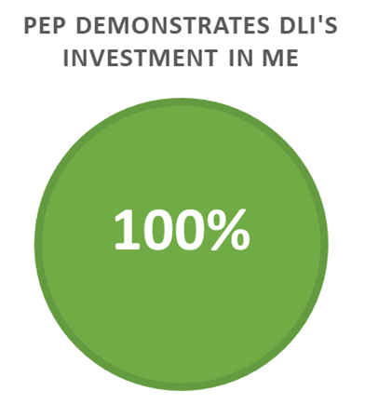
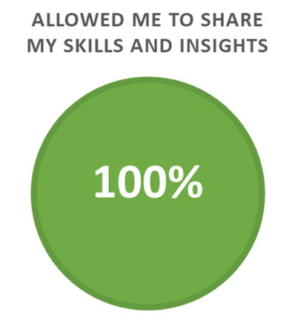
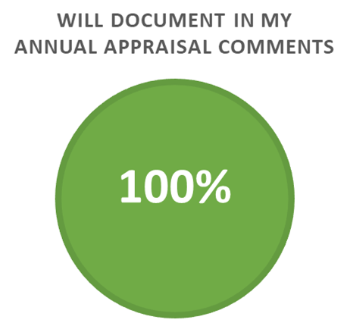
Peer Exchange Partnership (PEP)
Personal and Professional Value
Agree
Disagree
Neutral

Slide 17
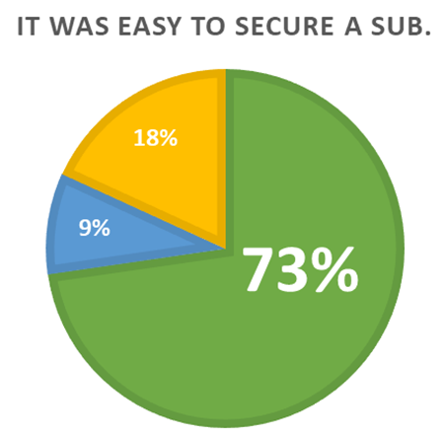
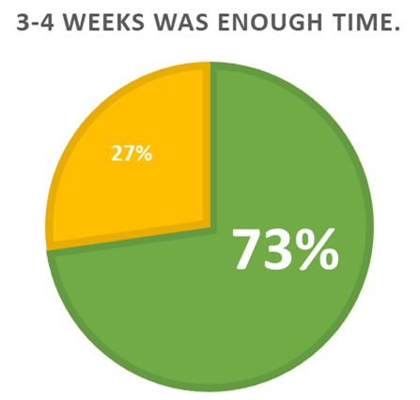
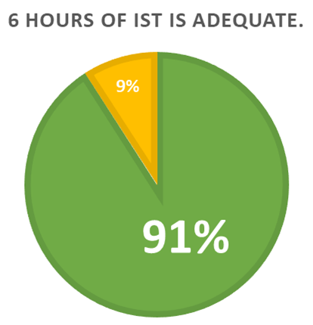
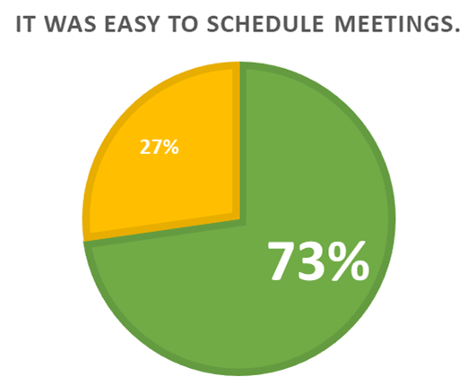
Peer Exchange Partnership (PEP)
Logistics
Agree Range
Disagree Range
Neutral

Slide 18
Peer Exchange Partnership (PEP)
Beta Test Feedback
Challenges:
Time to read and digest materials in training
Time to practice using non-evaluative language
Time for pre- and post- meetings
“Scheduling meetings was sometimes difficult with sickness, holidays, and leave. I sometimes had SLT at the end of the day too.”
“It takes time, but you honor the other person by self-reflecting and taking the time to prepare.”

Slide 19
Peer Exchange Partnership (PEP)
PEP Operational Logistics
Select Peer Observation Coordinator (POC)
Establish targeted outcomes
Advertise & promote PEP to faculty
Conduct training for PEP participants (instructors pair up)
Coordinate manpower and logistics support for substitutes
POCs provide coaching, liaising with program managers & section chiefs
POCs conduct survey, data collection, tracking metrics
After action reports to ensure continuity

Slide 20
Defense Language Institute English Language Center (DLIELC)
Current Implementation
PEP Cycle-1 (25 Aug - 20 Oct)
Recruited and trained 2 POCs
Advertised and recruited 9 participants
Conducted PEP Orientation Training
Peer partners (self-nominated and assigned)
Scheduling subs & coordinating with program managers
Maintaining data-tracker & survey feedback
PEP Cycle-2 (23 Oct - 15 Dec)
11 participants in que
Peer Coaching opportunity alongside PEP

Slide 21
Defense Language Institute English Language Center (DLIELC)
Questions?

Slide 22
Defense Language Institute English Language Center (DLIELC)
References
Bell, A., & Thomson, K. (2018). Supporting peer observation of teaching: Collegiality, conversations, and autonomy. Innovations in Education & Teaching International, 55(3), 276–284. https://doi.org/10.1080/14703297.2016.1212725
Buckingham, M., & Goodall, A. (2019). The Feedback Fallacy. Harvard Business Review, 97(2), 92–101.
Centre for Teaching Support & Innovation. (2017). Peer observation of teaching: Effective practices. Toronto, ON: Centre for Teaching Support & Innovation, University of Toronto.
Cosh, J. (1998). Peer Observation in Higher Education - A Reflective Approach. Innovations in Education & Training International, 35(2), 171. https://doi.org/10.1080/1355800980350211
Cosh, J. (1999). Peer observation: A reflective model. ELT Journal: English Language Teaching Journal, 53(1), 22. https://doi.org/10.1093/elt/53.1.22
Goker, S. D. (2006). Impact of peer coaching on self-efficacy and instructional skills in TEFL teacher education. System, 34(2), 239–254. https://doi.org/10.1016/j.system.2005.12.002
Gosling, D. (2002). Models of peer observation of teaching. Generic Centre: Learning and Teaching Support Network, 8(10).

Slide 23
Defense Language Institute English Language Center (DLIELC)
References continued
Hendry, G. D., & Oliver, G. R. (2012). Seeing is believing: The benefits of peer observation. Journal of University Teaching & Learning Practice, 9(1).https://ro.uow.edu.au/jutlp/vol9/iss1/7
Jewett, P. & MacPhee, D. (2012). Adding collaborative peer coaching to our teaching identities. The Reading Teacher, 66(2), 105-110.
Knight, J. (2019). Why Teacher Autonomy Is Central to Coaching Success. Educational Leadership, 77(3), 14–20.
Kinsella, K. (1995). Peers coaching teaching: colleagues supporting professional growth across the disciplines. To Improve the Academy, 14, 107-123.
Showers, B., & Joyce, B. (1996). The evolution of peer coaching. Educational Leadership, 53(6), 12.
Siddiqui, Z. S., Jonas-Dwyer, D., & Carr, S. E. (2007). Twelve tips for peer observation of teaching. Medical Teacher, 29, 297-300.
Tenenberg, J. (2016). Learning through observing peers in practice. Studies in Higher Education, 41(4),756-773.

