Slide 1
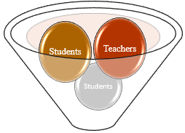
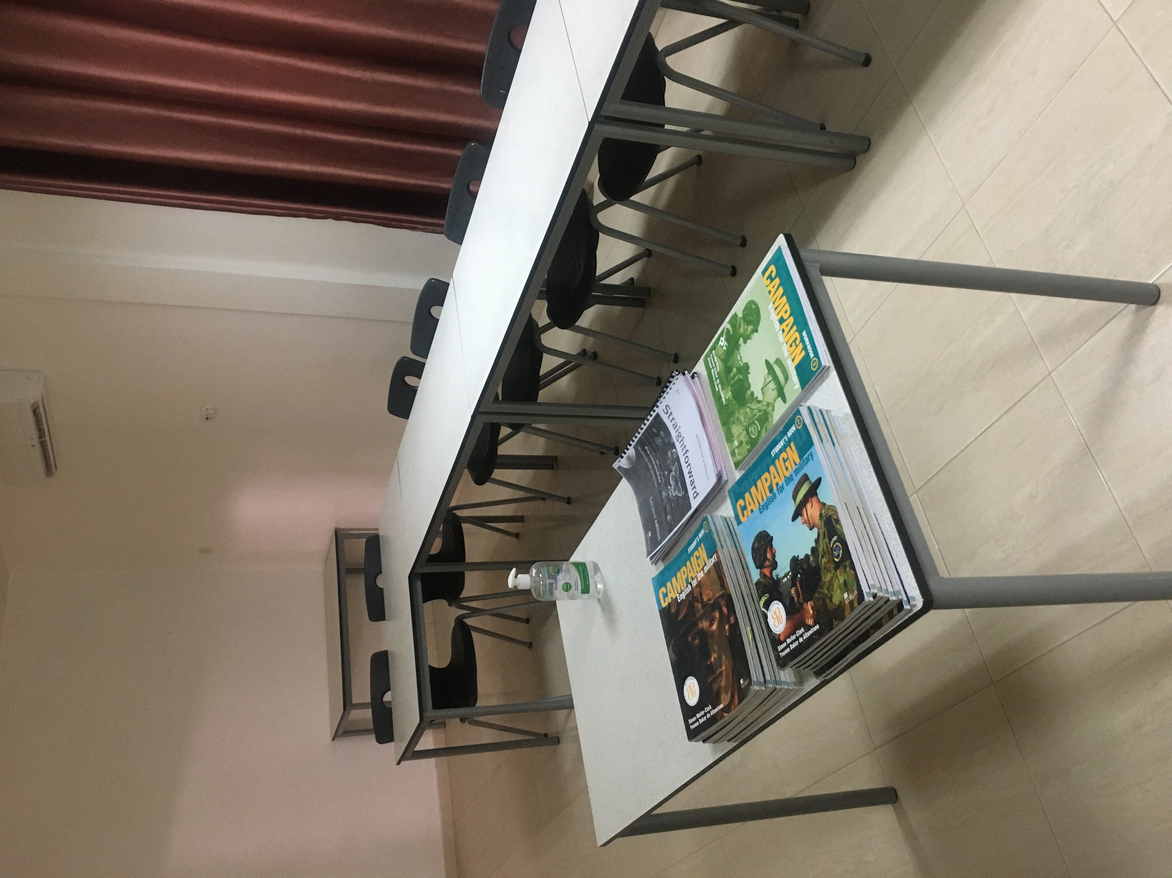
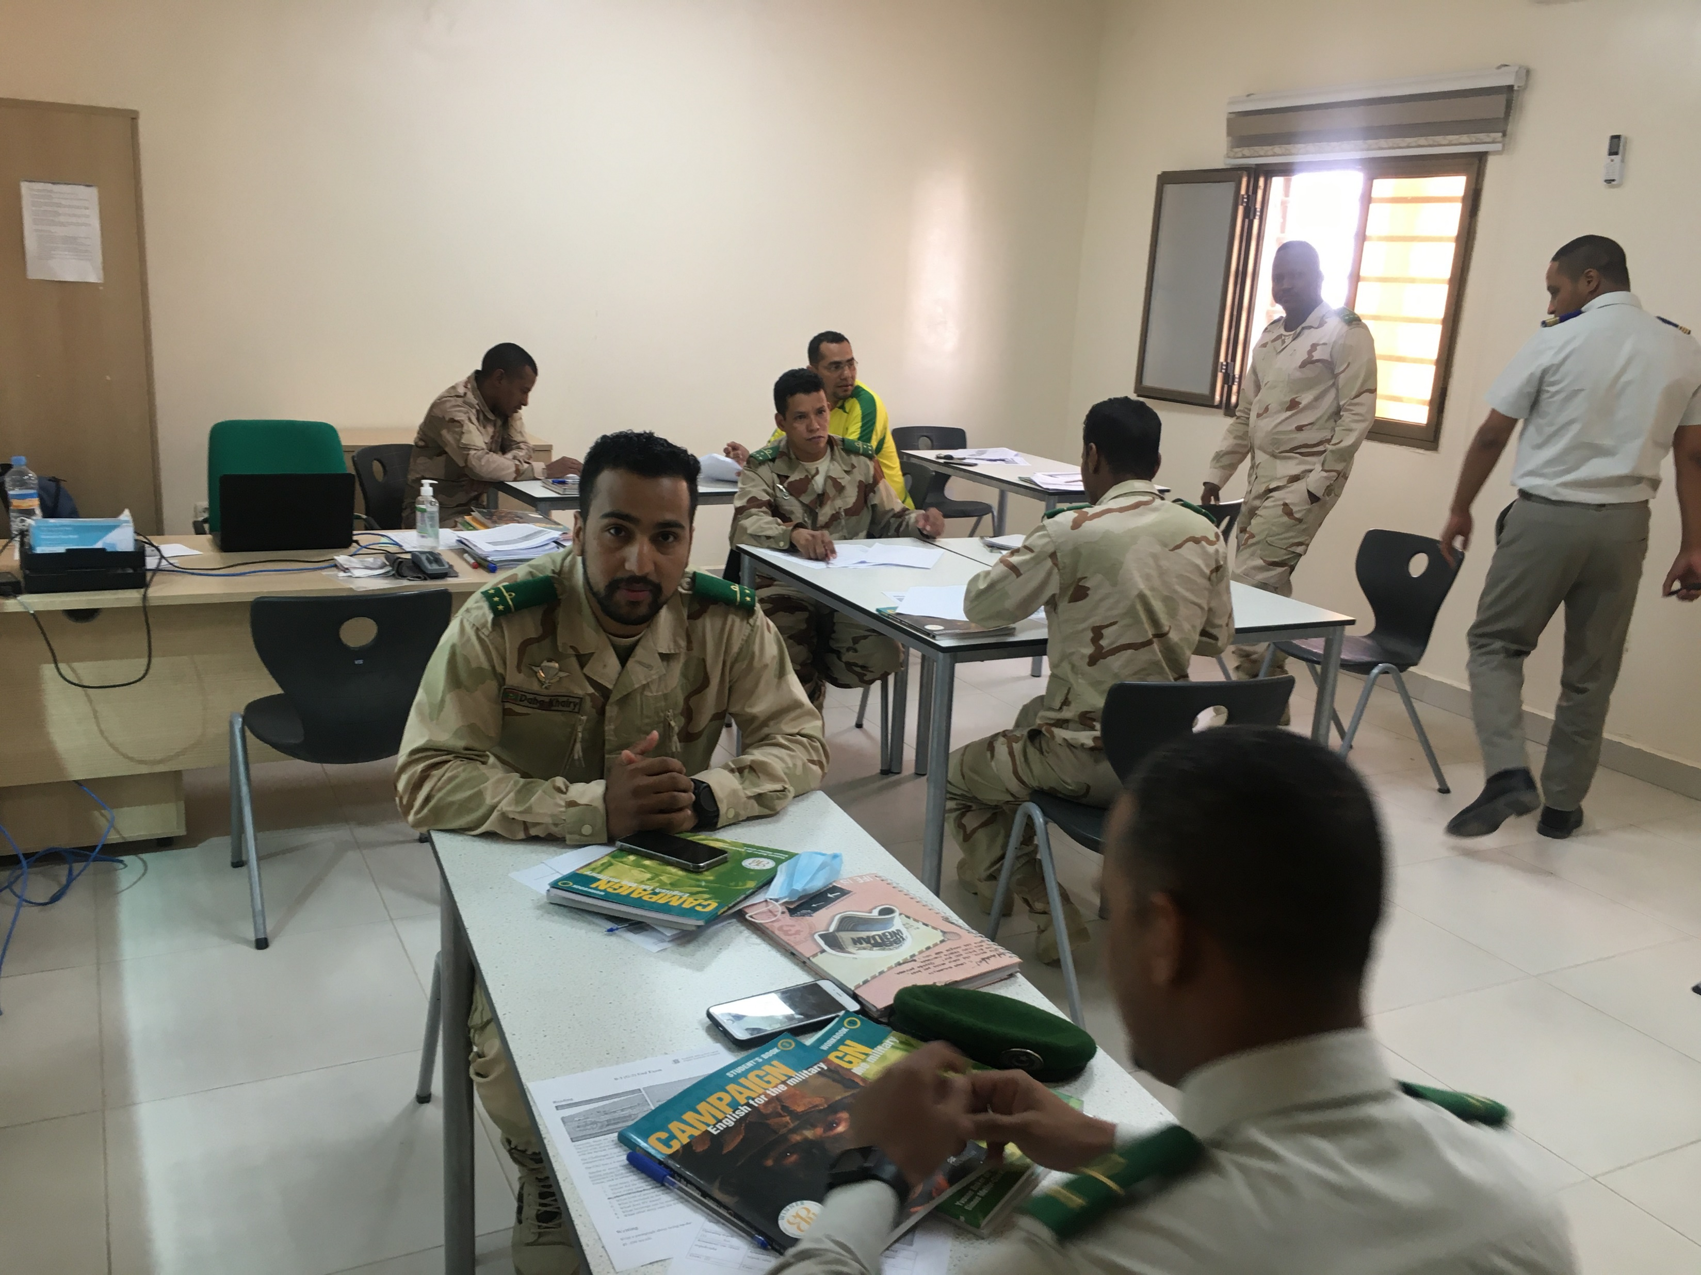
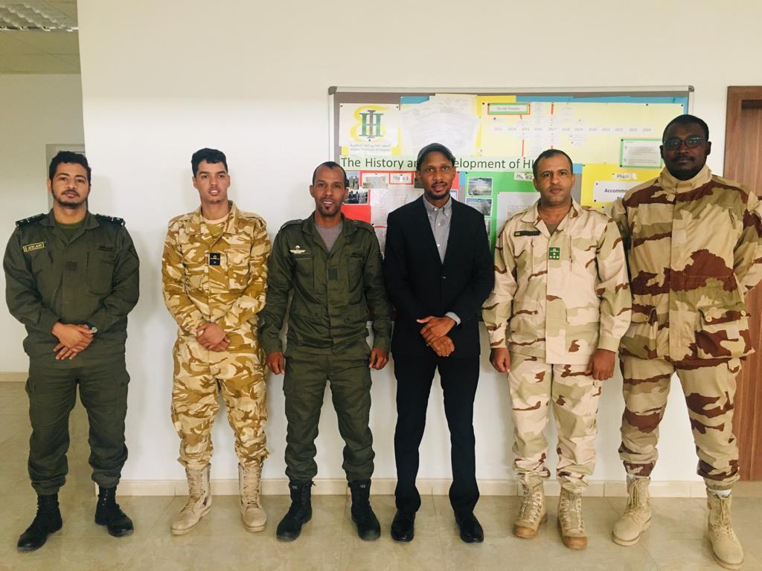
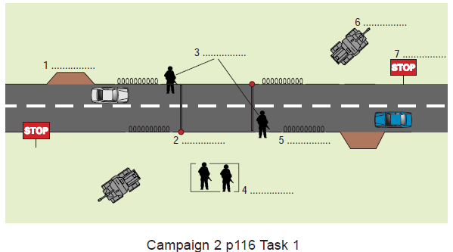
Mauritanian civil-military cooperation in an interactive classroom environment
NATO BILC MILITARY TERMINOLOGY CONFERENCE STOCKHOLM, SWEDEN (8-12 APRIL 2024)
Because of our students’ learning habits and expectations, we have to work hard to shift from the system they are used to (The Grammar Translation Method) to a new system (The Communicative Language Teaching (CLT) method.
In essence, we do our best to create a student-centered, interactive learning environment, where students actively engage in the learning process. This environment serves a dual purpose:
Students transition from merely knowing (memorizing) the rules to effectively applying them in real-life situations.
The Grammar Translation Method is an approach to language teaching that focuses on the explicit teaching of grammar rules and the translation of texts between the target language and the native language of the learners.
The Communicative Language Teaching (CLT) method is an approach to language teaching that emphasizes communication as the primary goal of language learning. So the learners are actively involved in the process.
The teacher leverages their understanding of the subject matter and experience to teach English within a military context while also drawing upon the students' hands-on experience to enhance their understanding.
Teachers and students teach and learn from each other.
Mohamed Meissara

