Slide 1
Not Just War Porn
Using video footage
In military language acquisition

Slide 2
Premise and Observation
PREMISE: an educational method that prioritizes emotional pathways will produce greater levels of long-term retention and learning.
OBSERVATION: In military language instruction, this is more easily said than done.

Slide 3
Underlying the Premise: the Roles of Emotion
Emotion is an on/off switch for learning…the emotional brain, the limbic system, has the power to open or close access to learning, memory, and the ability to make connections. –Priscilla Vail, educator
Emotions and feelings aren’t a luxury, they’re our way of communicating our mental states to other people. But they’re also a guide for us to make decisions. –Antonio Demasio, neurologist
Emotional stimuli comprise a privileged stimulus category that is not only prioritized but their processing also takes place in an obligatory fashion that is independent of attention. -Pessoa et al. Attention and Emotion

Slide 5
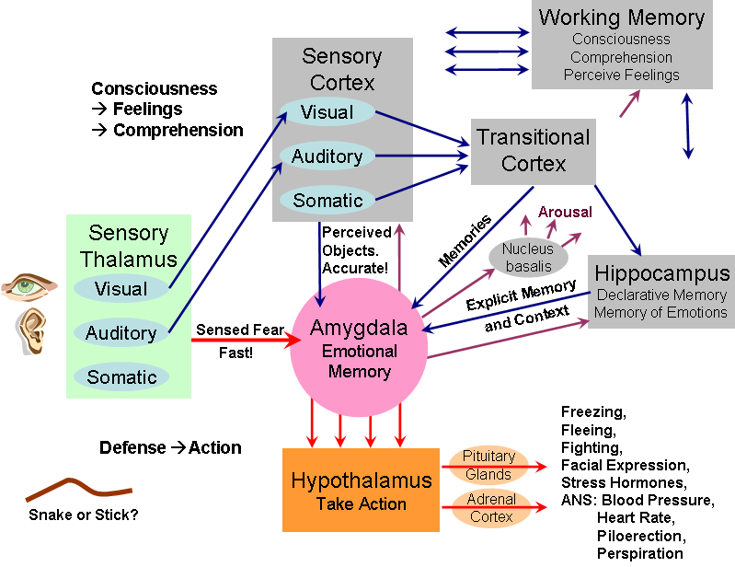

Slide 6
Problem: Video Material
While often chockablock with emotional content, much military video footage is burdened by one or more shortcomings:
Paucity of linguistic content, i.e. poor signal-to-noise ratio.
Little to no production values.
Shaky cam, blurred, pixilated video.
Indistinct, intermittent to non-existent audio.
Internally incohesive, showing no clear arc of development.
Too short, too long, and/or poorly edited.
Indeterminate as to time and place of action.

Slide 7
A shortcoming may not be a deal-breaker. A shaky cam video which is sufficiently content-rich and/or internally cohesive, historically relevant etc. may work well. In some contexts it adds validity.

Slide 8
Problem: Text material
The shortcomings of many military and military-related texts often present something of a mirror image wrt video material:
Fairly dense linguistic content, often in formal registers thick with occupational terminology and peppered with abbreviations.
Dull.. er, sober production values ("warfighting is serious business").
Graphics in grayscale or muted colors.
PowerPoint paragraph structure: bullets, lists, subsections galore.
Vivid language is anathema. Metaphors are out, precise detail is in.
Generally too long; see "precise detail" above.
Often describe idealized states, hence no time and place of action.

Slide 9
Gun to head, which would you choose to read?

Slide 10
More effective military-related texts
Magazine Articles
Memoirs

Slide 11
Video & Text Combos: Canada in Afghanistan (2006)
Video
Literature

Slide 12
Video & Text Combos: US in Afghanistan (2007-8)
Video
Literature

Slide 13
Video & Text Combos: UK in Afghanistan (2006)
Video
Literature

Slide 14
But..
Some problems may remain. For example:
Text mass may still be of such size that it gives the digital generation the heebee jeebees, their default MO being the sending and processing of information in bursts.
Text and/or video may contain content that is peripheral to the theme; text and/or video may be "boring" (often due to the lack of emotional stimuli).

Slide 15
The Hook (a.k.a. The Video)

Slide 16
Elements of "The Hook"
1. Palpable emotional content
- Engages affective pathways (e.g. limbic system)
2. Internal cohesion
- Facilitates processing
3. Minimal external context
- Stimulates curiosity
4. Relatively short duration
- The digital generation processes in bursts

Slide 17
Hook Type: Fog of War

Slide 18
Priming the Pump: set-up questions
00:03-00.18 What is making that "thump thump thump" sound?
00:38-00:41 That's an oddly-coloured blanket lying on top of that vehicle. Do we see that colour elsewhere? And PID that vehicle.
00:52-00:56 "Yeah, he got hit on the f-king turret." What's a turret?
01:10-01:12 One times KIA? KIA is a Korean car, right?
01:14-01:18 What happened there?
01:30-01:40 And what the f-k IS over there?
02:24-02:29 Who are those guys and why is the driver angry at them?

Slide 19
Auxiliary Material
Maps, etc.
Specs, cutways, etc

Slide 20
Anchor Text Type: Main Text

Slide 21
Color coding: Green
While this is primarily the story of Charles Company on Sept. 3 and 4, it should be known that Medusa was a huge operation– NATO’s first-ever ground combat assault and the biggest Canadian-led battle in more than half a century. The plan for Medusa had Charles Company in the south acting as the hammer, with Major Geoff Abthorpe’s Bravo Company in the north playing the anvil. To the east and west, other coalition forces– Dutch, Danish, American– hemmed in the insurgents and attempted to block their escape routes. While the Canadian forces consisted primarily of the line companies of 1st Battalion, Royal Canadian Regiment, out of Petawawa, Ontario, there were sizeable contingents from 2 Combat Engineer Regiment, the Royal Canadian Dragoons, Princess Patricia’s Canadian Light Infantry (PPCLI), rounded of with an ISTAR (Recce) Squadron led by Major Andrew Lussier and, of course, the men with no names– Canadian and allied special forces– flitting in and out of the shadows.

Slide 22
Color Coding: Blue
Difficulty in conquering the district comes not only from its inhabitants– it is the home of infamously intransigent Pashtun tribals and the birthplace of the Taliban– but from the terrain itself. Some people call this area by the Arghandab River an oasis, the 'green zone', and technically it is just that; however, such an image belies its strange desolation. The Registan Desert lies a few kilometres to the south like a giant furnace, making the air crispy dry and sucking all the moisture from the land. And so, despite the lush greenery, life is hard, the people are hard, even the dirt is hard.

Slide 23
Color coding: Yellow
berms
features
hatch
haze
jammed
leaflets
moisture
on scene
shredding
snipe
traversing

Slide 24
Color Coding: dual border box

Slide 25
Hook Type: Shock and Awe

Slide 26
Text sources for AF Hook
Package Q narrative
Technical (F-16 MLU manual)

Slide 27
Hook Type: Follow-Up

Slide 28
Hook Type: SME

Slide 29
Anchor Text Type: SME Text

Slide 30
Hook Type: Springboard

