Slide 1
Manuals, syllabuses, curriculums: stumbling blocks between teachers and learners
Jérôme COLLIN
Département Langue française
Ecole de guerre, Paris

Slide 2
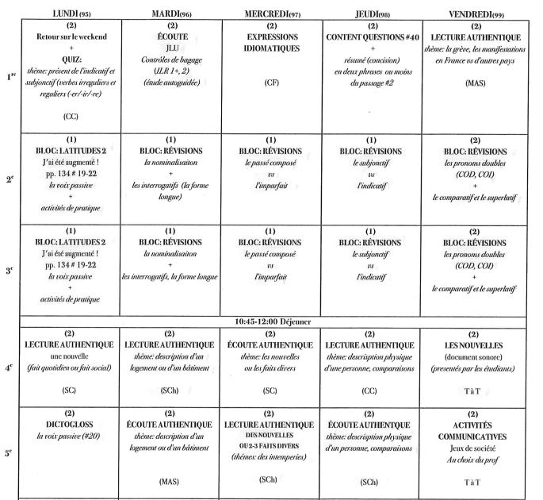
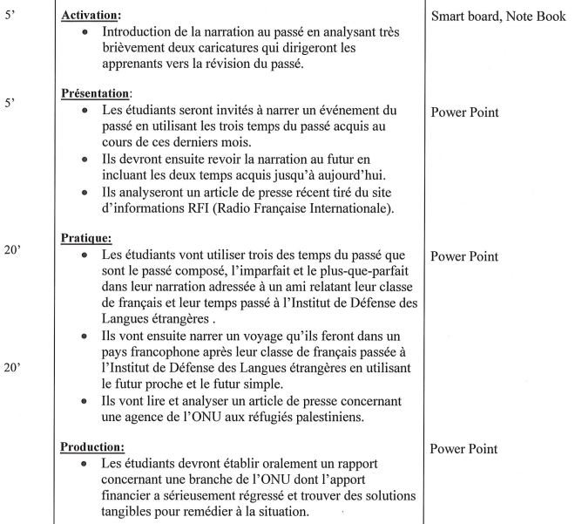
“what makes learners lose their natural motivation?”
“Anticipated teaching”

Slide 3
X
1 DEMOTIVATING TEACHERS
Status
Role
2 DEMOTIVATING THE LEARNERS
Cultural openness
Tolerance of ambiguity

Slide 4
1 DEMOTIVATING TEACHERS
Status
Role
2 DEMOTIVATING THE LEARNERS
Cultural openness
Tolerance of ambiguity

Slide 5
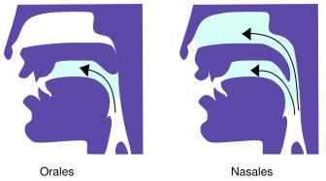
1 DEMOTIVATING TEACHERS
Status
Role
2 DEMOTIVATING THE LEARNERS
Cultural openness
Tolerance of ambiguity
S’EN ALLER
Je m’en vais
Tu t’en vas
Il s’en va
Nous nous en allons
Vous vous en allez
Ils s’en vont
EN
préposition | adverbe
Il va en France | Il en achète chaque jour
Il voyage en voiture | Il s'en va demain
Il veut tout voir en trois jours | Tu en penses quoi ?

Slide 6
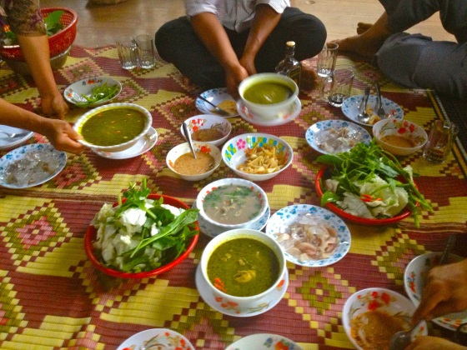
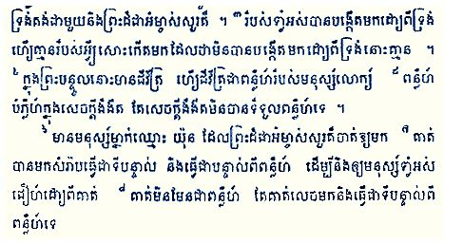
1 DEMOTIVATING TEACHERS
Status
Role
2 DEMOTIVATING THE LEARNERS
Cultural openness
Tolerance of ambiguity

Slide 7
1 DEMOTIVATING TEACHERS
Status
Role
2 DEMOTIVATING THE LEARNERS
Cultural openness
Tolerance of ambiguity

Slide 8
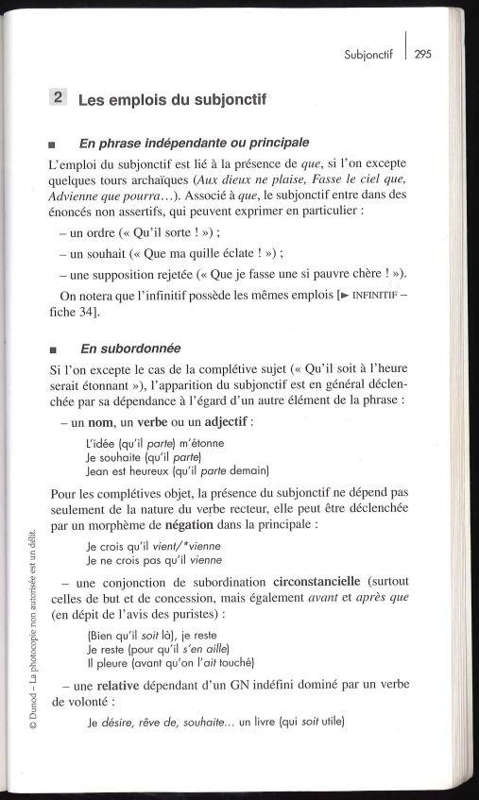
1 DEMOTIVATING TEACHERS
Status
Role
2 DEMOTIVATING THE LEARNERS
Cultural openness
Tolerance of ambiguity

Slide 9
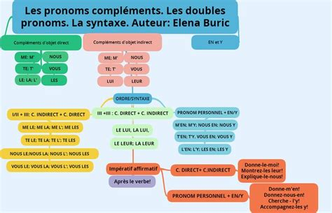
1 DEMOTIVATING TEACHERS
Status
Role
2 DEMOTIVATING THE LEARNERS
Cultural openness
Tolerance of ambiguity

Slide 10
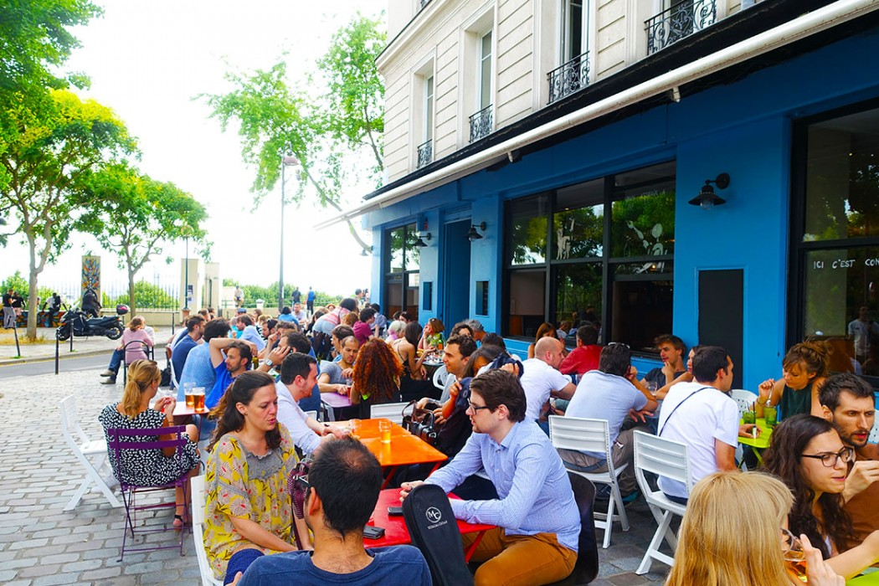
1 DEMOTIVATING TEACHERS
Status
Role
2 DEMOTIVATING THE LEARNERS
Cultural openness
Tolerance of ambiguity

Slide 11
Manuals, syllabuses, curriculums: stumbling blocks between teachers and learners
Jérôme COLLIN
Département Langue française
Ecole de guerre, Paris

