Slide 1
Training Teachers to Assess the Productive Skills
BILC Professional Conference - Zagreb 2018
Peggy Garza and Roxane Harrison
Partner Language Training Center Europe
at the George C. Marshall Center for Security Studies in Garmisch-Partenkirchen, Germany
A NATO Partnership Training and Education Center (PTEC) since 2014
NATO Institutional Accreditation since August 2018

Slide 2
Presentation outline
Challenges
Two different target audiences
Training plans for each
Teachers who assess speaking and writing in the classroom
Teachers who assist STANAG 6001 testers
Conclusions

Slide 3
General challenges for teachers
Nature of the productive skills
Time constraints
Giving feedback
Lack of assessment literacy
Competence demonstrated by performance
Not enough classroom time for speaking & writing practice and assessment
Additional time needed to give individualized feedback on writing
Feedback should be timely and meaningful

Slide 4
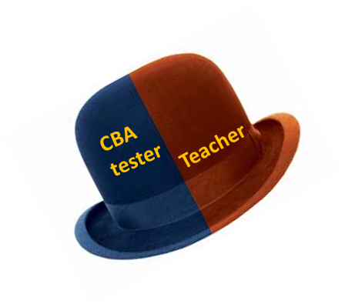
Assessing the productive skills: two perspectives
Classroom-based assessment (CBA)
Low stakes
Teachers’ roles:
STANAG 6001
High stakes
Teachers’ roles:
Design
Develop
Administer
Assess
Assist fully trained STANAG 6001 testers

Slide 5
Formal assessment literacy training
A good teacher never ceases to assess students, whether those assessments are incidental or intended (Brown 2004)
helps teachers use assessment in an informed way to:
Assess students’ learning and understanding
Reveal student strengths / show progress
Reveal student weaknesses and learning gaps
Target instruction or adapt course of learning
Motivate students

Slide 6
Basic training plan for teachers who assess productive skills in the classroom
General assessment concepts
Testing terminology
Test purposes and test types
Objective vs subjective testing
Formative and summative assessments
Assessing speaking
Assessment methods
Feedback considerations
Assessing writing
Assessment methods
Feedback considerations
Features of speaking
Features of writing

Slide 7
Achievement testing / proficiency tests
 | Achievement tests | Proficiency test / STANAG 6001
Purpose | To determine how well students have learnt/mastered the content on a particular course of study. | To determine language ability levels, regardless of how language was acquired, based on completing tasks with unrehearsed use of language.
Washback | Achievement tests are a fundamental part of language training program. Good achievement tests provide positive washback to a language training programs, inspiring teachers and learners alike. | In the classroom, STANAG 6001 test practice is possible, but test practice and familiarization is not language instruction. Teaching the test is not possible. This distinction should be part of assessment literacy training for teachers.
General assessment concepts

Slide 8
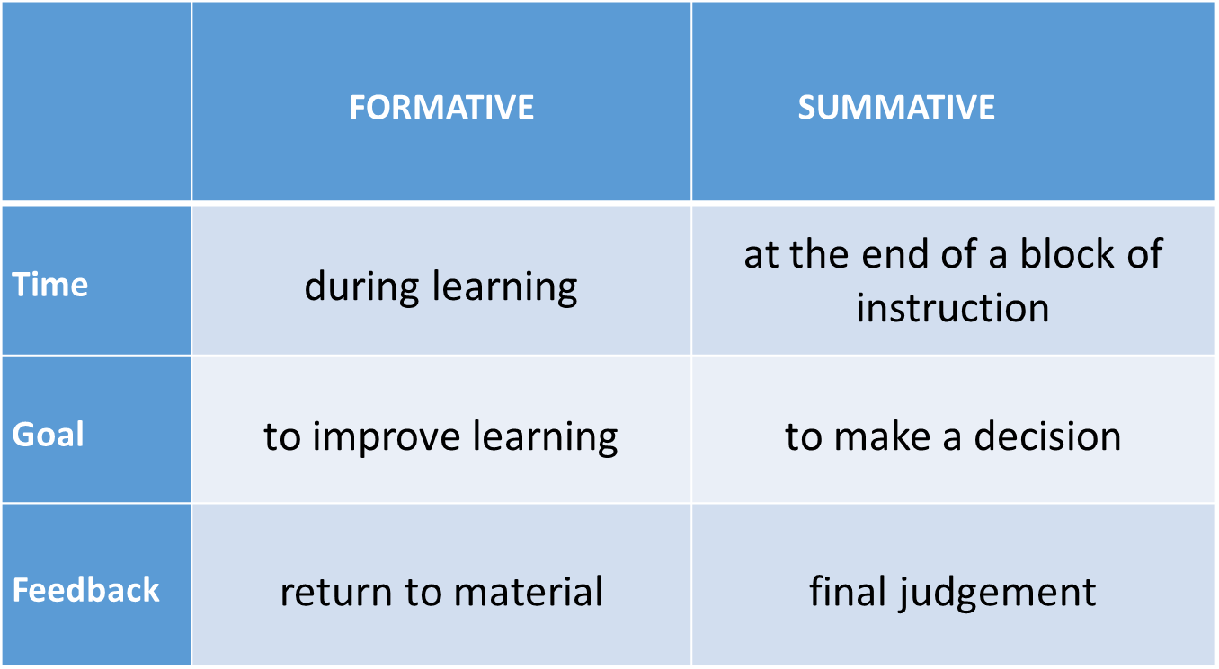
Formative vs summative assessment
General assessment concepts

Slide 9
Training Teachers Using classroom-based assessment for speaking and writing
Direct vs. indirect testing
Authentic use of target language
The unique and authentic features of speaking vs writing relate to:
Permanence
Production time
Distance between speaker/listener – writer/reader
Devices to enhance message – orthography vs. stress, intonation, pitch, volume, pausing, gesture, etc.
Complexity
Formality
Vocabulary
General assessment concepts

Slide 10
Hallmarks of assessing the productive skills
Performance
Techniques for eliciting performance
Design/develop level-appropriate tasks
Time considerations
Subjective assessment
Need for a rating scheme or rubric
Feedback
Timely
Constructive
Vehicle for improving learning
Vehicle for improving motivation
General assessment concepts

Slide 11
Classroom-based assessment for learning
Role plays & dialogs
Prepared monologs
Oral presentations
Debates
Summarizing
Retelling stories
Describe pictures
Guided/controlled
Bridge between objective and subjective formats
Examples
Dictation
Sentence completion
Picture-cued tasks (short answers, descriptions)
Extended
Letters, articles, essays, reports, summaries, research papers
Response to prompt or reading assignment
SPEAKING
WRITING

Slide 12
Alignment of test task & proficiency level
Interviews and reports
Sentence completion
Tasks for Higher Proficiency
Levels
Panel discussions
Picture-cued
Q & A
Tasks for Lower Proficiency
Levels
Timed paragraph writing
Extended
response
Anecdotes & narratives
Letter writing
Presentations
LOW
Debates
Role play dialogs
Essay
Evidence of learning
and
Evidence of areas for improvement
Evidence of learning
and
Evidence of areas for improvement

Slide 13
Considerations when giving feedback
Peer correction
Accuracy vs fluency
…decisions, decisions…
Teacher correction
Correction
codes
Immediate/on the spot vs Delayed feedback
Self correction
Error correction
vs.
guided learning
Individualized (targeted)
vs
Group or class feedback on trends
Rubrics
Assessment literate teachers make informed decisions to provide intentional, reasoned feedback

Slide 15
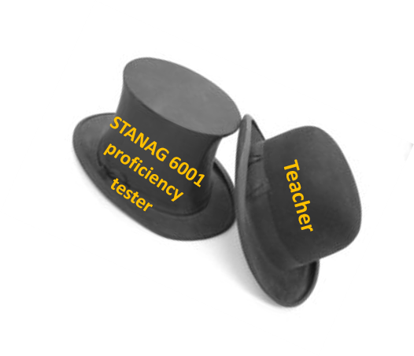
Training teachers to rate STANAG 6001 proficiency tests

Slide 16
Assistance to STANAG 6001 testing teams
Sometimes with high volume test administration, teachers assist
Normally don’t attend the Language Testing Seminar (LTS)
These teachers should be trained, certified and monitored
STANAG 6001 testing is high stakes testing
Raters of the speaking and writing tests require training
Training has direct impact on:
Test reliability
Fairness

Slide 17
The importance of training
Perform the required task to a common standard
gain knowledge of assessment methodology and testing principles
reach a common understanding/interpretation of rating scale
achieve consistency in the application of the rating criteria
minimize tester idiosyncrasies and construct-irrelevant variance
follow standardized testing procedures
enhance alignment of ratings
Increase/maintain professionalism and quality
make informed decisions
selection and qualification/certification of testers
Ensure that the inferences
made on the basis of the test results are
valid, accurate, and fair

Slide 18
Program for teachers who rate STANAG 6001 speaking and writing tests
Training plan
General testing topics
STANAG 6001 speaking tests
STANAG 6001 writing tests
Certification process
Monitoring and norming program

Slide 19
General testing topics
Ensure a common understanding of terminology
Familiarization with STANAG 6001
Characteristics of STANAG 6001 testing
Test purposes and test types
Proficiency tests and techniques
Test specifications
Uniqueness of testing the productive skills

Slide 20
Training plan for STANAG 6001 raters – writing & speaking
Training to rate STANAG 6001 tests
Familiarization with descriptors, including the plus levels
CTA exercises
Comparing base levels and plus levels
Benchmark tests at base levels and plus levels
Clear pass, clear fail and borderline pass and fail tests
Practice with rating factor grids
Speaking Tests
Learn the structure of a speaking test
Observe live speaking tests
Given prompts and role plays, determine the levels elicited
Rating practice
Writing Tests
Holistic rating: top down vs. bottom up
Given prompts, determine the levels elicited
Rating practice

Slide 21
Statement of confidentiality
Certification process
Independent rating of 6 or more tests at various levels, with at least 70% exact agreement with the official ratings and other ratings within a plus level.
A statement signed by anyone involved in test administration or rating that they will not reveal the contents of the test nor information about the performance of the test takers.
Why is it important?
To prevent test compromise
To protect the confidentiality of the test takers
Test takers should not get specific feedback on their performance

Slide 22
Inter- and intra-rater reliability
Monitoring and norming program
Reliability: the extent to which a test yields consistent and dependable results
Reliability indicators for tests of the productive skills
Inter-rater reliability
Two or more raters yield consistent scores for the same test
Intra-rater reliability
Same rater yields consistent scores across all tests
Why is this important?
To ensure that the ratings given by the raters are accurate and fair
To inform future (re) training and norming
Norming
Periodic norming sessions with other STANAG 6001 testers/raters

Slide 23
Conclusions
Two target audiences/two separate training programs
Positive washback
Formative assessment ---proficiency building
Understanding of STANAG 6001 tests of the productive skills----proficiency building and proficiency testing
Importance of more attention to writing
BILC Language Needs Analysis (LNA) findings on writing
Productive skills
may be challenging to teach and assess, but
are key to interoperability

