Slide 1
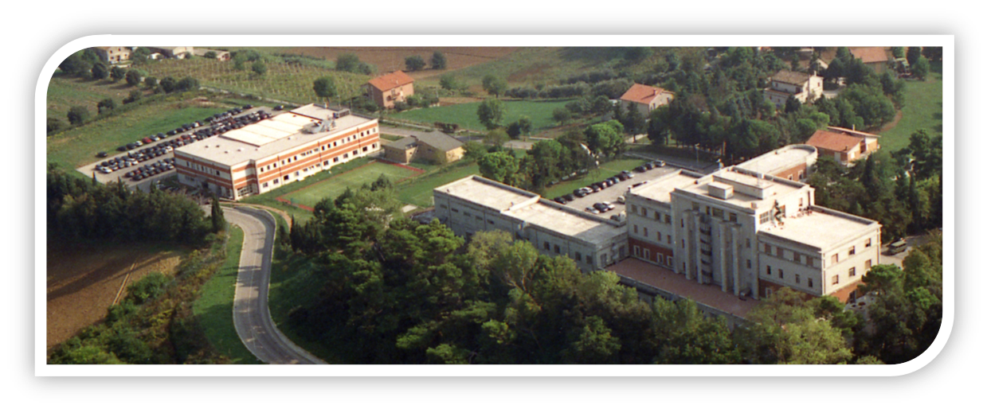
ITAF’s approach
Teaching approaches proven to work
BENJAMIN C PIM
(MA Language Testing)

Slide 2
CEN.FOR.AV.EN.
DIFFERENCES
SIMILARITIES
APPROACHES
OUR APPROACH
CONCLUSIONS

Slide 3
CEN.FOR.AV.EN.

Slide 4
CEN.FOR.AV.EN.

Slide 5
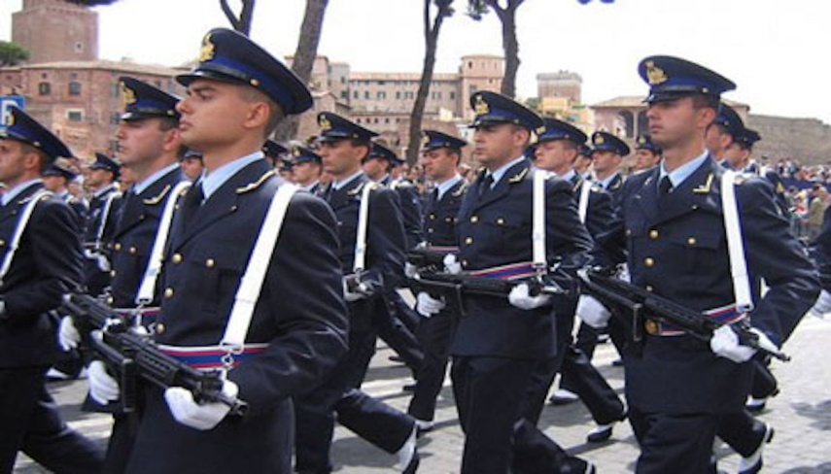
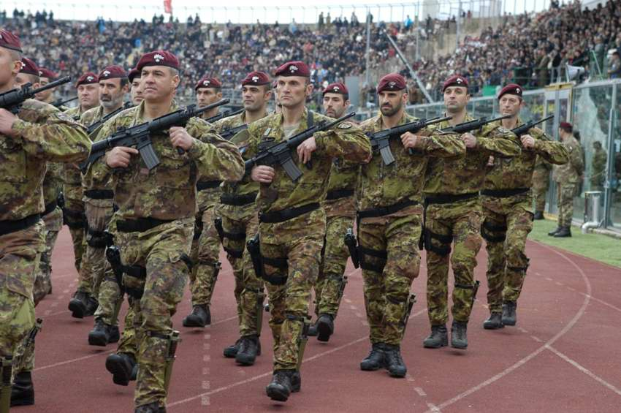
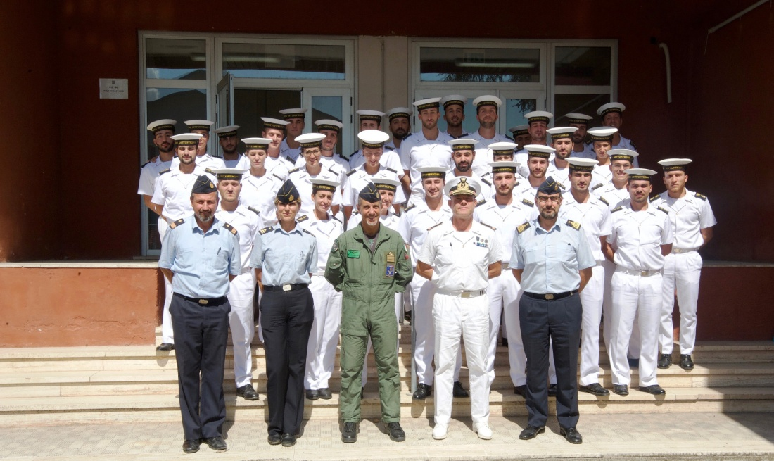
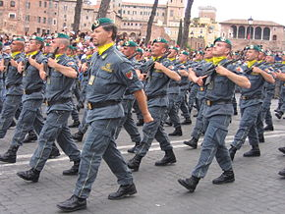
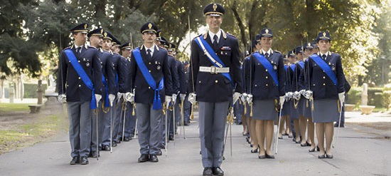
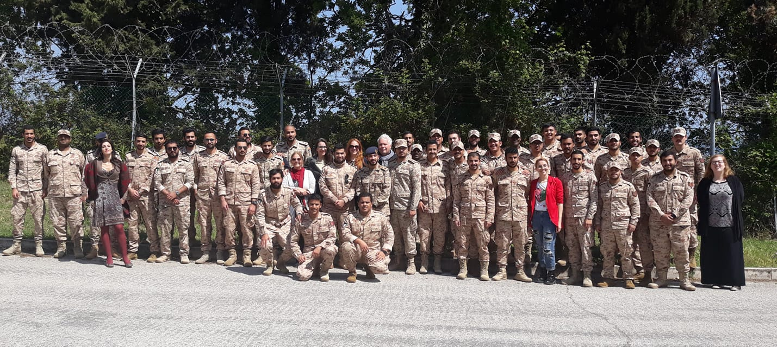
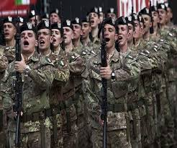
CEN.FOR.AV.EN.

Slide 6
CEN.FOR.AV.EN.
Course catalogue
AVIATION ENGLISH
MAINTENANCE ENGLISH
JTAC ENGLISH COURSE
G.E. (E-LEARNING + in-house)
G.E. FILMC
G.E. – COI
CRASH COURSES (L.O.T.E.)
ITALIAN
ACADEMIC WRITING

Slide 7
DIFFERENCES
student
L1
SCHEMA
EDUCATION
L2 LEVEL
APPROACH TO LEARNING
JOBS-ROLES-RANK
AGE

Slide 8
SIMILARITIES
Conservative
MALE (predominately)
Bands of ages
In the military
Hierarchy
Career path
Personal identity

Slide 9
APPROACHES
The Natural Approach
The Lexical Approach
Grammar Translation
The Direct Method
Eclectic approach
Sociocultural
Learning
TPR
Situational Language
Teaching
TBL
Audio-lingualism
The Silent way
Functional/Notional
Approach
Communicative
Language Teaching

Slide 10
APPROACH
Listen
Teach
Feedback
Implement
Explain
Monitorsupport

Slide 11
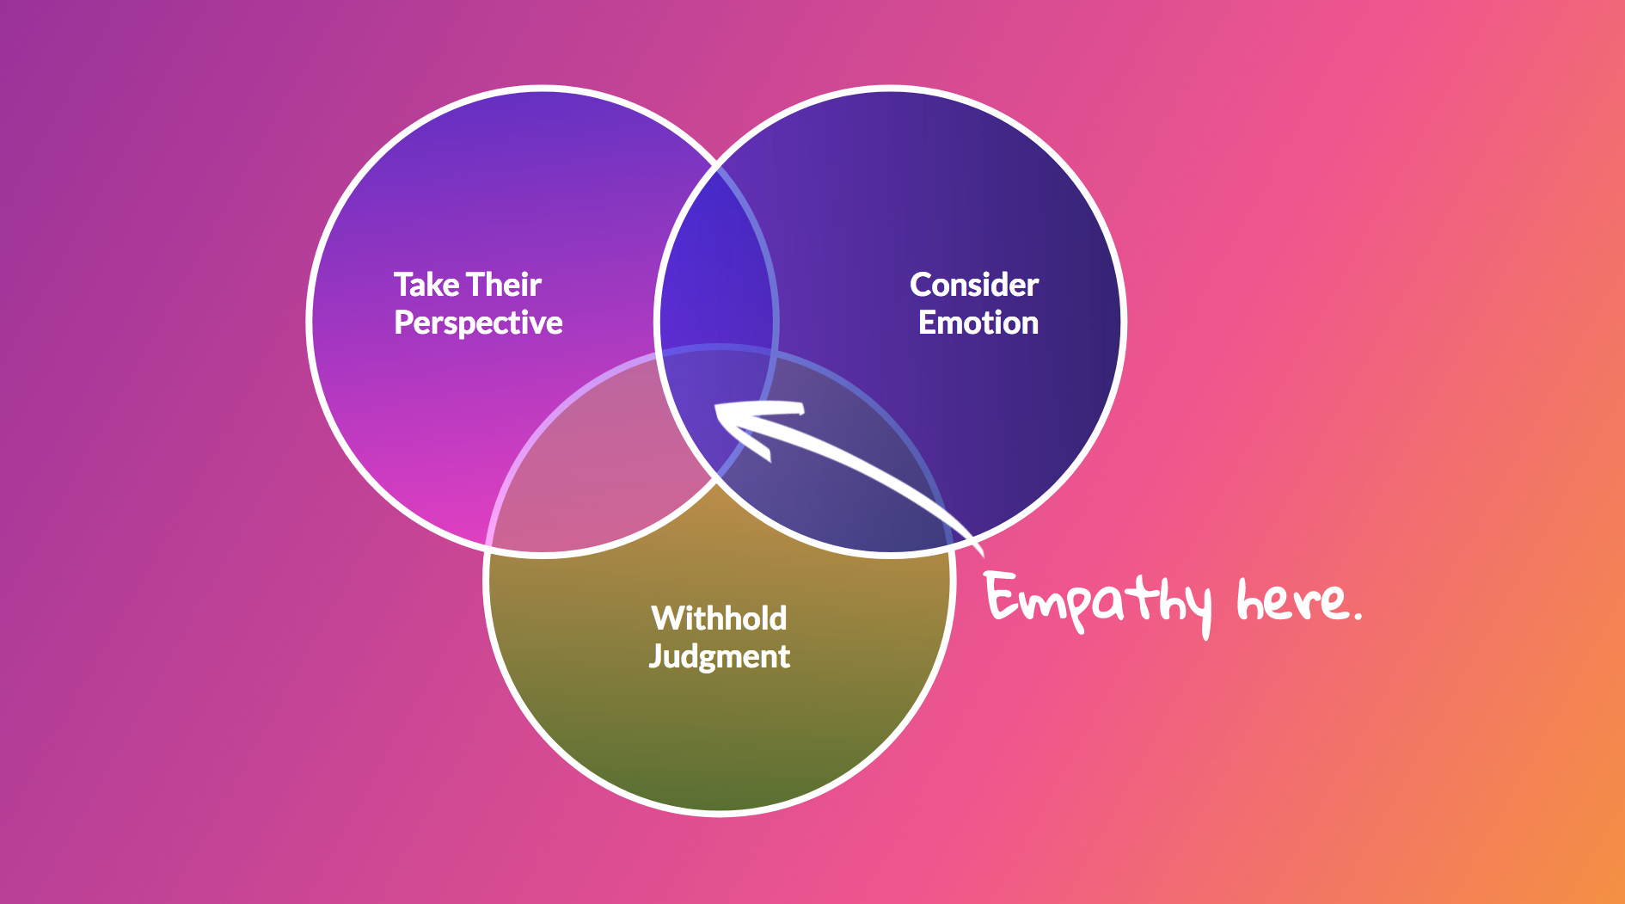
CONCLUSIONS
empathy

Slide 12
Many thanks for listening!
email: benjamin.pim@gmail.com

