Slide 1
The Milestones in Slovenian Military Terminology Management Challenges and Lessons Learned
Ana Hazler, Iris Žnidarič
Slovenian Armed Forces

Slide 2
Agenda
What kind of terminology are we dealing with
Situation overview
Terminology support cycle
Terminology standardization
Term selection process
Ad hoc vs. systematic terminology management
Terminology management process
Terminology Management Structure
Standing WG
Challenges and practical examples
MOterm dictionary
From term to dictionary
What terminology management tools do we use
Data collection and presentation

Slide 3
Situation overview
System in place since 2018
Bilingual terminology
Prescriptive terminology management
Standardized terminology (to avoid synonymity, ambiguity, misunderstandings)
Systematic terminology management
Ad hoc terminology management
Notes:
- a short overview: Slovenia became independent in 1991
Started-off exclusively as a systematic terminology management
Translation based terminology (a rich source of terms) was included subsequently

Slide 4
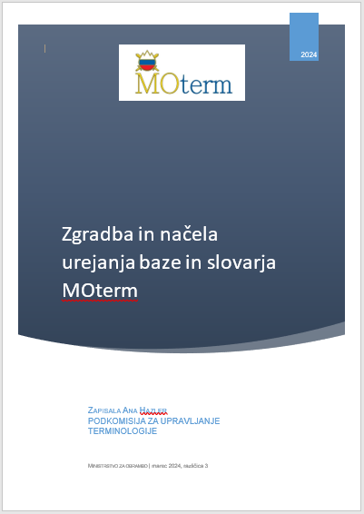
Terminology standardization
Terminology management process:
Terminology Management Manual
Terminology management structure
Terminology Standardization Board of the Ministry of Defence
Database:
MOterm Standard for database and dictionary management
Notes:
Možno, da GRE VEN
The manual was based on the NATO Terminology Manual (AAP-77) which follows the ISO standards and the Canadian Terminology manual.
Members of TC 37. Language and Terminology

Slide 5
Terminology support cycle
Term identification
WG processing
Terminology
Standardization Board Approval
End users
Inclusion in the dictionary & database
END USERS:
In-house translators
Military SMEs
External translators
Media representatives
General public
Notes:
Who do we support?
What do they/we need?

Slide 6
Term selection process
concept-based (on need basis)
translations
ad hoc terminology management
systematic terminology management
relevant term
concept-based
(from existing materials)
useful collocation
TERM PROPOSAL
working database
Standing Working Group
MOterm dictionary
(temporary inclusion)
Terminology Standardization Board
MOterm dictionary
Notes:
Ad hoc terminology management (Ad hoc experts
)
SOURCE: translations
text-oriented approach
ideally collected in a separate termbase
Challenge: not all translators use the same terminology (influenced by ad hoc SMEs)
Systematic terminology management
SOURCE: existing original materials and relevant ad hoc terminology
systematic concept-oriented approach (domain knowledge)
standardization

Slide 7
Terminology Management Structure
Translation Department
Ad hoc working groups
(translator – ad hoc expert(s))
Terminology Section/ Terminologist
Working database
(repository)
Notes:
Terminology from the Working database can be changed (reach back support): podpora sil z zmogljivostmi, ki so zunaj območja operacije (AJP) -> zunanja podpora

Slide 8
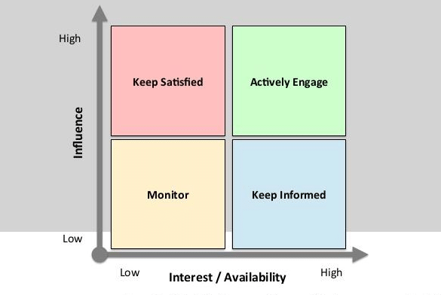
Systematic terminology management – Standing Working Group
Members with strong expertise, interest and influence
Additional military SMEs engaged, if needed
Terminology standardization model D (ISO 15188:2001(E)- Annex B)
Lessons learned
It takes time to „learn the craft“
Increased awarness among military SMEs
Live meetings work best
Standing WG
Marlow‘s Power/Interest Grid

Slide 9
Challenges
Psychological aspect
(the need for „adding one‘s two cents“ decreases; emotional attachment to terms)
Terminology rules vs. „real-life“ terminology
(terminology has to be usable)
Real-time feedback
(the news is disseminated immediately after the meeting)
Initial reluctance when coining new terms
Evolving terminology

Slide 10
Targeting
Initial reluctance when coining new terms
izbira cilja in delovanje nanj
ICDN
izbira in delovanje na cilj
IDC
ciljenje (reluctance to use a new term – „it doesn‘t mean anything“)
Notes:
Operativna raven (4 faze) taktični (6 faz)
izbira cilja in delovanje nanj (too wide, covers even more than what the process entails )
ICDN (never really in use, although gramatically correct)
izbira in delovanje na cilj (not gramatically correct, still too general)
IDC (widely used, but not correct)
ciljenje (reluctance to use a new term – „it doesn‘t mean anything“)

Slide 11
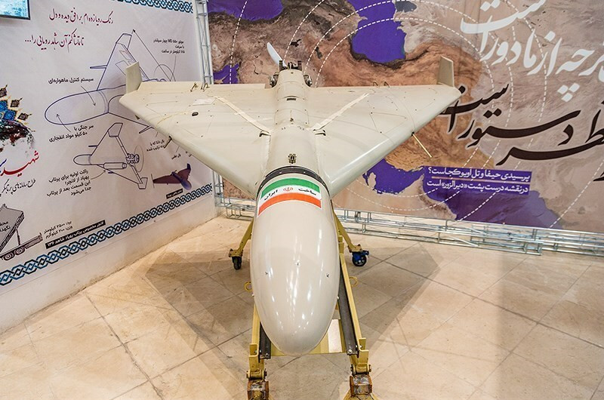
Loitering munition
Source: Wikipedia
Real-time feedback (the news is disseminated immediately after the meeting)
lebdeče strelivo
Kamikaza
samomorilski dron (suicide drone)
Brezpilotni letalski sistem bomba (BLS bomba)

Slide 12
Aircraft
Psychological aspect (emotional attachment to terms; strong opposing „camps“)
zrakoplov (in legislation) vs. letalnik
Slovenian aviation dictionaries contradict eachother in defining „zrakoplov“ and „letalnik“
Gigafida 2 corpus:
Alenka Kukovec Aviation Dictionary (1994) | Angleško-slovenski vojaški priročni slovar, Branimir Furlan, Marjan Mahnič (1999) | English-Slovenian Terminology Dictionary (2006) | Dominik Gregl Aviation Dictionary (2009) | Dictionary of Newer Vocabulary of the Slovenian Language(Aviation Department at the Engineering Faculty) (2012)* | Aviation Act (updated 2023)
zrakoplov | zračno plovilo | zrakoplov | letalnik | letalnik | zrakoplov
Gigafida 2.0 Corpora | zrakoplov | letalnik
overall concordance | 1286 (since 1993) | 797 (since 2007)
Concordance (up untill 2010) | 775 | 94
Concordance (after 2010) | 511 | 607
Notes:
- A lot of military xterminology is connected to the civilian sphere, so we need to make sure that we coordinate with them.

Slide 13
Aircraft
Psychological aspect (emotional attachment to terms; strong opposing „camps“)
zrakoplov (in legislation) vs. letalnik
Slovenian aviation dictionaries contradict eachother in defining „zrakoplov“ and „letalnik“
Gigafida 2 corpus:
Alenka Kukovec Aviation Dictionary (1994) | Angleško-slovenski vojaški priročni slovar, Branimir Furlan, Marjan Mahnič (1999) | English-Slovenian Terminology Dictionary (2006) | Dominik Gregl Aviation Dictionary (2009) | Dictionary of Newer Vocabulary of the Slovenian Language(Aviation Department at the Engineering Faculty) (2012)* | Aviation Act (updated 2023)
zrakoplov | zračno plovilo | zrakoplov | letalnik | letalnik | zrakoplov
Gigafida 2.0 Corpora | zrakoplov | letalnik
overall concordance | 1286 (since 1993) | 797 (since 2007)
Concordance (up untill 2010) | 775 | 94
Concordance (after 2010) | 511 | 607
Notes:
- A lot of military xterminology is connected to the civilian sphere, so we need to make sure that we coordinate with them.

Slide 14
Joint Terminal Attack Controller (JTAC)
Evolving terminology
navajalec letalske podpore („legacy“ of the Serbo-Croatian) navajati (Slovenian) – to quote, to make habit of– navoditi (Serbo-Cratian) – to direct
usmerjevalec letalske podpore
usmerjevalec združenih ognjev (administrative hurdles*)
kontrolor združenih ognjev

Slide 15
MOterm - From term to dictionary
To consider:
- Aim of the dictionary (military knowledge database)
- End users (different needs)
- Terminology and terminography standards (ISO 10241-1:2013)
Terminology and terminography standards remain the same through all phases.
Notes:
Adjust the dictionary data categories according to the needs of end users (not all categories have to be visible to everyone).

Slide 16
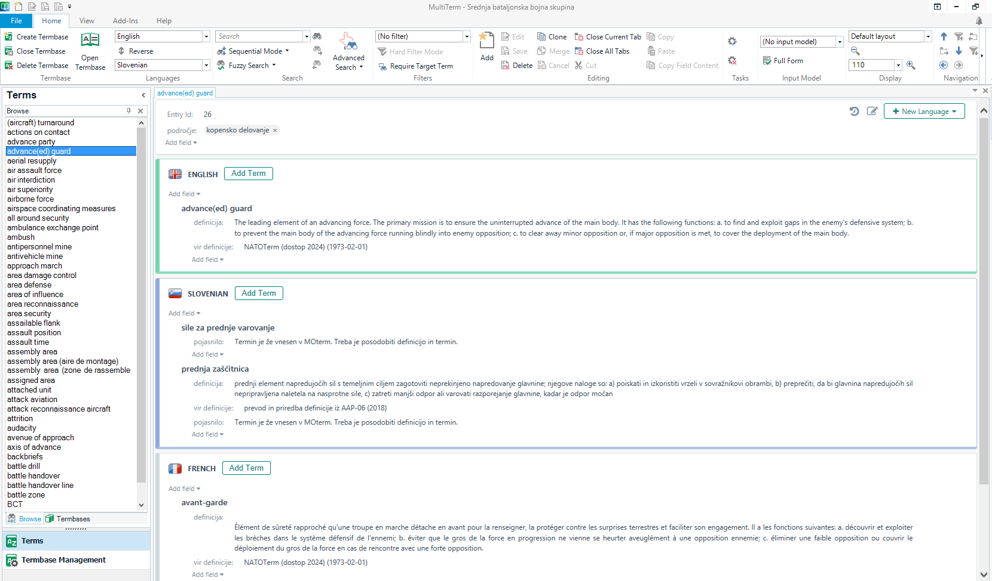
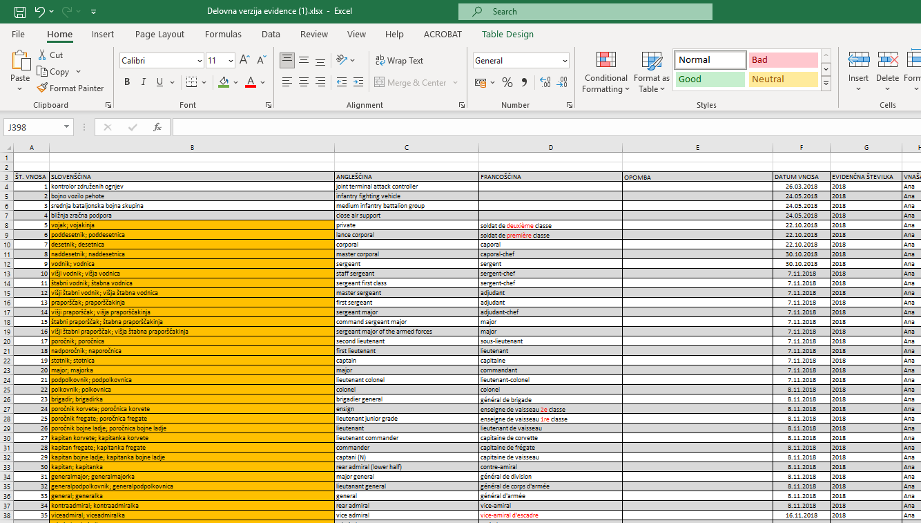
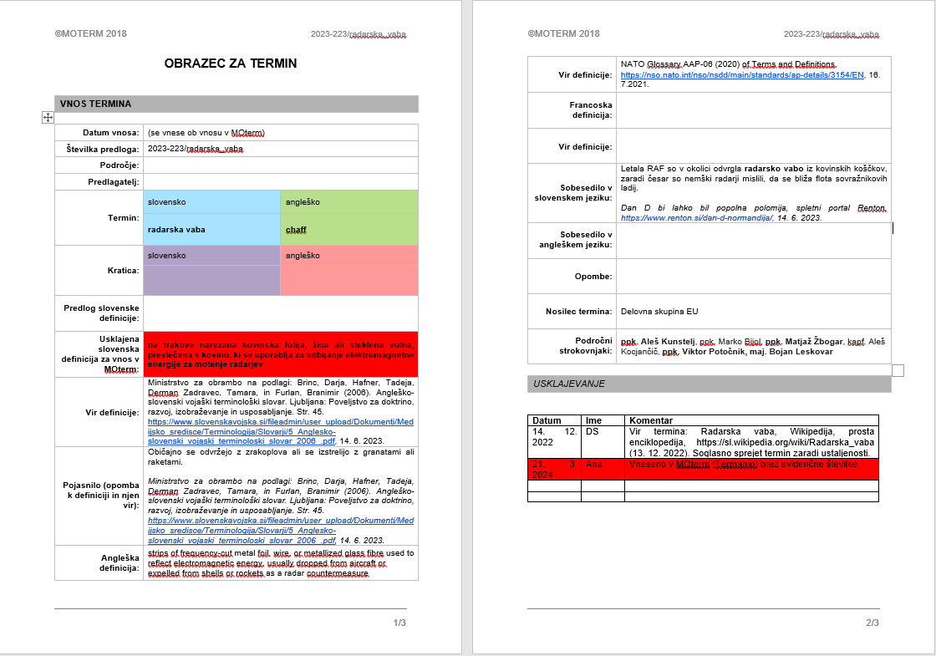
Terminology management tools
MultiTerm (backup database)
Excel Spreadsheets (term record)
Termania Terminology Platform (dictionary)
Forms to record the consensus details

Slide 17
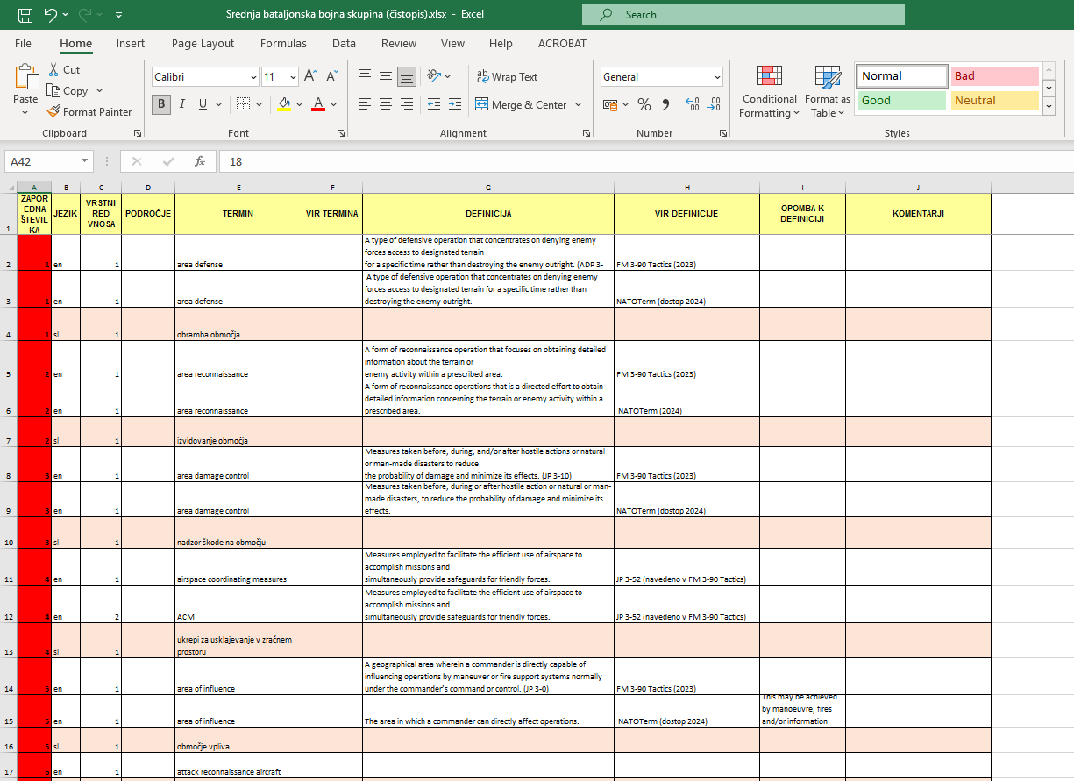
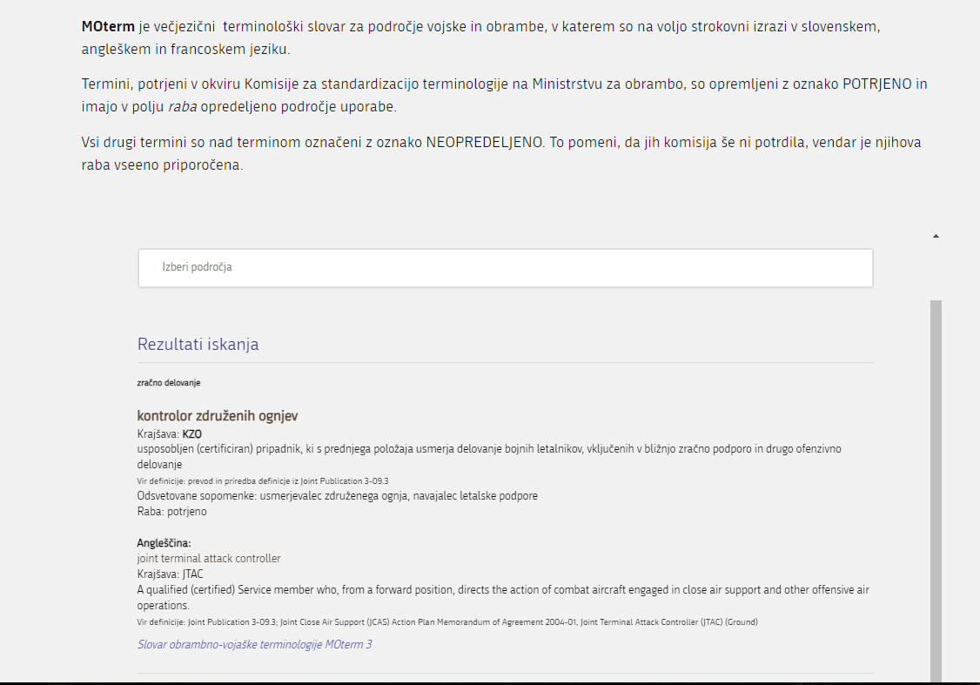
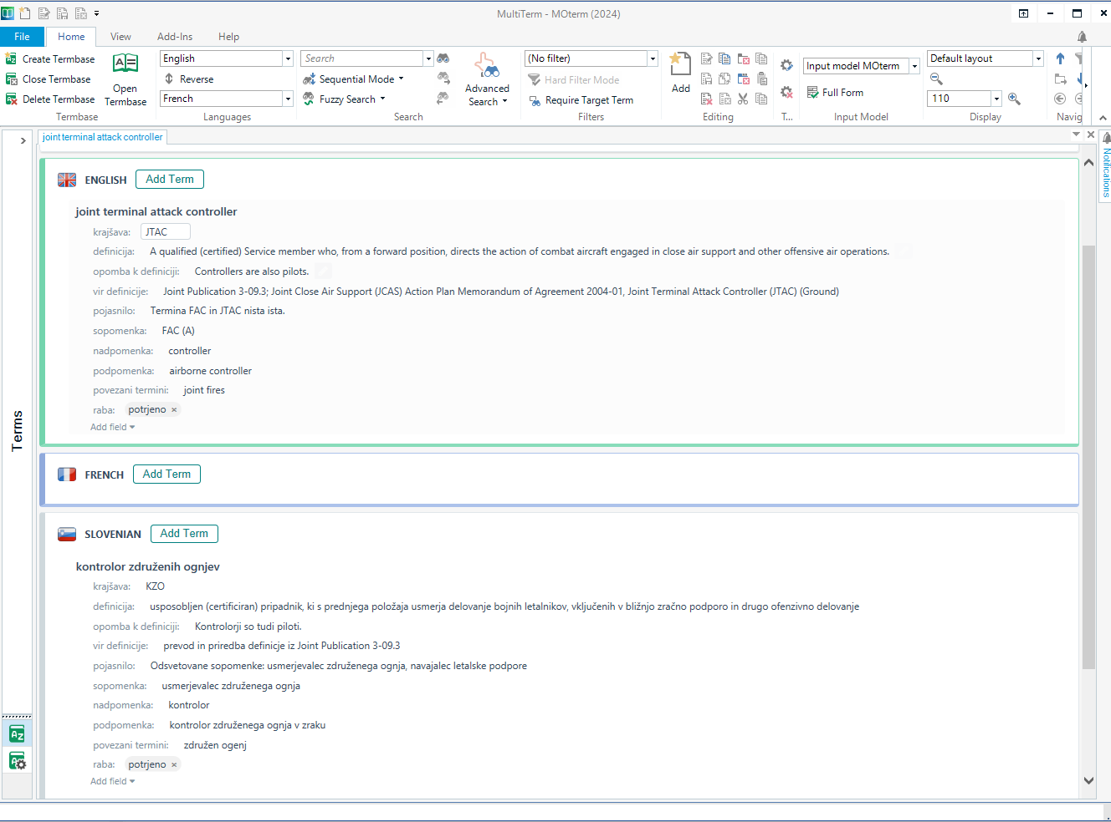
Data collection and presentation
Excel spreadsheets
Online dictionary
SDL MultiTerm
Domain
Term
Definition
Definition note
Definition reference
Usage
Synonym
Hypernym
Hyponym
Related term
Picture

Slide 18
MOterm Dictionary
API input on the Slovenian Armed Forces website
Termania Terminology Platform (dictionary)

Slide 19
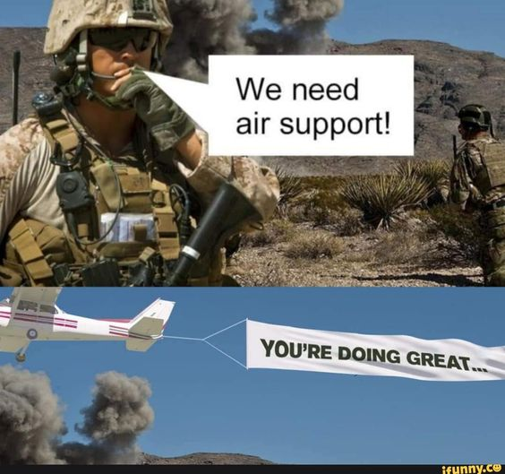
Thank you for your attention!

