Slide 1
Training of Military Interpreters in the Danish Defence
Claus Mathiesen
Head of Curriculum
Institute of Languages
Royal Danish Defence College

Slide 2
DEPLOYMENT
MILITARY INTERPRETER
MILITARY
CULTURAL ADVISOR
Military Interpretation
Operational Cultural Analysis
Function-oriented Language
MilEng, Intro Lang/Dialects
Development Economics
& Environment - Methods of Field Works
Tactics - Strategy & MilOps Leadership & Management
Advanced Language Religion - Social Structures
Basic Language History & Politics
Basic Mili tary Training
OFFICER

Slide 3
Language elements Proficiency levels aimed at (STANAG/ILR)
MODULES | Introduction to language studies | Listening | Speaking | Reading | Writing | Socio-Cultural Competence | Translation | Interpretation | Introduction to related lang/dial | Military English
Basic* (5/490) | pass | 2 | 2 | 2 | 1
Advanced* (5/460) |  | 3 | 3 | 3 | 2 | 2-3 | 3/2
Function-oriented** (8/420) |  | 3 | 3 | 3 | 2 | 2-3 | 3/2 | 3 | 0-1 | 2-3
SL->Da Da->SL
SL->Da Da->SL
*general language **military language Total number of lessons: approx. 1370

Slide 4
Main elements of the training programme

Slide 5
Students profile
Age 20-30
Male/female
Upper secondary school or higher
Partly or totally completed higher education
Selection process
1 out of 2, up to 1 out of 5, applicants admitted
Highly motivated
Psychological and physical tests

Slide 6
Interpretation and translation are two different matters!
the interpreter knows and works within the group of people he is supposed to ”serve”
often informal language,
the interpreter can ask for explanations and repetitions while interpreting
time pressure!
disturbing surroundings!
”you will hear this only once”!
you don’t know the angle of argumentation and the overall intention – you are ”blind”!!

Slide 7
First of two FAQs
How is the interpreter able to remember all that has been said, when he is interpreting consecutively?
Answer:
He isn’t – he is using mnemo-techniques and a specialized note-taking technique for interpreters

Slide 8
Note-taking techniques – ”new info” – and what else?
Lists!!
Names!!
Dates!!
Numbers!!
LAST PART of the message!!

Slide 9
Hierarchy of difficulty
(Written) translation of - informative/debating text - text on military topic | 1 3
Interpretation ”on sight” of - text on military topic | 7
Interpretation of dialogue on - general matters/”small talk” - information/debate - conversation on military topic | 4-5 6 8
Consecutive interpretation of - text on military topic (briefing) (short passages) | 10

Slide 10
Hierarchy of difficulty
Consecutive interpretation of - text on military topics (long passages) | 11
Simultaneous interpretation of text on military topic | 13
Consecutive interpretation - of fiction | 13+
Simultaneous interpretation of fiction | 15+
Simultanteous interpretation of fiction including structural information (poetry) | ??

Slide 11
The interpreter’s ”basic sins”
Misunderstandings!
Omissions!
Misinterpretations!
M.O.M.!!

Slide 12
Direction of Interpretation
From mother tongue to foreign language:
m-O-M
From foreign language to mother tongue:
M-O-m

Slide 13
PERFORMANCE ”Audience’s and user’s impression”
PROBLEM | REASONS | SOLUTIONS
Negative impression on the part of user/audience | - low voice (unclear/too low) insecure ”performance” - insecure use of relevant terminology (unnecessary ”mystification”) - exaggerated self-projection | - speak loud and clear, except when talking only to the person next to you - control your nervousness and concentrate - try to speak the language of the ”user”, e.g. Danish military argot/jargon (avoid culture-specific expressions from source lang.) - be forthcoming, know your place in the situation

Slide 14
INFORMATION
How much must the interpreter know about the meaning of a word to ”operate” with the word during interpretation?

Slide 15
What is Mt KILIMANJARO?
5 as with 4, + located in Tanzania,
6010 m, a little S of Equator, easy to climb
4 as with 3, + ”an extinct vulcano”
-------------------------------------------------------------------
3. A mountain in Africa, the highest peak of the continent
-------------------------------------------------------------------
2. A mountain
1. Something geographic
(0. No idea)

Slide 16
HICCUPS and TOOLS!

Slide 17
”Hiccups” - the tough things to interpret
expressions describing realities, e.g.
geographic, ethnographic, socio-economic, etc
proper names
persons, locations
addressing people
idiomatic expressions*
situational expressions
metaphores
terminology
acronyms
*must be interpreted as a whole, not word by word!

Slide 18
Second of two FAQs
How does the interpreter know what everything is called in the foreign language?
Answer:
He doesn’t – he is using his ”interpreter’s tools”

Slide 19
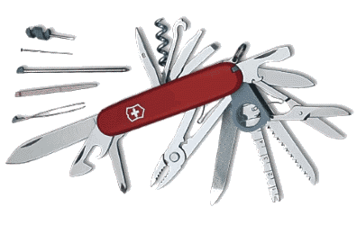
INTERPRETER’S TOOLS

Slide 20
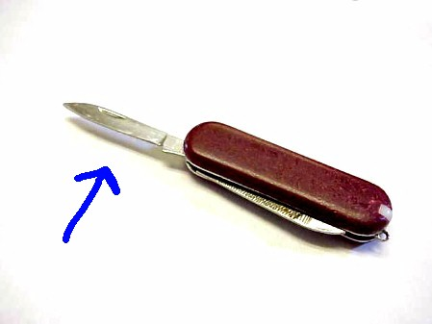
Sorry, mate: P – GEAC – LO!
ghkjksk

Slide 21
TOOLS
paraphrasing
generalising
exemplifying
antonymising
concluding
literal translation
omission

Slide 22
TOOLS

Slide 23
TOOLS?
???

Slide 24
TERMS in MILITARY TEXTS
”Besides the general problems of translation and interpretation, the question of terminology is probably the most important one in any military context.
One specific feature of different kinds of military texts is the frequency of all sorts of military terms.”
(G.M.Strelkovsky: ”Theory and Praxis of Military Translation and Interpretation”, Moscow 1979)

Slide 25
THE PROCESS
Impression by user/audience:
”Talking machine”
”Talking machine”
Interpreter’s reality:
???

Slide 26
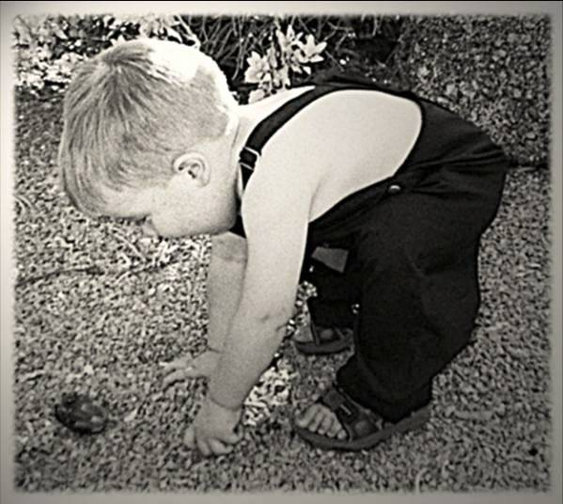
The interpreter’s personality
extrovert?
introvert?
curious!!!!!

Slide 27
The interpreter and his ”client(s)”
The interpreter shares with his ”client” the responsibility to get the full effect of the interpreter’s work
the interpreter must guide his ”client” (short passages, slower pace, repetition)
good cooperation during the preperation with the ”client” is the best way to ensure that the interpreter will be seen as the ideal ”talking machine”
content, language, psychology, expectations

Slide 28
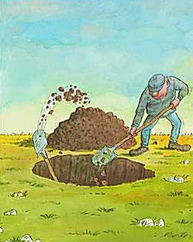
The interpreter’s ”client”
convuluted language by the ”client” may not happen because of bad intentions, but due to lack of understanding!

Slide 29
Training interpreters Focus points
short introduction to basic principles
also the obvious ones
lots of practical training
along with the progress in knowledge of military matters and related terminology
exercises as realistic as possible
using all techniques and ”tools”
focus on quality and performance
good individual feedback and guidance on alle aspects of the profession

Slide 30
GOOD PERFORMANCE
THE MILITARY INTERPRETER
”Interpreter’s TOOLS”
Mnemo- and Notetaking Techn.
Adaptability
Quick perception and analytical skills
Specific military terminology related to the topic (sufficient)
Knowledge of the specific military topic (sufficient)
Ability to prepare himself and his ”user” optimally
General military terminology
Sufficient general language proficiency to not interrupt or substantially hinder the communication for purely linguistic reasons
GENERAL KNOWLEDGE of MILITARY MATTERS
GENERAL KNOWLEDGE and COMMON SENSE

Slide 31
Miscellaneous
English!
Equipment!
Ethics and morale!

Slide 32
The Danish Military Interpreter

