Slide 1
MILITARY ENGLISH
VERSUS
GENERAL ENGLISH
A Case Study
of An English Proficiency Test
In The Italian Military
Capt. Francesco GRATTON
Notes:
As the slide says, the topic of my presentation is military English vs. general English based on a comparative study of two English Proficiency tests used in the Italian military.
CLICK

Slide 2
Anything????
No kidding!!!

Slide 3
Background
Case Study
Procedures
Results
Notes:
Before illustrating the case study, I will give some background information
which explains why the case study was conducted,
which procedures were followed
and the results found.
CLICK

Slide 4
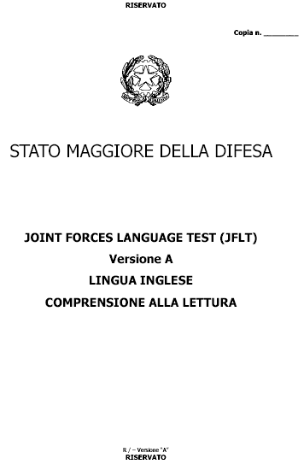
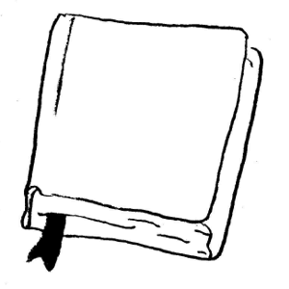
Background
: TUI vs. JFLT
September 2006
TUI Proficiency test
Since 1995
Notes:
In 2006, a new proficiency test adhering to the descriptors of the STANAG 6001 ed 2 was developed ……. and administered to the Italian defense personnel.
CLICK
The new test, called Joint Forces Language Test replaced the TUI proficiency test which had run its course after ten years of administration.
CLICK

Slide 5
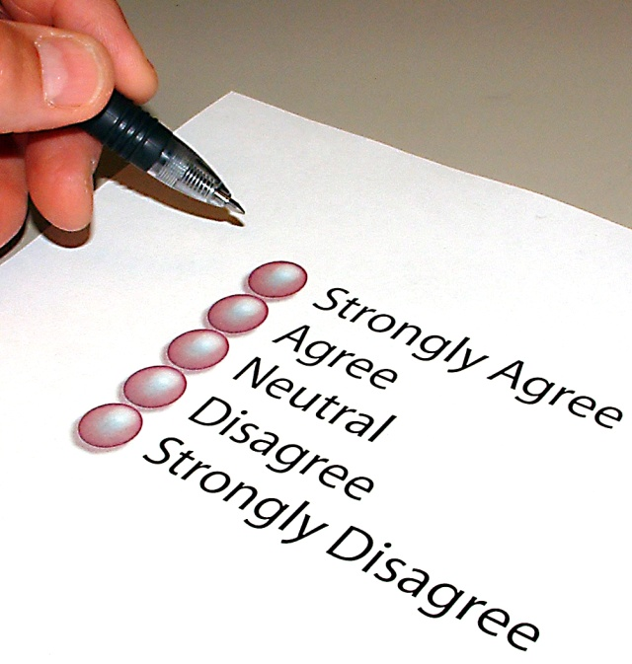
Students’ feedback
Validity
Reliability
Concurrent validity
Notes:
Of course, before administration, test analyses of validity and reliability were conducted on the JFLT and concurrent validity with the TUI established.
CLICK
Initial feedback from students was favorable to some extent ….. although more and more test takers questioned why …. the new test was not as military-flavored as the previous …… and if this could be a hindrance to some.
These queries were brought to our attention over time as many test takers claimed to prefer the previous test.
They found the texts and topics more familiar since many of them dealt with issues pertaining to their professional field.
CLICK

Slide 6
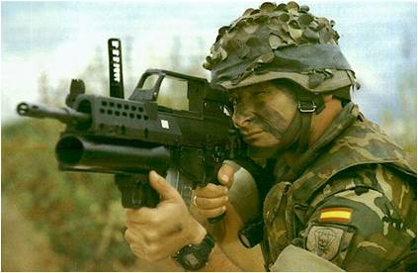
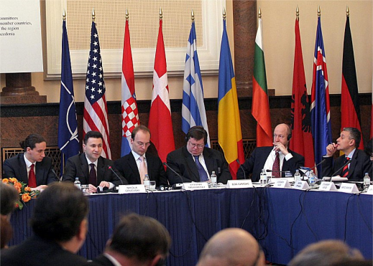
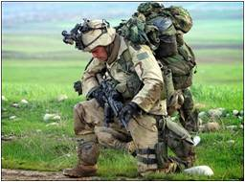
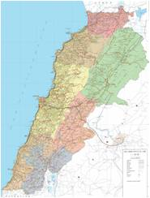
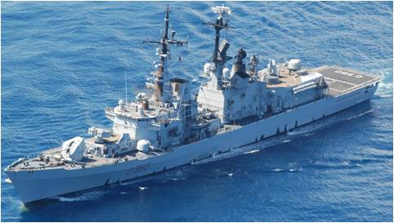
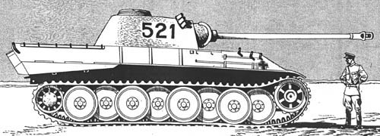
PROFESSIONAL MATTERS
Notes:
Truly, as much as test developers would normally try to select texts from a wide range of topics in order to have a representative sample of the level,........ they would also select authentic material ..... which the target test population would have an interest to read.,
and since the target test population is military, many of the level three items of the former test, the TUI, focused on military topics.
For example, there was a category in the TUI called ‘professional matters’ in which many of the texts dealt with military doctrine and issues which were strictly military in nature.
CLICK

Slide 7
How topic knowledge affects test scores….
positively
or negatively
Inferences on the test results
Notes:
But, these comments kept the test developers wondering. The issue of whether - and to what extent - topic knowledge affected test scores ………. needed to be addressed.
CLICK
It goes without saying that the extent to which prior knowledge of the topic due to …… let’s say……. experience in the field could affect test performance either positively or negatively,
CLICK
and thus the inferences we make on the test results.
CLICK

Slide 8
IMPACT OF TOPIC KNOWLEDGE ON…
POST
ASSIGNMENTS
SLP
Notes:
Could this in turn have an impact ……………. on the SLP and therefore on how posts are assigned?
CLICK

Slide 9
Background
Case Study
Procedures
Results
Notes:
Let’s take a look now at how the case study was built and conducted.
CLICK

Slide 10
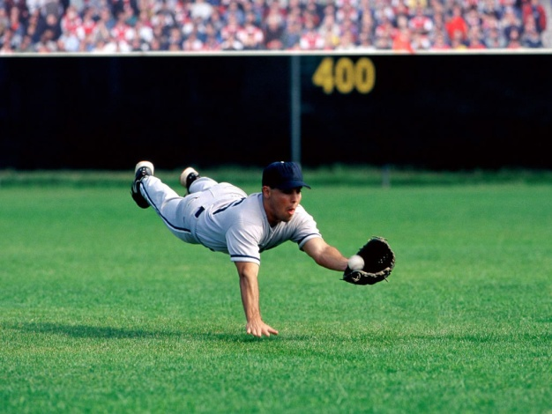
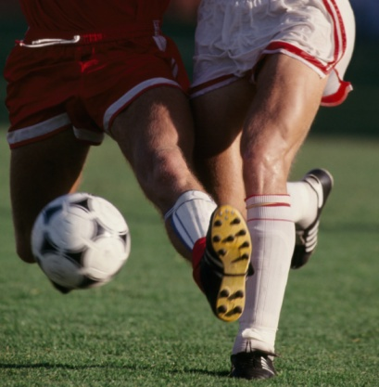
Case Study
1.
Corpus of TUI and JFLT
2.
Assumption: if a topic is known, the typical vocabulary is known.
3.
i.e.:
Notes:
The first step was to create a corpus of the two tests: the TUI and the JFLT and tag the most recurring vocabulary which had to do with military matters.
CLICK
As many scholars claim, topic knowledge and vocabulary go hand in hand, for it can be assumed that if a topic is known, whether due to work or life experience, most of the typical vocabulary relating to that topic is known.
CLICK
An argument can be made that if someone is fond of baseball or football, they would also know the typical terminology used in that sport.
CLICK

Slide 11
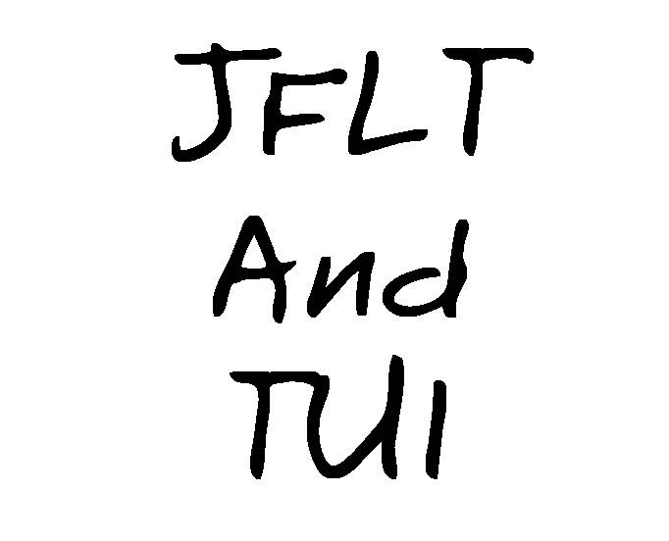
scrutiny with a lexical analysis software
WORDLISTS
Notes:
Before being administered to the sample of test-takers, the two proficiency tests underwent scrutiny with a lexical analysis software.
CLICK
This procedure made it possible to extrapolate different wordlists for different usage.
CLICK

Slide 12
Corpus: Advantages for testers
easy to obtain
customize the way info is received and stored
built for own specific purposes
Notes:
In this work I was driven by the idea that compiling small corpora (4 million words) might be of interest for a variety of reasons.
CLICK
First, on the practical side, they are very easy to obtain. E-papers and e-mail news, press, on-line articles will make it easier for testers to have access to a vast amount of news-related texts.
CLICK
Similarly, users can customize the way this information is received and stored as well as the very content of it. This can be of great relevance when exploring a particular type of text or discourse
CLICK
Testers can understand that they can build their own corpora for their own specific purposes, and that newly built tests can be an improved tool.
CLICK

Slide 13
Case Study:
COMPARISON BETWEEN:
military English
Corpus
of TUI and JFLT
more specific geopolitical language
LIST OF KEY WORDS
5000 words from TUI
10.000 from JFLT
Notes:
So...... The research was based on the comparison between technical military English and a more specific geopolitical language to which also the military, ................. especially at higher Stanag levels, belongs.
CLICK
The starting point for my research was a list of key words I obtained from the lexical analysis software which analyzed over 5000 words from the first test (TUI, 1997) and over 10.000 words from the second test analyzed (JFLT, 2003).
CLICK

Slide 14
CASE STUDY
ONLY
STANAG Level three
reading comprehension
Mini TUI
Mini JFLT
Notes:
For the purpose of this study,
CLICK
only level three reading comprehension components of the two tests were analyzed.
CLICK
These shortened tests were renamed mini TUI and mini JFLT
CLICK

Slide 15
MINI
TUI
MINI
JFLT
LEVEL 4
LEVEL 4
LEVEL 3
LEVEL 3
10
QUESTIONS
10
QUESTIONS
LEVEL 2
LEVEL 2
LEVEL 1
LEVEL 1
9 luglio 2009
Notes:
Ten items, taken from the reading comprehension of the entire test now made up the mini tests
CLICK

Slide 16
Background
Case Study
Procedures
Results
Notes:
The procedures which followed, were typical of any test analyses stage and that is….
CLICK

Slide 17
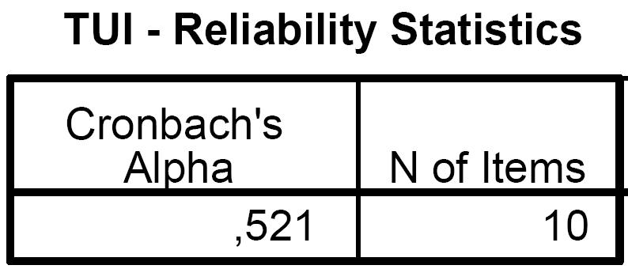
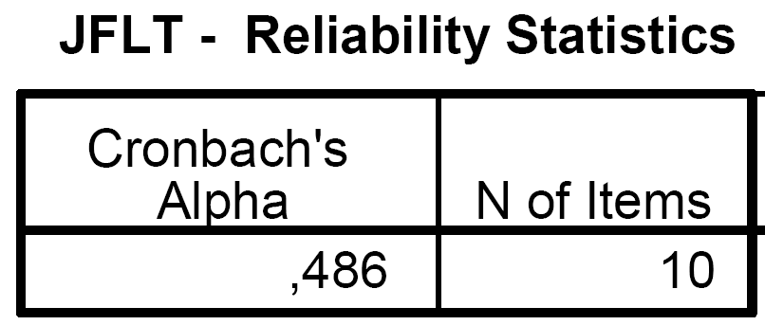
:
Procedures
Validity and
reliability
Cronbach's α (alpha): statistics used as a measure of the internal consistency reliability
Mini TUI
Mini JFLT
It will generally increase when the correlations between the items increase
Notes:
Validity and reliability studies of the two tests were carried out.
CLICK
Cronbach alpha coefficient was calculated to see how reliable the mini tests were and,
CLICK
As expected given the length of the test, the coefficients were very low..
Should anyone be interested in more information on this aspect, I would be more than happy to show additional slides at the end of the presentation.
CLICK

Slide 18
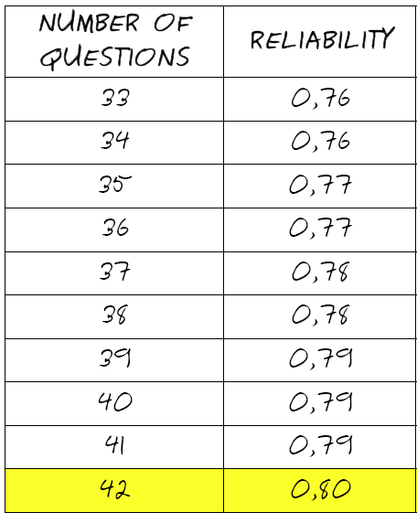
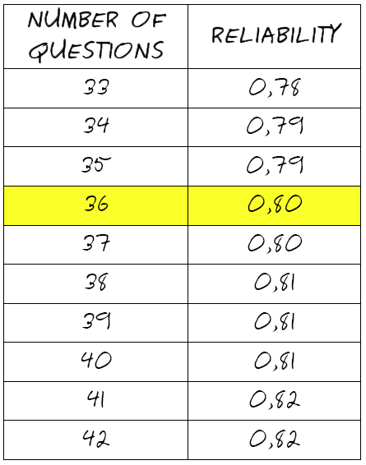
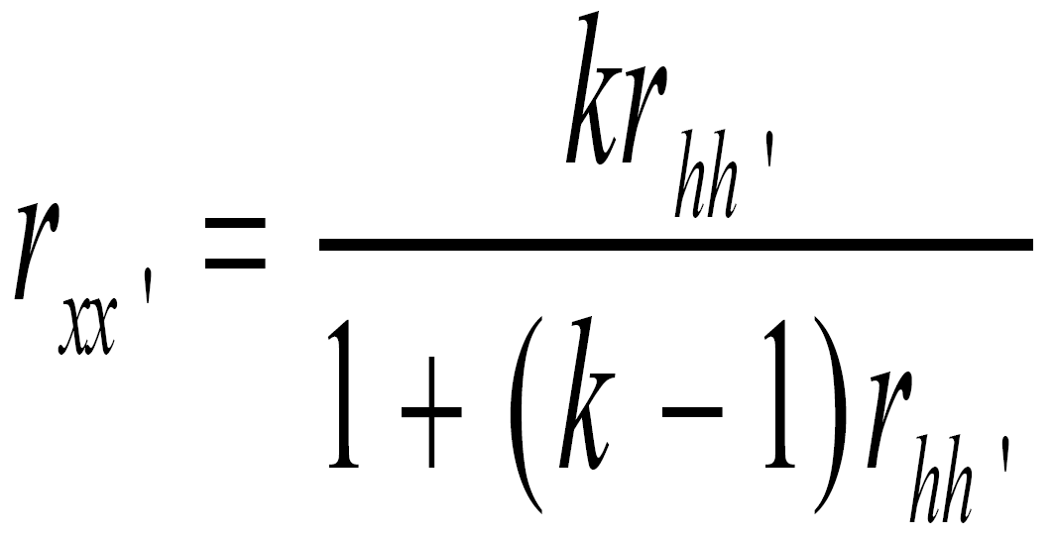
Spearman –Brown Prophecy
JFLT
TUI
Notes:
Used to ESTIMATE what level of reliability one would obtain by increasing the length the tests. The formula assumes that the additional items in the longer tests would be of equal reliability to the ones already in the tests

Slide 19
Procedures
:
paired t-samples
used to determine if two population means are equal.
example, a subject measured before and after a process change.
Notes:
Next, since we were dealing with ONE small group taking TWO different tests, the means on the tests were compared by using a statistical procedure called ‘paired t-samples’
This test was then used to determine if the two population means were equal.
CLICK
In this case study, the same sample was measured after having taken the two mini tests……. Soooo…. Same population, two different tests
CLICK

Slide 20
Procedures
Tests:
mini TUI and JFLTs
Verbal Protocol
Session
Notes:
A group of 16 students attending courses at the school were asked to volunteer their time after lessons to sit for the two mini tests
CLICK
and three of them were asked to give their contribution to a semi-mediated verbal protocol session.
CLICK

Slide 21
Procedures:
Verbal Protocol Session
to investigate thoughts and test strategies
turned into a semi-structured interview as students’ responses were probed in depth
Notes:
The verbal protocol session was conducted with the volunteers to investigate the thoughts and test strategies they adopted while responding to the test items.
CLICK
This verbal protocol then turned into a semi-structured interview as I delved into the students’ responses in depth.
CLICK

Slide 23
Background
Case Study
Procedures
Results
Notes:
What kind of results were obtained?
CLICK

Slide 24
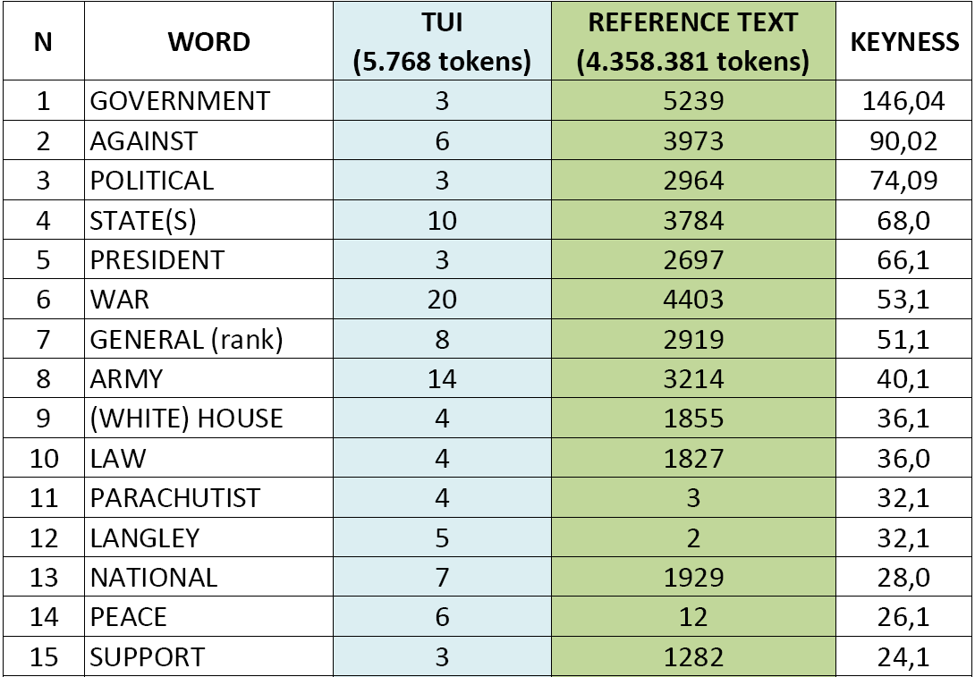
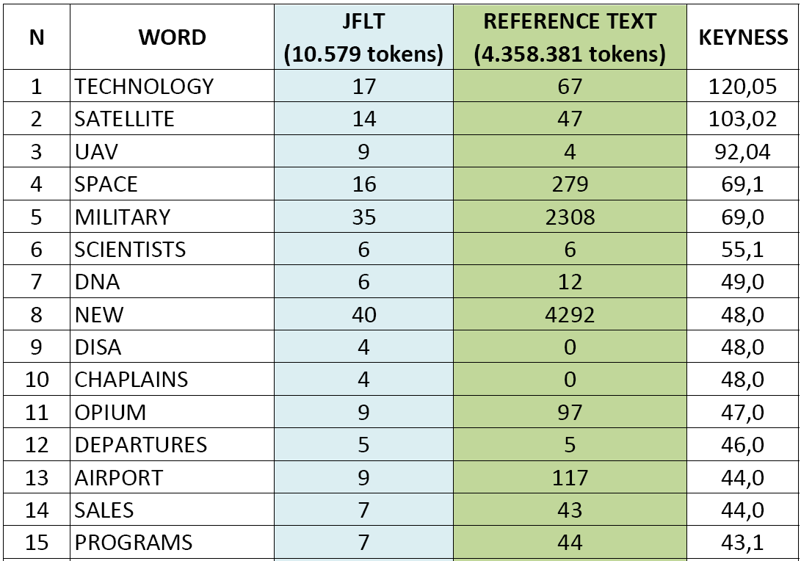
TUI
5000 words
JFLT:
10.000 words
Corpora
Results:
Notes:
First of all Keywords lists were created to locate, identify and analyse the words in the given texts;
CLICK
this was obtained by comparing the words in the small text (which was in turn the JFLT and the TUI) with the reference set of words taken from a larger corpus of more than 4 million entries I PERSONALLY created.
Then the software calculated both the frequency and the relevance, ...... the so told “keyness”
As easily inferred, key words give a reasonable clue of what the text is about. Therefore, any word deemed to be outstanding in its frequency in the text was considered "key".
Once again, time permitting, should anyone be interested I could show additional slides illustrating this aspect more in depth.
CLICK

Slide 25
Results:
Classical Item Analysis
FACILITY VALUE: FV
the % of people who get the item right
Notes:
The second step was to run classical item analysis, In particular the facility value and the discrimination index were calculated
CLICK
item analyses revealed that there were more items in the JFLT with higher facility values, that is the value which indicates how difficult or easy the item is for that test population
CLICK

Slide 26
how well the item
Distinguished
Between good and bad achievers
Classical Item Analysis
DISCRIMINATION INDEX: DI
how well an item distinguished between examinees who performed well on the overall test, and those who did not.
Notes:
The discrimination indices found, indicated once again that some items just did not discriminate properly between high achievers and low achievers. This could have been due to a number of reasons including ambiguous options.
CLICK

Slide 27
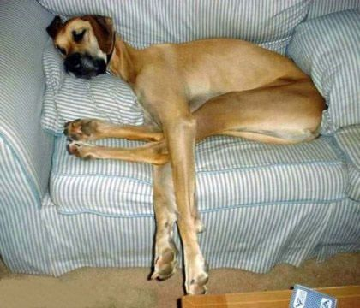
Yeah….
Right…

Slide 28
Results:
Paired t sample
difference btwn
the means of
JFLT and TUI
the difference in means is not due to chance
Notes:
The mean column in the paired-samples t test table,.............displays the difference in percentage between the means of the JFLT and the TUI measurements
CLICK
The second value highlighted in yellow is result of a calculation which renders the so called alpha level' o level of significance
The value of .00 IS SIGNIFICANT meaning that the results are not due to chance and that there is indeed a relation between them.
the In a nutshell what can be said is that this value for the different scores obtained on the two tests we can conclude that the average drop IN score IS due to chance variation, and can be attributed to the tests being different.
CLICK

Slide 29
Verbal Protocol Session
“... it is clear that you’ve got to avoid local strifes...”
“...I prefer being tested on familiar topics....”
Notes:
Test takers’ comments as they were responding to the two tests revealed the thought processes.
CLICK
One volunteer basically said that the texts had to do with basic military knowledge and even without reading the text, …… I am quoting: it’s clear that you’ve got to avoid local strives’ ………. which was the option he chose as the correct answer.
CLICK
The test takers also expressed their appreciation for being tested on familiar topics even if one volunteer in particular, also added that he did not know whether this was to be considered an advantage or a disadvantage.
CLICK

Slide 30
Verbal Protocol Session
TUI items
… seemed familiar and therefore easier to respond
JFLT items
must be read more carefully to choose the key.
Notes:
The verbal protocol and subsequent interview were transcribed and analyzed.
CLICK
The recurring comments that the students made when tackling mini TUI items was that the item seemed familiar and therefore easier to respond
CLICK
whereas when tackling mini JFLT items……….. especially those dealing with economic and/or geopolitical issues,……….. they seemed to have to read more carefully to find the correct answer.
CLICK

Slide 31
BUT…
JFLT was easier!!!
9 luglio 2009
31
Notes:
However,
the main observation that could be made was that, contrarily to what the students’ perceptions of the test were, their means on the tests indicated that they found the JFLT easier than the TUI. Statistically speaking, …. As we saw in the previous slides …….. these results were not due to chance alone.
CLICK

Slide 32
LIMITATIONS
Additional candidates and items
Over time and across skills
Correlation between topics and specific military background
Notes:
Although the results of this study may have shed some light on how topic selection can affect test performance whether positively or negatively, this research has some limitations ....NOT MANY.....just some…:
CLICK
Additional candidates and items would be needed since 16 volunteers are not a very statistically significant sample, and with 10 items the test is obviously too short
CLICK
The research should be conducted over time and over all across skills
CLICK
careful correlation studies should be carried out in terms of how students perform on specific military tasks and topics in relation to their military background and work experience.
CLICK

Slide 33
Davidson (1997):
ME WRITE TESTS
QUIT
WORK
MAKE
TESTS
“…. writing tests …….. is an ethical enterprise”
Notes:
as Davidson so rightly puts it,
CLICK
‘writing test is more than a technical activity,………. it is an ethical enterprise’;……… obviously, more research into this area should be conducted for the stakes involved, given the inferences made on the test scores and in turn, the decisions made on these inferences which affect test takers positively or negatively.
CLICK

Slide 34
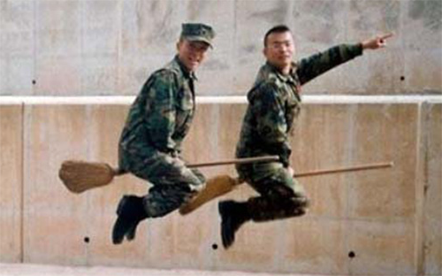
CONCLUSION
Topic knowledge
Creates A FALSE
sense of confidence
Notes:
The conclusion drawn was that prior knowledge of the topic, created a FALSE sense of confidence with the item affecting test performance negatively. It could very well be ………. that candidates answered the item according to their knowledge of the topic ………. rather than carefully reading the text and checking for the task they were being asked to perform.
Obviously this case study stemmed from a ‘hunch’ or ‘hypothesis’ …………….. that topical knowledge might in someway affect test performance and acting upon this ‘intuition’, a small study was conducted. Although limited, it is my belief that these tentative conclusions should be delved into more deeply.
CLICK

Slide 35
QUESTIONS?

Slide 36
QUESTIONS?

Slide 37
Thank You!!
canutesting@sclingue.esercito.difesa.it
francesco.gratton@gmail.com

