Slide 1



The Benefits of Local and Overseas Immersions

Slide 2
Immersion Philosophy
No duplication of things that can be done in the classroom at DLI

Slide 3
Glossary
BC Basic Course
DLPT Defense Language Proficiency Test
FLO Final Learning Objectives
FTX name of our local immersion facility
FY Fiscal Year
ILO Immersion Language Office
ISO Isolation
OCONUS Outside Continental United States
PEP Proficiency Enhancement Program
RA Research & Analysis
SITREP Situational Report

Slide 4
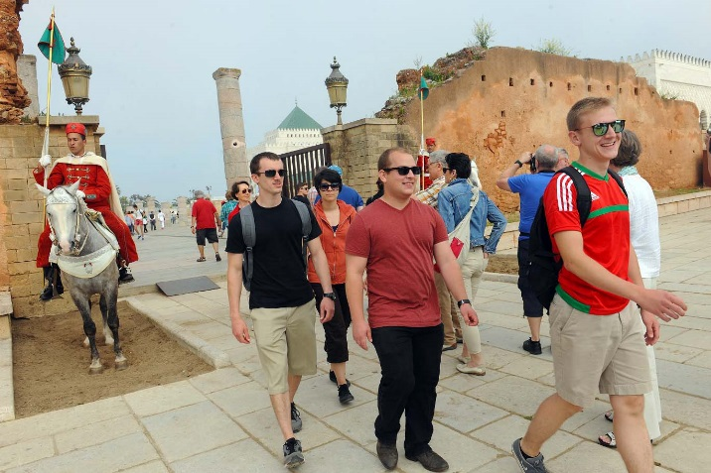
OCONUS Immersion
Country | # of Events | Country | # of Events
Korea | 84 | Russia | 3
Chile | 4 | China | 41
Jordan | 18 | Ukraine | 28
Puerto Rico | 29 | Egypt | 25
Morocco | 58 | Costa Rica | 1
Taiwan | 36 | Turkey | 5
Latvia | 14 | Philippines | 1
Spain | 2 | India | 1
France | 4
Tajikistan | 3
Uruguay | 1
Japan | 1
Germany | 1
CONUS | 2
From August 2005,
Thru 26 August 2015:
362 OCONUS programs
3,215 participants
21 countries/regions
70 +% for Arabic, Chinese and Korean

Slide 5
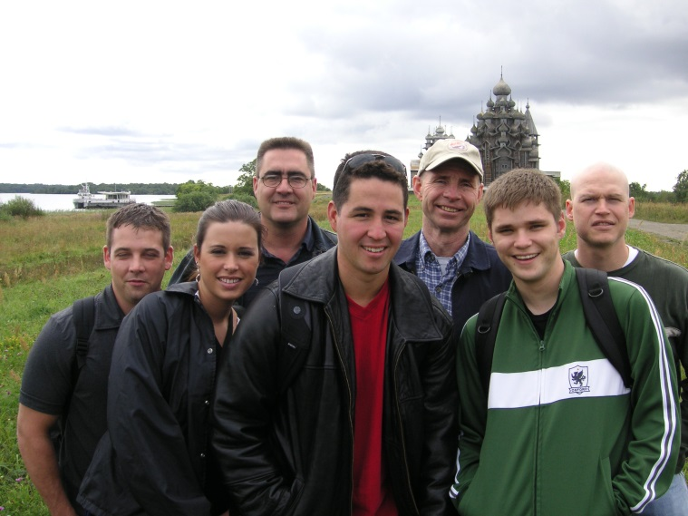
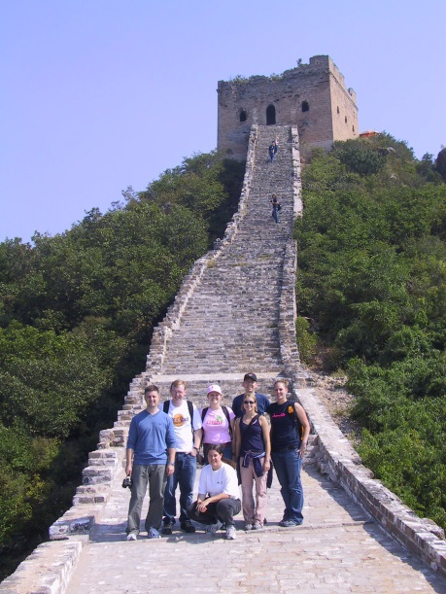
OCONUS Immersions Breakdown by FY
FY | Events | Participants
FY05/06 | 13 | 95
FY07 | 25 | 233
FY08 | 25 | 217
FY09 | 17 | 131
FY10 | 27 | 216
FY11 | 30 | 270
FY12 | 47 | 433
FY13 | 54 | 508
FY14 | 60 | 550
TOTAL | 297 | 2653

Slide 6
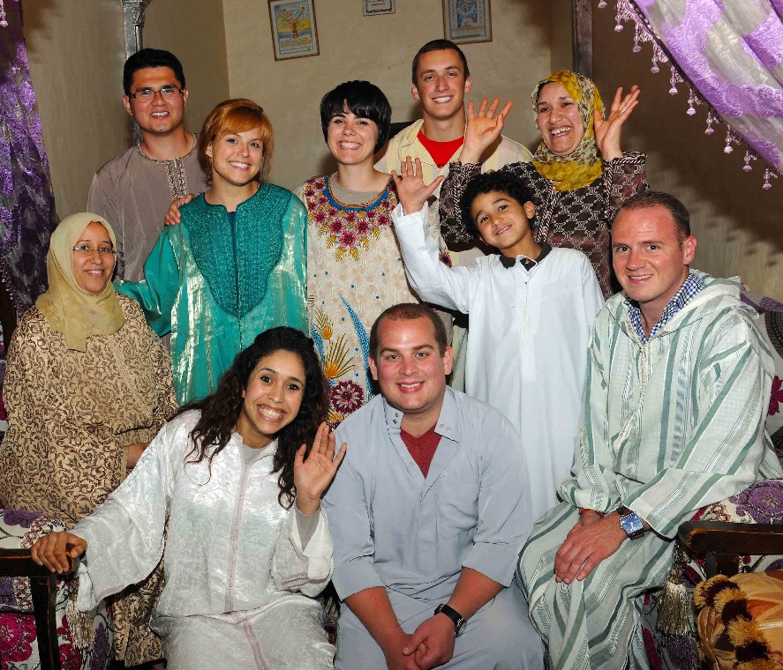
OCONUS Immersion Program Management
Pre-program:
  Identify and set up new sites
  Student selection
  Curriculum development
  Organization and Pre-departure briefings
During-program:
  Daily SITREP
Post-program:
  Documentation of students’ progress
    Diagnostic Assessment
    DLPT scores
    OCONUS Self-assessment Questionnaire
    After Action Reports
  Quality control and program improvement

Slide 7
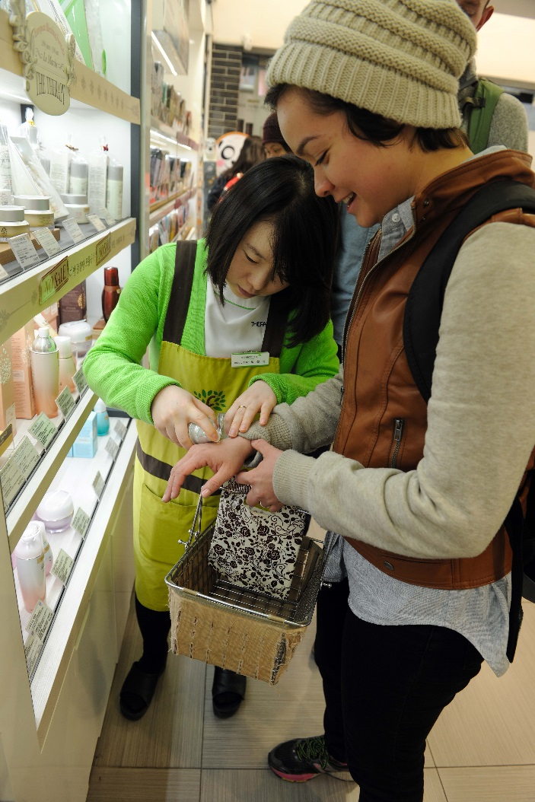
A Typical OCONUS Program
Program Length:
  4-6 weeks for Basic Course students
  2-4 weeks for Intermediate/Advanced
  students
Group Composition:
10 students, including a Group Leader
Timing of OCONUS immersions
  End of 2nd; beginning of 3rd semester

Slide 8
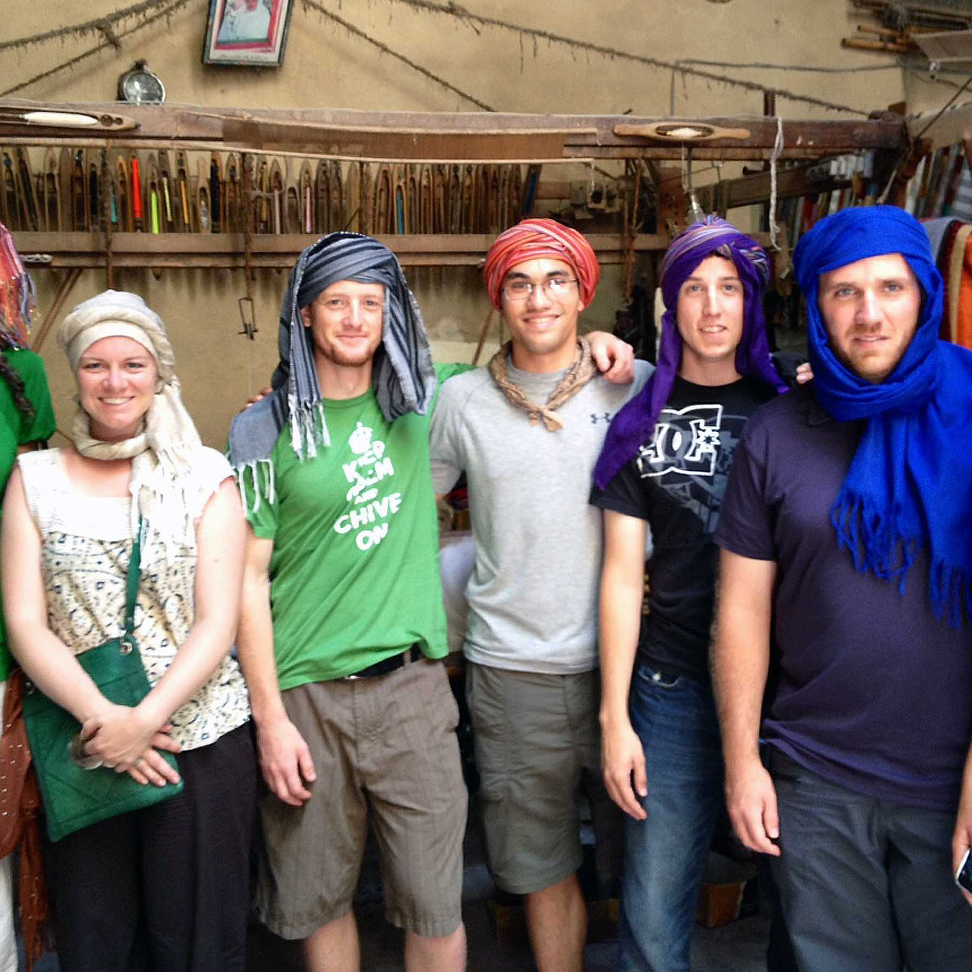
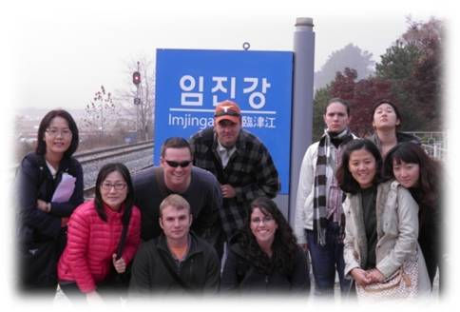
OCONUS Curriculum
30-35 instructional hours/week
1-2 hours daily homework
One-on-one tutoring
Guest-speaker lectures
and roundtable discussions
Weekend cultural excursions

Slide 9
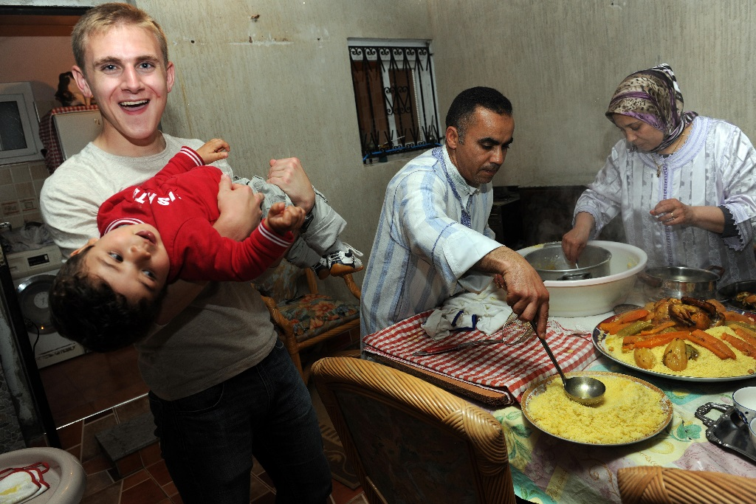
OCONUS Accommodations
Home-stays in:
  Korea, Morocco, Puerto Rico, Turkey, Latvia, Japan, Chile, Uruguay, France, Germany
On/off campus student housing (dorms, apartments, hotels)
  Taiwan, Puerto Rico, Jordan

Slide 10

OCONUS Immersions Effects on DLPT Scores
Study conducted in 2009 by RA at DLI:
  Randomized Student Selection, DLPT
  207 BC students
    Arabic (3 Egypt, 1 Jordan)
    Korean (4 Korea)
    Chinese (4 China)
  4 week immersion program
OCONUS Event | Control Group # of Ss | Immersion Group # of Ss
Arabic | 38 | 34
Chinese | 36 | 34
Korean | 28 | 37
TOTAL | 102 | 105

Slide 11
Major Findings (1)
A higher percentage of the Immersion students passed 2/2/1+ (92% vs. 78%) and 2+/2+/2 (41% vs. 33%)
  **Regardless of: Target language, DLPT version, Pep and non-pep, Gender, Recycle status, OCONUS timing

Slide 12
OCONUS Self-Assessment Results (N=1,110)
Confidence in using the language 3.62
Motivation in using the language 3.60
Understanding culture 3.60
Improving overall proficiency 3.58
Taking linguistic risks 3.56
Less anxiety in speaking to NS 3.55
Using communication strategies 3.53
Tolerance of linguistic unknown 3.39
Using available resources for learning 3.24
Making decisions about learning 3.18
4 = maximum benefits, 1 = minimum benefits

Slide 13
OCONUS Immersion: Student Quotes
Maj Herbert, William J. - Taiwan Immersion: “I took my DLPT this week, a little more than 10 months into the Chinese course. I got a 2+/2+. I really believe a lot of that is owed to the immersion experience.“
SGT Renee M. Green; Korea Immersion: "I thought the course content was excellent and the program really focused on explaining high level concepts in Korean. The program is well organized and the excursions and activities directly align with what is being taught which I thought was an effective teaching method: learn about it in the morning, experience it in the afternoon."

Slide 14
OCONUS Immersion: Student Feedback
Students participate in sensing sessions after each immersion event
Regardless of language or length of stay, responses are overwhelmingly positive
Students who experienced homestays were particularly excited about their immersion experience
Students share their experience with newer students and create anticipation for those who are still scheduled to go
With few exceptions, students tend to describe the immersion experience as a ‘life changing event’

Slide 15
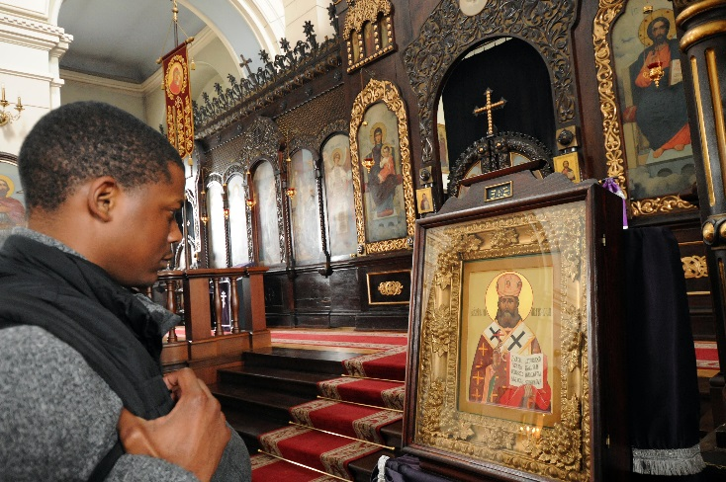
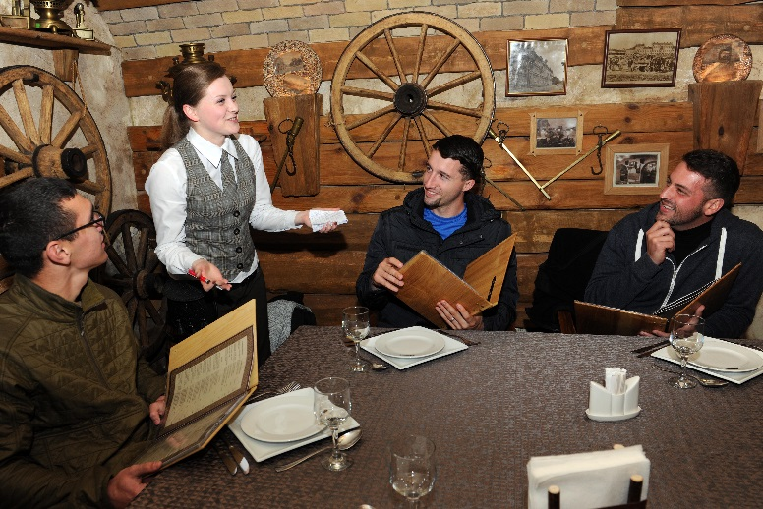
ILO Goals
20% in FY15
27% in FY16
50% by FY21
Establish new immersion sites that are culturally sound and safe
Enhance program quality by incorporating more Content Based Instruction (CBI)

Slide 16
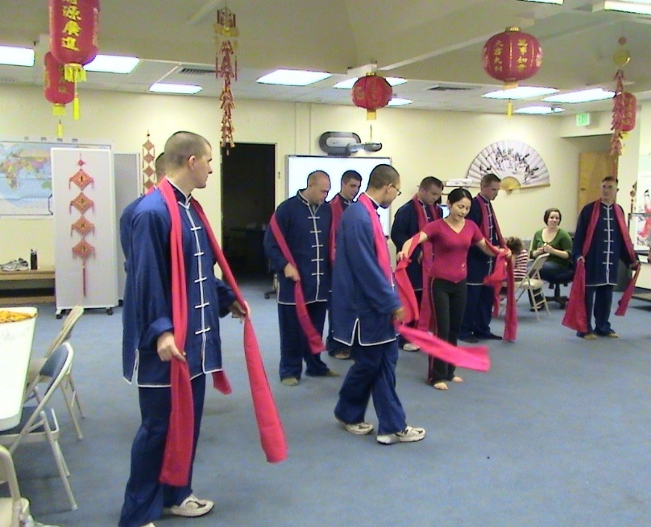
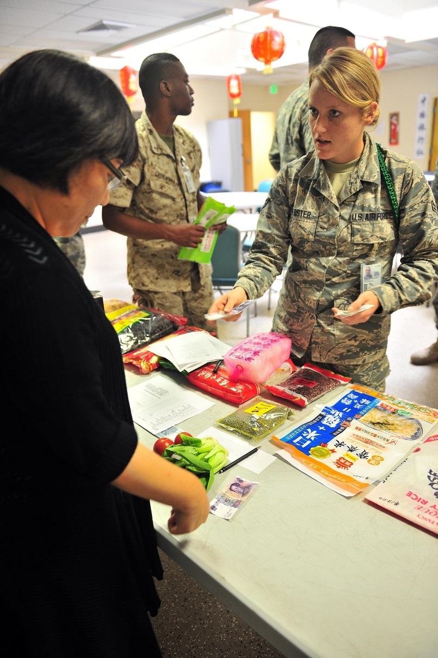
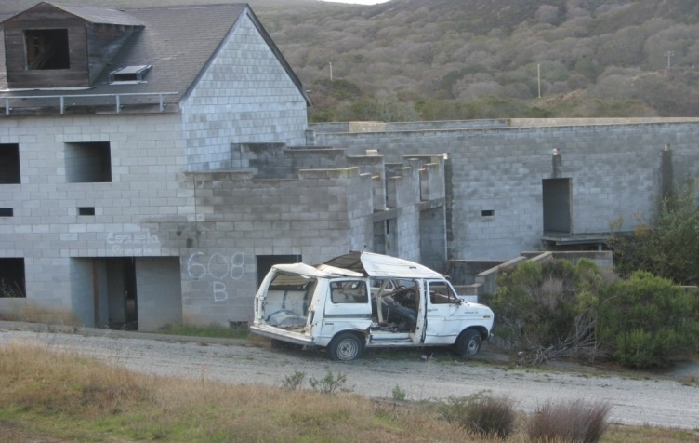
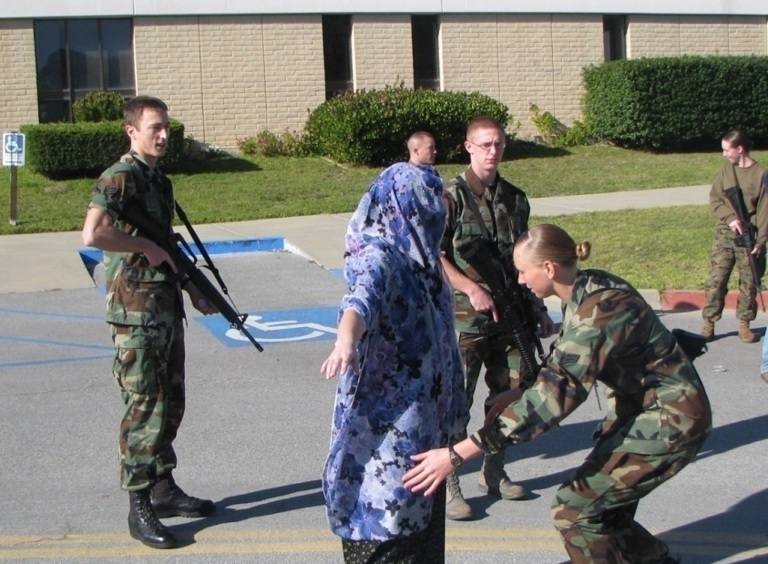
Iso-immersion Program

Slide 17
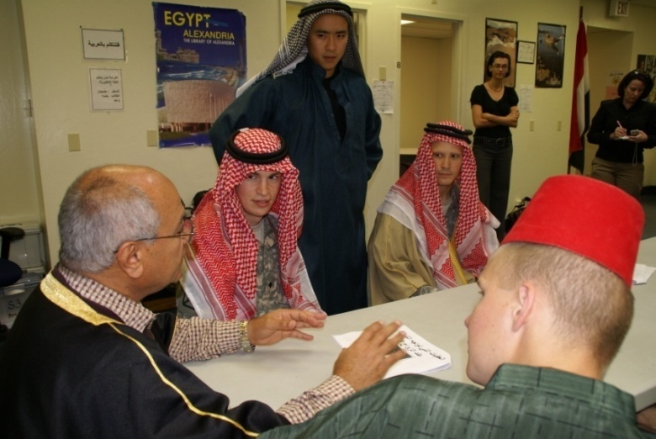
Iso-immersion Overview
History:
2003, first 3-day Iso-immersion conducted at DLI
2006, dedicated Immersion Facility, with overnight training
2010, “overnight” portion cancelled
2014, (starting FY15) reinstating overnight immersions
Iso-immersion Training:
Part of the basic curriculum for:
  Arabic
  Korean
  Chinese
  Russian
  Spanish
  Persian/Farsi
  Pashto
  French

Slide 18
Iso-immersion Summary by FY
Fiscal Year | Number of Events | Number of Students
2007 | 152 | 3,415
2008 | 183 | 3,713
2009 | 178 | 3,165
2010 | 213 | 3,688
2011 | 208 | 3,917
2012 | 252 | 4,295
2013 | 262 | 4,000
2014 | 253 | 4,002

Slide 19

Iso-immersion Activities Overview
Target Language Only
Expansion of classroom learning
Military and FLO content
Simulating real life
Problem solving
Exposure to culture

Slide 20
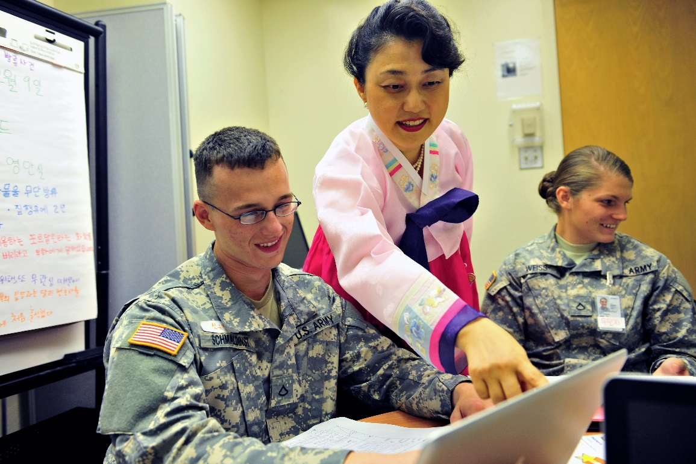
Activities with military content
Increase in military content since FY08
  Humanitarian Relief Operation
  Non-combatant Evacuation (NEO)
  Military to Military Joint Exercises
  Civil Affairs/ Reconstruction
  Base Camp Assessment
  Local Incidents

Slide 21
Student Feedback
Questions Immersion Student Opinion Questionnaire (ISOQ) | DLI Mean (FY06-FY12) No. = 23,722
1. Used listening skills during FTX. | 3.43
2. Used reading skills during FTX. | 3.01
3. Used speaking skills during FTX. | 3.63
4. Gained a better understanding of culture/language. | 3.02
5. Spoke target language only. | 3.14
6. Target language only policy was enforced. | 3.28
7. Improved comprehension ability in conversations. | 3.10
8. Increased speaking ability. | 3.08
9. Increased confidence in speaking the language. | 3.05
10. Reduced anxiety in speaking to native speakers. | 3.14

Slide 22
Iso-immersion: Student Feedback
“This one day was worth a month of classes because I was forced to communicate, rather than concentrate on being correct.” (Arabic Student)
“I got back from my China immersion a week ago and this was a similar environment.” (Chinese student)
“It was relieving to know that I can survive a day only in Chinese. I feel much more confident about speaking Chinese as a result.” (Chinese Student)
“The investigation into the Lebanese weapon smuggling was thoroughly enjoyable and we were able to use all skills.” (Arabic Student)

Slide 23
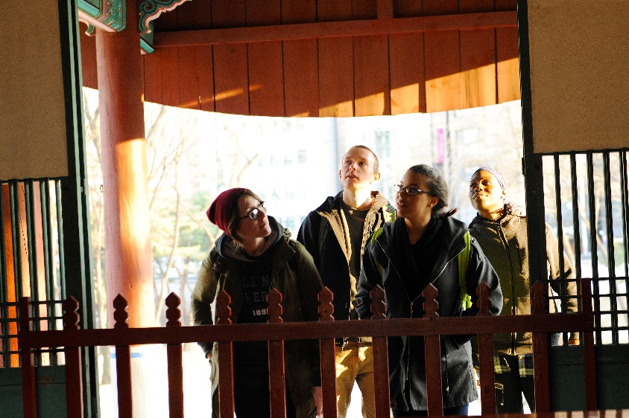
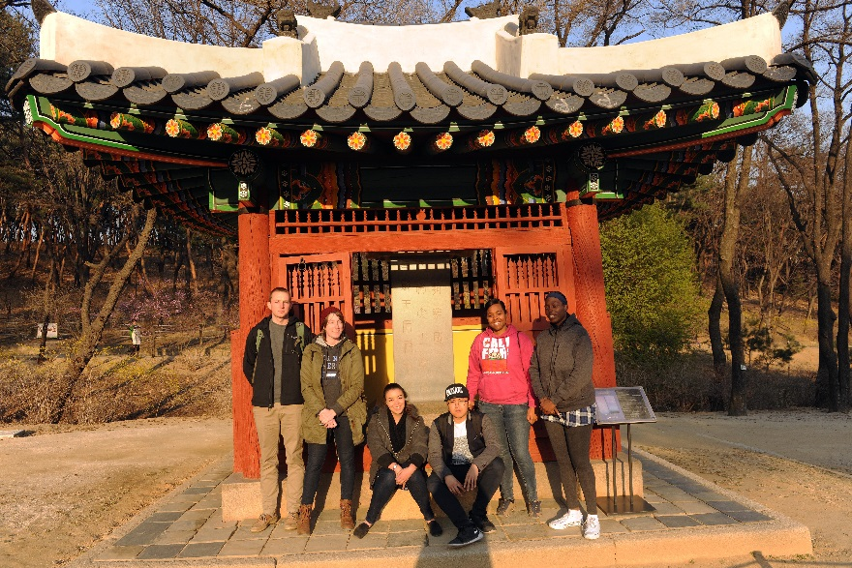
Iso-immersion
Student Feedback Cont’
The immersion experience is far superior to normal classroom activities as far as experience gained compared to time and energy expended. If these kind of evolutions could be included more in the curriculum of the language program, it would be of immeasurable value to the language student. (Korean student)
“I learned a lot about job related tasks and skills. It's refreshing to shy away from the textbook and experience challenging and job related activities.” (Korean Student)

