Slide 1
Instructor Performance Evaluation
Susan Butcher - Defense Language Institute English Language Center (DLIELC)
Notes:
Welcome
We are here to provide a brief introduction to the new Instructor Performance Evaluation at DLIELC and tell you about the process we used to develop and implement it.
Our hope is that you there will be elements of this process and the new system that will be applicable to any language teaching institution.

Slide 2
Agenda
FY 17 Overview of DLIELC
Background of Instructor Evaluation
2016 formation of Instructor Evaluation Working Group (IEWG)
Road to the Evaluation Rubric
Evaluation process
Rubric
Notes:
Agenda - Let them read it.
FY 17 Overview of DLIELC
Background of Instructor Evaluation
2016 formation of Instructor Evaluation Working Group (IEWG)
Road to the Evaluation Rubric
Evaluation process
Rubric

Slide 3
Overview of DLIELC – FY 17
Trained 3,019 students from 116 countries, including 713 US Army students and ROTC cadets
Graduation success rate: 96%
Average daily load: 707 students in 3 different sections
Peak number: 1,003 students (reached in May)
 | Total # Instructors | # assigned to classroom | T : S ratio
May | 204 | 138 | 1:5
Sept | 195 | 104 | 1:7
Notes:
Here are a few quick statistics about DLIELC to help you understand the background and scope of the project.
DLIELC teaches international military students from all over the world.
Typical student load 707 students
We have general English, Specialized English which is English for special purposes based on students’ technical career fields, Advanced English which caters mostly to EFL instructors
Typical instructor/student ration is around 1:6
Our 200+ instructors are evaluated twice per year.

Slide 4
Background/History
Replacing an evaluation format from the 1980s
Core docs (job descriptions) have changed
Several past initiatives to update evaluations
Perceptions of subjectivity
Time-consuming for supervisors
Issues with unannounced observations
Notes:
Here are some of the reasons why there was a need to replace the previous instructor evaluation process.
It was old! - Replacing an evaluation format from the 1980s
Our core personnel documents (which are our job descriptions) have changed several times
Several initiatives to update evaluation were started over the years, but due to mission requirements, they were not completed.
Many instructors perceived the system to be subjective, since there were no clearly stated standards for rating instructors
The process was very Time-consuming for supervisors who spend several hours on each observation
Unannounced observations were a point of contention

Slide 5
Road to the Rubric
Instructor Evaluation Working Group process:
Researched industry best practices
Defined a “Fully Successful” instructor as one who meets the rigorous core doc standards
Examined core doc for observable classroom duties
Surveyed supervisors for observation criteria
Observed in AE/SE/GE classes
Composed set of criteria for Evaluation
Tested rubric in AE/SE/GE classes
Notes:
This is the process we went through to develop the rubric that you are about to see.
Researched industry best practices and decided on criterion based rubric system.
Defined a “Fully Successful” instructor as one who meets the rigorous core doc standards (for other institutions this could be an instrcutors job descriptions or a list of standards and expectations for instruction)
Examined core doc for observable classroom duties - because not all core doc duties were related to classroom instruction or easily observable
Surveyed supervisors for observation criteria – we asked them what they look for in classroom observations
Observed in AE/SE/GE classes
Composed set of criteria for Evaluation
Tested rubric in AE/SE/GE classes

Slide 6
Participation
Instructor Evaluation Working Group :
4 instructors / 2 supervisors / 2 chiefs representing all areas of instruction
72 people attended weekly information sessions
9 focus groups: 15 supervisors and 43 instructors
27 supervisors conducted 54 validation trials
Created for teachers by teachers.
Notes:
Who participated in this process?
In 2016, Instructor Evaluation Working Group formed to update the process – 4 instructors, 2 supervisors, 2 chiefs representing all areas of instruction
72 people attended weekly information sessions - were we shared information about the project, collected questions and suggestions, solicited volunteers to participate in focus groups.
9 focus groups: 15 supervisors and 43 instructors
- The focus groups helped define evaluation criteria, provided examples, and revised evaluation procedures
27 supervisors conducted 54 validation trials of the rubric
The importance of giving you this information is to show that nearly half of the instructional staff participated in some way in this project.
This is important because….
we relied on the expertise of many talented teachers.
it gave people a sense of being involved and having a voice in the project
it gave people the information they need to feel more comfortable prior to this big change that will affect their career.

Slide 7
Significant Changes
Reduction in number of ratings from 5 to 3
Synthesis of 36 elements into 11 criteria
Development of detailed descriptors and examples for each rating for all 11 criteria
Addition of a post-observation conference
Automation of parts of the process
Notes:
This are some of the significant changes from the previous evaluation system:
Reduction in number of ratings from 5 loosely defined rating to 3 ratings with clearly defined standards
Simplified 36 elements into 11 criteria
Development of detailed descriptors and examples for each rating for all 11 criteria
Addition of a post-observation conference - with the purpose of gathering additional information about the class that was observed through dialogue between the supervisor and instructor.
The supervisor and instructor sit down and discuss the lesson - The supervisor asks questions about the lesson to gather more evidence and the instructor shares anything that he/she would like the supervisor to know about the lesson, the class, etc.
Automation of parts of the process -

Slide 8
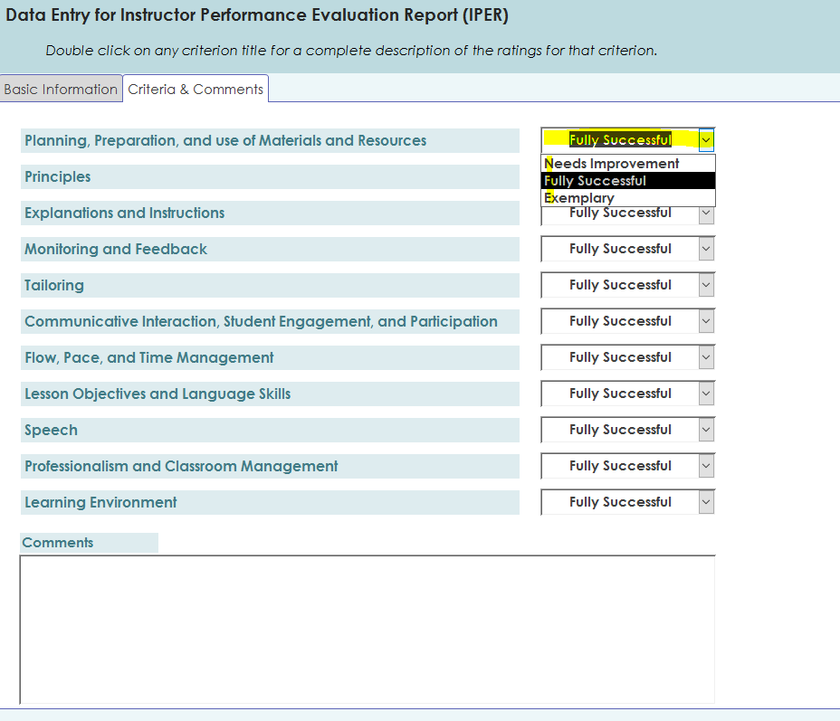
Notes:
This is what supervisor sees when entering ratings and comments into the system
The supervisor compares observation notes to the rubric descriptors and selects appropriate rating.
Click slide to make rubric appear.

Slide 9
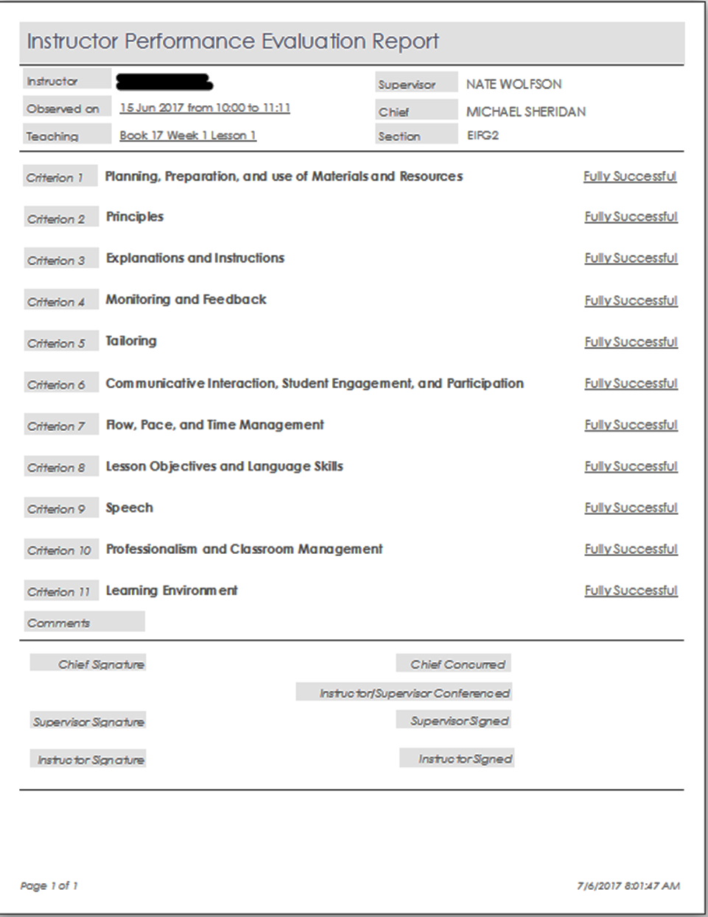
Notes:
This is what the evaluation report looks like.
Dates and signatures
11 individual ratings
comments (CLICK TO HIGHLIGHT) - Comments would be displayed here.

Slide 10
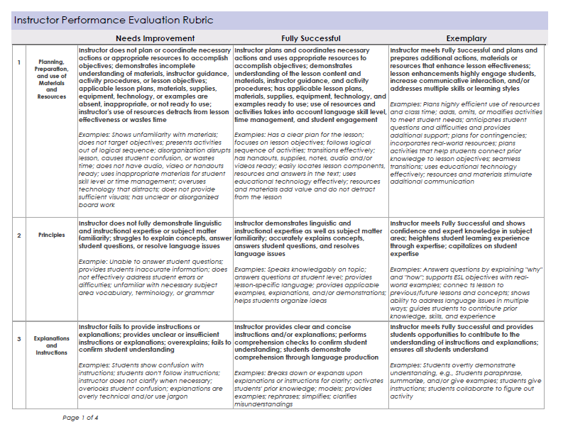
Why a rubric?
“It's essential that different individuals, using the same framework, can agree on the level of performance for what they observed . . . .”
-- Charlotte Danielson, expert in the design of teacher evaluation systems.
Notes:
Ask audience for answer. Why do we use rubrics?
Sample answers:
Standardization - A rubric gets everyone on the same page.
Set of standard criteria for evaluation
We use it to keep us focused on the performance standards established for us in the Core Doc.
Lets take a look at how the IPER rubric will help us do this.

Slide 11
The Rubric in Use
Observation tool
Evaluation tool
Criterion-referenced instrument
Professional development tool
Notes:
As an Observation tool –
We use it to collect evidence on classroom performance
It helps FOCUS observation on performance standards
As an Evaluation tool –
We use it to analyze evidence according to defined performance standards
As a Criterion-referenced instrument
it minimizes subjectivity and increases inter-rater reliability.
Using a rubric helps ensure (as much as possible) that no matter who is observing a class, the evaluation ratings will be the same.
As Professional development tool
It helps both instructors and supervisors set clear goals for daily classroom instruction and continuous improvement

Slide 12
Rubric Criteria Example #1
 |  | Needs Improvement | Fully Successful | Exemplary
1 | Planning, preparation, and use of Materials and Resources | Instructor does not plan or coordinate necessary actions or appropriate resources to accomplish objectives; demonstrates incomplete understanding of materials, instructor guidance, activity procedures, or lesson objectives; applicable lesson plans, materials, supplies, equipment, technology, or examples are absent, inappropriate, or not ready to use; instructor's use of resources detracts from lesson effectiveness or wastes time Examples: Shows unfamiliarity with materials; does not target objectives; presents activities out of logical sequence; disorganization disrupts lesson, causes student confusion, or wastes time; does not have audio, video or handouts ready; uses inappropriate materials for student skill level or time management; overuses technology that distracts; does not provide sufficient visuals; has unclear or disorganized board work | Instructor plans and coordinates necessary actions and uses appropriate resources to accomplish objectives; demonstrates understanding of the lesson content and materials, instructor guidance, and activity procedures; has applicable lesson plans, materials, supplies, equipment, technology, and examples ready to use; use of resources and activities takes into account language skill level, time management, and student engagement Examples: Has a clear plan for the lesson; focuses on lesson objectives; follows logical sequence of activities; transitions effectively; has handouts, supplies, notes, audio and/or videos ready; easily locates lesson components, resources and answers in the text; uses educational technology effectively; resources and materials add value and do not detract from the lesson | Instructor meets Fully Successful and plans and prepares additional actions, materials or resources that enhance lesson effectiveness; lesson enhancements highly engage students, increase communicative interaction, and/or address multiple skills or learning styles Examples: Plans highly efficient use of resources and class time; adds, omits, or modifies activities to meet student needs; anticipates student questions and difficulties and provides additional support; plans for contingencies; incorporates real-world resources; plans activities that help students connect prior knowledge to lesson objectives; seamless transitions; uses educational technology effectively; resources and materials stimulate additional communication
Notes:
Let’s look at how the rubric is organized and how it defines a set of performance standards?
DON’T READ CONTENT – FOCUS ON FORMAT
Let’s look at one criterion from the Rubric. “Planning, preparation and use of Materials and Resources”
Click slide to highlight parts of rubric one at a time.
• 11 criteria titles are along left side.
• 3 Ratings (across the top)
What do the ratings mean?
Fully Successful: Meeting rigorous standards of core doc. “Battle Ready” or “Good to go.”
Exemplary: Fully Successful plus... Going above and beyond… significantly improving learning experience for students.
This category was created through the participation of many instructors/supervisors in focus groups and through observing what many of our outstanding instructors do in the classroom on a daily basis
Needs Improvement: Does not meet core doc standards … therefore, unacceptable, requires further action.
Descriptors :
Bold text.
detailed descriptors define each rating criterion.
It is the description of a classroom performance that meets the core doc standards.
Performance is evaluated on the descriptor, not the italicized examples.
Examples:
Observable examples of what might be seen that fits the descriptor above it.
The examples are not intended to be all-inclusive.
There is no checklist of required lesson features nor will all examples be observed.

Slide 13
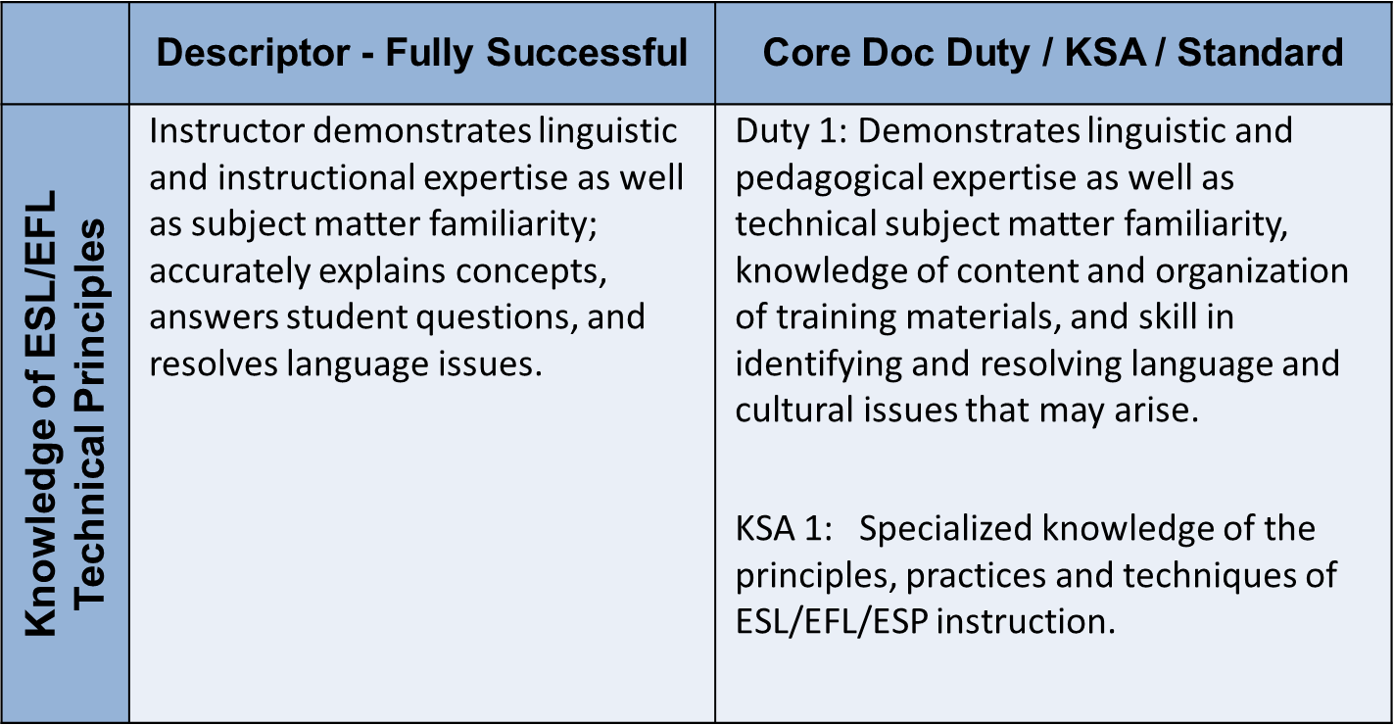
Fulfilling Core Doc Duties = ‘Fully Successful’
Notes:
This is an example of how the descriptors come directly from the core personnel document.
Give them time to read.
We tried to accurately reflect the essential elements of the core doc standards.
To do so we changed things that are difficult to observe like “knowledge” and “skill” to actions that we can see performed in the classroom, like “accurately explaining concepts” and “answering student questions”
KSA = Knowledge, Skills, Abilities

Slide 14
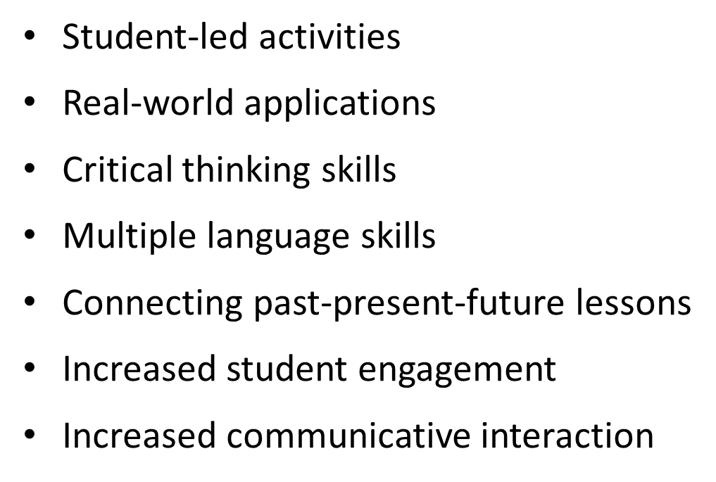
Trends found in ‘Exemplary’
Notes:
Delving a little bit deeper into exemplary, since this is probably where most instructors like to focus.
These are just some examples from Exemplary ratings.
• Student led activities
• Real-world applications
• Critical thinking skills
• Multiple language skills
• Connecting past-present-future lessons
• Increased student engagement
• Increased communicative interaction

Slide 15
What determines a rating?
Sustained
Significant
Prevalent
Central
Major
Key
Predominant
Consistent
Notes:
When the performance crosses into “Needs Improvement” or “Exemplary” is it enough to give that rating?
Performance elements from NI or Exemplary descriptors must have a significant impact on the class or the lesson to result in NI or Exemplary ratings within a given criterion.
The words on the slide—sustained, significant, prevalent, central, major, key, predominant, consistent—further illustrate the degree of impact on the lesson.
Demonstrating one thing in NI or Exemplary does NOT mean that the performance MUST receive that rating overall.

Slide 16
We all need people who will give us feedback.
That’s how we improve. -- Bill Gates

