Slide 1
BAT2: An Overview:
What has happened since 2003
Ray Clifford
STANAG 6001 Testing Workshop
3-5 September 2019
in Tours, France

Slide 2
We have been part of something miraculous!
We have kept the BAT international language testing project functioning since its conception in 2003.
We have done so with a lot of volunteers and very little money.
We have created professional testing workshops that are now regularly offered.
We have produced supporting documentation.

Slide 3
The BAT undertaking was…
Unprecedented and unmatched in:
  Scope.
  Duration.
  Teamwork.
  Innovation.
  Efficiency and Effectiveness
  Return on Investment.
  Measurable beneficial Impact.

Slide 4
How did this all begin?
2003. The idea of a Benchmark Advisory Test was first proposed at a BILC conference.
  Captured on hand-drawn transparencies.
  Projected on an overhead projector in a general session.
2006. A survey was conducted on the desirability of creating a BILC-sponsored, “benchmark” test with advisory ratings.

Slide 5
Summary of Survey Results
A “benchmark” test would be welcomed by most countries.
(The scores should be advisory in nature.)
Providing “plus” level ratings would allow greater fidelity in making comparisons.
BILC should proceed with plans to:
  Develop a benchmark STANAG test of reading comprehension.
  Explore internet delivery options.

Slide 6
The Benchmark Advisory Test Project Was Formally Launched in 2006
A concept plan was completed in 2006.
Item development began with a BILC Study Group, which became a Working Group in 2008.
This Working Group was diverse.
  13 members from 8 nations participated.
  And many more nations submitted test items.

Slide 7
2008. NATO Allied Command Transformation (ACT) added funding.
BAT-S: Oral Proficiency Interview by Phone
BAT-W: Writing Proficiency Test by Internet
BAT-L: Listening Proficiency Test by Internet
BAT-R: Reading Proficiency Test by Internet
Notes:
7

Slide 8
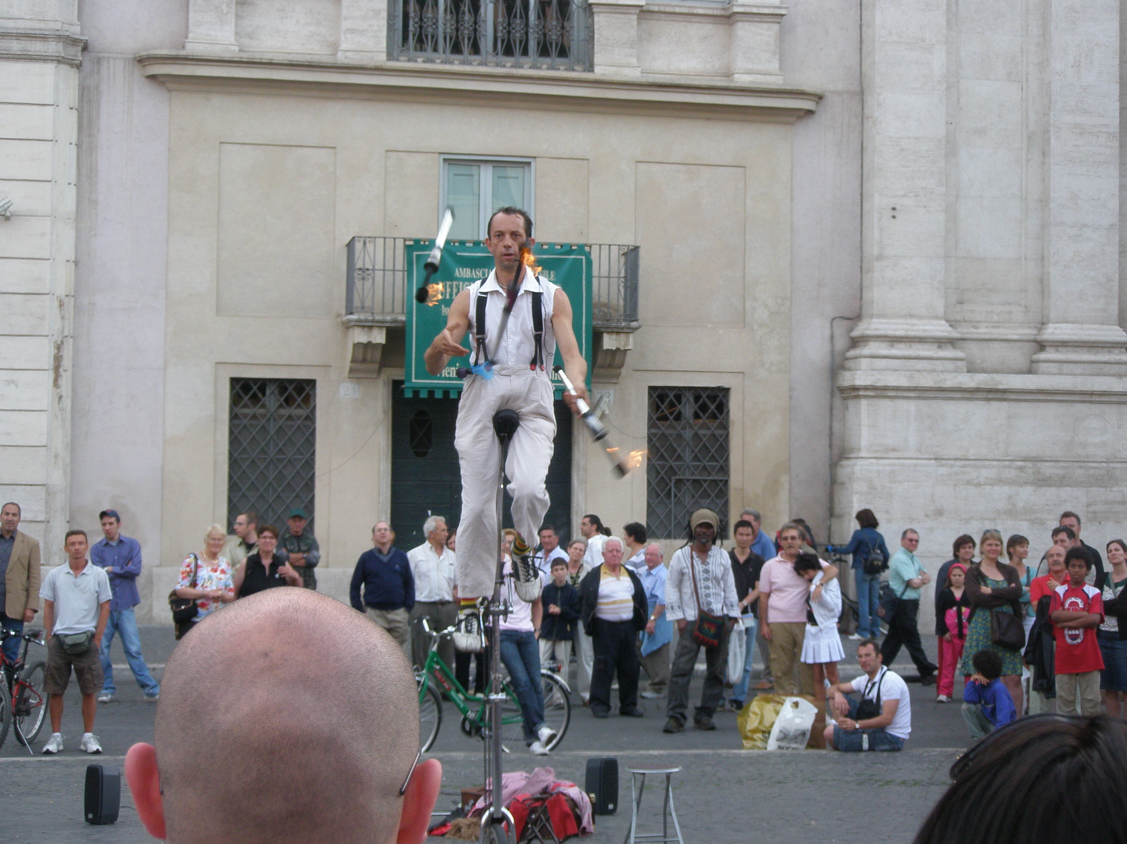
BAT then became a high-level project that required a lot of juggling…

Slide 9
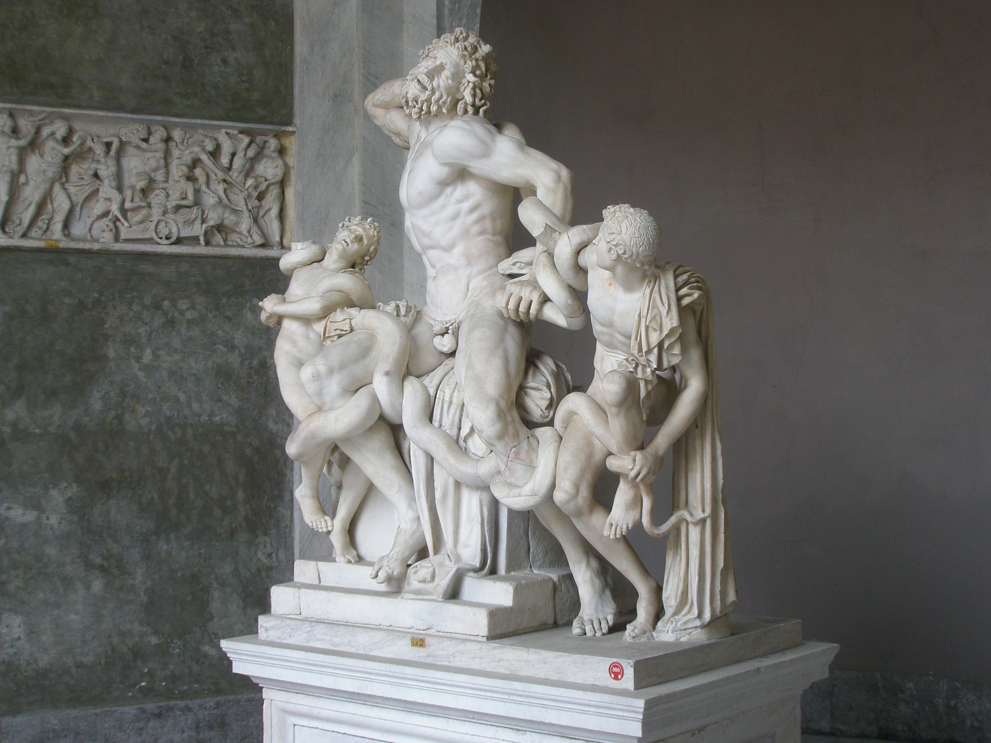
Fortunately, we had hard-working volunteers…

Slide 10

who were able to get ahead,…

Slide 11
and they were not afraid to innovate!
BAT used a fully integrated, criterion-referenced model that would:
  Be applied across all of the BAT design, development, and scoring activities.
  Allow direct application of the STANAG 6001 Proficiency Scales
  Demonstrate construct validity without the need for a large number of test takers.

Slide 12
As pointed out by Richard Luecht*
(a cognitive psychologist at the
University of North Carolina at Greensboro)
“… establishing the necessary links between constructs and test scores is, fundamentally, a design problem that requires careful alignment of potentially [usually] incongruent models.”
“Three of these models are:
  (1) the theoretical construct model,
  (2) the test development model,
  (3) the psychometric scoring model.”
* “Multistage Complexity in Language Proficiency Assessment, Foreign Language Annals, Vo. 36, No. 4, p. 527 (2003)

Slide 13
Using a CR approach solves a scoring problem that arises whenever one tests Reading and Listening proficiency.

Slide 14
A Traditional Method
Of Setting Cut Scores
100
50
0
Level
3
Group
Groups of ”known” ability
Test to be calibrated
Level
2
Group
Level
1
Group

Slide 15
The Results One Hopes For:
Distinct “cut” scores between the scores of the calibration groups
Level
3
Group
100
50
0
Groups of “known” ability
Level
2
Group
Level
1
Group

Slide 16
The Results One Always Gets:
100
 | ???
 | ???
50
 | ???
 | ???
0
Level
3
Group
Groups of ”known” ability
Level
2
Group
Bands of Overlapping Test Scores
Level
1
Group

Slide 17
No matter where the cut scores are set, they are wrong for someone.
100
 | ???
 | ???
50
 | ???
 | ???
0
Level
3
Group
Groups of ”known” ability
Level
2
Group
Where in the overlapping range should the cut score be set?
Level
1
Group

Slide 18
Why does this “overlap” in total test scores occur?
The test design is not aligned with the multilevel construct.
  Each level is not being tested separately.
The scoring method is not aligned with the construct.
  Each level is not being scored separately.
  Tests which yield a single, total score are using the equivalent of an average score across all parts of the test.

Slide 19
Criterion-Referenced Tests
Measure each proficiency level separately.
  Three separate tests for levels 1 through 3.
  Or three subtests within a longer test.
Rate ability at each level separately.
Use a “floor” and “ceiling” approach, and check for sustained ability at each level.
May also use a within-level scale such as:
  Sustained (consistent evidence) = 70% to 100%
  Developing (present, inconsistent) = 55% to 65%
  Emerging (some limited evidence) = 30% to 50%
  Random (occasional evidence) = 0% to 25%
Notes:
19

Slide 20
To have direct evidence of a C-R test’s validity requires full alignment, including level-by-level scoring.
What: | = | How Tested: | = | How Scored:
STANAG |  | Aligned Test Design |  | Score Each Level | & | Pick the Highest Level Passed
Level 3 |  | Level 3 Test |  | Level 3 Score |  | Passed at 3 ?
Level 2 |  | Level 2 Test |  | Level 2 Score |  | Passed at 2 ?
Level 1 |  | Level 1 Test |  | Level 1 Score |  | Passed at 1 ?

Slide 21
Not having separate scores leads to inaccurate language test results, because:
Language learners do not completely master one proficiency level before they begin learning the skills described at the next higher level, artificially raises scores.
Language learners develop conceptual control or even partial control over the next higher proficiency level by the time they have attained sustained, consistent control over the lower level, artificially raises scores.

Slide 22
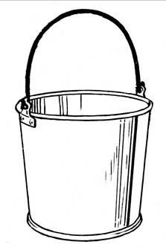
STANAG 6001 Levels are like buckets; how much water is in each bucket is more important than how much total water there is.
The blue arrows indicate the water (ability) level observed at each level for a Level 1 speaker.
3
2
1
Some Level 2 skills will develop before Level 1 is mastered and some Level 3 skills will develop before Level 2 is mastered.
But the buckets will still reach their full (or mastery) state sequentially.

Slide 23
C-R scoring always requires a score for each criterion!
Consider for example, a Reading test like the BAT Reading test which was designed
  To test three different proficiency levels,
  Using 60 test items,
  With 20 test items at each level.

Slide 24
Total-Score Results vs Criterion-Referenced Results: Total “water” versus “water distribution”
 | Level 1 Results | Level 2 Results | Level 3 Results | Total Score | C-R Level
Alice |  |  |  | 45 | ?
Bob |  |  |  | 45 | ?
Carol |  |  |  | 45 | ?

Slide 25
Total-Score Results vs Criterion-Referenced Results: Total “water” versus “water distribution”
 | Learner Results @ Level 1 | Learner Results @ Level 2 | Learner Results @ Level 3 | Total Score | C-R Level
Alice | 16 Sustained | 15 Sustained | 14 Sustained | 45
Bob |  |  |  | 45
Carol |  |  |  | 45
Notes:
25

Slide 26
Total-Score Results vs Criterion-Referenced Results: Total “water” versus “water distribution”
 | Learner Results @ Level 1 | Learner Results @ Level 2 | Learner Results @ Level 3 | Total Score | C-R Level
Alice | 16 Sustained | 15 Sustained | 14 Sustained | 45 | 3 (Barely)
Bob |  |  |  | 45
Carol |  |  |  | 45
Notes:
26

Slide 27
Total-Score Results vs Criterion-Referenced Results: Total “water” versus “water distribution”
 | Learner Results @ Level 1 | Learner Results @ Level 2 | Learner Results @ Level 3 | Total Score | C-R Level
Alice | 16 Sustained | 15 Sustained | 14 Sustained | 45 | 3 (Barely)
Bob | 20 Sustained | 20 Sustained | 5 Random | 45
Carol |  |  |  | 45
Notes:
27

Slide 28
Total-Score Results vs Criterion-Referenced Results: Total “water” versus “water distribution”
 | Learner Results @ Level 1 | Learner Results @ Level 2 | Learner Results @ Level 3 | Total Score | C-R Level
Alice | 16 Sustained | 15 Sustained | 14 Sustained | 45 | 3 (Barely)
Bob | 20 Sustained | 20 Sustained | 5 Random | 45 | 2 (Clearly)
Carol |  |  |  | 45
Notes:
28

Slide 29
Total-Score Results vs Criterion-Referenced Results: Total “water” versus “water distribution”
 | Learner Results @ Level 1 | Learner Results @ Level 2 | Learner Results @ Level 3 | Total Score | C-R Level
Alice | 16 Sustained | 15 Sustained | 14 Sustained | 45 | 3 (Barely)
Bob | 20 Sustained | 20 Sustained | 5 Random | 45 | 2 (Clearly)
Carol | 20 Sustained | 13 Developing | 12 Developing | 45
Notes:
29

Slide 30
An Example of Total-Score Results vs Criterion-Referenced Results
 | Learner Results @ Level 1 | Learner Results @ Level 2 | Learner Results @ Level 3 | Total Score | C-R Level
Alice | 16 Sustained | 15 Sustained | 14 Sustained | 45 | 3 (Barely)
Bob | 20 Sustained | 20 Sustained | 5 Random | 45 | 2 (Clearly)
Carol | 20 Sustained | 13 Developing | 12 Developing | 45 | 1+ ( 1 with developing abilities @ Level 2)
Notes:
30

Slide 31
As we have seen, scores on Criterion-Referenced tests can be more informative than a single overall test score.
However with the original BAT study, we couldn’t take advantage of that information.

Slide 32
With the original BAT project in 2009, we only had overall results.
An Example | National Test | BAT
Level 3 | 10 | 5
Level 2 | 10 | 10
Level 1 | 10 | 15
Does this pattern 25 (5+10+10) of 30 = 83% agreement?

Slide 33
Overall Comparisons are Overstated
An Example | National Test | BAT
Level 3 | 10 | 5
Level 2 | 10 | 10
Level 1 | 10 | 15
Does 5+10+10 = 25 / 30 => 83% agreement? No, because the people don’t match!

Slide 34
Overall Comparisons are Overstated
An Example | National Test | BAT
Level 3 | 10 | 5 1 match @ 3
Level 2 | 10 | 10 4 matches @ 2
Level 1 | 10 | 15 5 matches @ 1
1+4+5=10 exact matches for 30 people => 33% -- not 83% -- agreement!

Slide 35
With BAT2 in 2019, we have person-by-person comparisons.
And the positive impact of 10 years of collaboration and training is evident.
Note the tight “shotgun pattern” produced by the following comparison graphs.

Slide 36
BAT2 & National Reading Results
 | National Reading |  |  |  |  |  |  |  | Total
BAT2 Reading |  | 0 | 0+ | 1 | 1+ | 2 | 2+ | 3
 | 3 |  |  |  |  | 2 | 8 | 51 | 61
 | 2+ |  |  |  |  | 7 | 7 | 18 | 32
 | 2 |  |  |  |  | 9 | 4 | 5 | 19
 | 1+ |  |  |  | 1 | 24 | 11 | 12 | 49
 | 1 |  |  |  | 2 | 8 | 3 | 6 | 17
 | 0+
 | 0
Total |  | 0 | 0 | 0 | 3 | 50 | 33 | 92 | 178

Slide 37
BAT2 & National Listening Results
 | National Listening |  |  |  |  |  |  |  | Total
BAT2 Listening |  | 0 | 0+ | 1 | 1+ | 2 | 2+ | 3
 | 3 |  |  |  |  | 7 | 7 | 53 | 67
 | 2+ |  |  |  |  | 12 | 8 | 18 | 38
 | 2 |  |  |  |  | 6 | 7 | 6 | 19
 | 1+ |  |  |  | 1 | 16 | 8 | 8 | 33
 | 1 |  |  |  | 1 | 7 | 3 | 0 | 11
 | 0+ |  |  |  |  | 1 | 5 | 1 | 7
 | 0 |  |  |  |  | 2 |  | 1 | 3
Total |  | 0 | 0 | 0 | 2 | 51 | 38 | 87 | 178

Slide 38
We are pleased (even ecstatic) about our progress toward comparability, but we are not satisfied with the status quo.
The non-random variance (the pattern of mismatches) in the preceding charts indicates that the national test results were generally higher than BAT2 results.
Students reported that…
  the test passages in the national tests were shorter than the passages in BAT2.
  On the BAT2 Reading, they were not given enough time.

Slide 39
Some Ways Agreement Might be Improved
Use a “BAT” with more test items and more time per item.
Add additional instructions in the booklet “BILC Best Practices in STANAG 6001 Testing” about:
  The relationship between text types and passage lengths.
    Loosely connected sentences / 50-60 Words
    Cohesive paragraphs /150-180 Words
    Cohesive extended text / 300-400 Words
  How difficult it is to align items with the author’s purpose and at the same time maintain item independence – which is why it is easier to use one question per passage.
  The need for increasingly nuanced item responses as one moves up the proficiency scale.

Slide 40
That’s for the Future…
Today we should celebrate our accomplishments!

Slide 41
We are Miracle Workers
!
Maybe we need a new BILC badge?

