Slide 1
Language Proficiency Assessment Detlev Kesten Associate Provost, Academic Support

Slide 2
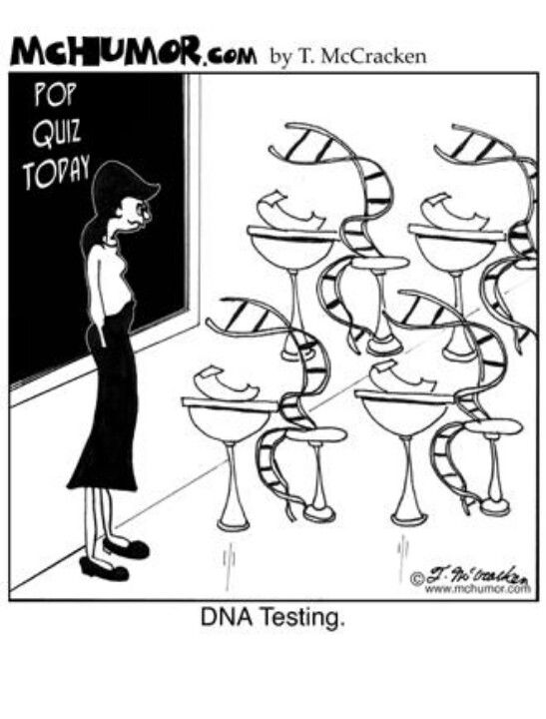

Slide 3
DLPT Scope (DODI 5160.71)
… the DLPT System is the only test battery authorized for assessing an individual’s proficiency in a foreign language and for determining qualification for receiving a Foreign Language Proficiency Bonus (FLPB) for military personnel …
Notes:
High Stakes tests – determine job suitability and pay.

Slide 4
Linguistic Testing
Notes:
(Video file: 20150623_PPS5_Testing.wmv)

Slide 5
Interagency Language Roundtable (ILR)
The following website explains the various ILR levels DLIFLC uses to determine a student’s proficiency level:
http://www.govtilr.org/Skills/ILRscale2.htm

Slide 6
Glossary of Terms
CRT – Constructed Response Test
DLPT – Defense Language Proficiency Test
FLPB – Foreign Language Proficiency Bonus
ICPT - In Course Proficiency Test
ILR – Interagency Language Roundtable
MCT – Multiple Choice Test
OPI – Oral Proficiency Interview

Slide 7
LPAD Mission Statement
Develop, validate, administer, sustain, and assess results of standardized language proficiency tests; educate on standards and evaluate student feedback, all in support of the Defense Foreign Language Program.

Slide 8
LPAD Org Chart
Director,
Language Proficiency Assessment
Deputy Director
Technology
Evaluations Division (EV)
Oral Proficiency Standards Division (PSD)
Test Review and Education Division
(TRE)
Test Management Division
(TM)
Test Production Division
(TP)
Test Analysis and Design Division
(TAD)

Slide 9
Summary of LPAD Functions
TP: Produce language proficiency assessments in Listening and Reading Comprehension.
TRE: Review test items and train faculty and staff in ILR.
TAD: Design and analyze the performance of language proficiency assessments.
PSD: Certify and manage the performance of Oral Proficiency Interview (OPI) testers.
TM: Schedule and administer DLI graduation tests and external OPI.
EV: Survey students and report statistics and red-flags.
Technology: Design and maintain automated solutions for language testing business processes.

Slide 10
DLPT Lifecycle
NEEDS ANALYSIS
LESSONS LEARNED
TEST SPECS
PLANNING
MAINTAIN EVALUATE
FRAME WORK
QA / QC
Ethical Practices
IMPLEMENTATION
DEVELOPMENT
DEPLOY TEST
STANDARD SETTING
PRETEST & ANALYZE
DEVELOPMENT

Slide 11
Test Production
Test platforms:
Multiple Choice (MCT) – high volume (>200/yr).
Constructed Response (CRT) – low volume.
Standard development latency: ~30 months.
Standard development cost (Listening + Reading): ~$1.25M.
Sustainment and Computer Adaptive Tests require pools of characterized items:
Generated via automatic seeding of new items in the released test forms.

Slide 12
Test Review and Education
Conduct independent target language reviews of each test-item set for correctness, completeness, appropriateness, and adherence to specified ILR levels.
Provide Text Typology and Passage Rating training under the ILR Guidelines to all DLPT5 test developers, independent reviewers, and DLIFLC faculty (by request).
Represent DLI at the ILR testing work-group with various government agencies and international partners which continues to refine the specifications.

Slide 13
Test Analysis & Design
Coordinate DLPT design initiatives:
DLPT5 Validity Framework
What do DLPT scores mean? How should they be used?
Item Bank Specification
Are we asking the right questions?
Web-Based Field Testing
Can we obtain a representative sample of examinees to calibrate items?
Small-n Standard Setting Study
How do we set passing scores without item parameter data?

Slide 14
Test Analysis & Design
Conduct statistical analysis of:
Item response data
Do test items perform within specified tolerances?
Test form reliability
Are results on different test forms equivalent?
Standard setting cut score recommendations
Are cut scores fair, reliable and valid?
Examinee comments / feedback
Have examinees expressed actionable concerns?
Item bank characteristics
What is the distribution of content across the range of difficulty?

Slide 15
Proficiency Standards Division
Train and certify select faculty as OPI testers at DLIFLC.
Provide orientation training for DLIFLC faculty on the ILR and OPI.
Ensure appropriate interpretation and uniform implementation of the ILR at DLIFLC and the DLIFLC contract entities.
Provide quality assurance that OPI testers (DLIFLC and contract) are providing consistently fair and accurate assessments.

Slide 16
Test Management Division
Schedule, test, and report results for DLIFLC resident students.
Grade all Constructed Response Tests administered.
FY15 volume: DLPT (RC+LC)@ DLI: 8,237 (Worldwide: ~123,000); OPI: DLI: 2,979, External: 18,827; ICPT: 10,745; CRT Grading: 10,193.
Test capacity: 5 DLPT test labs; 7 OPI studios.
New semester-based scheduling requires 3 additional OPI studios.

Slide 17
Evaluation Division
Provide DLIFLC leadership with valid and reliable evaluative information.
Outcomes (FY15):
5,630 ISQ/ESQ Evaluation surveys.
127 Red Flag reports.
218 Snapshot reports.
216 Attrition surveys.
394 Non-Resident Surveys.

Slide 18
Technology
DOMINO (Test Item Development and Workflow Automation System)
Centralized and version controlled system hosting 49 DLPT5 development projects
52 active users
7,670 test passages; 11,464 test items
Enforces standardized workflow and task assignment processes
Expanding for contractor-model of DLPT item development, Psychometric support and direct reporting

Slide 19
Technology
SharePoint
Platform for ongoing DLPT5 External Review contract
150 active users
5,008 test items
Repository of previously contracted DLPT5 items
32,952 test items
TDMS (Test Management System)
Automatic scheduling and scoring processes for OPI and DLPT
Repository of score data
Expanding to support Psychometric Item-Response data requirements

Slide 20
Questions
Comments
Discussion

