Slide 1
MAKING THE LEAP FROM
LEVEL 2 TO LEVEL 3

Slide 2
MAKING THE LEAP FROM LEVEL 2 TO LEVEL 3
THE MILITARY ACADEMY OF SAINT CYR COËTQUIDAN

Slide 3
MAKING THE LEAP FROM LEVEL 2 TO LEVEL 3
WHAT DO WE TEACH?
An academic programme
3 branches: Science and Engineering, Economics and Public Management, Foreign Affairs and Strategic Studies
Plenty of various topics according to each branch
7 language: Spanish, Italian, German, Arabic, Russian, French as a foreign language…
English is the only compulsory topic ALL cadets have to take

Slide 4
MAKING THE LEAP FROM LEVEL 2 TO LEVEL 3
WHO ARE WE?
60 + resident teachers
30 language teachers
17 English teachers and instructors

Slide 5
MAKING THE LEAP FROM LEVEL 2 TO LEVEL 3
WHO ARE WE?
60 + resident teachers
30 language teachers
18 English teachers and instructors
WHO DO WE TEACH?
Saint Cyr
The Combined Arms School
Foreign Cadets

Slide 6
MAKING THE LEAP FROM LEVEL 2 TO LEVEL 3
CADET PROFILE(S) – SPECIFICITIES AND DIFFICULTIES
Academic backgrounds can vary a lot between one cadet and another
Age differences, maturity, motivation…
Language levels!
Only about 150 hours devoted to English over the whole academic period
Directions from Army stakeholders (level 3333 for all young officers)

Slide 7
MAKING THE LEAP FROM LEVEL 2 TO LEVEL 3
STARTING POINT
A few simple assessments :
Functional / practical English > professional skills
Old habits die hard : the traditional way to learn a language (lists of verbs, grammar rules, written exercises, translation exercises…)
Problem : how can you become proficient if you don’t want to speak?

Slide 8
MAKING THE LEAP FROM LEVEL 2 TO LEVEL 3
LEVEL 3
- Stanag 6001 : ”Demonstrates, through spoken interaction, the ability to effectively understand face-to-face speech delivered with normal speed and clarity in a standard dialect.”

Slide 9
MAKING THE LEAP FROM LEVEL 2 TO LEVEL 3
« BUT WHAT’S THE POINT? »
Explaining why it is important (or vital) to develop skills that go beyond the practical aspect of a language
Trying to find incentives

Slide 10
MAKING THE LEAP FROM LEVEL 2 TO LEVEL 3

Slide 11
MAKING THE LEAP FROM LEVEL 2 TO LEVEL 3
MAKING IT ATTRACTIVE TO LEARN ENGLISH
Choosing topics and activities that are consistent with the cadets’ future jobs
Using ‘fun’ tools, apps or sites : making it a pleasure to come to class
Keeping in mind they are from the « connected generation »

Slide 12
MAKING THE LEAP FROM LEVEL 2 TO LEVEL 3
topics and activities that are consistent with the cadets’ future jobs
The news, conflicts, military operations… = the professional aspect
Working on « operational English », talking about army branches, MOS…
Allowing learners to choose the topics they want to study
Field exercises simulations

Slide 13
MAKING THE LEAP FROM LEVEL 2 TO LEVEL 3
making it a pleasure to come to class
Websites such as Quizlet, Classtools… https://quizlet.com/c-hess
http://www.classtools.net
Transforming a class into a relaxing moment

Slide 14
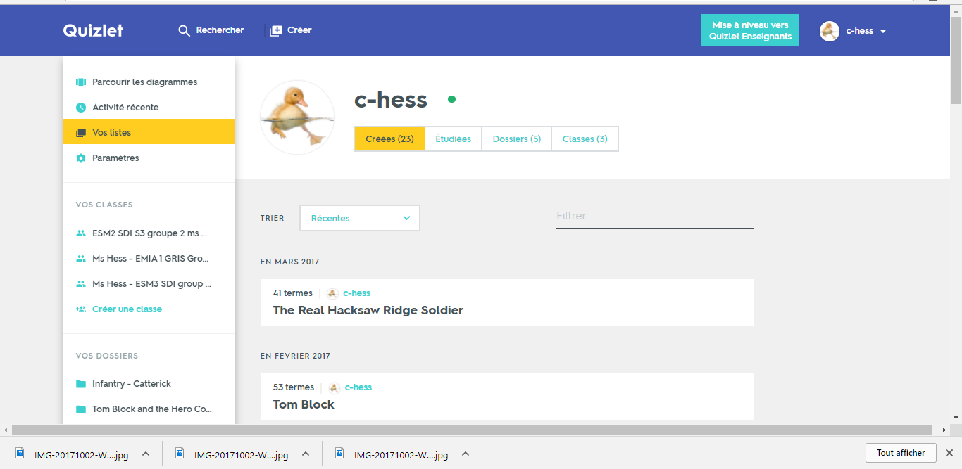
MAKING THE LEAP FROM LEVEL 2 TO LEVEL 3

Slide 15
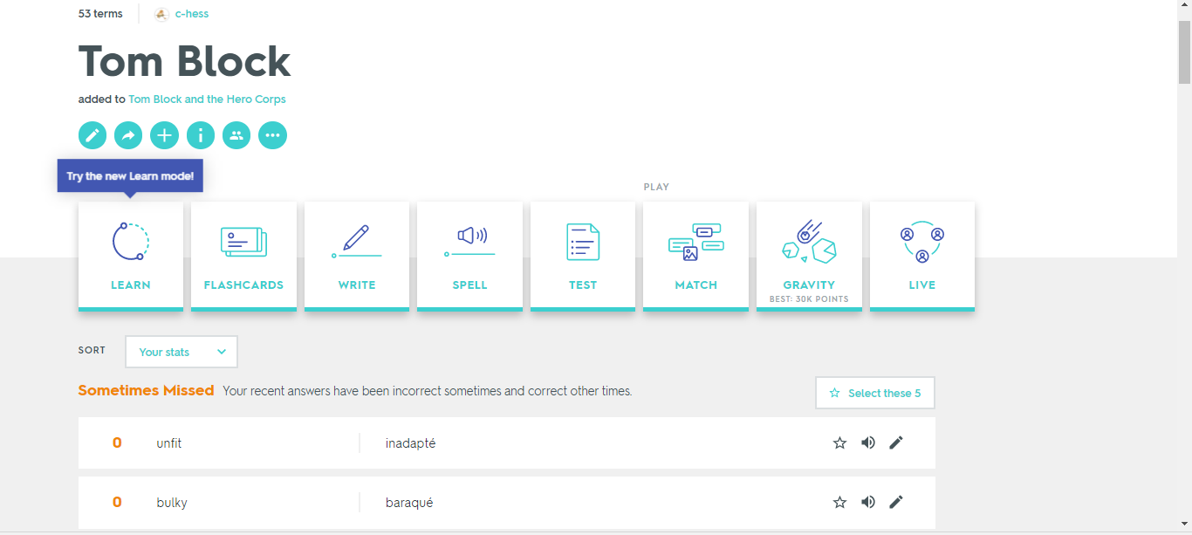
MAKING THE LEAP FROM LEVEL 2 TO LEVEL 3

Slide 16
MAKING THE LEAP FROM LEVEL 2 TO LEVEL 3

Slide 17
MAKING THE LEAP FROM LEVEL 2 TO LEVEL 3
GIVING LEARNERS AN ACTIVE ROLE IN THEIR TRAINING
Encouraging them to choose or propose some topics they would like to study
Giving them access to language labs
« Art of Public Speech »

Slide 18
MAKING THE LEAP FROM LEVEL 2 TO LEVEL 3
GIVING LEARNERS MORE TIME
Made-to-measure, tailored training
Individual speaking practice

Slide 19
MAKING THE LEAP FROM LEVEL 2 TO LEVEL 3
CONCLUSION - It is possible to make learners reach level 3
Mixing item the learners need with others they enjoy
Combining traditional methods with new ways
Making it comfy to learn
BUT – …

