Slide 1
A Historical Perspective of Validity
David Oglesby
Partner Language Training Center Europe

Slide 2
What is Validity?
Merriam-Webster: (the quality of being) well-grounded (OE) or justifiable (AF); at once relevant (ML) and meaningful (OE)
Cambridge: The state of being acceptable (AF) or reasonable (AF)
Oxford: The quality of being logically (AF) or factually (L) sound (OE)
etymology
1540s, from Middle French validité or directly from Late Latin validitatem (nominative validitas) "strength," from Latin validus

Slide 3
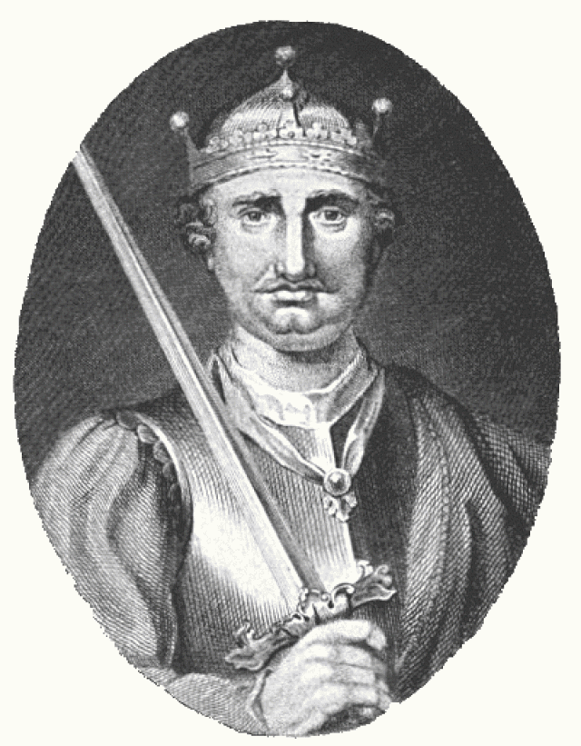
Why is Validity so Hard to Define?
Blame William the Conqueror who introduced the “fancy” speech of Norman overlords to the Old English-speaking world of “plainspoken” Anglo-Saxons, resulting in synonym-rich Middle/Modern English.
∴
Old English | Anglo French
snail | escargot
house | mansion
wisdom | prudence
strength | validity

Slide 4
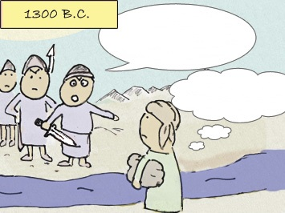
The Shibboleth Test
Quickly! What’s the word for a stalk of grain?
?
She sells seashells by the sea shore…She sells seashells by the sea shore.
She sells shibboleths by the sea shore.

Slide 5
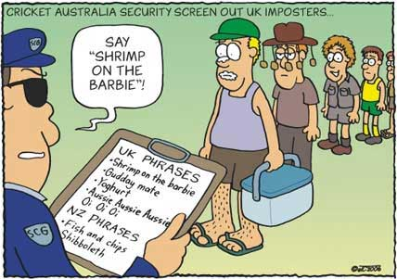
A Modern, Practical Shibboleth Test

Slide 6
An Early Definition of Test Validity
“Two of the most important types of problems in measurement are those connected with the determination of what a test measures, and of how consistently it measures. The first should be called the problem of validity, the second, the problem of reliability.”
Buckingham, McCall, Otis, Rugg, Trabue, & Courtis (1921)
“By validity is meant the degree to which a test or examination measures what it purports to measure.”
Ruch (1924)

Slide 7
Correlation as an Indicator of Validity
1896: Karl Pearson’s product-moment correlation coefficient measured the degree of linear dependence between two variables (e.g., test scores with grades).
1905: Alfred Binet’s “standardized” intelligence test used the same instrument, testing conditions, and scoring methods.
1927: Truman Kelley claimed that a final measure of validity was its prognostic value – the correlation of a test and a later-demonstrated degree of success or failure.
1946: J. P. Guilford proposed that a test was valid for anything with which it correlates.
1950: Anne Anastasi cautioned that “to claim that a test measures anything over and above its criterion is pure speculation”

Slide 8
Problems with Notion that Validity = Correlation
Finding criterion data
Establishing reliability of criterion
Establishing validity of criterion
If valid, measurable, criteria exist, why are different tests needed?
Can the same test be used for different purposes as long as it correlates with external criteria?

Slide 9
Alternatives to Correlation-related Validity
Content validity
“observation of the things and processes which are the aims of instruction is the final proof of validity” (Rulon, 1946)
Could involve professional judgment of individual test developer (Kelley, 1927) or panel of experts (Gulliksen, 1950)
Construct validity
a posteriori
based on empirical data – especially, factor analysis (Spearman, 1904)
analysis should reveal latent trait(s) of interest
a priori
articulated set of theoretical concepts (nomological net) and their interrelations (Cronbach & Meehl, 1955)
Loevinger (1957) suggested that “since predictive, concurrent, and content validities are all essentially ad hoc, construct validity is the whole of validity from a scientific point of view”

Slide 10
What is a Construct?
According to Cronbach & Meehl (1955), a construct is:
a postulated attribute (trait) assumed to be reflected in test performance
defined implicitly by a network of associations or propositions in which it occurs
J.D. Brown (2000) defines a construct as an attribute, proficiency, ability, or skill that happens in the human brain and is defined by established theories
Trait of interest (e.g., L2 reading ability)
Limit Construct-irrelevant variance
Ensure Construct is fully represented

Slide 11
Validity Types in Profusion
Known-groups
Intrinsic rational
Theory-based
Cross-sectional
Empirical-judgmental
Artifactual
Synthetic
Translational
Etiological
Elemental
Predictive
Response
Self-defining
Convergent
Circumstantial
Manifest
Intervention
Job component
Curricular
Rational
Performance
Raw
Incremental
Indirect
Edumetric
Structural
Construct
Nomological
External test
Treatment
Cross-cultural
Face
Natural
Generic
Symptom
Procedural
Quantitative face
Status
Scientific
Trait
Cognitive
General
Population
Design
Definitional
Consensual
Inferential
Linguistic
Longitudinal
Internal
Postdictive
Extra-test
Scoring
Divergent
Judgmental
Intrinsic content
Job analytic
Factorial
Situational
Consequential
Generalized
System
Summative
Site
Functional
Theoretical
External
Cultural
User
Relational
Differential
Conceptual
Particular
Psychometric
Logical
Direct
Social
Faith
Lower-order
Washback
Common sense
Interpretative
Abstract
Systemic
Derived
In situ
Concrete
True
Contextual
Diagnostic
Concurrent
Content
Fiat
Practical
Prima Facie
Context
Representational
Prospective
Interpretive
Intrinsic
Formative
Concept
Decision
Congruent
Local
Single-group
Operational
Relevant
Elaborative
Statistical
Sampling
Descriptive
Essential
Cross-age
Semantic
Criterion-related
Domain
Retrospective
Ecological
Higher-order
Administrative
Substantive
Specific
Empirical
Cluster domain
Instructional
Translation
Occupational

Slide 12
Standards* for Educational and Psychological Tests
Edition | Validity
1954 | Construct, concurrent, predictive, content
1966 | Criterion-related, construct, content
1974 | Criterion-related, construct, content
1985 | Unitary (with content-/criterion-/construct-related evidence)
1999 | Unitary: 5 sources of evidence**
2014 | Unitary: more focus on fairness & use of technology
* American Psychological Association, American Educational Research Association, National Council on Measurement in Education
* * test content, response processes, internal structure, relations to other variables, and consequences of testing

Slide 13
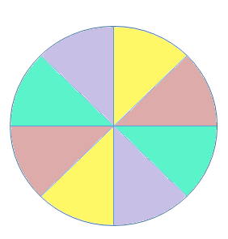
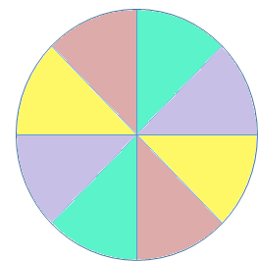
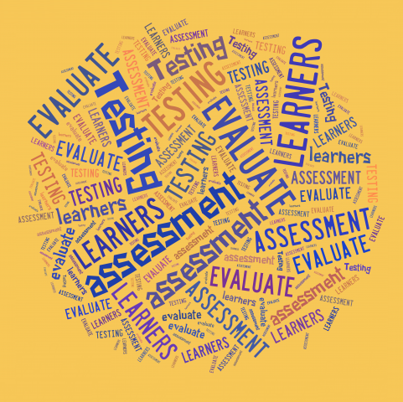
Random Language-Testing Research
face
cognitive
reliability
practicality
Evidence-centered design
all
content
convergent
washback
authenticity
standardized
communicative
validity,
is crucial for
tests.
discriminant
construct
logical inferencing
adaptive
objectives-based
interactiveness
predictive
fair
concurrent
factor analysis
proficiency
generalizability
Recent studies indicate that for…

Slide 14
E Pluribus Unum: A Unitary Concept of Validity
“Validity is an integrated evaluative judgment of the degree to which empirical evidence and theoretical rationales support the adequacy and appropriateness of inferences and actions based on test scores and other modes of assessment.”
Samuel Messick (1989)

Slide 15
Validation as Investigations of Inferences
Validation requires a definition of what is to be inferred from test scores and data to show that there is an acceptable basis for such inferences
Validity is inferred, not measured
Validity is judged as adequate, marginal or unsatisfactory
Kane (1992) proposed an argument-based approach to validation to make the task of validating inferences derived from test scores both scientifically sound and manageable
First – Determine inferences to be derived from test scores
Second – Decide on sources of evidence supporting/refuting inferences
Third – Gather and analyze evidence
Finally – Judge defensibility of test score use for a particular purpose

Slide 16
Validation Models for Language Testers
Weir (2005)
Socio-Cognitive Model
Chapelle, Enright & Jamieson (2008)
Interpretive Argument-based Model
Bachman & Palmer (2010)
Assessment Use Argument (AUA)
Kane (2013)
Interpretation/Use Argument (IUA)
Kenyon (2014)
Integrated Validation Argument Framework

Slide 17
Toulmin’s (1958) Argument Structure
Claim
unless
Alternative Explanation
Warrant
since
so
on account of
supports/ refutes
Backing
Data
Rebuttal Data

Slide 18
Kenyon’s Integrated Validation Argument Framework
drawn from
Bachman and Palmer Assessment Use Argument
1. Consequences
A
Beneficial
2. Decisions
A
Values Sensitive
B
Impartial
using
3. Interpretations
A
Meaningful
B
Impartial
C
Generalizable
D
Model
E
Sufficient
4. Assessment Records
A
Consistent
operationalizing
training
5. Assessment Performance
I
Assessment Implementation
II
Assessment Delivery
designing
I
Conceptual Assessment Framework
6. Design
IA
Student Model
IB
Evidence Model
IC
Task Model
ID
Assembly Model
planning
7. Plan
I
State Anticipated Decisions/Consequences
II
Domain Analysis
III
Domain Modeling
drawn from Mislevy et al: Evidence Centered Design

Slide 19
Embretson’s Universal Validity System
Scoring
Models
Testing
Conditions
Item
Design
Principles
Other
Measures
Latent
Process
Studies
Test
Specs
Psycho-
metric
Properties
Utility
Logic/
Theory
Domain
Structure
Impact
Internal →Meaning
External→Significance

Slide 20
Internal Categories of Evidence
Logic/Theoretical Analysis | Theory of the subject matter content, specification of areas and their interrelationships
Latent Process Studies | Studies on content interrelationships, prerequisite skills, impact of task features & testing conditions on responses, etc.
Testing Conditions | Available test administration methods, scoring mechanisms (raters, machine scoring, computer algorithms), testing time, locations, etc.
Item Design Principles | Scientific evidence and knowledge about how features of items impact the KSAs applied by examinees-- Formats, item context, complexity and specific content

Slide 21
Internal Categories of Evidence
Domain Structure | Specification of content areas and levels, as well as relative importance and interrelationships
Test Specifications | Blueprints specifying domain structure representation, constraints on item features, specification of testing conditions
Psychometric Properties | Item interrelationships, DIF, reliability, relationship of item psychometric properties to content & stimulus features, reliability
Scoring Models | Psychometric models and procedures to combine responses within and between items, weighting of items, item selection standards, relationship of scores to proficiency categories, etc. Decisions about dimensionality, guessing, elimination of poorly fitting items etc. impacts scores and their relationships

Slide 22
External Categories of Evidence
Utility | Relationship of scores to external variables, criteria & categories
Other Measures | Relationship of scores to other tests of knowledge, skills and abilities
Impact | Consequences of test use, adverse impact, proficiency levels & etc

Slide 23
A Black Hole of Evidence
Theoretical
Cross-sectional
Intrinsic rational
Practical
Rational
Differential
Edumetric
Consequential
Circumstantial
Known-groups
Theory-based
Empirical-judgmental
Artifactual
Synthetic
Etiological
Elemental
Predictive
Logical
Response
Self-defining
Convergent
Manifest
Intervention
Job component
Curricular
Performance
Raw
Incremental
Indirect
External test
Construct
Structural
Nomological
Cross-cultural
Procedural
Face
Natural
Generic
Symptom
Status
Quantitative face
Site
General
Population
Trait
Cognitive
Definitional
Treatment
Inferential
Consensual
Linguistic
Longitudinal
Internal
Scoring
Postdictive
Extra-test
Judgmental
Generalized
System
Factorial
Functional
Summative
External
Cultural
User
Relational
Scientific
Abstract
Particular
Direct
Social
Faith
Lower-order
Washback
Common sense
Systemic
Derived
In situ
Concrete
True
Contextual
Diagnostic
Concurrent
Content
Fiat
Prima Facie
Intrinsic
Context
Representational
Prospective
Interpretive
Formative
Design
Decision
Congruent
Local
Single-group
Operational
Relevant
Elaborative
Statistical
Sampling
Descriptive
Essential
Cross-age
Semantic
Job analytic
Concept
Domain
Retrospective
Criterion-related
Ecological
Substantive
Specific
Higher-order
Administrative
Translational
Occupational
Cluster domain
Instructional
Translation
Psychometric
Divergent
Situational
Conceptual
Empirical
Intrinsic content
Interpretative
Construct validity functions as a black hole from which nothing can escape: once a question gets labeled as a problem of construct validity, its difficulty is considered superhuman and its solution beyond a mortal’s ken.
Denny Borsboom, University of Amsterdam

Slide 24
Paul Newton (Oxford) Proposes Evaluation vice Validation
 | Focus for Evaluation (What needs to be investigated in order to evaluate the policy)
 | Measurement | Decisions | Impacts
Scientific (technical) Evaluation | Potential of measurement procedure to support accurate measurement of attribute (defined by its construct) | Potential of measurement-based decision-making procedure to support accurate decisions | Potential of measurement-based decision-making policy to achieve other desired impacts
Ethical (social) Evaluation | Potential of construct to scaffold shared meaning within a wider community (street cred or stakeholder buy in) | Likelihood that benefits accrued from accurate decisions will be judged to outweigh costs from inaccurate ones | Likelihood that benefits accrued from all non-decision-related impacts will be judged to outweigh their costs
Legal Evaluation | Potential to implement the measurement-based decision-making policy without infringing the law

Slide 25
문제
cheist
հարց
swali
الأسئلة
sual
otázka
shimon
ìbéèrè
kysymys
vấn đề
fråga
întrebare
კითხვა
題
вопрос
kwestie
questão
spørgsmål
pregunta
soru
vraag
ספק
يستفهم
質問
küsimus
سؤال
суроо
Frage
pyetje
ερώτηση
คำถามคำตอบ
प्रश्न
vprašanje
kérdés
jautājums
tapuy
kétség
pergunta
domanda
пытанне
асуулт
запитання
pitanje
сұрақ
ceist
klausimas

Slide 26
Reading List
Anastasi A. The concept of validity in the interpretation of test scores. Educ. Psychol. Meas. 1950; 10:67–78.
American Educational Research Association, American Psychological Association, & National Council on Measurement in Education (2014). Standards for educational and psychological testing. Washington, DC: American Educational Research Association
Bachman, L., & Palmer, A. (2010). Language assessment in practice: Developing language assessments and justifying their use in the real world. Oxford, UK: Oxford University Press.
Chapelle, C. A. (1999). Validation in language assessment. Annual Review of Applied Linguistics, 19, 254-272.
Chapelle, C. A., Enright, M. K., & Jamieson, J. (2008). Building a validity argument for the test of English as a foreign language. New York, NY: Routledge.
Chapelle, C. A., Enright, M. K., &. Jamieson, J. (2010). Does an argument-based approach to validity make a difference? Educational Measurement: Issues and Practice, 29(1), 3-13.
Cizek, G. (2012). Defining and distinguishing validity: Interpretations of score meaning and justifications of test use. Psychological Methods, 17(1), 31-43
Embretson, S. (1983). Construct validity: Construct representation versus nomothetic span. Psychological Bulletin, 93, 179-197.
Embretson, S. (1998). A cognitive design system approach to generating valid tests: Application to abstract reasoning. Psychological Methods, 3, 380-396.
Fulcher, G. & Davidson, F. (2007). Language testing and assessment: An advanced resource book. New York, NY: Routledge.

Slide 27
Reading List
Kane, M. (1992). An argument-based approach to validation. Psychological Bulletin, 112, 527-535.
Kane, M. (2006). Validation. In R. Brennan (Ed.), Educational measurement (4th ed., pp. 17-64). Westport, CT: American Council on Education and Praeger.
Kane, M. T. (2013), Validating the Interpretations and Uses of Test Scores. Journal of Educational Measurement, 50: 1–73.
Lissitz, R., & Samuelsen, K. (2007). A suggested change in terminology and emphasis regarding validity and education. Educational Researcher, 36, 437-448.
Loevinger, J. (1957). Objective tests as instruments of psychological theory. Psychological Reports, Monograph Supplement, 3, 635-694.
Messick, S. (1989). Validity. In R. L. Linn (Ed.), Educational measurement (3rd ed. pp. 13-103). New York, NY: American Council on Education and Macmillan.
Mislevy, R., Steinberg, L., &. Almond, R. (2003). On the structure of educational assessments. Measurement: Interdisciplinary Research and Perspectives, 1, 3-62.
Shepard, L. (1993). Evaluating test validity. In L. Darling-Hammond (Ed.), Review of research in education (pp. 405-450). Washington, DC: American Educational Research Association.
Sireci, S. (2009). Packing and unpacking sources of validity evidence: History repeats itself again. In R. Lissitz (Ed.), The concept of validity (pp. 19-38). Charlotte, NC: Information Age Publishers.

Slide 28
Reading List
Shepard, L. (1993). Evaluating test validity. In L. Darling-Hammond (Ed.), Review of research in education (pp. 405-450). Washington, DC: American Educational Research Association.
Zumbo, B. (2009). Validity as contextualized and pragmatic explanation, and its implications for validation practice. In R. Lissitz (Ed.), The concept of validity (pp.65-82). Charlotte, NC: Information Age Publishers.
Kane, M. T. (2013), Validating the Interpretations and Uses of Test Scores. Journal of Educational Measurement, 50: 1–73.

