Slide 1
ENGLISH TEACHING
FACULTY
DEVELOPMENT
WORKSHOP
ACT.547

Slide 2
FDW SOLVED THE MYSTERY OF WHAT WORKS

Slide 3
BREAKING NEWS

Slide 4
Notes:
THE FDW GANG NAILED IT THE PARTNER LANGUAGE TRAINING CENTER EUROPE
GATHERED THE WELL-KNOWN FDW GANG TO ACCOMPLISH THE DIFFICULT TASK OF DEVELOPING A NEW WORKSHOP, THIS TIME TO SUPPORT TEACHERS.
THE WORKSHOP IS AIMED AT ENHANCING THEORETICAL KNOWLEDGE AND PRACTICAL SKILLS OF TEACHING ENGLISH.

Slide 5
English Teaching Faculty Development Workshop
The BILC community identified a need for professional development for teaching faculty
Two-week interactive workshops for experienced English language teachers
Aimed at enhancing theoretical knowledge and practical skills of teaching English
Notes:
“THE BILC COMMUNITY IDENTIFIED A NEED FOR PROFESSIONAL ...”
THE SUGGESTION WAS TO DEVELOP...
“TWO-WEEK INTERACTIVE WORKSHOPS... , ... SKILLS OF TEACHING ENGLISH” IN PHASE ONE , PLTCE CONDUCTED SURVEYS IN FOUR NATIONS THROUGH QUESTIONNAIRES AND FOCUS GROUP MEETINGS WITH ENGLISH LANGUAGE TEACHERS TO SUBSTANTIATE THE NEED FOR SHORT COURSES OR WORKSHOPS FOR TEACHING PROFESSIONALS THE CHARACTERISTICS OF THE POTENTIAL TARGET AUDIENCE, THE SCOPE, TIME AND RESOURCES NEEDED TO ACCOMPLISH THE PROJECT
PHASE TWO WAS CARRIED OUT IN BRUGES DURING THE BILC CONFERENCE. MR. KEITH WERT AND MS. PEGGY GARZA LED A STUDY GROUP ON THIS SUBJECT. THE CONCLUSIONS OF BOTH PHASE ONE AND TWO WERE CLEAR… “PROFESSIONAL DEVELOPMENT ...,... DEVELOPMENT WORKING GROUP”

Slide 6
English Teaching Faculty Development Workshop
PLTCE gathered a group of teachers to accomplish this “Mission”
They were...
Notes:
SO PLTCE DECIDED TO GATHER A WORKING GROUP TO FULFIL THIS NEED AND DEVELOP A WORKSHOP TO SUPPORT THE LANGUAGE SCHOOLS’ EFFORTS TO MEET NATO REQUIREMENTS AND PROVIDE LANGUAGES TEACHERS FACULTY DEVELOPMENT OPPORTUNITIES.
AND THE WORKING GROUP WAS…

Slide 7
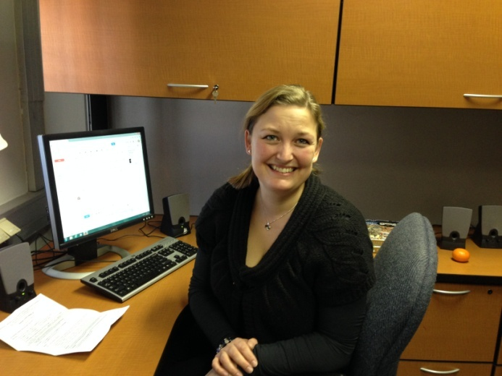
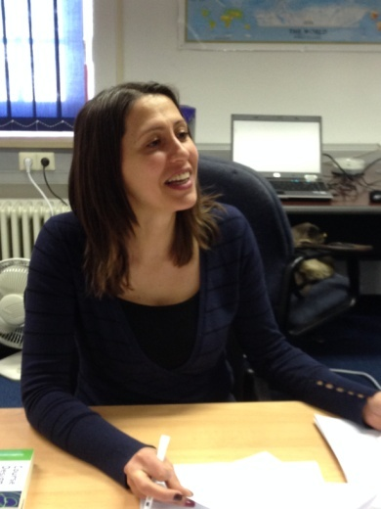
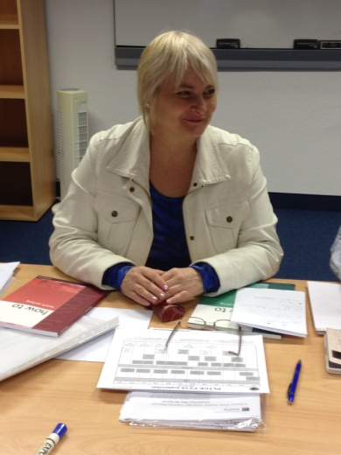
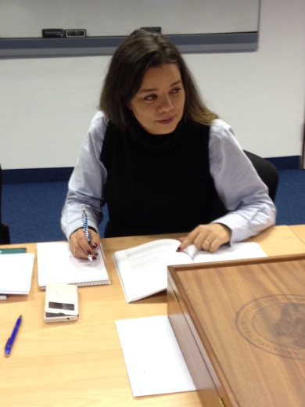
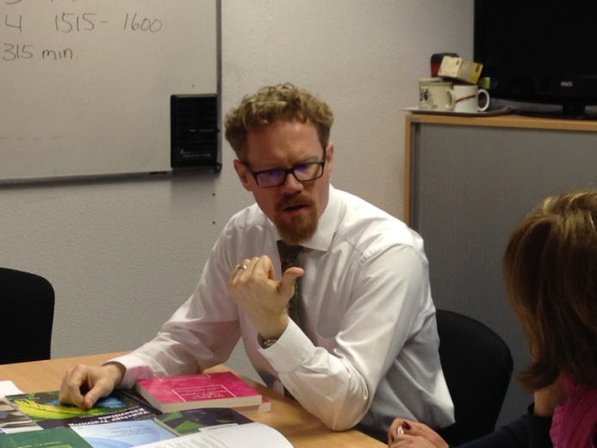
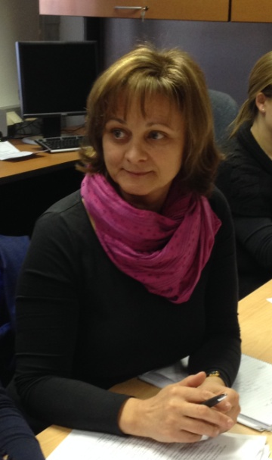
Curriculum Development
Working Group
Ms. Christine Worm
Denmark
Ms. Valentina Eneva
Bulgaria
Dr. Gabriella Kiss
Hungary
Ms. Peggy Garza
USA
LT Estela Parreira
Portugal
Mr. Roger Embree
USA
Ms. Dubravka Zupanec
Slovenia
Notes:
INTRODUCE EVERYONE BY NAME AND COUNTRY

Slide 8
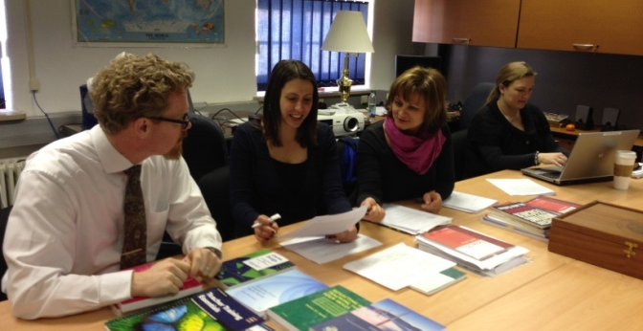
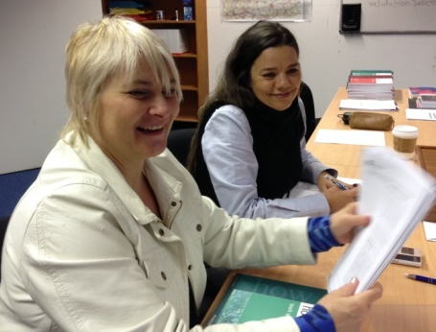
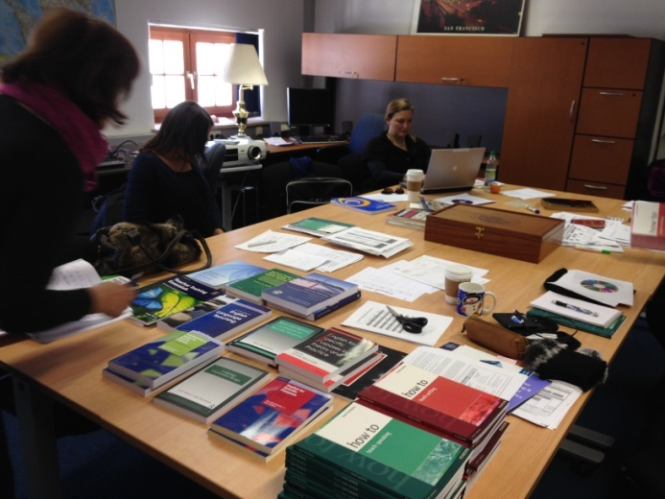
English Teaching Faculty
Development Workshop
Design
WG accomplishments- Meeting #1
Produced learning outcomes
Produced outline
Determined instructional methods
Drafted teaching notes
Selected textbooks
Notes:
THEY MET LATE NOVEMBER AND… “BOY”… WAS THE AGENDA DEMANDING. BUT THEY WORKED HARD, AND I MEAN, REALLY HARD., THEIR ACCOMPLISHMENTS IN THE FIRST MEETING ARE NOTEWORTHY.
THEY… “Produced learning outcomes… , … Selected textbooks”

Slide 9
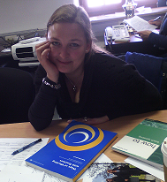
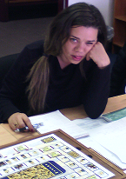
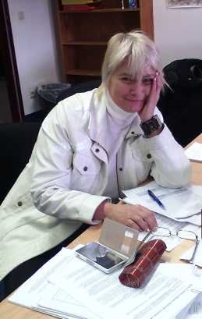
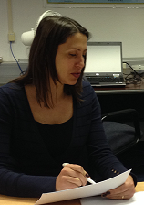
English Teaching Faculty
Development Workshop
Homework
Power Point Presentations
Activities
Worksheets
Handouts
Games
Notes:
BUT LIFE IS NOT EASY AND… THEY HAD HOMEWORK TO DO… AT HOME! BACK TO THEIR COUNTRIES THEY DEVELOPED… “Power Point Presentations... , ... Games”

Slide 10
English Teaching Faculty
Development Workshop
Development
WG accomplishments- Meeting #2
Reviewed and fine-tuned
Daily teaching points
Activities
Worksheets
Handouts
Determined facilitator roles
Notes:
IN MEETING TWO… WELL THIS IS WHAT THEY WORKED ON… “Reviewed and fine-tuned… , …. Determined facilitator roles”. WE SHOULD ALSO MENTION MS. JEANNIE WEDDLE AND THANK HER. SHE PUTS ALL TOGETHER IN FOLDERS AND...
BY NOW, YOU MIGHT THINK: ALL READY, RIGHT? WELL... “NOP”, NOT QUITE, ALMOST THOUGH.
IN MARCH... WELL IN MARCH...

Slide 12
Notes:
AS YOU CAN SEE THE TOPIC FOR THIS WORKSHOP IS “TEACHING SPEAKING AND WRITING FOR MILITARY PURPOSES”. HOWEVER, JUST TO BE AS CLEAR AS WE CAN…

Slide 13
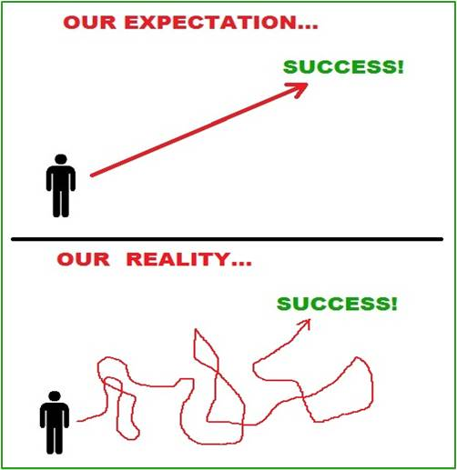
English Teaching Faculty
Development Workshop
What this is:
Military flavor and context
Practice oriented
What this is not:
A course in military terminology
Introductory teaching training
Purely theory and concepts
Notes:
THIS WORKSHOP IS… “Military flavor … , … oriented” . THIS WORKSHOP IS NOT… “A course in military terminology…”.
OF COURSE OUR EXPECTATIONS WERE… BUT REALITY WAS SLIGHTLY DIFFERENT.

Slide 14
English Teaching Faculty
Development Workshop
Topics
STANAG 6001
Military contexts
Military Students
Notes:
AS YOU HAVE SEEN THE TOPIC WAS/IS “TEACHING SPEAKING AND WRITING FOR MILITARY PURPOSES”, AND OF COURSE STANAG 6001

Slide 15
English Teaching Faculty
Development Workshop
Workshop Features
Schedule: 0830-1600
Materials.: A handbook with worksheets and appendixes. (STANAG 6001, Edition 5, Glossary of instructional terms, References and electronic references )
Two textbooks :
How to Teach Speaking by Scott Thornbury
How to Teach Writing by Jeremy Harmer
Notes:
NOW LET’S LOOK AT THE WORKSHOP FEATURES… TIGHT SCHEDULE, AH?

Slide 16
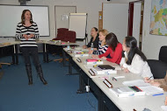
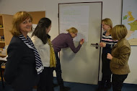
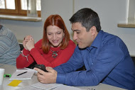
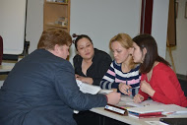
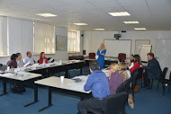
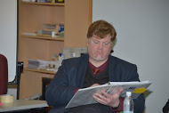
English Teaching Faculty
Development Workshop
Workshop Features
Format: quite varied to foster maximum interaction
plenary input sessions and discussions
individual work followed by sharing with partners
pair work and small group work.

Slide 17
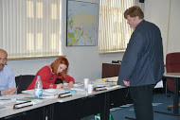
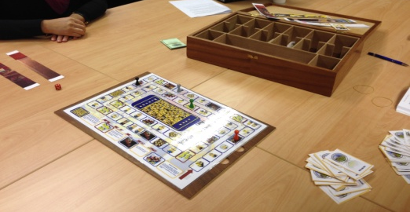
English Teaching Faculty
Development Workshop
Workshop Features
Microteaching: two videotaped microteaching sessions each week, accompanied by peer feedback
Review: Some games were used to review concepts and terms (Board game, Puzzle, “The Hangman”)
Homework: The participants were
given reflection questions/topics
asked to write in their journals

Slide 18
English Teaching Faculty
Development Workshop
Workshop Feedback
The workshop strengths were:
Microteaching
Reflection and journal writing
Excellent textbooks
BILC Military English Glossary
Good balance of concepts and practical work
Cooperative learning
Modeling of sound methods of teaching
speaking and writing
Mix of facilitators from different BILC nations
Notes:
THE STRENGTHS WERE…

Slide 19
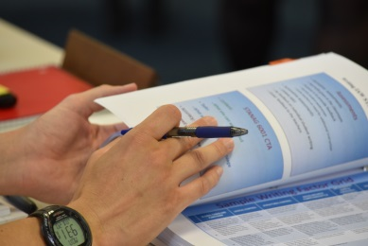
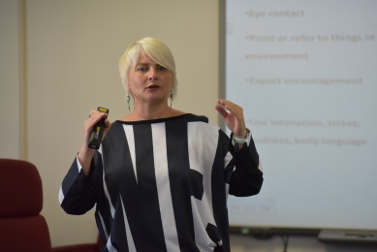
English Teaching Faculty
Development Workshop
The workshop covered:
Teaching and speaking challenges
STANAG 6001
Exploration of teaching
Cooperative learning
Organizing speaking activities
Giving instructions
Giving feedback
Monitoring and Correcting
Influence of culture on writing

Slide 20
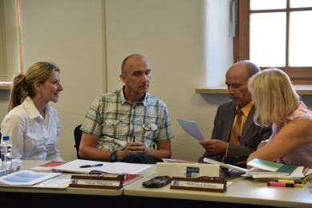
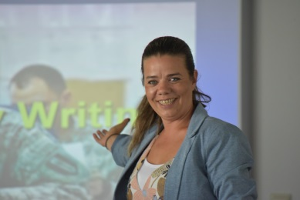
English Teaching Faculty
Development Workshop
The workshop covered:
The writing process and process writing
Genre and genre analysis
Military genre
Six traits of writing
Writing activities
Teaching organization, cohesion and
coherence
Games in the classroom

Slide 21
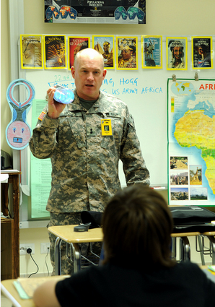
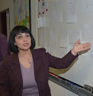
English Teaching Faculty
Development Workshop
Instructions
Cooperative Learning
Feedback
Stages
Speaking IAW STANAG 6001
TEACHING SPEAKING
USING COURSEBOOK MATERIAL
USING A RECIPE
MICROTEACHING
Notes:
HERE ARE EXAMPLES OF SOME OF THE PRESENTATIONS USED DURING THE WORKSHOP - SPEAKING

Slide 22
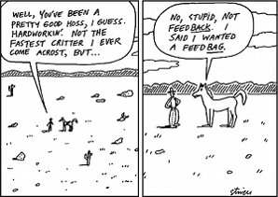
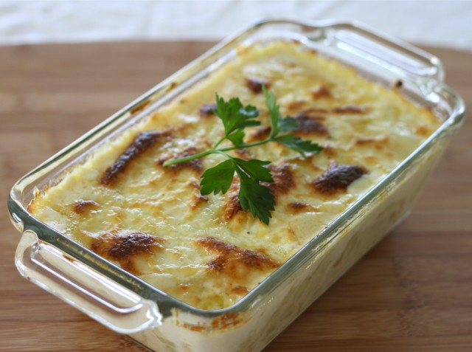
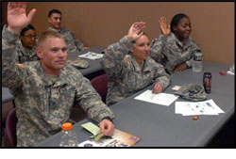
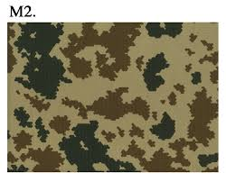
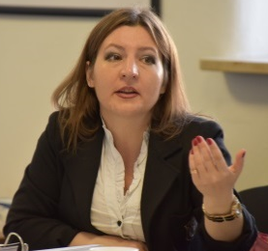
English Teaching Faculty
Development Workshop
The writing process
and process writing
What makes us different?
Cultural Influences
Feedback
Speaking vs. Writing
Writing IAW STANAG 6001
Responding to writing
Activity route map
Effective
Military
Communication
Before cooking
In the kitchen
Set up the ingredients
Cook
Serve
Post cooking
Before the lesson
In class
Set up the activity
Run the activity
Close the activity
Post activity
MICROTEACHING
Notes:
HERE ARE EXAMPLES OF SOME OF THE PRESENTATIONS USED DURING THE WORKSHOP - WRITING

Slide 24
Notes:
SO… COME AND TAKE PART IN OUR NEXT WORKSHOP!!!!! WE ARE WAITING FOR YOU!!!
THANK YOU!

