Slide 1

BILC Professional Seminar 2016
Augmenting Reality:
Textbooks vs. Authentic Material in the ESP Classroom
Dr Dugald Sturges
Head of English Language Instruction
Federal Office of Languages, Hürth, Germany
Budapest, 25 October 2016

Slide 2

reality
plural realities
1 : the quality or state of being real
2 a (1) : a real event, entity, or state of affairs <his dream became a reality> (2) : the totality of real things and events <trying to escape from reality> b : something that is neither derivative nor dependent but exists necessarily
3 : television programming that features videos of actual occurrences (as a police chase, stunt, or natural disaster) - often used attributively <reality TV>
2
Notes:
2

Slide 3
reality
plural realities
1 : the quality or state of being real
2 a (1) : a real event, entity, or state of affairs <his dream became a reality> (2) : the totality of real things and events <trying to escape from reality> b : something that is neither derivative nor dependent but exists necessarily
3 : television programming that features videos of actual occurrences (as a police chase, stunt, or natural disaster) - often used attributively <reality TV>
Source: Merriam-Webster‘s Dictionary
3
Notes:
3

Slide 4
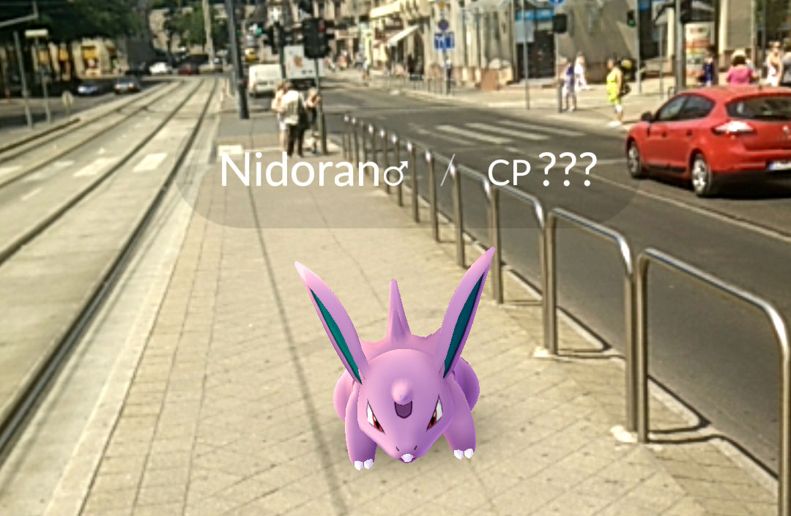


Reality?

Slide 5
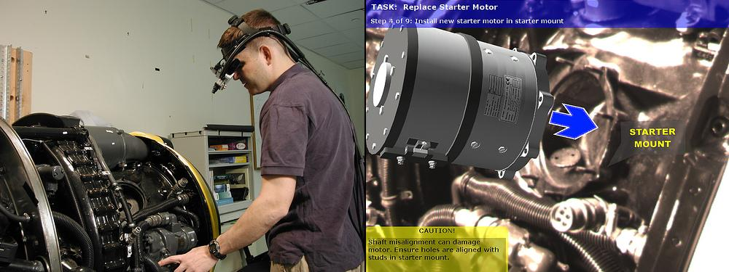
Augmented Reality
Combining the virtual and the real to simulate real life tasks and situations

Slide 6
Augmentation / Simulation
What technical training and technical language instruction have in common:
Simulation of real life situations – often high stakes
Simulation is not reality
The goal is to make materials as close as possible to reality and still be controlable for teaching purposes – Make it real, but focus

Slide 7
Reality in the Classroom
Def. 1: We CAN use real objects or language samples in the classroom
Def. 2 a 1: We can SIMULATE real events or situations in the classroom
Def 2 a 2: We CANNOT recreate the totality of real things and events in the classroom
Def 2 b: We def. can PRESENT something that is neither derivative nor dependent but exists necessarily

Slide 8



Reality in the Classroom
Def 3: Is this “Reality”? Or “Scripted Reality”?
> Often, Reality is structured (“rigged”) to fit into a dramatic television format
Like TV, the Language Classroom is not “Reality”.
> Real life objects and situations need to be given a context in order to focus on the language skills needed out there in “Reality”
Language Teaching is ALWAYS “Scripted Reality”

Slide 9
Real Text, Authentic Text or Textbook?
Which is best? It depends on what skills we aim to develop.
Active: Develop productive skills – get students to produce standard language.
Here we want material which demonstrates the rules.
Passive: Develop receptive skills – prepare students to understand and deal with reality – which includes non-standard texts.

Slide 10
“Real” vs. “Authentic”
“Real Text”
Texts which actually exist outside of the classroom; not an imitation of reality, but genuine.
“Authentic Text”
Texts that do not exist outside of the classroom – at least in the form presented – but which faithfully resemble an original.

Slide 11
Reality in the classroom
What are the limitations of realia in task-based learning?
How can real texts be adapted or augmented to meet language teaching objectives?

Slide 12
Problems with using real documents
Linguistic
- Incorrect grammar,
orthography
- Non-standard terminology
- Typos
Security
- Restricted documents
- Personal Data
Safety
- Technical inaccuracy
- Obsolesence
Pedagogical
– Are not intended for language
teaching
Solution: Real texts need to be didacticized

Slide 13
Didacticizing real material
Didacticizing:
(…) turning into useable teaching/learning material any authentic sample of the target language (…) which is relevant to the objectives of the learners and therefore to the teaching/ learning objectives of the course.
Cf. David Singleton. Language and the Lexicon: An Introduction. New York, Abingdon, 2000. P. 226.

Slide 14
Didacticizing real material
Strategies for teachers
Selection – What documents are appropriate for this group of learners?
Focus – What learning objectives can be met using this text?
Transfer – What useful tasks or exercises can be derived from the content (linguistic and topical) of this document?

Slide 15
Didacticizing real material
Strategies for learners
Comprehension – What does this document have to do with the reality of my workplace?
Inquiry – Why did the teacher give me this text? What is expected of me here in class?
Acceptance – How will the things learned by working with this document help me do my real-world job?

Slide 16
Real material for technical language training
Realia (actual work documents)
Subject matter training material (learning material from outside the language classroom)
Subject matter-related texts (specialist journals, etc)

Slide 17
Real material for technical language training
Realia (actual work documents)
Pro:
Are familiar to the learner
Are what the learner deals with outside the classroom
Con
Are in no way focused with regard to language teaching objectives

Slide 18
Real material for technical language training
Subject matter training material (learning material from outside the language classroom)
Pro
Systematically present topical material
Often include useful exercises and learning tasks
Con
Lack of linguistic focus (again)

Slide 19
Real material for technical language training
Subject matter-related texts (specialist journals, etc)
Pro
Present new developments in the learner‘s professional field
Long and detailed presentation of topics
Con
Usually require higher general language proficiency levels than manuals, etc.

Slide 20
Teaching and Learning Materials
Enhancing performance through standardization while at the same time leaving room for individual tailoring
Tailored language training rather than fixed curriculum
No commercial textbooks, but
  teachers‘ resources
  inhouse-produced, skills-related teaching material
20
Notes:
20

Slide 21



Technical English
for Aircraft Maintenance
Picture by Kogo, CC-BY-SA 3.0
Picture by Julian Herzog, CC-BY 4.0
Public Domain
21
Notes:
21

Slide 22

Technical English
for Aircraft Maintenance
Picture by Kogo, CC-BY-SA 3.0
Picture by Julian Herzog, CC-BY 4.0
Public Domain
22
Notes:
22

Slide 23
Technical English for Aircraft Maintenance
Course objective:
Enable maintenance personnel to work with technical documentation and maintenance manuals in English
Course content:
Basic generic and specialist vocabulary
Reading comprehension
Functional writing
Research skills
23
Notes:
23

Slide 24
Technical English for Aircraft Maintenance
Challenges:
Whose reality? – Participant diversity with regard to specialist fields and aircraft
What do they need? - Balance of general proficiency and specialist language skills
What language skills are really needed?
Multi-platform approach: How do we find a balance between generally relevant and specifically real texts?
24
Notes:
24

Slide 25
Creating authentic material
Focus - Determine language learning objective
Edit – Make sure text length is manageble
Correct – Standardize terminology and grammar
Disclaimer – This is NOT a real text!

Slide 26
Technical English for Aircraft Maintenance
Challenges when applied in classroom reality
“Not my trade!”: Resistance to course material which does not specifically simulate students’ real life tasks
“Not my manual!”: Resistance to documentation that does not precisely correspond to that used at their real life workplace
- “Not my machine!”: Resistance to material dealing with other aircraft / other services
26
Notes:
26

Slide 27
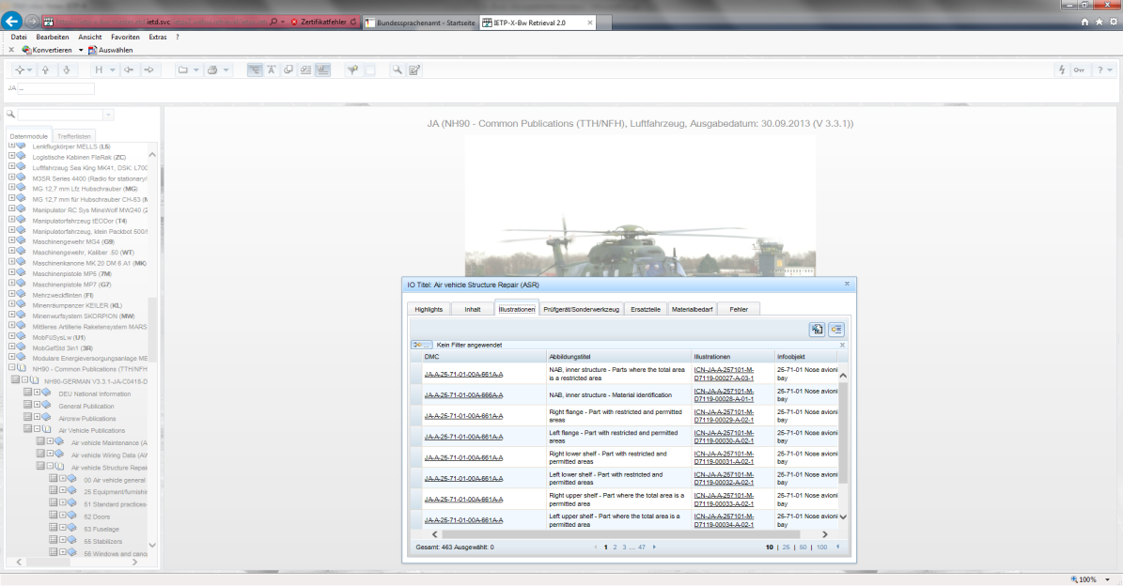
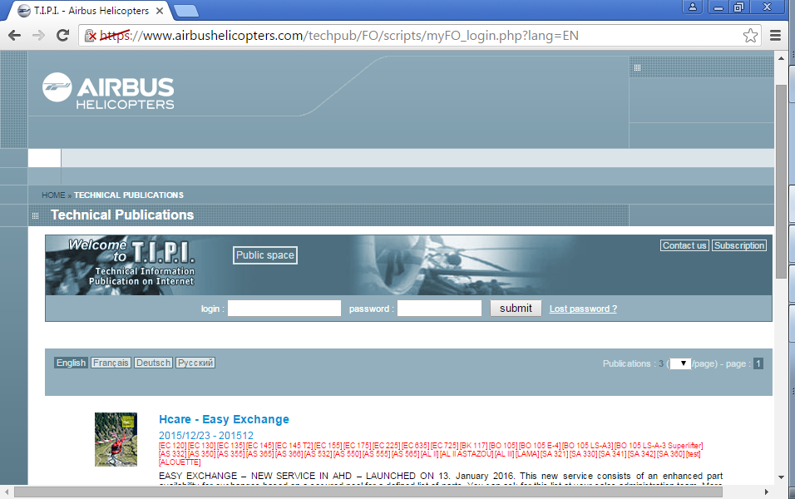
Parallel realities

Slide 28


Parallel realities
Students are used to technical training which is
Aircraft specific
Branch specific

Slide 29
Lessons learned – in the classroom
Augment the authentic material provided in the coursebook with individually tailored material – in particular real documents
Adjust focus to the real world needs of the learners – but didacticize!
Implement student feedback in instruction
Communicate this feedback to course developers and stakeholders

Slide 30
Conclusion
We can familiarize students with the typical language of documents they have to work with.
We can give them the tools to find the information themselves.
We cannot provide students all aspects of a technical system – nor should we try to.
We can and must augment set course material with individually tailored real life texts.
Our goal: If we cannot make it real, at least we can make it authentic.

Slide 31
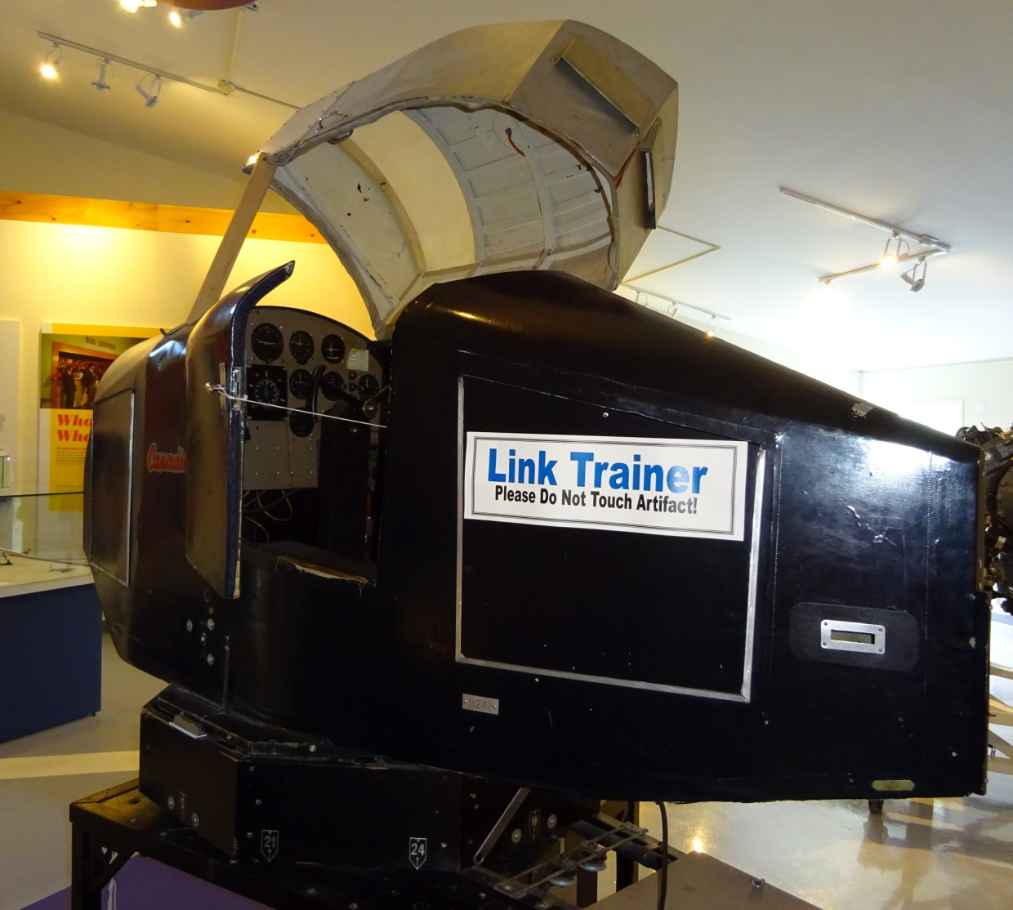
Köszönöm szépen!
Link Trainer Flight Simulator, ca. 1940

