Slide 1
TriaLling BAT2 Writing Prompts
D L I E L C
Defense Language Institute English Language Center
a cooperative project
BILC STANAG 6001 Testing Workshop 2018
Kranjska Gora, Slovenia
David Oglesby Roxane Harrison Edelmira Nickels

Slide 2
Benchmark advisory test (BAT)
Benchmark Advisory Test (BAT) background
Who, what, when, where, why, and how?
Outcomes and resultant BILC actions
Ten years of language testing standardization and norming
Advanced Language Testing Seminar
Annual STANAG 6001 Testing Workshop
Language Standards and Assessment Seminar
Special projects and seminars (e.g., Level 4, IRT)

Slide 3
2nd-Generation Benchmark advisory test (BAT2)
BAT2 background, progress, and timeline
Who, what, when, where, why, and how?
What has been done so far?
What is being done currently?
What remains to be done?
When will testing start?
What will become of the data collected?
Post-BAT2 plans

Slide 4
Need for new writing tests
Exposure of existing BAT writing prompts
Used for training and standardization purposes in LTS, ALTS, BILC Workshops
New writing format
Less emphasis on Level 1 proficiency
Single response to spiraling prompts
Opportunity for international cooperation
Valuable development and moderation experience

Slide 5
Creating new writing tests
Prompt creation & moderation
Test forms & moderation
Trialling prompts
Results and actions
Readiness for live testing
Revision of writing test specs
Survey questionnaires and moderation

Slide 6
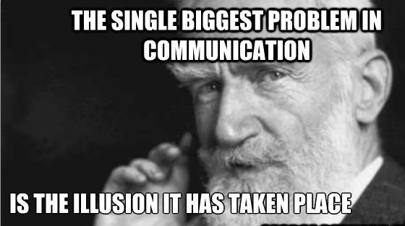
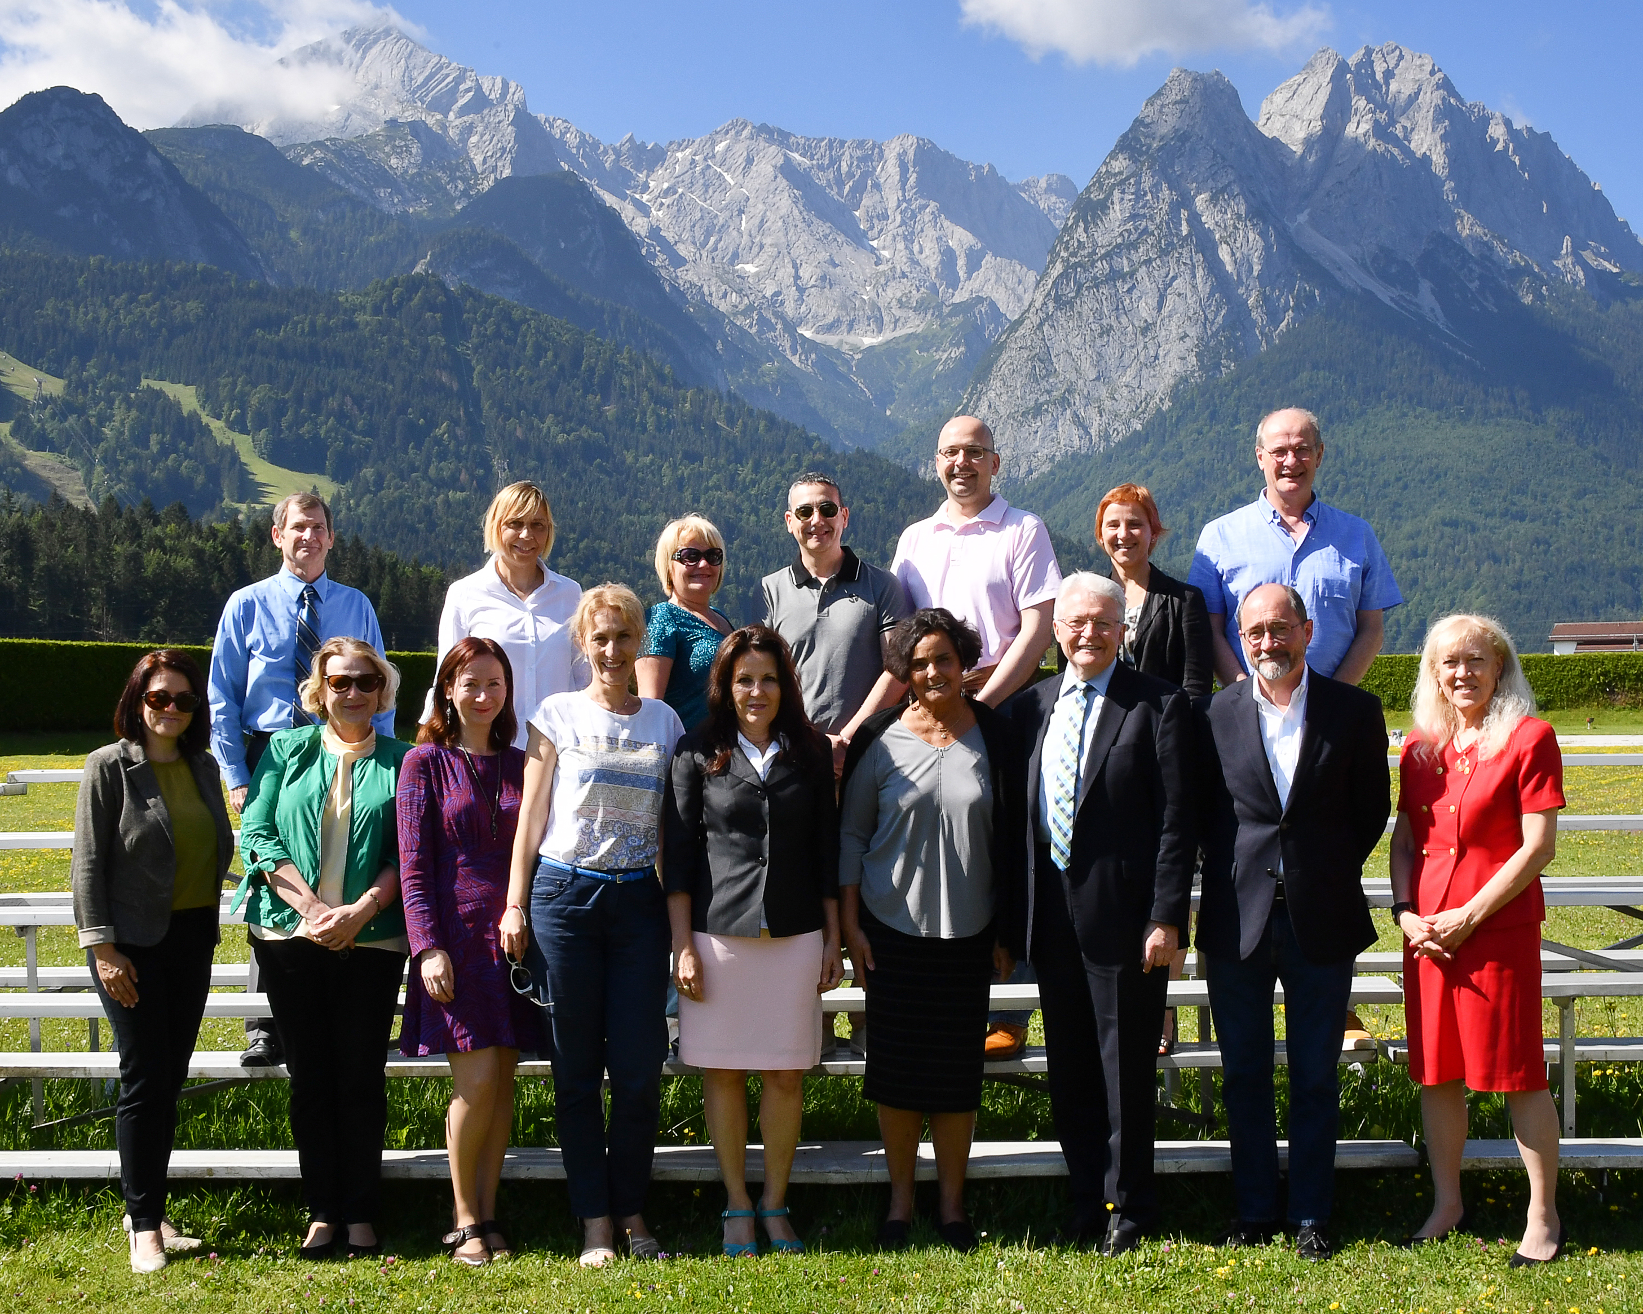
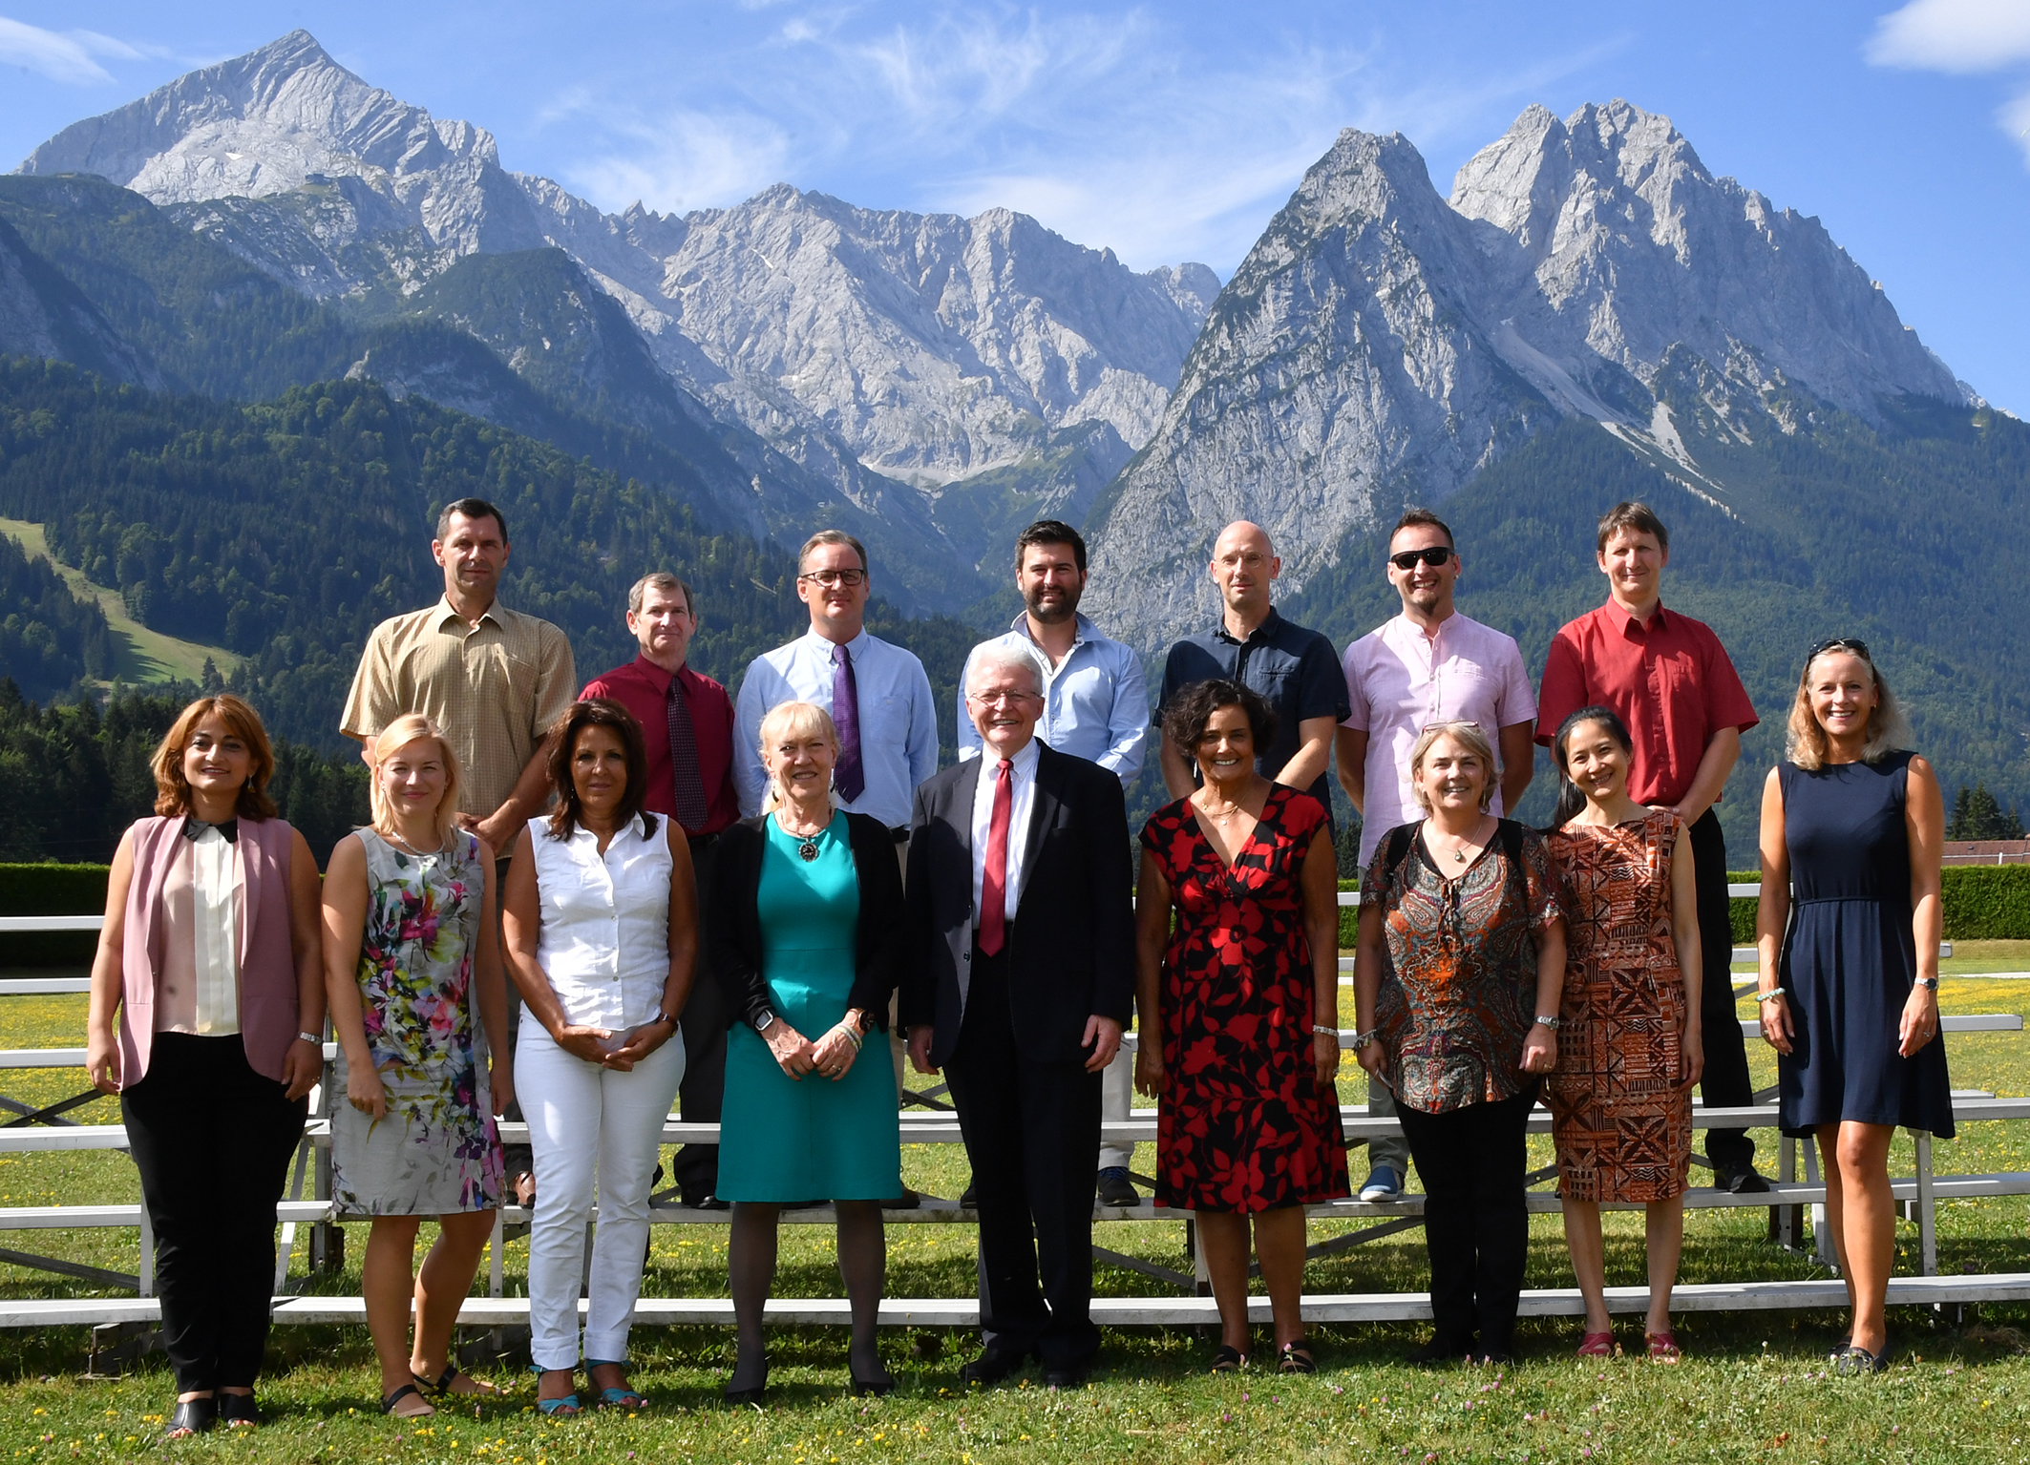
Prompt creation & moderation
BAT2 Norming Forums
ACTFL Schoology
Residential Norming Forum
Moderation round 1
Moderation round 2

Slide 7
First prompt Selections draft Test Forms

Slide 8
Moderate edit moderate
Moderation round 3
Moderation round 4
Moderation round 5
Moderation round 6

Slide 9
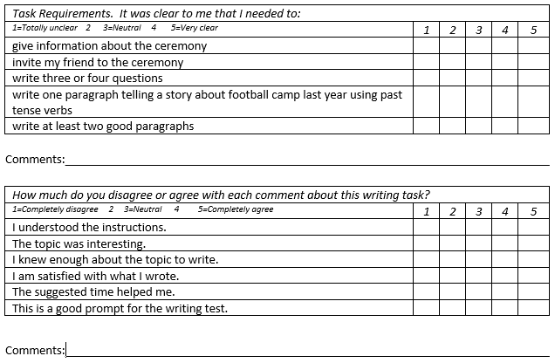
Qualitative surveys
Survey questionnaires
Input from ALTS Facilitators
Moderation of surveys
Moderation round 2
Moderation round 3

Slide 10
PLTCE DLIELC Liaison
Negotiating Timelines
Numbers
Test takers
Sets to trial
Communications
Exchange of test items

Slide 11
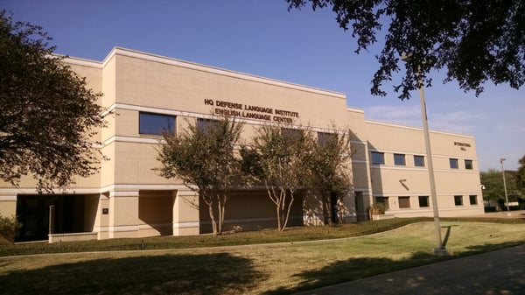
TrialLing prompts
The DLIELC team
Steps in the process

Slide 12
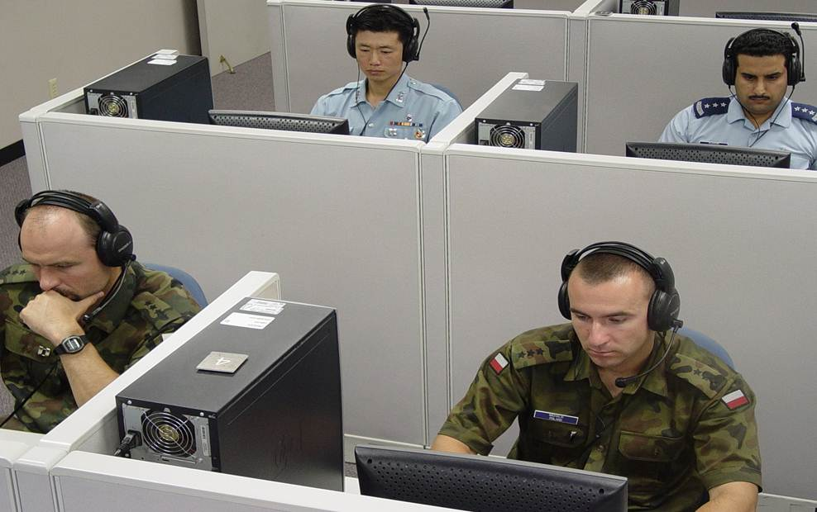
TrialLing population
Mirror NATO & partner nation test-taker population
Nationalities
Levels
Motivation
Briefing the trialling population

Slide 13
Recap - Where we are
Prompt creation & moderation
Test forms & moderation
Trialling prompts
Results and actions
Readiness for live testing
Revision of writing test specs
Survey questionnaires and moderation
Jan-July 2018
July & August
August
August
September

Slide 14
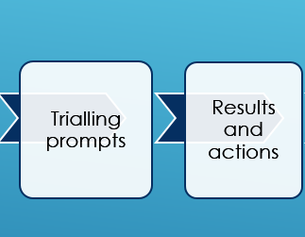
RECAP - Next Steps
Provide diagnostic feedback to trial test-takers
Rate trial test scripts
Run stats on ratings / analyzing data
Analyze qualitative data
Edit prompts, if required
Construct the tests
In hand
September
pending…
Sep/October

Slide 15
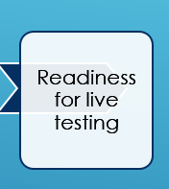
Transfer to ACTFL / LTI
Upload tests to web platform
BAT2-W ready for live testing
pending…
8 – 22 October
November 2018

Slide 16
Thank you for your attention ☺
D L I E L C
Defense Language Institute English Language Center

