Slide 1
Equipping ADF members with the ability to influence the outcome of interactions conducted in an intercultural environment
Defence Force School of Languages
Anya Ivanova, Head of Development
Australian Defence Force School of Languages
Oct 2022

Slide 2
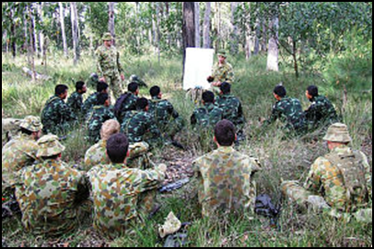
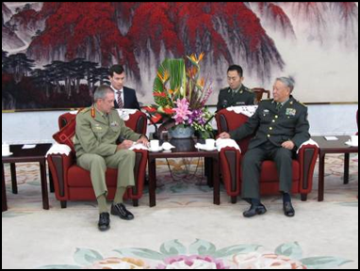
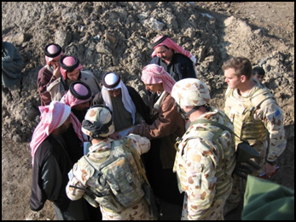
Australian Defence Force School of Languages (DFSL)
DFSL Mission: To train and assess Defence personnel in languages other than English to enhance Defence capability.

Slide 3
Languages Taught
Long Courses
Arabic
Chinese
French
German
Indonesian
Japanese
Khmer
Korean
Malay
Portuguese
Spanish
Tetum
Thai
Tok Pisin
Vietnamese
Short Courses
Arabic
Fijian
Filipino
French
Indonesian
Malay
Tetum
Tok Pisin
Urdu
Refresher Courses
Arabic
Chinese
Dari
Filipino
French
Indonesian
Japanese
Khmer
Korean
Malay
Pashtu
Portuguese
Russian
Tetum
Thai
Vietnamese
Assess Only
Persian
Hindi
Russian
Pashto
Defence Force School of Languages

Slide 4
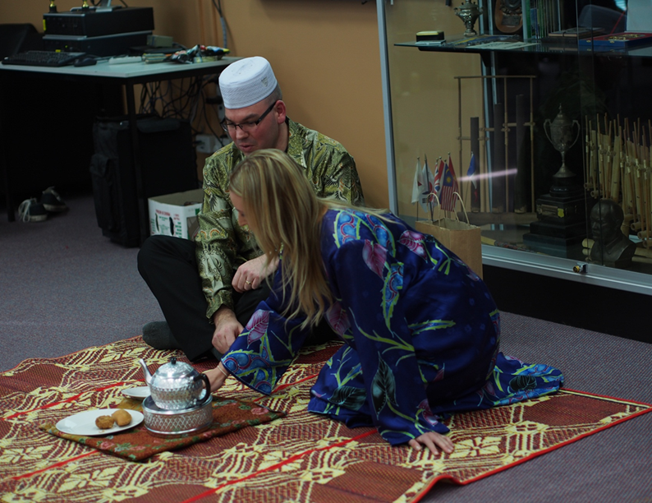
DFSL courses
Method of selecting students
Full time intensive nature of our training
Small classes
In-house course design and
development

Slide 5
LOTE Strategic Engagement (SE) course
ADF focus on International Engagement
Purpose - to prepare selected ADF members for overseas representational postings and to produce graduates with sufficient command of the target language and sufficient level of cultural knowledge to act as communication facilitators within routine and non-routine military settings at the strategic level

Slide 6
Communication breakdowns in ADF context
Imprecise interpretation of a target language cultural norm or linguistic expression implications
Goal: Reducing the risk of military confrontation & increasing interoperability with key partners
Notes:
[Anthony J. Liddicoat (2008:134) . [in his work: ‘Language Planning and Questions of National Security] argues that language issues arise in communication both within coalitions of allies and in communicating with local people in theatres of conflict]
-Imprecise interpretation of a target language cultural norm or linguistic expression can potentially lead to miscommunication or communication breakdowns.
- These potential communication breakdowns can have very serious implications in the civilian world and could be absolutely critical in the military context
- On the other hand deeper understanding of the target country cultural nuances can help to reduce the risk of military confrontation, assist with the (ADF) ongoing task of increasing interoperability with key partners and improving the coordination of responses to shared international challenges including terrorism, humanitarian assistance and disaster relief.

Slide 7
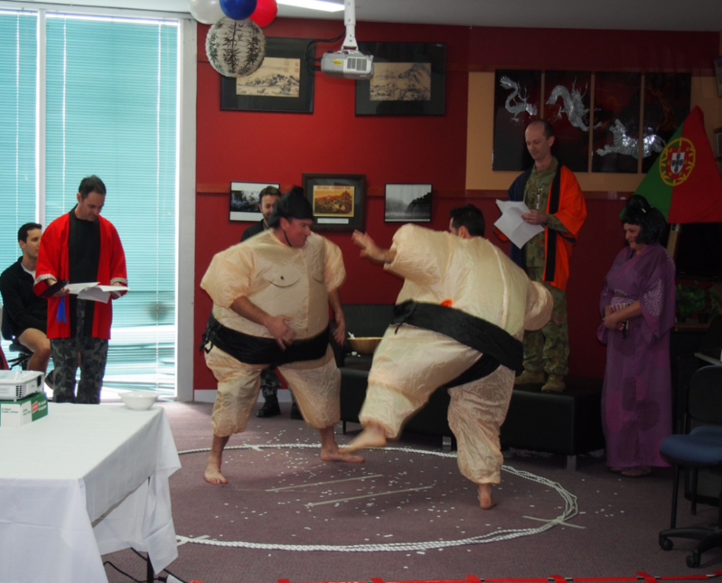
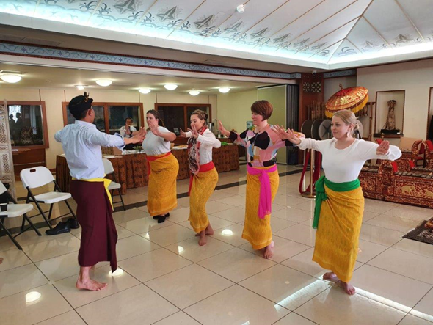
1. Intercultural Awareness LO
LOTE skills are taught in conjunction with the
intercultural awareness LO entitled ‘Work
collaboratively in an intercultural context to
support SE tasks’.
Language teaching and learning
as an intercultural venture
Notes:
The designers of SE course training and assessment strategy considered the ways that most efficiently meet ADF requirements. A lot of thought went into creating multiple course development and delivery solutions to address this issue. They were developed based on our understanding of language teaching and learning as an intercultural venture.
The intercultural awareness LO has a significant attitudinal component, as well as underpinning knowledge and skills required to work collaboratively in an intercultural context. Our students are required to participate in intercultural events, multiple rapport building and workplace based role-plays and visits involving target language culture. The content of this module is intended to be Interwoven with all the other LOs on this course, however, teachers can choose to address certain aspects of the module in stand-alone lessons.
As part of this module SE students get to learn about the importance of cultural awareness and significance of intercultural communication, various factors shaping national/regional identity of people in the target country (e.g. history, values, attitudes, norms, social structure and status, customs, social conventions), and strategies that can be used to facilitate intercultural communication. The requirement to apply these strategies is built into the SE course assessment rubrics. This way information is collected on students’ ability to show interest and respect, ask questions to seek clarification, [withhold judgement], adapt responses, and so on.
SE students are encouraged to reflect, discuss, engage in multiple tasks and draw on their own experiences when working on this module of the course. [As part of their studies they are also encouraged to critically examine their own culture as well as the Target Language culture. As Liddicoat and Scarino (2013:2) argue LOTE learning is “both an act of learning about the other and about the self and of the relationships which exist between self and other”.]
To successfully pass this LO the students need to apply culturally appropriate target language and behaviour, as well as strategies to facilitate intercultural communication through a number of assessment events. They are also required to share target culture and intercultural knowledge and experiences with their classmates.
The content of this module assists SE graduates with their task of moving between different linguistic and cultural systems. It also helps them to embrace the new cultural identity that LOTE learning is inevitably framing.

Slide 8
2. Rapport building language
Built into the SE course design to support SE graduates’ future contribution to the relationship building
Application of appropriate use of social and cultural conventions, eg: use of honorifics, social norms re physical contact, etc

Slide 9
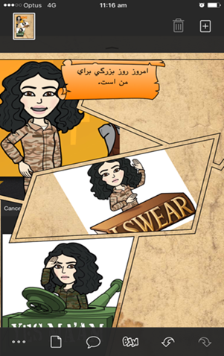
3. Military Terminology Module and Workplace Task Specific Modules
‘Apply basic military terminology in rapport building conversations’ module
8 main military related themes:
1. Military equipment;
2. Military personnel;
3. Politics and society;
4. International Defence relations;
5. Security;
6. Military role, issues and operations;
7. Religion and economy; 8. Ceremonies.
‘Communicate in Target Language in support of SE tasks’ module

Slide 10
4. Language Learning Strategies (LLS) Module
Taught concurrently with the rest of the SE curriculum
Main focus on the specific strategies that support SE students’ acquisition of vocabulary, grammar, speaking, listening, reading, writing, translating and interpreting skills, language enabling strategies that can facilitate communication are also covered.

Slide 11
Ability to express both agreement and disagreement with others
One of the skills identified in the SE Training Needs Analysis (TNA)
Ability to ‘soften’ how the disagreement is expressed to maximise the chances that their disagreement is received well and to avoid causing offence or tension
Debate language task format and role plays of military meetings

Slide 12
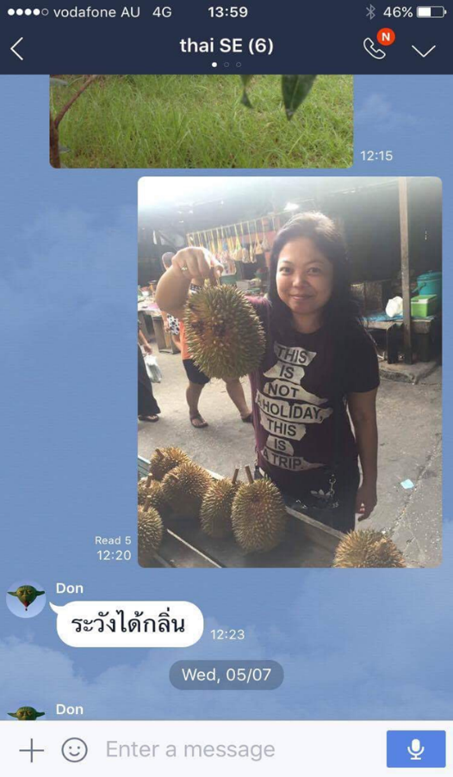
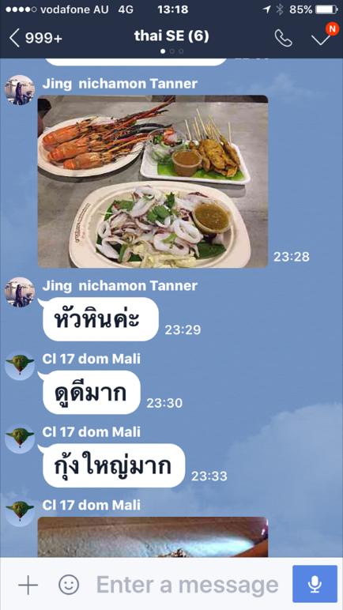
5. In-Country Training Module
One of the final SE LOs which is
conducted over 2 weeks in a target
language country.
Purpose: to provide SE students with language and cultural learning opportunities which can only be gained in-country, such as interacting with members of diverse TL speech communities. On ICT students do two very important things: “they communicate with native speakers trying to be equal to them and at the same time absorb all cultural nuances they need”.

Slide 13
Development and delivery approaches
Range of development and delivery approaches used to introduce the above course design solutions
Course design documents ensure consistency across multiple LOTE courses but offer enough flexibility to course developers and deliverers to accommodate different learning and teaching styles and needs
Technology as an integral tool to intercultural language teaching

Slide 15
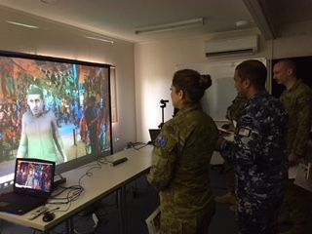
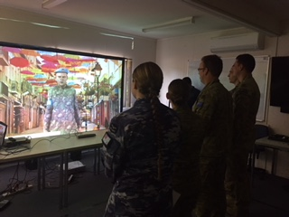
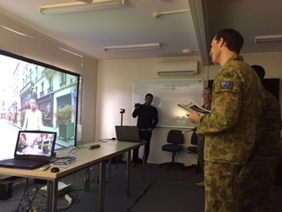
AARP
‘The avatar role-play made
me feel engaged and involved’.
‘Leading edge. Better than current computer games’.
‘It felt like I was talking and interacting with a ‘new’ person in TL’. ‘Feels like talking with a stranger’.
‘This tool would definitely be of greatest advantage to language classes without
mixed gender instructors’.
‘It was so much FUN!’

Slide 17
Conclusion
DFSL as an institution not only recognises the need for an intercultural focus in language learning, we have developed a solid practice of intercultural teaching.
Professor David W. Lovell (2017:88) argues that in today’s world ADF “soldiers are increasingly asked to do much more than fight in armed conflicts”. They act as peacekeepers, as emergency responders, they are required to negotiate and develop trust.
Our focus is on the real life workplace application of the cultural knowledge and the ability of DFSL graduates to engage effectively with their military counterparts
Notes:
DFSL SE curriculum integrates a range of course development and delivery solutions which facilitate the ability of DFSL graduates to build relationships in their future jobs, e.g. intercultural awareness module, rapport building language and language required to conduct business relating to SE plans and activities, military terminology and workplace task specific modules. To consolidate their linguistic and intercultural skills, SE students participate in in-country training which provides an authentic and diverse training environment with experiences in numerous lingua-cultural interactions not possible in Australia. The ICT activities are designed to give SE students real insights into target country culture and opportunities to further develop their linguistic and cultural knowledge.
There is definitely a place in DFSL SE curriculum for cultural facts which give key insights into target language culture, but our focus is on the real life workplace application of the cultural knowledge and the ability of DFSL graduates to engage effectively with their military counterparts. This is why intercultural awareness is taught and assessed concurrently with the rest of DFSL SE curriculum.
Languages and cultures, as well as the understanding of the nature of language teaching are constantly evolving. ADF strategic priorities are also constantly changing. Professor David W. Lovell (2017:88) argues that in today’s world ADF “soldiers are increasingly asked to do much more than fight in armed conflicts”. They act as peacekeepers, as emergency responders, they are required to negotiate and develop trust.
This is why we at DFSL are conscious of the need to be responsive and adaptable to constantly changing ADF requirements, and are always in the process of ongoing revision of our teaching and learning priorities and practices. The ultimate goal we are pursuing is to enhance ADF LOTE capability which will enhance Australia’s international strategic partnerships.

Slide 18
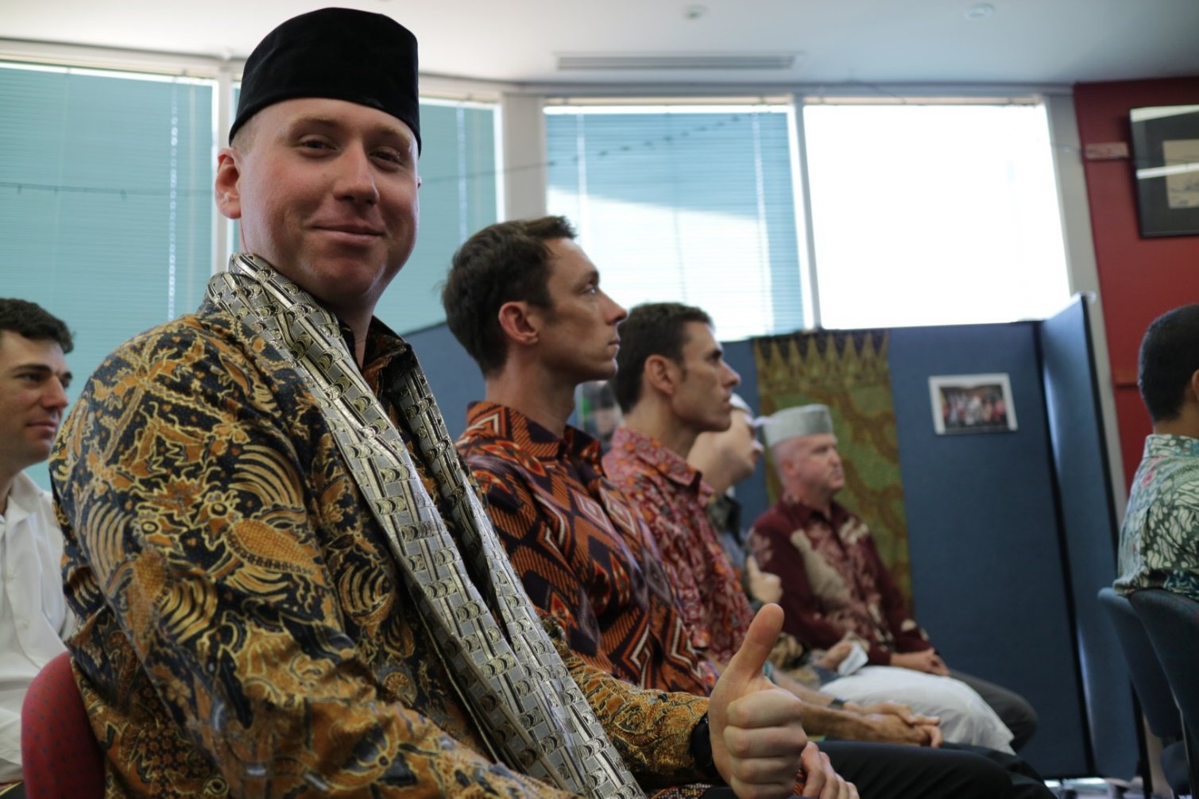
Thank you
Notes:
Students on the Tetum OE course are given a virtual lesson on Timorese Drums and Rhythms during remote ICTs in September 2021

Slide 19
References:
Australian Government, Department of Defence, 2016 Defence White Paper
Bennett, J.M. (1986) Modes of Cross-Cultural Training: Conceptualizing Cross-Cultural Training as Education. International Journal of Intercultural Relations 10, 2:117-34
Coalition of Distinguished Language Centers, (2015) What works: Helping Students Reach Native-Like Second-Language Competence, Virginia Institute Press
Deck, D. (1999) Development of an intensive integrated curriculum of teaching Indonesian to foreign speakers: an Australian perspective, Bandung conference paper
Hinchcliffe, M. (2009) Soft Power and the Role of the ADF in Shaping the Australian Security Environment. Australian Defence Force Journal, Issue 179
Kramsch, C. (2008). Ecological perspectives on foreign language education. Language Teaching, 41(3)
Liddicoat, A.J. (2008) Language Planning and Questions of National Security: An Overview of Planning Approaches, Current Issues in Language Planning, 9:2, 129-153
Liddicoat, A.J. and Scarino, A.(2013). Intercultural Language Teaching and Learning. Oxford, Wiley Blackwell
Lovell, D. W. (2017) Creating strategic corporals? Preparing soldiers for future conflict. Australian Defence Force Journal
Nye, J (2002). The Paradox of American Power: Why the World’s Only Superpower Can’t Go It Alone. Oxford: Oxford University Press, p.8
Shi-xu and Wilson, J. (2001). Will and Power: Towards Radical lntercultural Communication Research and Pedagogy. Language and Intercultural Communication, v1 n1 p76-93
Surachestpong, I. (2016) A Needs Assessment of Intensive Language Teaching at the ADF School of Languages, dissertation
Xue, J. (2014). Cultivating Intercultural Communication Competence through Culture Teaching. Theory and Practice in Language Studies; London Vol. 4, Iss. 7

