Slide 1
Establishing a Successful Language Training Program in Afghanistan
David Oglesby
Defense Language Institute English Language Center

Slide 2
Key Components
“P" - Purpose
“R" - Realism
“E" - Efficiency
“S" - Support
“T" - Trust
“O” - Outcomes

Slide 3
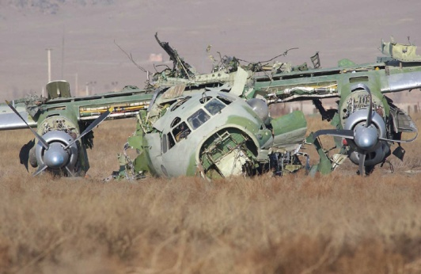
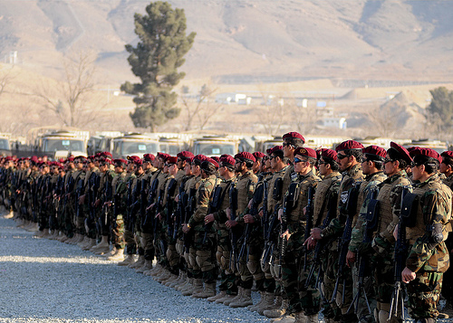
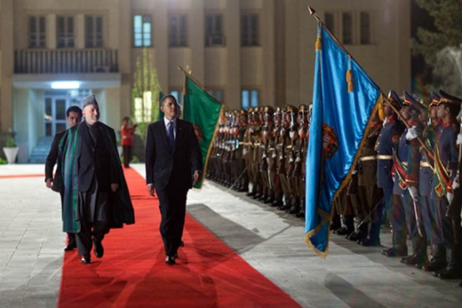
Purpose
Based on Needs
Flight Safety
Cooperative Efforts
Training Investments
Support Mission
Empower Combat Forces
Develop Self-sustaining Forces
Focus on Vision
Building Partnerships
Peace through Understanding

Slide 4
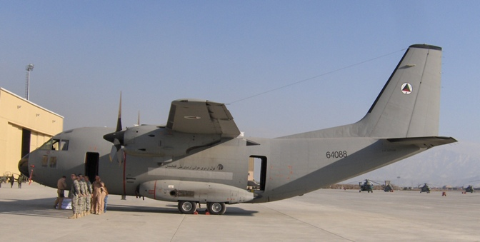
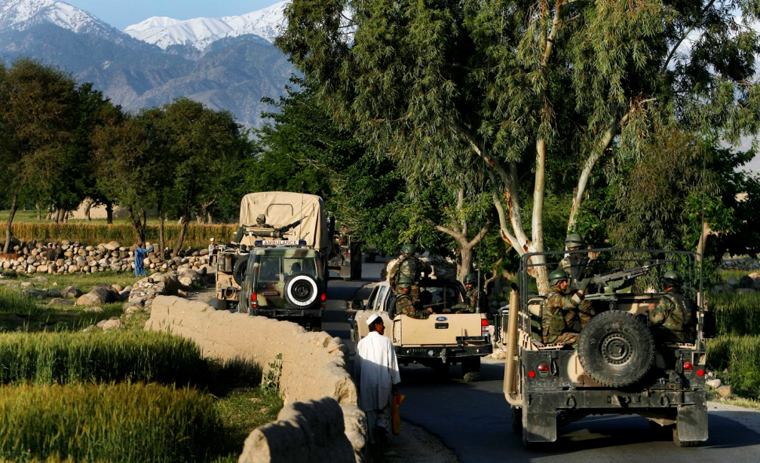
“The things which are most important don't always scream the loudest.” Bob Hawke
C-27 pilots need to communicate with the tower
Commandos need Special Forces training
AF military leaders need to interact with attaché community
Language instructors need teacher training

Slide 5
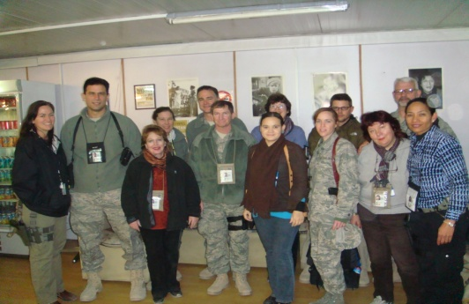
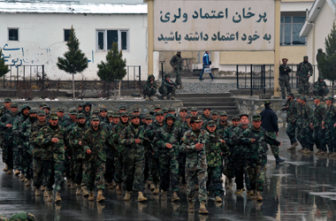
Realism
Support
Manpower
Cost
Timely Delivery
ANSF Force Growth
Operations tempo
Measureable Outcomes
STANAG 6001/ILR 2
ICAO Level 4
ECL/ALCPT 80

Slide 6
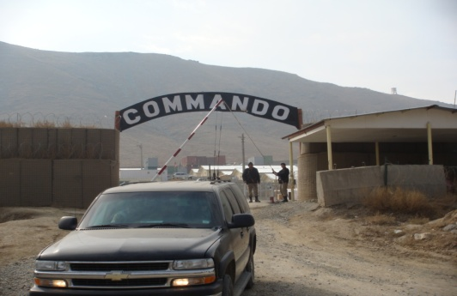
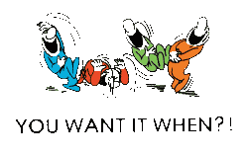
“I reject your reality and substitute my own.” Adam Savage
MoD and MoI force growth creates even greater need
Conduct missions or get language training
ICAO Level 4 tasks roughly equivalent to STANAG 6001 Level 2
Contracts can cost over $300,000 per instructor

Slide 7
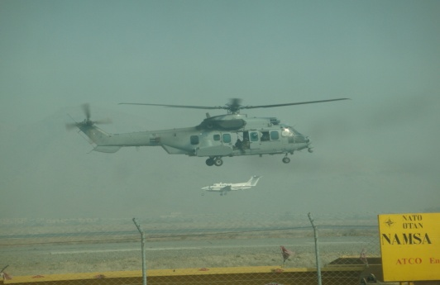
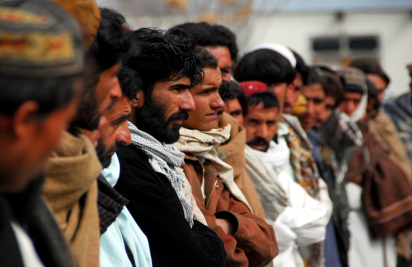
Efficiency
Courses
Specificity of Content
Intensive vs. Nonintensive
Length of Study
Students
Selecting Candidates
Tracking progress
Assessments
Aptitude
Placement
Exit

Slide 8
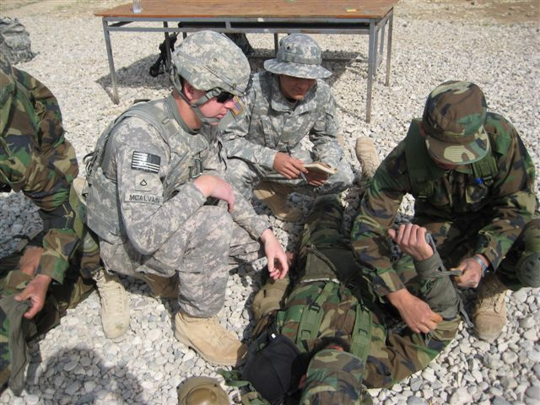
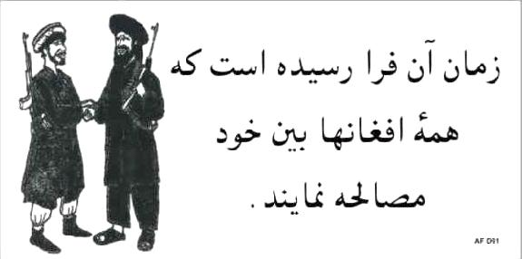
“Obviously, the highest type of efficiency is that which can utilize existing material to the best advantage.” J. Nehru
Matching human resources and training requirements
Customizing courses puts standards in jeopardy
Many enlisted Afghan soldiers are illiterate
No language aptitude tests available in Dari/Pashto

Slide 9
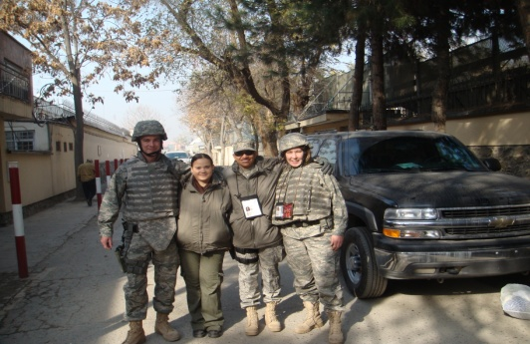
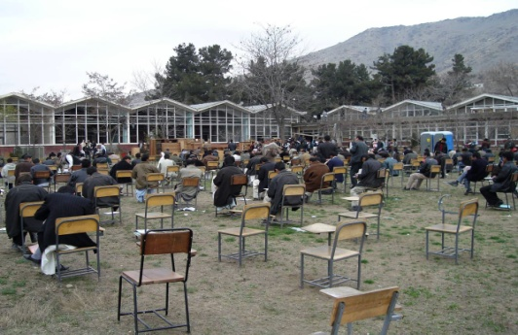
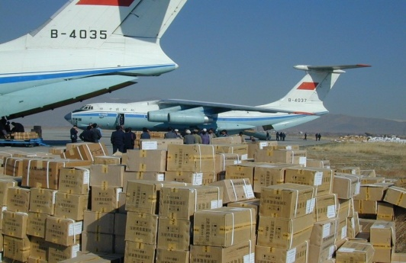
Support
Staff
Indigenous
Government
Contract
Facilities
Secure
Viable
Equipment
Available
Usable
Connected

Slide 10
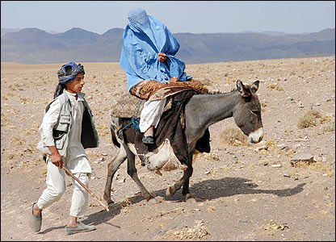
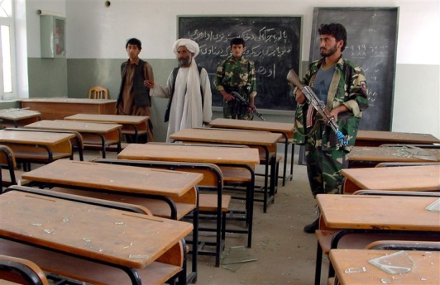
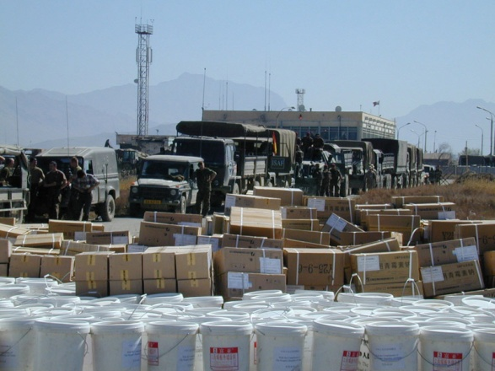
“If you support the community, they will support you.” Jerry Greenfield
Selecting, training & retaining indigenous instructors
Attracting government/contract instructors is costly
Finding or building secure, accessible schoolhouses
Coordinating among training sites and military staffs requires special effort

Slide 11
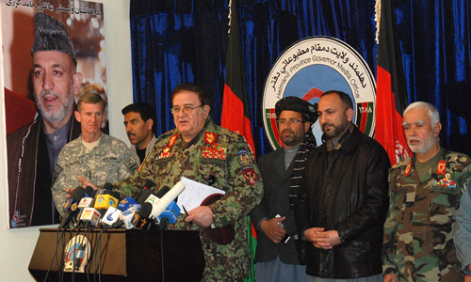
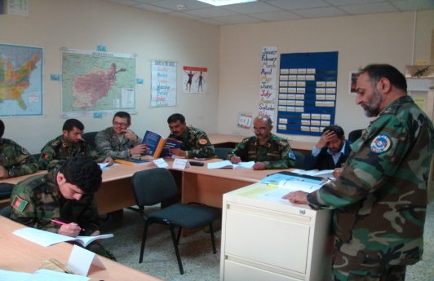
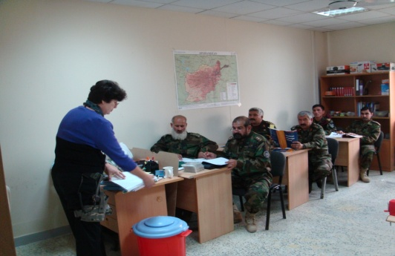
Trust
Stakeholder Confidence
Afghan MoD/MoI
Coalition trainers
Sponsoring agency
Student Buy In
Rapport
Empowerment
Host Nation
Classroom ambassadors
Armed guests

Slide 12
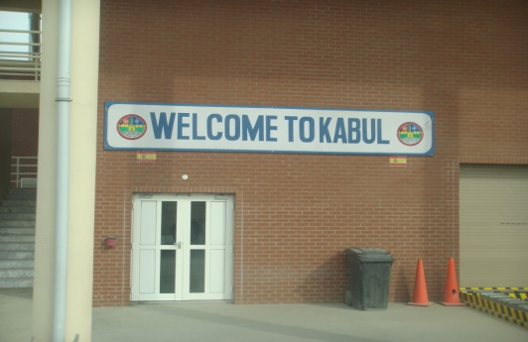
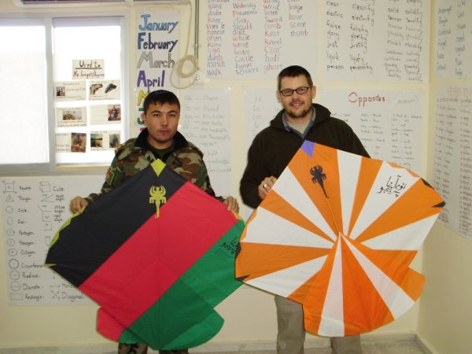
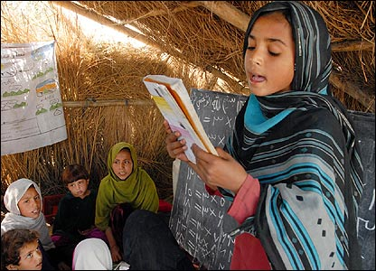
“Wise men put their trust in ideas and not in circumstances” Ralph Waldo Emerson
Adhering to standards despite exigencies
Going native – whatever that means
Bridging the gap in cultures and standards of living
Vicariously experiencing Afghan hospitality

Slide 13
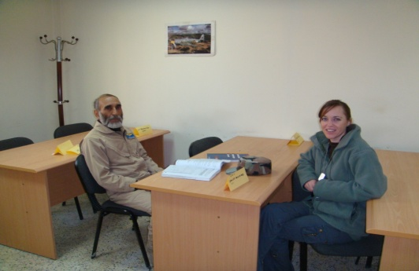
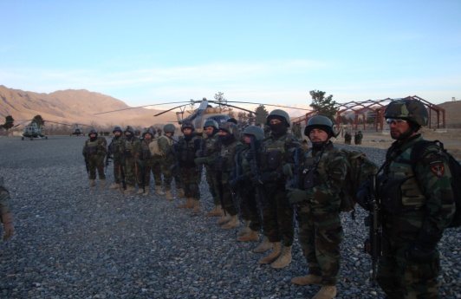
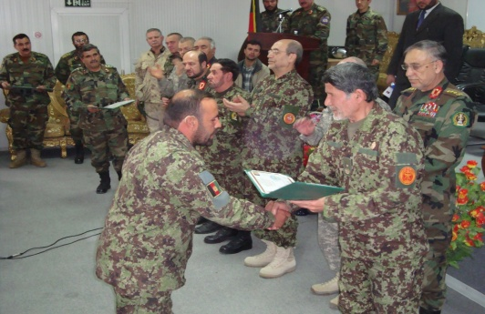
Outcomes
Results
Individual
Occupational
National
Relevance
Adapting
Persevering
Way Ahead
Building on successes
Emphasizing TRANSITION in CSTC-A

Slide 14
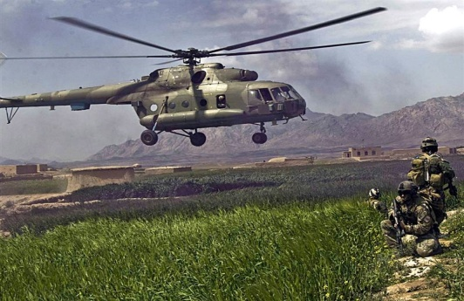
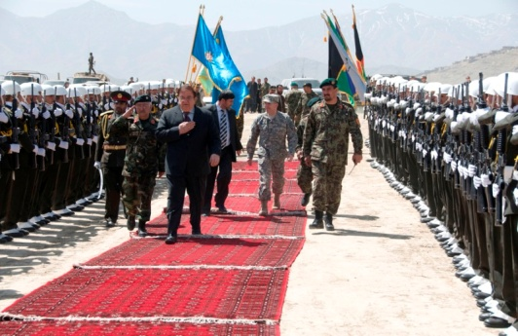
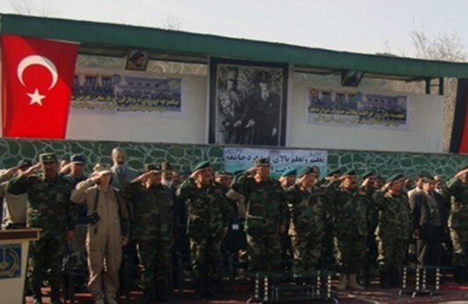
“If you accept the expectations of others, especially negative ones, then you never will change the outcome.” Michael Jordan
DLIELC’s language training efforts in Afghanistan have evolved over 7 years
Afghan Air Corps assuming more flying responsibilities
Commandos trained in psyops engaging local population
New Afghan Defense University will have a Foreign Language Institute

Slide 15
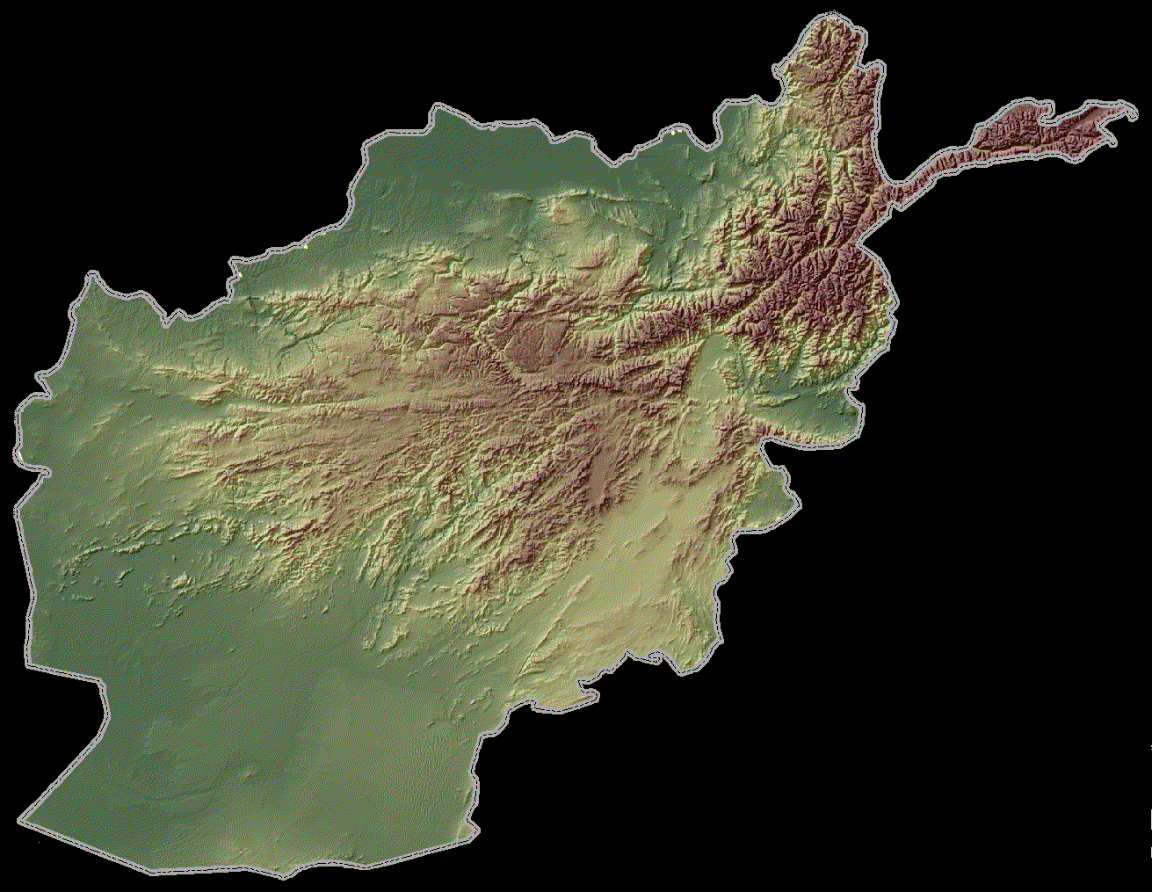
PRESTO
English
Language Training Program
E
L T P
X

